Slide 1
HTML

Slide 2
What is Html
Hyper Text Markup Language
A set of markup tags
Tags describe document content
Contain HTML tags and plain text

Slide 3
Concepts
Tags
Elements
Attributes

Slide 4
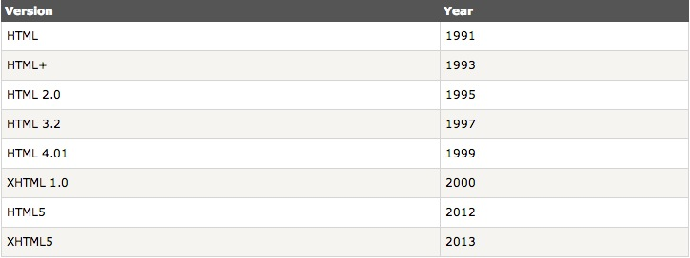
HTML history
Notes:
Tim Berners-Lee European laboratory For Particle Physics in Geneva, Switzerland
HTML -> SGML Standard Generalized Mark-up Language
XHTML -> XML
2005, Web Hypertext Application Technology Working Group (WHATWG)

Slide 5
Basic structure
<!DOCTYPE html> //Document type declaration
<html> //This is the an THML document
<head> //Contain information about page
<title>First Web Page</title>
</head>
<body> //main content of the document
This is my first html page
</body>
</html>

Slide 6
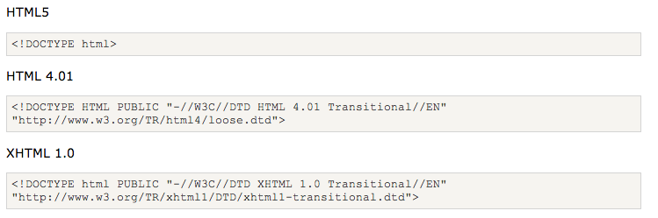
Document type

Slide 7
Basic tags in body
Block tags
h1-h6, p
Inline tags
b/strong, i/em
q, blockquote
code, samp, dfn, var

Slide 8
Most used tags
Links <a>
Lists <ul> <ol> <li> <dl> <dt> <dd>
Images <img>
Forms <form> <input>
Tables <table> <tr> <td> <th>
Div <div>
Span <span>

Slide 9
Tags in head
<title>
<meta>
<script>
<link>
<base>
<meta name=“viewpoint” content=“width=device-width, initial-scale=1.0” />

Slide 10
HTML layout
<div id="container">
<div id="header">
<h1> Web Page</h1>
</div>
<div id=”navigation">
<ul>
<li>HTML</li>
</ul>
</div>
<div id=“aside”>
</div>
<div id="content">
<p>main content</p>
</div>
<div id="footer">
Copyright
</div>
</div>
header
navigation
content
aside
footer

Slide 11
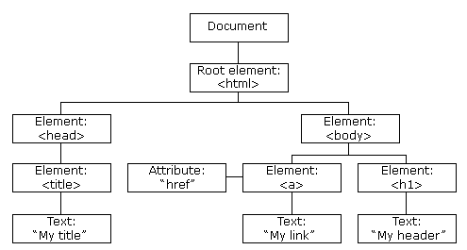
How browser render
Layout engine
DOM
Notes:
Webkit
Gecko

Slide 12
principles
1. Having something to say
2. Keeping it simple
3. Make sure it uses valid HTML
4. Make the element semantics by using attribute

Slide 13
Find error
http://github.com/fuying/frondendtraining

Slide 14
HTML5
New features should be based on HTML, CSS, DOM, and JavaScript
Reduce the need for external plugins (like Flash)
Better error handling
More markup to replace scripting
HTML5 should be device independent
The development process should be visible to the public

Slide 15
New features
The <canvas> element for 2D drawing
The <video> and <audio> elements for media playback
Support for local storage
New content-specific elements, like <article>, <footer>, <header>, <nav>, <section>
New form controls, like calendar, date, time, email, url, search

Slide 16
Html5 Layout
<header>
<h1>Title</h1>
</header>
<nav>
<ul>
<li></li>
</ul>
</nav>
<aside>
<p>illustration</p>
</aside>
<article>
<section>
<h2>Title</h2>
<p>content</p>
</section>
……
</article>
<footer>
<p>content</p>
</footer>
<header>
<nav>
<article>
<aside>
<footer>

Slide 17
Most used
<article>
<fieldset>
<video>
<audio>

Slide 18
reference
http://www.w3schools.com/tags/default.asp
http://www.htmldog.com/
http://validator.w3.org/check
http://www.w3.org/People/Raggett/book4/ch02.html
http://taligarsiel.com/Projects/howbrowserswork1.htm

