Slide 1
CSS

Slide 2
How is browser present
Box
Document flow

Slide 3
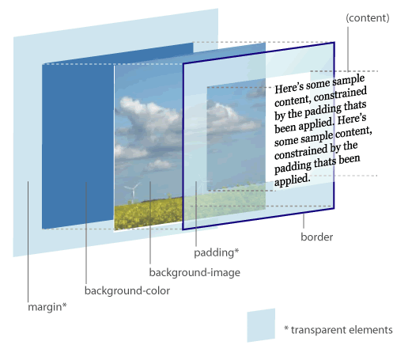
Box Model
Border
Padding
Margin
Notes:
Margin collpsed

Slide 4
Document flow
block, inline
<p class=”red">
This is a block element
</p>
<p class=”red">
<em>this is a inline element</em>
<span>this is also a inline element</span>
</p>

Slide 5
What is CSS
Cascading Style Sheet
Style
sheet
cascading
It’s for present you HTML content

Slide 6
History
CSS1 | 1996
CSS2 | 1998
CSS2.1 | 2011
CSS3 | now

Slide 7
Component of CSS
Selector
Id, class, tag
Declaration
Rules
#container .nav a {
width:100px;
height:100px;
background:#C90502;
}

Slide 8

Selector
body div div {
border: 5px solid red;
}
.container > div {
border: 5px solid red;
}
#content {
border: 5px solid red;
}
<body>
<div class="container">
<div id="content">
<p>main content</p>
</div>
</div>
</body>

Slide 9
Declarations
Property
Position
Box
Other
Background, text
Value
Number
Number + px, em
Percentage
url
Color
String

Slide 10
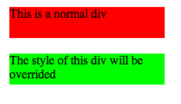
Why it is Cascading
Override the style
div {
background-color: #ff0000;
margin: 20px;
height: 40px;
width: 200px;
}
.override {
background-color: #00ff00;
}
<div>
This is a normal div
</div>
<div class="override">
The style of this div will be overrided
</div>

Slide 11
Ways to write CSS
Inline
Internal Style Sheet
External Style Sheet

Slide 12

Single item
Button
Box model
Border, padding, margin, width, height
Background style
Text style

Slide 13
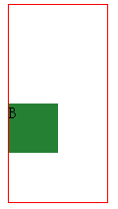
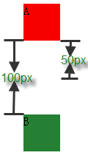
Two items
Margin collapse
Vertical direction
Near margin

Slide 14

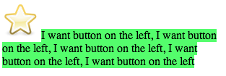
Location(1)
Float
img {
float: left;
}
<section>
<img src=“star.png"/>
<span>
I want button on the left, I want button on the left, I want button on the left, I want button on the left, I want button on the left
</span>
</section>
Notes:
文字长些

Slide 15




Location(2)
Position
Absolute, fixed, relative, static
.position {
position: ***;
top: 0;
left: 0;
margin: 0;
}
Notes:
Absolute used with relative

Slide 16
Principles
DRY
Group the normal CSS code
Shorthands properties
header,
article {
width: 1024px;
margin: 0 auto;
padding-bottom: 100px;
}
#content {
padding: 40px 20px 0 30px;
}
#content {
padding-top: 40px;
padding-right: 20px;
padding-bottom: 0;
padding-left: 30px;
}
Notes:
h1, h2, h3 {}
Use margin: 3px 0; instead of margin-top, margin-bottom seperately

Slide 17
CSS3
Animations
Backgrounds and Borders
Selectors
2D/3D Transformations
Text Effects
User Interface
Multiple Column Layout
…
Notes:
An animation is an effect that lets an element gradually change from one style to another style
@keyframe name
2. background-size, multiple background, etc. border-image, border-radius, etc. box-shadow
3. Attribute selector [attr$=“.pdf”]
4. transform: rotate()
5. text-shadow
6. box-sizing, resize, outline, nav-top, etc
7. column-count, column-gap, column-rule
@media all

Slide 18
References
http://codepen.io/pen/
http://csslint.net/
http://www.tutorialchip.com/css/css-frameworks-easy-ways-to-keep-your-website-in-style/
http://coding.smashingmagazine.com/2008/11/12/12-principles-for-keeping-your-code-clean/
https://github.com/necolas/idiomatic-css
http://www.vanseodesign.com/css/css-selector-performance/
http://www.vanseodesign.com/css/understanding-css-floats/
http://w3help.org/zh-cn/kb/index.html
http://www.css3.info/preview/

