Slide 1



^{Whitepaper}
²⁰²²
^{PHOTO HERE}
^{Introduction}
Definition of “Fuyoh”
Fuyoh is used when wow is just not wow enough. This word also can be shortened to “fooh” or “fuh” if desired. Fuyoh sounds like a Chinese word but is actually a mash up “fulamak” from Malay and “aiyoyo” from Tamil, making fuyoh is just an exclamation..
Updated: 1/10/2022

Slide 2

^{Our}
^{Mission statement}
FuYoH are not creating tokens to solve the world’s biggest blockchain issues but instead a token that can be used everyone in the community. FuYoH is an Asia meme token with aims to be used widely that give back rewards. Fun for the community and long-term benefit for all holders. FuYoH will focus on 3 area which is Trading, Community Events and Games. Each area covers very broad activities which we will lay it out and let the community decide or we get the community to dictate what activities, application, events need to be done.
In conclusion, we will work based on Community engagement and supported by the Fuyoh Team.
^{PHOTO HERE}

Slide 3



^{OVERVIEW & TERMINOLOGY}
We have seen many Meme token appearing plentifully but none focusing solely on South East Asia meme and most of it either related to dogs or cats. Fuyoh is a south Asian Meme words that being utter commonly and we believe to make it worth to be mentioned and join the ranks of meme internationally.
In recent years, a comedian by the name of “Uncle Roger” in the US, somehow popularized this word it his YouTube channel. Since then, this word become popular and echoes by many. We encourage everyone to subscribe to his YouTube channel.
Project Name
⁰¹
FuYoH
Ecosystem
⁰²
Polygon & Binance Smart Chain
Objective
⁰³
FuYoH is an Asia meme token with aims to be used widely that give back rewards. A Fun token for the community and long-term benefit for holders.

Slide 4

“Meme Coins”
^{HISTORY}
In 1976, an evolutionary biologist named Richard Dawkins coined the word ‘meme’ in his book describing a ‘gene-centered’ view of evolution, The Selfish Gene. Dawkins defined a ‘meme’ as an idea, behavior, or style that spreads from person to person within a culture. Years later, the rise of the internet and the formation of a culture around it would see the phrase re-appropriate to describe a piece of media, often humorous, that spreads virally, leaping from IP address to IP address via a process described broadly as imitation. The prolific nature of the internet meme was apparent by the year 2010, when a Japanese kindergarten teacher, Atsuko Sato, posted several images of her Shiba Inu dog, Kabosu, to her personal Tumblr blog. One image in particular featured Kabosu sitting on a couch while glaring sideways at the camera with raised eyebrows. By the year 2013, the image of the perpetually surprised Kabosu had gained both viral fame and the attention of IBM and Adobe software engineers, Billy Markus and Jackson Palmer.
These engineers would use the image to become the face of their ‘joke’ payment system intended to satirize the wild speculation in cryptocurrencies at the time, Dogecoin (Chayka, 2013). Dogecoin is considered to be the first ever ‘meme coin’, and, more specifically, the first ever ‘dog coin’. Dogecoin sat primarily idle until the years 2020-2021 when it rose astronomically after fans of the coin organized on the social platforms TikTok and Reddit to thrust it into the mainstream spotlight (with the help of SpaceX and Tesla founder, Elon Musk)
^{Non-Fungible Tokens}
Contrary to current practice of using Ethereum, non-fungible tokens (NFTs) first made their debut on the Bitcoin blockchain during 2012-2013 with ‘colored coins’ being arguably the first NFTs to exist. These coins were made of small denominations of bitcoin and were used to represent a multitude of assets including property, coupons, subscriptions, and more.
Unfortunately, the design of Bitcoin was never meant to enable this type of behavior and with increasingly apparent flaws in implementation, colored coins failed to gain traction. However, the colored coin concept led many people to realize the massive potential for asset issuing on the blockchain (Portion, 2021). In 2014, Robert Dermody, Adam Krellenstein, and Evan Wagner founded Counterparty, a peer-toHistory 5 6 peer financial platform and distributed open-source Internet protocol built on top of the Bitcoin blockchain (Portion, 2021). It was only a matter of time before internet culture would fully take advantage of the ability to distribute images via the blockchain, and by 2016, “Rare Pepes”, a series of memes featuring a frog character, had launched on Counterparty.
“Rare Pepes” would later move to the ethereum blockchain when it began to gain prominence in early 2017, and the series would serve as the inspiration for John Watkinson and Matt Hall to create what is now one of the most popular NFT collections, Cryptopunks, in 2017 (Portion, 2021).

Slide 5
“Meme Coins”
^{HISTORY}
^{Rationale}
As aforementioned, memes have played a critical role in the inception and evolution of both satirical cryptocurrencies and non-fungible tokens. However, as demonstrated by the idle years of Dogecoin, a humorous image (or concept) alone is not enough to fuel sustained interest. The renewed attention on Dogecoin in 2020-2021 can be attributed to the formation and definition of an affinity space. When studying the topology of successful internet memes, Knobel and Lankshear (2007) identified affinity spaces as a key attribute correlated to the fecundity of a given meme,
“Overall, the playfulness seen in most of these online memes—whether absurdist or aimed at social commentary—taps into shared popular culture experiences and practices. This in turn helps to define certain affinity spaces (e.g., gamer spaces, photoshopper spaces, manga/anime spaces, left-leaning political spaces, “good” community member spaces, spaces created by fans of Asian popular cultures, blogger spaces) by semiotic nods and winks to those “in the know” as it were. “Outsiders” to these spaces will often have difficulty seeing the humor in or point to many of these memes.” (Knobel and Lankshear, 2007).
Dogecoin’s meteoric rise in the years 2020-2021 was not the result of increased utility of the token nor advancements in its technology, but was initiated by fans of the currency banding together on different social media platforms and garnering the interest of influential individuals, such as Elon Musk, who ultimately desired to be apart of the phenomenon. Dogecoin founder, Billy Markus, summed up the success of token in recent years by saying, “it all comes down to the community dogecoin fosters”. (Adamczyk, 2021). Community, in this context, being synonymous with Knobel and Lankshear’s (2007) definition of an affinity space. NFTs also follow Knobel and Lankshear (2007) proposed topology. Most images featured in NFT collections fall into the “absurdist” or “aimed at social commentary” categories, with the application of the technology in this context itself often being commentary around ownership and artist rights. A similar pattern of community derived value is additionally apparent within the NFT 7 setting.
When analysing the rise of CryptoPunks, Nansen, a blockchain analytics platform, highlights the use of CryptoPunks as a social currency as a major factor in their valuation,
“When purchasing a CryptoPunk, not only are you buying an image but also a membership to one the coolest and most OG clubs in the NFT space. Membership in this club is powerful. It conveys the message that you were in early, that you recognize the historical significance of the project and that you are notable in the NFT space. It also unlocks access to social networks, exclusive chats, free claim on other NFT collections (like a Meebit at the time of launch).”
Hence, a conclusion can be drawn that with the astronomical rise of both meme coins and NFTs in 2021, the fundamental desire of humans, as social beings, to connect with one another and be a part of a community is now more prevalent than ever. Additionally, given the circumstances of 2021, a global pandemic that restricted the ability of most to interact with one another in the physical world, a rapid migration, exploration, and creation of digital and virtual spaces that communities could form within was both expected and necessary.

Slide 6



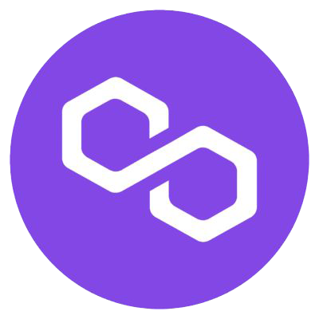
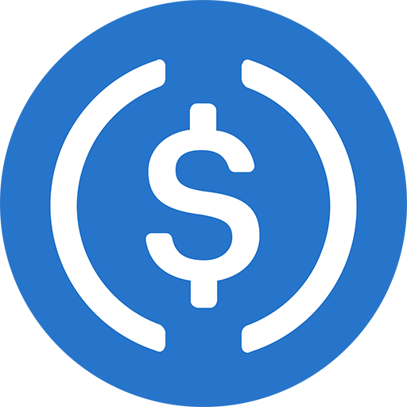



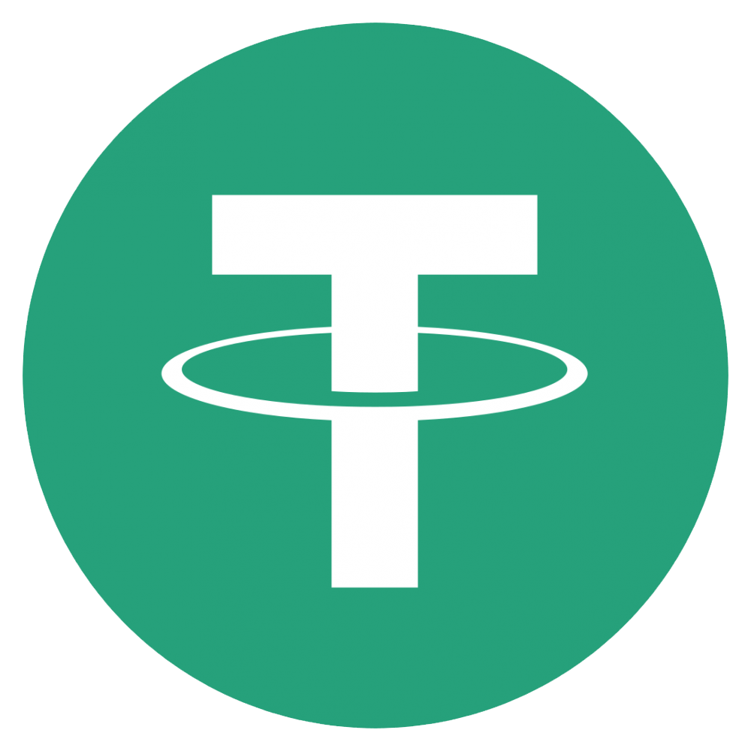
^{TOKENOMICS}
^{DISTRIBUTION}
The FuYoH token is an inherently deflationary token due to its fixed max supply, the amount of token that will ever exist in the lifetime of the cryptocurrency, of 10,000,000,000,000,000 FYH tokens. There are no team allocations of tokens. All tokens in existence will be made available for public sale, airdrops, events and rewards.
^{THE FUYOH TOKEN}
The FuYoH token is an ERC20 token under the symbol, FYH (all uppercase). The token contract address is: 0x0d450bf37Ec899cCA90ede124b3E69C9Ae2F2F1C
^{IDO}
^{IDO Launchpad : DodoBSC}
Initial Price: 0.0000000005190072605802942 BNB = 0.000000188 USDT = 1 FYH
Total Supply: 10000000000000 FYH (10 Trillion)
^{Hard Cap: 921,200 BUSD}
Tokens for Participants: 4,900,000,000,000 FYH (4.9 Trillion)
^{FUYOH (FYH) Polygon}
Official Swap/Exchange
Official Pairs
^{FUYOH (FYH) BSC}
Official Swap/Exchange

Slide 7


^{TOKENOMICS}
^{TOKEN VESTING}
^{Token Lock @ Unicrypt}
Locked token will be for future rewards, airdrop and events activities. We plan to lock this for 1-2 year(s) at Unicrypt.
^{THE TOKEN BURN}
“Burning” crypto means permanently removing a number of tokens from circulation. This is typically done by transferring the tokens in question to a burn address, i.e. a wallet from which they cannot ever be retrieved. This is often described as destroying tokens. A project burns its tokens to reduce the overall supply. Depending on the market demands, we will be expecting to burns at least 20%-50% of the total supply. We will conduct Token burn from time to time, it will not be every day, but definitely we will burn it.
We may also put to vote with the community to decide the "when" and the "amount". This will give the community ability to decide collectively the burning exercise of Fuyoh Token. The proof of burn will be published.
All burning will be sent to this address: 0x000000000000000000000000000000000000dEaD
^{FUYOH (FYH) Polygon}
Locked Amount
7,853,559,467,353,930.585794976 FYH
Locked Percentage
78.5356%
Locked Contract Address
https://polygonscan.com/address/0x2621816be08e4279cf881bc640be4089bfaf491a
^{FUYOH (FYH) BSC}
Locked Amount
7,256,594,835,740,840.96593742 FYH
Locked Percentage
72.5654%
Locked Contract Address
https://bscscan.com/address/0xeaed594b5926a7d5fbbc61985390baaf936a6b8d

Slide 8

^{WHAT WE WILL DO!}
What we have plan and layout to proceed with Fuyoh as a Asia Meme Community
^{Community Events}
We will draft it, the community decide or the community plan it and decide
^{Fuyoh Wallet}
Our own non-custodial web wallet that will allow trading and swap
^{Social Media Platform}
We are planning to have our own platform to allow community post and interaction
^{Token Rewards}
^{Surprise Airdrop}
A plan for all social activities on Fuyoh will be rewarded accordingly
Yes. You heard that right, we will conduct a surprise airdrop from time-to-time
^{Swap & Exchanges}
^{Gaming}
Slowly but surely we will add more swap and exchange to allow Fuyoh widely tradeable
Partnered with Online Gaming that allow Fuyoh Token to be use as one of the exchangeable token
^{Online Shopping}
We are planning it but no concrete agreement yet to allow Fuyoh Token to be use to purchase items online

Slide 9
We showing only those that not done or in the process/planning
^{TIMELINE}
^{Increasing Vesting}
Building and Deploying A non-custodial Wallet
Fuyoh Community Portal (Social Media Platform)
As mentioned we are looking into locking more Fuyoh token for future use
A non-custodial wallet with a build-in with a Atomic Swap capability
This will be a challenge but we have plan and idea what to deploy for the community purposes
COMPLETED
⁰¹
⁰²
⁰³
⁰⁶
⁰⁵
⁰⁴
^{Online Shopping}
^{Swap & Exchange}
^{Non-Crypto Gaming Portal}
This will be the most difficult as we need to work with Online shopping portal to allow Fuyoh Token to be use. Or we may have to build our own Online Shopping Portal for our own community to sell/buy using Fuyoh Token where we can get other to join in.
We will try to add more liquidity to whichever Swap & Exchange available to us
To add onto our existing arrangement with a Crypto Gaming.

Slide 10
DISCLAIMER
Included within this Whitepaper is financial information, approximations, and positions that take into consideration and derive from known and unknown variables and risks. Results may vary substantially from expressed views and forward-looking language here within. The information shared in this document is not an exhaustive list nor is it a full and complete representation. It does not seek or intend to pursue any element or notion of a binding agreement. The Whitepaper is written to communicate to potential community members the aspirations of FuYoH and to provide additional information for those interested in the analysis of this project to make an educated decision. We recommend reviewing this document in its entirety

Slide 11







Website: https://www.fuyoh.asia | Email: info@fuyoh.asia

