Slide 1
5.对比关系

Slide 2
对比关系
解题原则：
  对比关系提示对比内容语义或感情色彩相反

Slide 3
对比关系
时间对比：
before, until, previous, once, early, formerly, initially, pristine, begin, start, origin, create
current, recently, now, today,
later, future;

Slide 4
对比关系
结构对比：
far from…,
unlike,
not…but…, on the other hand, rather than, more…than…,
instead (of), in contrast (to), on the contrary, otherwise

Slide 5
对比关系
动词逻辑关系对比：
give way to,
be challenged by,
be discredited by,
shift / decay / change / distinguish from…to…,
replace / reconcile…with…,
动词 + between…and...

Slide 6
对比关系
特殊含义对比：
paradoxical /paradoxically,
ironical/ironically,
unexpected/unexpectedly
curiously
surprisingly

Slide 7
对比关系
反义词直接对比：
encourage / discourage,
active / dormant

Slide 8
对比关系
Paradoxically, Robinson’s excessive denials of the worth of early works of science fiction suggest that she has become quite _______ them.
A. enchanted by
B. enamored of
C. skeptical of
D. encouraged by
E. offended by
F. reflective about

Slide 9
对比关系
Paradoxically, Robinson’s excessive denials of the worth of early works of science fiction suggest that she has become quite _______ them.
A. enchanted by
B. enamored of
C. skeptical of
D. encouraged by
E. offended by
F. reflective about

Slide 10
对比关系
Paradoxically, Robinson’s excessive denials of the worth of early works of science fiction suggest that she has become quite _______ them.
A. enchanted by
B. enamored of
C. skeptical of
D. encouraged by
E. offended by
F. reflective about

Slide 11
对比关系
Paradoxically, Robinson’s excessive denials of the worth of early works of science fiction suggest that she has become quite _______ them.
A. enchanted by
B. enamored of
C. skeptical of
D. encouraged by
E. offended by
F. reflective about

Slide 12
A
enchant v. (施魔法)使迷醉
同义词：charm

Slide 13
B
enamored adj. 使爱上，使着迷
词根am/im: to love
同根词：
amicable:
inimical:

Slide 14
对比关系
It is truly paradoxical that the Amazon, the lushest of all rainforests, is rooted in the most ________ of all soils.
A. acidic
B. coarse
C. stark
D. impoverished
E. infertile
F. austere

Slide 15
对比关系
It is truly paradoxical that the Amazon, the lushest of all rainforests, is rooted in the most ________ of all soils.
A. acidic
B. coarse
C. stark
D. impoverished
E. infertile
F. austere
Notes:
lush 茂盛的

Slide 16
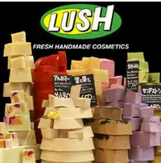


lush adj. 茂盛的
同义词：profuse

Slide 17
对比关系
It is truly paradoxical that the Amazon, the lushest of all rainforests, is rooted in the most ________ of all soils.
A. acidic
B. coarse
C. stark
D. impoverished
E. infertile
F. austere

Slide 18
B
coarse adj. 粗燥的，低劣的
形近词：
hoarse adj. 嗓子沙哑的

Slide 19
C
stark adj. 严酷的(harsh)；完全的(sheer)
stark future
stark poverty

Slide 20
D
impoverish v.
使成赤贫
im(进入)+pover(贫困)+ish
参考： poverty

Slide 21
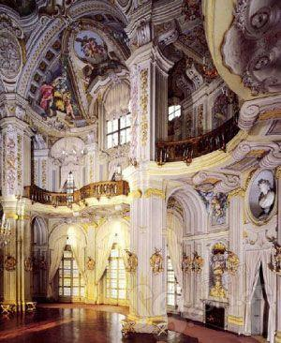
F
austere adj.
1. severe 严厉的
2. 没有装饰的，朴素的
反义词：
baroque巴洛克式的, 过份雕琢的， 复杂的

Slide 22
对比关系
It is truly paradoxical that the Amazon, the lushest of all rainforests, is rooted in the most ________ of all soils.
A. acidic
B. coarse
C. stark
D. impoverished
E. infertile
F. austere

Slide 23
对比关系
It is truly paradoxical that the Amazon, the lushest of all rainforests, is rooted in the most ________ of all soils.
A. acidic
B. coarse
C. stark
D. impoverished
E. infertile
F. austere

Slide 24
对比关系
Far from viewing Jefferson as a skeptical but enlightened intellectual, historian of the 1960’s portrayed him as ____ thinker, eager to fill the young with his political orthodoxy while censoring ideas he did not like.
an adventurous
a doctrinaire
an eclectic
a judicious
a cynical

Slide 25
对比关系
Far from viewing Jefferson as a skeptical but enlightened intellectual, historian of the 1960’s portrayed him as ____ thinker, eager to fill the young with his political orthodoxy while censoring ideas he did not like.
an adventurous
a doctrinaire
an eclectic
a judicious
a cynical

Slide 26
orthodox adj. 正统的，东正教的
ortho(正)+dox(观点)->正统观点
同根词：
orthodontics
ortho(正)+dont(=dent牙齿)
畸齿矫正学

Slide 27
反义词：
heterodox adj. 非正统的
heresy n. 异端邪说
here(异)+sy
heretic n. 异教徒

Slide 28
censor v. 审查
censorship n. 检查制度

Slide 29
对比关系
Far from viewing Jefferson as a skeptical but enlightened intellectual, historian of the 1960’s portrayed him as ____ thinker, eager to fill the young with his political orthodoxy while censoring ideas he did not like.
an adventurous
a doctrinaire
an eclectic
a judicious
E.a cynical

Slide 30
B
doctrinaire adj. 教条的
doctrine n.

Slide 31
C
eclectic adj. 折衷的
eclecticism n. 折衷主义

Slide 32
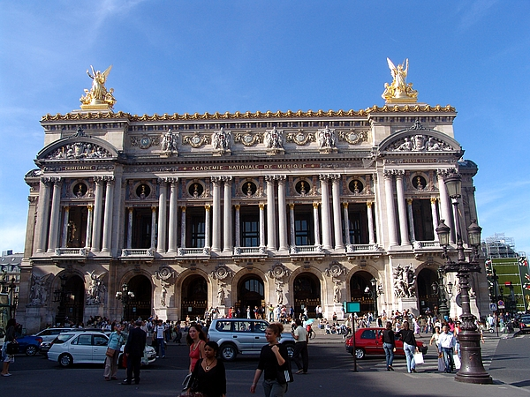
折衷主义建筑风格

Slide 33
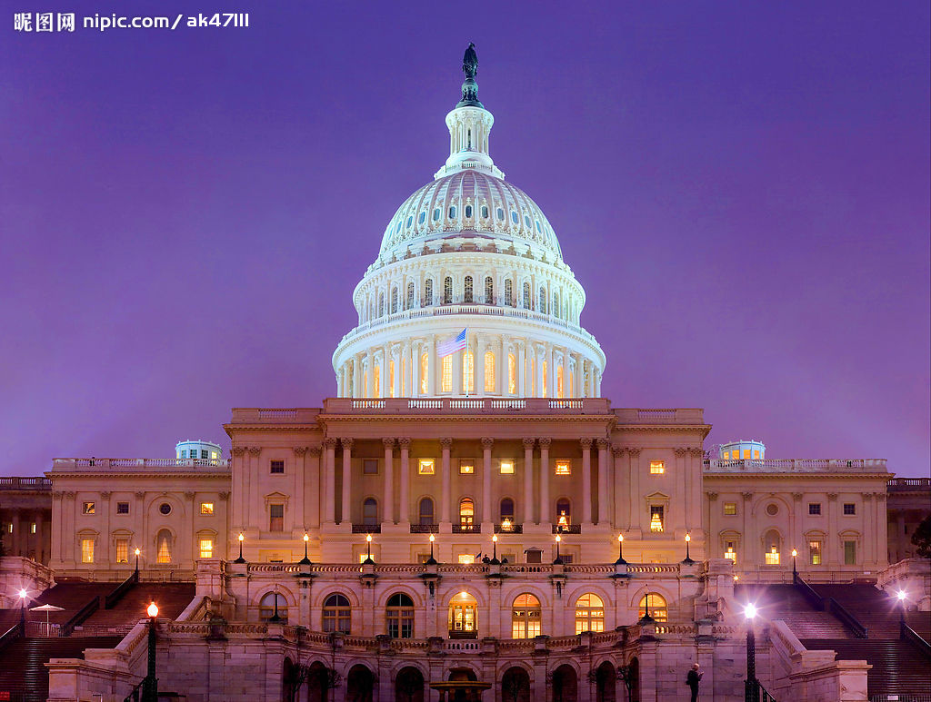
折衷主义建筑风格

Slide 34
D
judicious adj.
明智的，有判断力的
反义词：
injudicious

Slide 35
对比关系
Far from viewing Jefferson as a skeptical but enlightened intellectual, historian of the 1960’s portrayed him as ____ thinker, eager to fill the young with his political orthodoxy while censoring ideas he did not like.
an adventurous
a doctrinaire
an eclectic
D.a judicious
E. a cynical

Slide 36
对比关系
Far from viewing Jefferson as a skeptical but enlightened intellectual, historian of the 1960’s portrayed him as ____ thinker, eager to fill the young with his political orthodoxy while censoring ideas he did not like.
an adventurous
a doctrinaire
an eclectic
a judicious
E. a cynical

Slide 37
对比关系
Just as such apparently basic things as rocks, clouds, and clams are, in fact, intricately structured entities, so the self, too, is not an “elementary particle,” but is _____construction.
a complicated
a convoluted
a distorted
an amorphous
an illusory

Slide 38
对比关系
Just as such apparently basic things as rocks, clouds, and clams are, in fact, intricately structured entities, so the self, too, is not an “elementary particle,” but is _____construction.
a complicated
a convoluted
a distorted
an amorphous
an illusory

Slide 39
对比关系
Just as such apparently basic things as rocks, clouds, and clams are, in fact, intricately structured entities, so the self, too, is not an “elementary particle,” but is _____construction.
a complicated
a convoluted
a distorted
an amorphous
E. an illusory

Slide 40
intricate adj.
1. elaborate 错综复杂的
2. complex 难理解的

Slide 41
complicated 内在的结构的复杂
convoluted 表面的缠绕的复杂

Slide 42
C
distort v. 扭曲
distorted adj.
distortion n.

Slide 43
D
amorphous adj. 无定形的 shapeless
a+morph(形状)+ous->无形状的
同根词：
morphology 形态学
metamorphose 变形

Slide 44
对比关系
Just as such apparently basic things as rocks, clouds, and clams are, in fact, intricately structured entities, so the self, too, is not an “elementary particle,” but is _____construction.
a complicated
a convoluted
a distorted
an amorphous
E.an illusory

Slide 45
对比关系
Just as such apparently basic things as rocks, clouds, and clams are, in fact, intricately structured entities, so the self, too, is not an “elementary particle,” but is _____construction.
a complicated
a convoluted
a distorted
an amorphous
E.an illusory

Slide 46
对比关系
Rather than enhancing a country’s security, the successful development of nuclear weapons could serve at first to increase that country’s _______.
A. boldness
B. influence
C. fragility
D. responsibility
E. moderation
F. vulnerability

Slide 47
对比关系
Rather than enhancing a country’s security, the successful development of nuclear weapons could serve at first to increase that country’s _______.
A. boldness
B. influence
C. fragility
D. responsibility
E. moderation
F. vulnerability

Slide 48
对比关系
Rather than enhancing a country’s security, the successful development of nuclear weapons could serve at first to increase that country’s _______.
A. boldness
B. influence
C. fragility
D. responsibility
E. moderation
F. vulnerability

Slide 49
对比关系
Rather than enhancing a country’s security, the successful development of nuclear weapons could serve at first to increase that country’s _______.
A. boldness
B. influence
C. fragility
D. responsibility
E. moderation
F. vulnerability

Slide 50
对比关系
It comes as no surprise that societies have codes of behavior; the character of the codes, on the other hand, can often be____. (OG P60 1)
predictable
unexpected
admirable
explicit
confusing

Slide 51
对比关系
It comes as no surprise that societies have codes of behavior; the character of the codes, on the other hand, can often be____. (OG P60 1)
predictable
unexpected
admirable
explicit
confusing

Slide 52
对比关系
It comes as no surprise that societies have codes of behavior; the character of the codes, on the other hand, can often be____. (OG P60 1)
predictable
unexpected
admirable
explicit
confusing

Slide 53
对比关系
It comes as no surprise that societies have codes of behavior; the character of the codes, on the other hand, can often be____. (OG P60 1)
predictable
unexpected
admirable
explicit
confusing

Slide 54
对比关系
Many artists believe that successful imitation, far from being symptomatic of a lack of _____, is the first step in learning to be creative.
elegance
resolution
goodness
originality
sympathy

Slide 55
对比关系
Many artists believe that successful imitation, far from being symptomatic of a lack of _____, is the first step in learning to be creative.
elegance
resolution
goodness
originality
sympathy

Slide 56
对比关系
Many artists believe that successful imitation, far from being symptomatic of a lack of _____, is the first step in learning to be creative.
elegance
resolution
goodness
originality
E.sympathy

Slide 57
对比关系
Many artists believe that successful imitation, far from being symptomatic of a lack of _____, is the first step in learning to be creative.
elegance
resolution
goodness
originality
E.sympathy

Slide 58
对比关系
Since 1813 reaction to Jane Austen’s has oscillated between ___ and condescension; but in general later writers have esteemed her works more highly than did most of her literary ____.
Blank (i) | Blank (ii)
A adoration | D contemporaries
B indifference | E followers
C dismissal | F precursors

Slide 59
对比关系
Since 1813 reaction to Jane Austen’s has oscillated between ___ and condescension; but in general later writers have esteemed her works more highly than did most of her literary ____.
Blank (i) | Blank (ii)
A adoration | D contemporaries
B indifference | E followers
C dismissal | F precursors

Slide 60
对比关系-第一空
Since 1813 reaction to Jane Austen’s has oscillated between ___ and condescension; but in general later writers have esteemed her works more highly than did most of her literary ____. (E28.8)
Blank (i) | Blank (ii)
A adoration | D contemporaries
B indifference | E followers
C dismissal | F precursors

Slide 61
condescend v. 屈尊, 贬低
相关词：
descend 下降，ascend上升

Slide 62
对比关系-第一空
Since 1813 reaction to Jane Austen’s has oscillated between ___ and condescension; but in general later writers have esteemed her works more highly than did most of her literary ____.
Blank (i) | Blank (ii)
A adoration | D contemporaries
B indifference | E followers
C dismissal | F precursors

Slide 63
对比关系-第一空
Since 1813 reaction to Jane Austen’s has oscillated between _A__ and condescension; but in general later writers have esteemed her works more highly than did most of her literary ____.
Blank (i) | Blank (ii)
A adoration | D contemporaries
B indifference | E followers
C dismissal | F precursors

Slide 64
C
dismiss v. 解雇，开除
dismissal n.
反义词：
summon 召集

Slide 65
对比关系-第二空
Since 1813 reaction to Jane Austen’s has oscillated between _A__ and condescension; but in general later writers have esteemed her works more highly than did most of her literary ____.
Blank (i) | Blank (ii)
A adoration | D contemporaries
B indifference | E followers
C dismissal | F precursors

Slide 66
F
precursor n.
先驱
pre(前面)+curs(跑)+or->跑在前面

Slide 67
对比关系-第二空
Since 1813 reaction to Jane Austen’s has oscillated between __A_ and condescension; but in general later writers have esteemed her works more highly than did most of her literary ____.
Blank (i) | Blank (ii)
A adoration | D contemporaries
B indifference | E followers
C dismissal | F precursors

Slide 68
对比关系-第二空
Since 1813 reaction to Jane Austen’s has oscillated between __A_ and condescension; but in general later writers have esteemed her works more highly than did most of her literary __D__. (E28.8)
Blank (i) | Blank (ii)
A adoration | D contemporaries
B indifference | E followers
C dismissal | F precursors

Slide 69
Jane Austen
'' It is a truth universally acknowledged, that a single man in possession of a good fortune, must be in want of a wife.''

Slide 70
对比关系
Recent research indicates that a system of particles which has apparently decayed to randomness from _____ state can be returned to that state; thus the system exhibits a kind of memory of its _____ condition.
Blank (i) | Blank (ii)
A an equilibrium | D lesser
B an ordered | E earlier
C a chaotic | F present

Slide 71
对比关系
Recent research indicates that a system of particles which has apparently decayed to randomness from _____ state can be returned to that state; thus the system exhibits a kind of memory of its _____ condition.
Blank (i) | Blank (ii)
A an equilibrium | D lesser
B an ordered | E earlier
C a chaotic | F present

Slide 72
对比关系-第一空
Recent research indicates that a system of particles which has apparently decayed to randomness from _____ state can be returned to that state; thus the system exhibits a kind of memory of its _____ condition.
Blank (i) | Blank (ii)
A an equilibrium | D lesser
B an ordered | E earlier
C a chaotic | F present

Slide 73
对比关系-第一空
Recent research indicates that a system of particles which has apparently decayed to randomness from ___B__ state can be returned to that state; thus the system exhibits a kind of memory of its _____ condition.
Blank (i) | Blank (ii)
A an equilibrium | D lesser
B an ordered | E earlier
C a chaotic | F present

Slide 74
A
equilibrium n. 平衡
equi+libr(平衡)+ium
同根词：
libra n. 天秤座
librate v. 保持平衡

Slide 75
C
chaos n.
混乱
chaotic adj. 混乱的

Slide 76
对比关系-第二空
Recent research indicates that a system of particles which has apparently decayed to randomness from _B____ state can be returned to that state; thus the system exhibits a kind of memory of its ___E__ condition.
Blank (i) | Blank (ii)
A an equilibrium | D lesser
B an ordered | E earlier
C a chaotic | F present

Slide 77
对比关系
Adam Smith’s Wealth of Nations (1776) is still worth reading, more to appreciate the current __ of Smith’s valid contributions to economics than to see those contributions as the _____ of present-day economics.
Blank (i) | Blank (ii)
A disregard | D outgrowths
B presumptuousness | E precursors
C relevance | F vestiges

Slide 78
对比关系
Adam Smith’s Wealth of Nations (1776) is still worth reading, more to appreciate the current __ of Smith’s valid contributions to economics than to see those contributions as the _____ of present-day economics.
Blank (i) | Blank (ii)
A disregard | D outgrowths
B presumptuousness | E precursors
C relevance | F vestiges

Slide 79
对比关系-第一空
Adam Smith’s Wealth of Nations (1776) is still worth reading, more to appreciate the current __ of Smith’s valid contributions to economics than to see those contributions as the _____ of present-day economics.
Blank (i) | Blank (ii)
A disregard | D outgrowths
B presumptuousness | E precursors
C relevance | F vestiges

Slide 80
B
presumptuous adj.
胆大妄为，放肆的
来自presume放肆；

Slide 81
对比关系-第一空
Adam Smith’s Wealth of Nations (1776) is still worth reading, more to appreciate the current __ of Smith’s valid contributions to economics than to see those contributions as the _____ of present-day economics.
Blank (i) | Blank (ii)
A disregard | D outgrowths
B presumptuousness | E precursors
C relevance | F vestiges

Slide 82
对比关系-第一空
Adam Smith’s Wealth of Nations (1776) is still worth reading, more to appreciate the current _C_ of Smith’s valid contributions to economics than to see those contributions as the _____ of present-day economics.
Blank (i) | Blank (ii)
A disregard | D outgrowths
B presumptuousness | E precursors
C relevance 正面感情色彩 | F vestiges

Slide 83
对比关系-第二空
Adam Smith’s Wealth of Nations (1776) is still worth reading, more to appreciate the current _C_ of Smith’s valid contributions to economics than to see those contributions as the _____ of present-day economics.
Blank (i) | Blank (ii)
A disregard | D outgrowths 自然产物
B presumptuousness | E precursors 先驱
C relevance | F vestiges 遗迹

Slide 84
对比关系-第二空
Adam Smith’s Wealth of Nations (1776) is still worth reading, more to appreciate the current _C_ of Smith’s valid contributions to economics than to see those contributions as the __E___ of present-day economics.
Blank (i) | Blank (ii)
A disregard | D outgrowths
B presumptuousness | E precursors
C relevance | F vestiges

Slide 85
时间对比类

Slide 86
时间对比类
关键词为与时间相关的词
是提示反义的逻辑关系

Slide 87
时间对比类
分为两型：
时间对比I 型为：时间不同内容相反
时间对比II 型为：时间上后者否定前者

Slide 88
I. 时间不同，内容相反

Slide 89
I. 时间不同，内容相反
Often the difficulties of growing up in the public eye cause child prodigies to ____ the world of achievement before reaching adulthood: happily, they sometimes later return to competition and succeed brilliantly.
ridicule
conquer
retire from
antagonize
examine

Slide 90
I. 时间不同，内容相反
Often the difficulties of growing up in the public eye cause child prodigies to ____ the world of achievement before reaching adulthood: happily, they sometimes later return to competition and succeed brilliantly.
ridicule
conquer
retire from
antagonize
examine

Slide 91
prodigy n. 奇才
child prodigy 神童

Slide 92
I. 时间不同，内容相反
Often the difficulties of growing up in the public eye cause child prodigies to ____ the world of achievement before reaching adulthood: happily, they sometimes later return to competition and succeed brilliantly.
ridicule
conquer
C.retire from
D.antagonize
E.examine

Slide 93
I. 时间不同，内容相反
Often the difficulties of growing up in the public eye cause child prodigies to ____ the world of achievement before reaching adulthood: happily, they sometimes later return to competition and succeed brilliantly.
ridicule
conquer
retire from
antagonize
E.examine

Slide 94
D
antagonize:counteract
对抗
派生词：
antagonism 对抗，antagonist对手

Slide 95
I. 时间不同，内容相反
Although Johnson’s and Smith’s initial fascination with the fortunes of those jockeying for power in the law firm _____ after a few months, the two paid sufficient attention to determine who their lunch partners should be.
A. revived
B. emerged
C. intensified
D. flagged
E. persisted
F. declined

Slide 96
I. 时间不同，内容相反
Although Johnson’s and Smith’s initial fascination with the fortunes of those jockeying for power in the law firm _____ after a few months, the two paid sufficient attention to determine who their lunch partners should be.
A. revived
B. emerged
C. intensified
D. flagged
E. persisted
F. declined

Slide 97
I. 时间不同，内容相反
Although Johnson’s and Smith’s initial fascination with the fortunes of those jockeying for power in the law firm _____ after a few months, the two paid sufficient attention to determine who their lunch partners should be.
A. revived
B. emerged
C. intensified
D. flagged
E. persisted
F. declined

Slide 98
jockey
n. 赛马骑师
vt. 骑马；驾驭
vi. (for)谋取

Slide 99
I. 时间不同，内容相反
Although Johnson’s and Smith’s initial fascination with the fortunes of those jockeying for power in the law firm _____ after a few months, the two paid sufficient attention to determine who their lunch partners should be.
A. revived
B. emerged
C. intensified
D. flagged
E. persisted
F. declined

Slide 100
I. 时间不同，内容相反
Although Johnson’s and Smith’s initial fascination with the fortunes of those jockeying for power in the law firm _____ after a few months, the two paid sufficient attention to determine who their lunch partners should be.
A. revived
B. emerged
C. intensified
D. flagged 偃旗息鼓，衰退
E. persisted
F. declined

Slide 101
D
flag v. to decline in vigor or strength
变弱，疲乏
flagging adj. 下垂的，衰弱的
反义词：
thriving 兴旺的

Slide 102
I. 时间不同，内容相反
Until the current warming trend exceeds the range of normal climatic fluctuations, there will be, among scientists, considerable ______the possibility that increasing levels of atmospheric CO2 can cause long-term warming effects.
A. interest in
B. uncertainty about
C. enthusiasm for
D. worry about
E. experimentation on

Slide 103
I. 时间不同，内容相反
Until the current warming trend exceeds the range of normal climatic fluctuations, there will be, among scientists, considerable ______the possibility that increasing levels of atmospheric CO2 can cause long-term warming effects.
A. interest in
B. uncertainty about
C. enthusiasm for
D. worry about
E. experimentation on

Slide 104
until 改成before

Slide 105
I. 时间不同，内容相反
Until (before) the current warming trend exceeds the range of normal climatic fluctuations, there will be, among scientists, considerable ______the possibility that increasing levels of atmospheric CO2 can cause long-term warming effects.
A. interest in
B. uncertainty about
C. enthusiasm for
D. worry about
E. experimentation on

Slide 106
I. 时间不同，内容相反
Until (before) the current warming trend exceeds the range of normal climatic fluctuations, there will be, among scientists, considerable ______the possibility that increasing levels of atmospheric CO2 can cause long-term warming effects.
A. interest in
B. uncertainty about
C. enthusiasm for
D. worry about
E. experimentation on

Slide 107
I. 时间不同，内容相反
Salazar’s presence in the group was so _____ the others that they lost most of their earlier ______; failure, for them, became all but unthinkable.
Blank (i) | Blank (ii)
A unnoticed by | D confidence
B reassuring to | E exhilaration
C unexpected by | F trepidation

Slide 108
I. 时间不同，内容相反
Salazar’s presence in the group was so _____ the others that they lost most of their earlier ______; failure, for them, became all but unthinkable.
Blank (i) | Blank (ii)
A unnoticed by | D confidence
B reassuring to | E exhilaration
C unexpected by | F trepidation

Slide 109
all but 几乎

Slide 110
I. 时间不同，内容相反-第二空
Salazar’s presence in the group was so _____ the others that they lost most of their earlier ______; failure, for them, became all but unthinkable.
Blank (i) | Blank (ii)
A unnoticed by | D confidence
B reassuring to | E exhilaration
C unexpected by | F trepidation

Slide 111
I. 时间不同，内容相反-第二空
Salazar’s presence in the group was so _____ the others that they lost most of their earlier __F____; failure, for them, became all but unthinkable.
Blank (i) | Blank (ii)
A unnoticed by | D confidence
B reassuring to | E exhilaration
C unexpected by | F trepidation

Slide 112
F
trepidation 恐惧
同根词：
intrepid 无畏的

Slide 113
I. 时间不同，内容相反-第一空
Salazar’s presence in the group was so ____ the others that they lost most of their earlier __F____; failure, for them, became all but unthinkable.
Blank (i) | Blank (ii)
A unnoticed by | D confidence
B reassuring to | E exhilaration
C unexpected by | F trepidation

Slide 114
I. 时间不同，内容相反-第一空
Salazar’s presence in the group was so __B___ the others that they lost most of their earlier __F____; failure, for them, became all but unthinkable.
Blank (i) | Blank (ii)
A unnoticed by | D confidence
B reassuring to 放心 | E exhilaration
C unexpected by | F trepidation

Slide 115
I. 时间不同，内容相反
New technologies often begin by (i) __________ what has gone before, and they change the world later. Think how long it took power - using companies to recognize that with electricity they did not need to cluster their machinery
around the power source, as in the days of steam. Instead, power could be (ii) __________their processes. In that sense,many of today’s computer networks are still in the steam age. Their full potential remains unrealized.

Slide 116
Blank (i) | Blank (ii)
A uprooting | D transmitted to
B dismissing | E consolidated around
C mimicking | F incorporated into

Slide 117
I. 时间不同，内容相反-第一空
New technologies often begin by (i) __________ what has gone before, and they change the world later. Think how long it took power - using companies to recognize that with electricity they did not need to cluster their machinery
around the power source, as in the days of steam. Instead, power could be (ii) __________their processes. In that sense,many of today’s computer networks are still in the steam age. Their full potential remains unrealized.

Slide 118
Blank (i) | Blank (ii)
A uprooting | D transmitted to
B dismissing | E consolidated around
C mimicking | F incorporated into

Slide 119
Blank (i) | Blank (ii)
A uprooting | D transmitted to
B dismissing | E consolidated around
C mimicking | F incorporated into

Slide 120
mimic:
To copy or imitate closely, especially in speech, expression, and gesture
模仿

Slide 121
I. 时间不同，内容相反-第二空
New technologies often begin by (i) ____C______ what has gone before, and they change the world later. Think how long it took power - using companies to recognize that with electricity they did not need to cluster their machinery
around the power source, as in the days of steam. Instead, power could be (ii) __________their processes. In that sense,many of today’s computer networks are still in the steam age. Their full potential remains unrealized.

Slide 122
Blank (i) | Blank (ii)
A uprooting | D transmitted to
B dismissing | E consolidated around
C mimicking | F incorporated into

Slide 123
E
consolidate v. 巩固
con+solid(结实)+ate
consolidation n.
反义词：
fragmentation 分裂

Slide 124
Blank (i) | Blank (ii)
A uprooting | D transmitted to
B dismissing | E consolidated around
C mimicking | F incorporated into=combined

Slide 125
I. 时间不同，内容相反
New technologies often begin by (i) ____C______ what has gone before, and they change the world later. Think how long it took power - using companies to recognize that with electricity they did not need to cluster their machinery
around the power source, as in the days of steam. Instead, power could be (ii) ____D______their processes. In that sense,many of today’s computer networks are still in the steam age. Their full potential remains unrealized.

Slide 126
规律
模仿 vs. 创新

Slide 127
II. 时间上后者否定前者

Slide 128
II. 时间上后者否定前者
Before about 1960, virtually all accounts of evolution assumed most adaptation to be a product of selection at the level of populations; recent studies of evolution, however, have found no ____ this pervasive view of selection.
A. departures from
B. basis for
C. bias toward
D. precursors of
E. criticisms of

Slide 129
II. 时间上后者否定前者
Before about 1960, virtually all accounts of evolution assumed most adaptation to be a product of selection at the level of populations; recent studies of evolution, however, have found no ____ this pervasive view of selection.
A. departures from
B. basis for
C. bias toward
D. precursors of
E. criticisms of

Slide 130
II. 时间上后者否定前者
Before about 1960, virtually all accounts of evolution assumed most adaptation to be a product of selection at the level of populations; recent studies of evolution, however, have found no ____ this pervasive view of selection.
A. departures from
B. basis for
C. bias toward
D. precursors of
E. criticisms of
Notes:
account 解释，pervasive普遍的

Slide 131
II. 时间上后者否定前者
Scientists’ pristine reputation as devotees of the disinterested pursuit of truth has been _____ by recent evidence that some scientists have deliberately _____ experimental results to further their own careers.
Blank (i) | Blank (ii)
A reinforced | D replicated
B compromised | E fabricated
C resuscitated | F challenged

Slide 132
II. 时间上后者否定前者
Scientists’ pristine reputation as devotees of the disinterested pursuit of truth has been _____ by recent evidence that some scientists have deliberately _____ experimental results to further their own careers.
Blank (i) | Blank (ii)
A reinforced | D replicated
B compromised | E fabricated
C resuscitated | F challenged
Notes:
pristine 远古时代，

Slide 133
pristine adj.
1.远古的；
2.新鲜的
pristine:decay/stable:fluctuation
新鲜的就不会腐烂/稳定的不会波动

Slide 134
devoted adj. 虔诚的，热爱的
de+vote(发誓)->
devotion n. 热爱，献身
devotee 狂热者

Slide 135
II. 时间上后者否定前者-第一空
Scientists’ pristine reputation as devotees of the disinterested pursuit of truth has been _____ by recent evidence that some scientists have deliberately _____ experimental results to further their own careers.
Blank (i) | Blank (ii)
A reinforced | D replicated
B compromised | E fabricated
C resuscitated | F challenged

Slide 136
C
resuscitate v. 使复活
re+sus(在下面)+cit(引起)+ate->
同义词：
revive v.

Slide 137
B
compromise
1.妥协；
2. 危害
反义词：
intransigent 不妥协

Slide 138
II. 时间上后者否定前者-第一空
Scientists’ pristine reputation as devotees of the disinterested pursuit of truth has been __B___ by recent evidence that some scientists have deliberately _____ experimental results to further their own careers.
Blank (i) | Blank (ii)
A reinforced | D replicated
B compromised | E fabricated
C resuscitated | F challenged

Slide 139
D
replicate = duplicate 复制

Slide 140
E
fabricate v.
1. 制造
2. 编造，捏造

Slide 141
II. 时间上后者否定前者
Scientists’ pristine reputation as devotees of the disinterested pursuit of truth has been __B___ by recent evidence that some scientists have deliberately __E___ experimental results to further their own careers.
Blank (i) | Blank (ii)
A reinforced | D replicated
B compromised | E fabricated
C resuscitated | F challenged

Slide 142
出题规律
科学的客观性和公正性经常受到挑战

