Slide 1
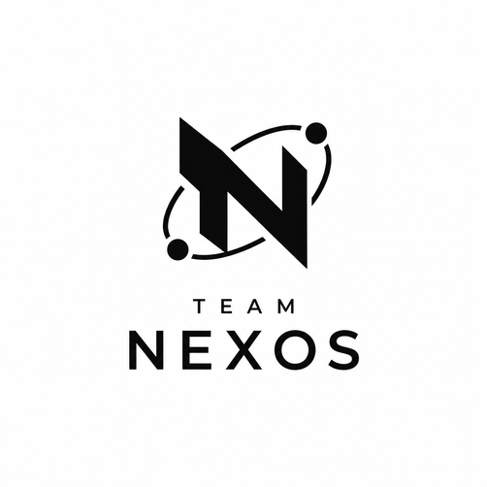
Evidently
AI-POWERED RESUME SCREENING PLATFORM

Slide 2
Problem Statement
RECRUITERS SPEND SIGNIFICANT TIME REVIEWING RESUMES AND PREPARING INTERVIEW QUESTIONS MANUALLY. DEVELOP AN AI-POWERED APPLICATION THAT ANALYZES RESUMES, MATCHES THEM WITH JOB DESCRIPTIONS, IDENTIFIES SKILL GAPS, AND GENERATES PERSONALIZED INTERVIEW QUESTIONS.

Slide 3
The Solution
Evidently is a platform where a recruiter uploads a batch of resumes and a job description, and the AI does the screening work for them. It reads every resume, compares it to the job requirements one by one, and gives each candidate a score. But instead of just handing over a number, it shows exactly which line in the resume earned that score. Recruiters get a ranked list of candidates, know exactly what each one is missing, and get interview questions built around those specific gaps, all in minutes instead of hours.

Slide 4
Features
BULK UPLOAD
- Upload many resumes at once and watch them process live.
AI MATCHING
- Compares each resume to the job requirements using AI, one requirement at a time.
EVIDENCE LINKING
- Click any score and see the exact resume text that backs it up.
SKILL GAP ANALYSIS
- Shows what's missing, what's weak, and what's claimed but never proven.

Slide 5
Features
SMART Interview Questions
- Generated from each candidate's real gaps, not a generic question bank.
RANKING Dashboard
- All candidates for a role, sorted and filterable, in one place.
Cheat Detection
- Catches hidden text or fake instructions someone sneaks into a resume to trick the AI.
Fair SCREENING MODE
- Hides names and colleges while scoring, so bias doesn't creep in.

Slide 6

key features
SEMANTIC VECTOR MATCHING
STRUCTURAL BIAS MITIGATION
MALICIOUS INPUT DEFENSE
CONTEXTUAL GAP INFERENCE
EVIDENCE GROUNDING

Slide 7

Tech we
used
AI & ML
Google Gemini
Groq Cloud
pgvector
FRONTEND
Next JS
Typescript
Tailwind CSS
DOCUMENT PARSING
PDF parse
mammoth
DATABASE & ORM
PostgreSQL
Prisma ORM
Pgvector extension
BACKEND
Appwrite

Slide 8

Impact
FOR RECRUITERS:
Screening goes from hours of manual reading to minutes of review, so recruiters spend less time sorting resumes and more time on final decisions.
TIME SAVED, REALISTICALLY:
Reading and comparing 30-50 resumes manually takes 3-4 hours. Evidently gets that down to a ranked shortlist in minutes.
BETTER FIRST-ROUND INTERVIEWS:
Questions are grounded in each candidate's actual gaps, so even less experienced interviewers ask sharper, more relevant questions.

Slide 9
Impact
MORE CONSISTENT Screening:
Every resume is judged against the same requirements the same way, reducing the variation between recruiters or a tired day.
A stEP TOWARD FAIRER SCREening:
Blind screening reduces the chance a name or college influences the score, without removing the recruiter's final judgment.
OnE HONEST CAVEAT, WORTH stating out loud:
This is a screening aid, not a decision-maker. It surfaces evidence faster than a human could, but the recruiter still makes the final call.

Slide 10

Thank You!
Team Nexos
Fuzail Mansuri
Abrar Patel

