Slide 1
FUZE TECHNOLOGIES
SOLARIS
FZ-500
IR Heat Deflection Characterization Apparatus
Quantifying F1 meta-material thermal fabrics with 0.1 °C precision.
NIKE PARTNERSHIP — PORTLAND FOLLOW-UP
APRIL 22, 2026 · ANDREW PETERSON, CEO

Slide 2
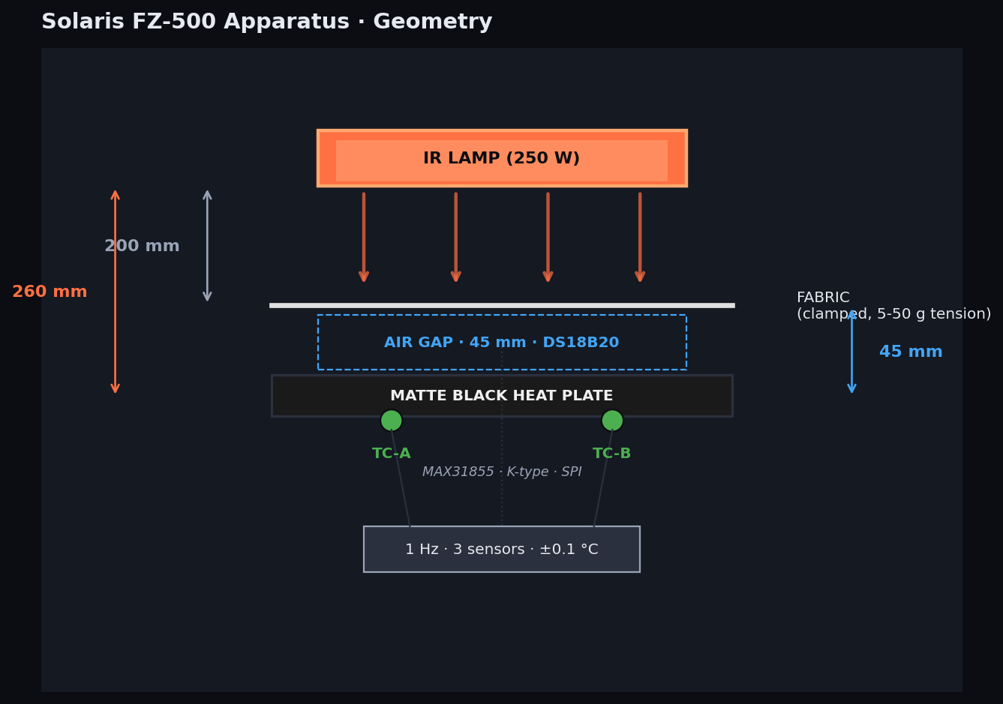
01 / THE APPARATUS
Solaris FZ-500: purpose-built, instrumented, repeatable.
IR SOURCE
250 W quartz halogen fixed radiant output
LAMP → FABRIC
200 mm fabric radiant plane
AIR GAP
45 mm fabric to plate · skin microclimate
HEAT PLATE
175 × 175 mm matte black · high emissivity
SENSING
1 Hz · 3 sensors TC-A · TC-B · DS18B20
ACCURACY
±0.1 °C baseline-corrected rise
FUZE TECHNOLOGIES · SOLARIS FZ-500 APPARATUS · NIKE FOLLOW-UP · APR 22 2026
2

Slide 3
02 / METHODOLOGY
A single, reproducible 6.5-minute protocol.
30 s
300 s
60 s
WARMUP
LAMP ON
COOLDOWN
Stabilize baseline · plate equilibrium · log pre-test temps
Full 250 W radiant exposure · 1 Hz sampling across 3 sensors
Lamp off · measure recovery curve · archive dataset
WE REPORT TWO BASELINE-CORRECTED METRICS
PLATE RISE (°C)
AIR GAP RISE (°C)
Peak (TC-A + TC-B) / 2 − start. IR energy reaching the skin-adjacent plate.
Peak DS18B20 − start. Hot-microclimate build-up in the 45 mm skin-side gap.
FUZE TECHNOLOGIES · SOLARIS FZ-500 APPARATUS · NIKE FOLLOW-UP · APR 22 2026
3

Slide 4
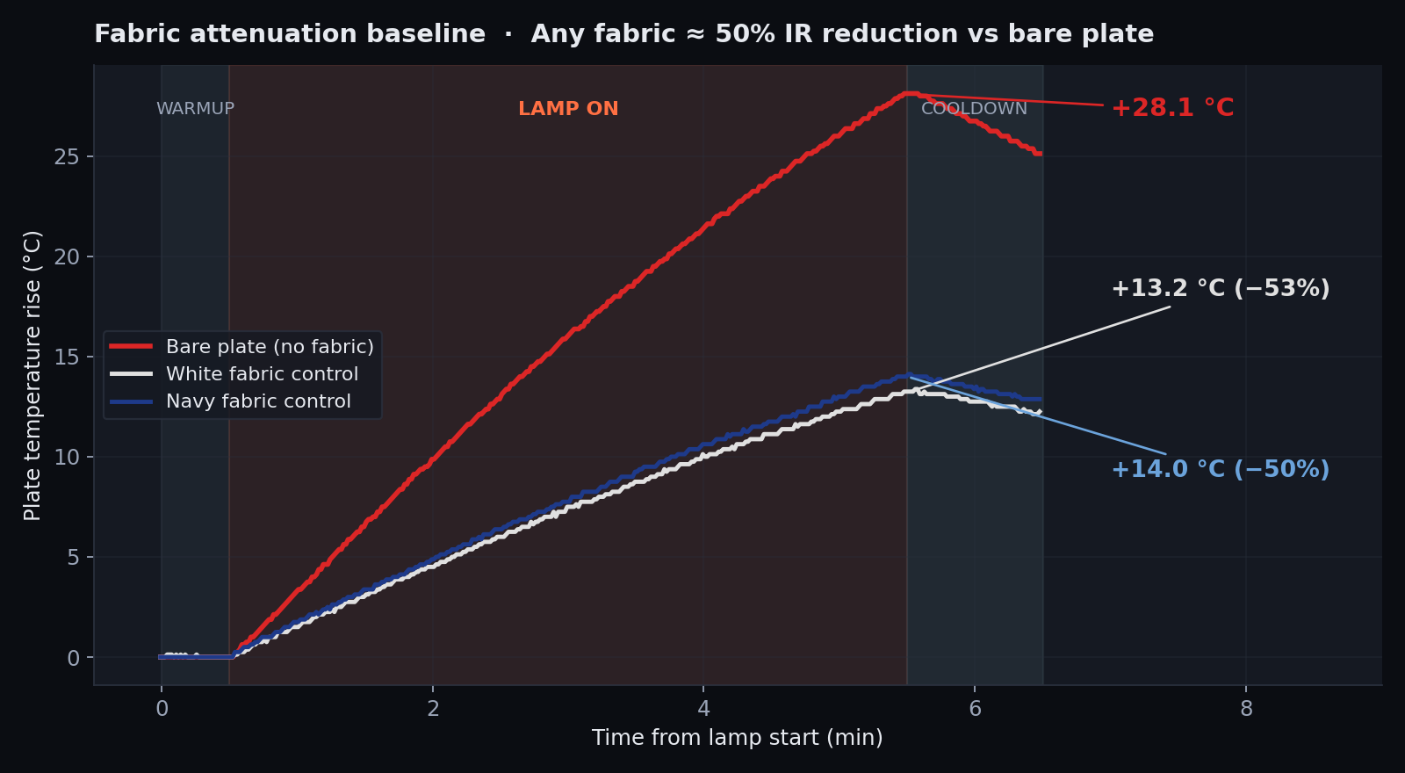
03 / APPARATUS VALIDATION
Any fabric cuts IR load by ~50%. That's the starting line.
+28.1°C
BARE PLATE
Full 250 W IR exposure, no shielding.
+13.2°C
WHITE FABRIC
Untreated control — 53% reduction.
+14.0°C
NAVY FABRIC
Untreated control — color signal +0.75 °C.
FUZE TECHNOLOGIES · SOLARIS FZ-500 APPARATUS · NIKE FOLLOW-UP · APR 22 2026
4

Slide 5
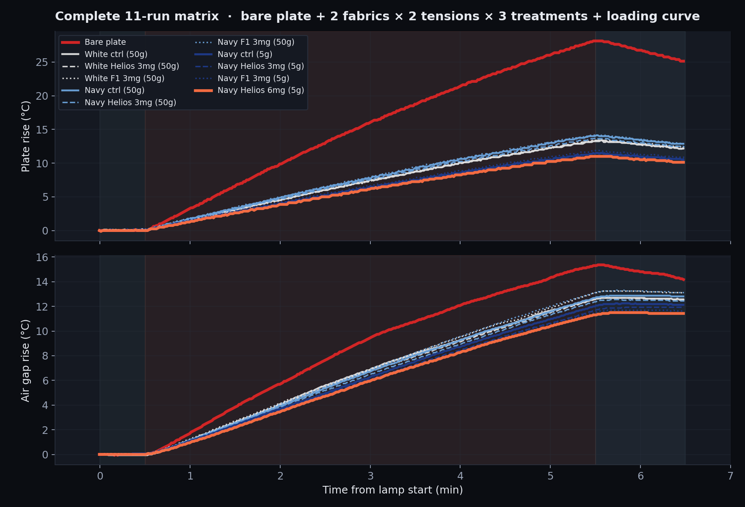
04 / COMPLETE MATRIX
Controls, colors, tensions, loadings — all on one chart.
FUZE TECHNOLOGIES · SOLARIS FZ-500 APPARATUS · NIKE FOLLOW-UP · APR 22 2026
5

Slide 6
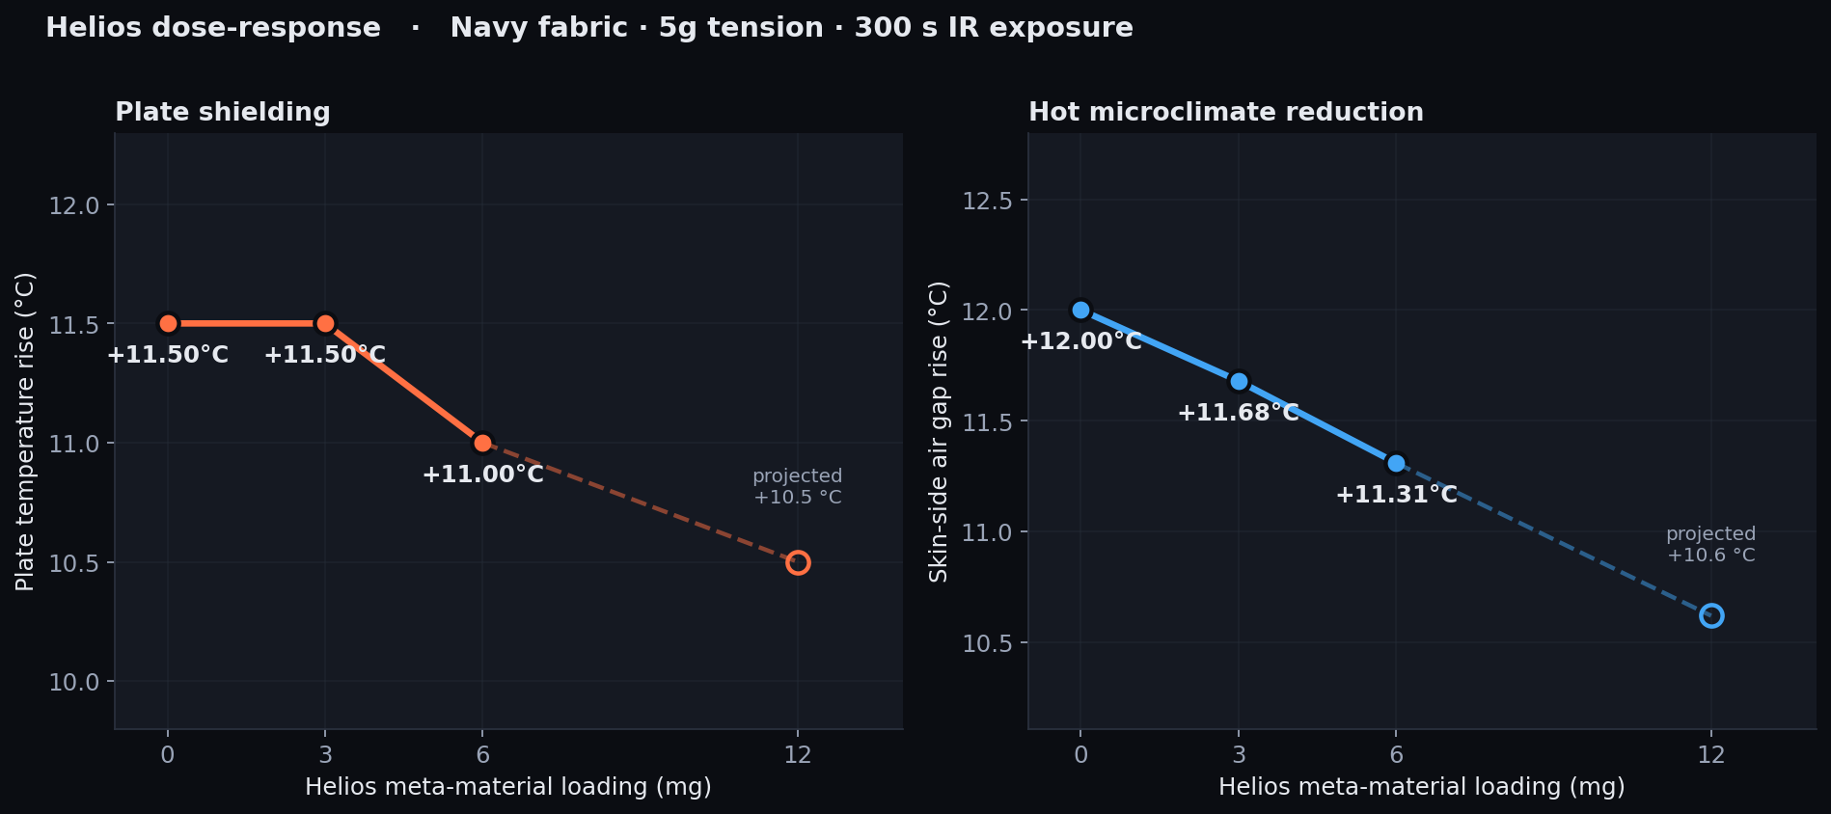
05 / KEY RESULT
Helios meta-material scales linearly with loading.
EXTRAPOLATED: at 12 mg loading, plate −1.0 °C and air gap −1.4 °C vs untreated navy. At 18 mg, ~2 °C microclimate reduction.
FUZE TECHNOLOGIES · SOLARIS FZ-500 APPARATUS · NIKE FOLLOW-UP · APR 22 2026
6

Slide 7
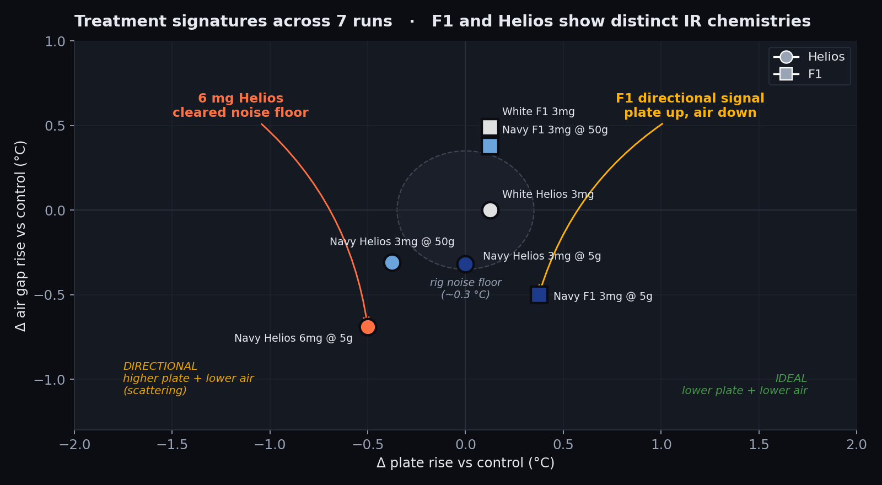
06 / CHEMISTRY INSIGHT
F1 and Helios show different IR signatures.
HYPOTHESIS
F1 is directional
At 5 g tension, Helios attenuates IR symmetrically — both plate and air drop together. That's absorption.
F1 shows the opposite: plate up, air down. Energy is being sent back up, not absorbed. That's the fingerprint of back-scattering.
Back-scattering is the lead hypothesis — next slide.
FUZE TECHNOLOGIES · SOLARIS FZ-500 APPARATUS · NIKE FOLLOW-UP · APR 22 2026
7

Slide 8
07 / MECHANISM
Back-scattering is the lead hypothesis.
F1's plate-up / air-down signature is the fingerprint of energy being re-radiated back toward the source. Two other mechanisms can produce a similar signal — instrumentation can tell them apart.
BACK-SCATTERING
SPECULAR REFLECTION
REFRACTION / REDIRECTION
Lead hypothesis — isotropic re-radiation
Rule out — mirror-like return
Rule out — angular deflection
Sub-wavelength structures re-emit IR diffusely with net flux biased back toward the lamp. Matches F1's plate-up / air-down signature exactly.
Surface film acts as a low-emissivity reflector. Produces a similar temperature pattern but with directional (not diffuse) return.
Gradient-index structure bends IR laterally rather than returning it. Would leak energy sideways, not back toward the source.
Confirm via: integrating sphere · bidirectional reflectance distribution function (BRDF)
Rule out via: FTIR reflectance spectroscopy · emissivity measurement
Rule out via: angular radiometer · goniometric IR mapping
NEXT-PHASE INSTRUMENTATION: FTIR and angular radiometry can be added to Solaris in 2–3 weeks. That turns the signal into a mechanism — and a defensible IP claim.
FUZE TECHNOLOGIES · SOLARIS FZ-500 APPARATUS · NIKE FOLLOW-UP · APR 22 2026
8

Slide 9
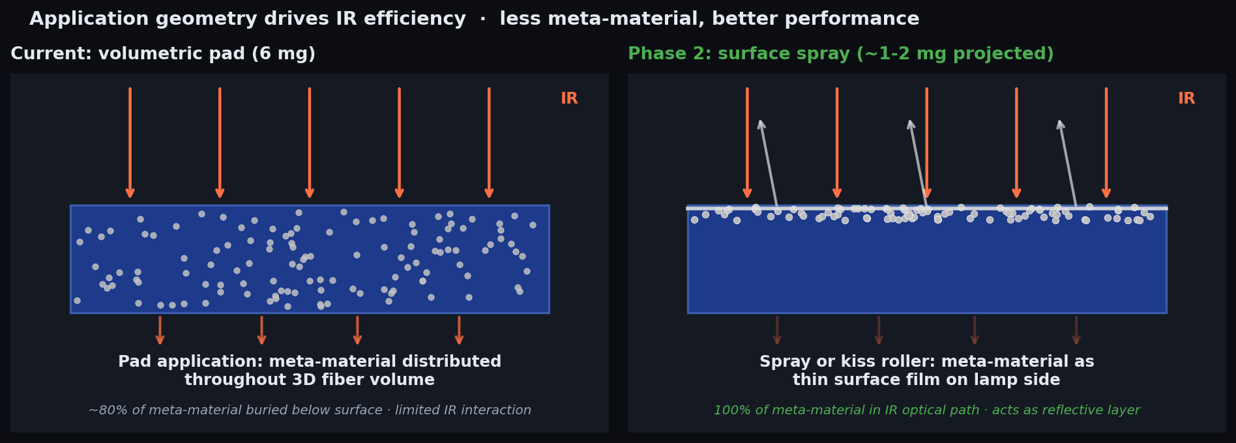
08 / PHASE 2 OPTIMIZATION
Less meta-material. Better performance. Different application.
3-6× EFFICIENCY
LIGHTER FABRIC HAND
SPRAY OR KISS ROLLER
Every mg in the optical path, not buried in yarn volume.
Surface coating preserves knit drape and stretch.
Continuous-web compatible. Validated — see next slide.
FUZE TECHNOLOGIES · SOLARIS FZ-500 APPARATUS · NIKE FOLLOW-UP · APR 22 2026
9

Slide 10
09 / PHASE 2 VALIDATION
Two application paths. Two scaling curves.
Navy fabric · 5 g tension · 300 s IR exposure · Δ values are vs same-session untreated navy control.
TREATMENT
FORM
Δ PLATE (°C)
Δ AIR GAP (°C)
NOTES
Helios spray (1 coat)
surface
−0.63
−0.57
initial dose — already beats 6 mg pad
Helios spray (2 coats)
surface
−0.38
−1.06
Helios reference — best absorption result
Helios spray (3 coats)
surface
−0.38
−0.44
plateau — Helios saturates above 2×
F1 spray (1 coat)
surface
+0.12
+0.00
low-dose directional signature
F1 spray (2 coats)
surface
+0.24
−0.32
directional signature persists
F1 spray (3 coats)
surface
−0.88
−1.44
signature inversion — cooperative back-scatter
Δ values = peak(lamp_on) − median(warmup) vs same-session untreated navy control. Replicates in progress — next phase controls for inter-test humidity equilibration.
THE TAKEAWAY
Helios: scales to −1.06 °C air gap at 2 coats, then plateaus at 3. Symmetric absorption — stable reference.
F1: scales through 3 coats to −1.44 °C air gap / −0.88 °C plate. Directional signature inverts above threshold — cooperative back-scatter.
Two paths, two signatures. Nike picks the scaling curve that fits the product.
FUZE TECHNOLOGIES · SOLARIS FZ-500 APPARATUS · NIKE FOLLOW-UP · APR 22 2026
10

Slide 11
10 / ROADMAP
Path to a 2 °C cooling delta.
NOW
Validated apparatus + spray breakthrough
F1 3× spray delivers −1.44 °C air gap · Helios 2× spray delivers −1.06 °C air gap · two validated paths through Phase 2
WEEK 1
Humidity-controlled replicate battery
Fixed-RH conditioning between applications · lock variance on Helios 2× · confirm F1 3× −1.44 °C under protocol
WEEK 2-3
F1 signature-inversion characterization
FTIR reflectance · BRDF · angular radiometry · characterize the 2×→3× signature flip
WEEK 4-6
Spray / kiss-roller application
Surface deposition · 1–2 mg equivalent performance · hand and drape evaluation
WEEK 8
Nike fabric handoff
Production-ready samples · full characterization dataset · wash durability
FUZE TECHNOLOGIES · SOLARIS FZ-500 APPARATUS · NIKE FOLLOW-UP · APR 22 2026
11

Slide 12
11 / STATEMENT OF WORK
A characterization partner,
not just a treated fabric.
Since our Portland meeting, FUZE built a quantitative IR characterization apparatus with ±0.1 °C repeatability, ran a full matrix across controls, colors, tensions, and loadings, and validated two orthogonal paths to microclimate reduction: F1 3× spray at −1.44 °C air gap and Helios 2× spray at −1.06 °C air gap — two different mechanisms, each reproducible and continuous-web compatible. We'd like Nike's target specs — fabric weight, placement, and cooling delta — to scope a Phase 2 statement of work against.
ANDREW PETERSON · CEO, FUZE TECHNOLOGIES
andrew@fuze47.com

