Slide 1
基于RetinaNet的人脸口罩检测
Face Mask Detection with RetinaNet
傅仲强
2021.01.04

Slide 2
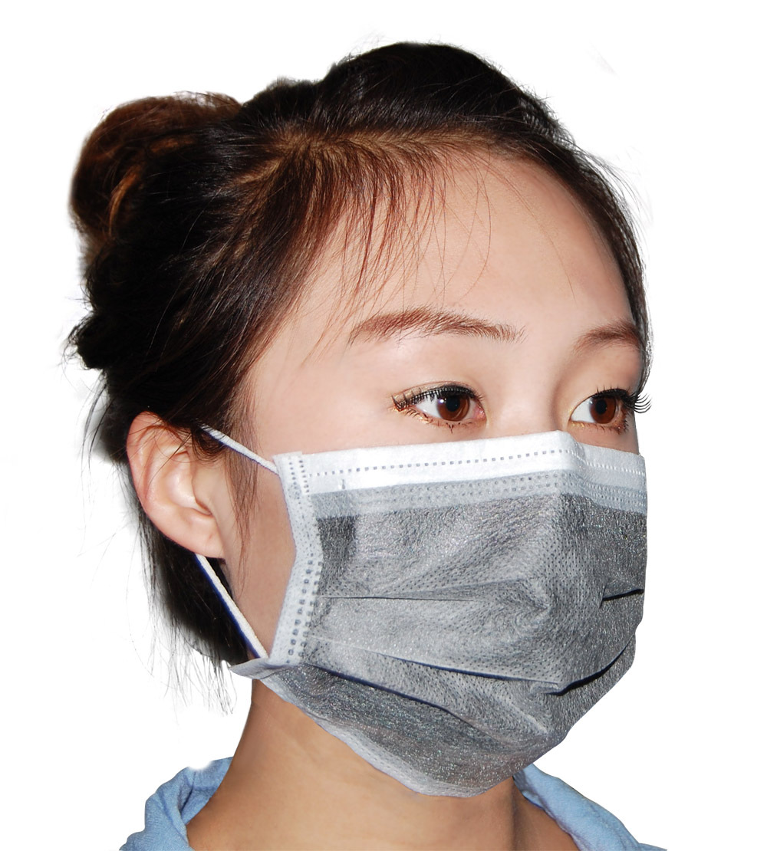
背景
Covid-19 一种由新型冠状病毒感染引起的急性呼吸道传染病，目前正在国外广泛流行 ，在国内仍有零星散发的个例。正确佩戴医用口罩，作为预防新冠病毒，降低病毒的传播与扩散的风险的最为简单有效的手段，也是国内各类场所防疫的必备要求。
基于深度学习的计算机视觉检测技术，能够快速、有效的识别出口罩的佩戴。

Slide 3
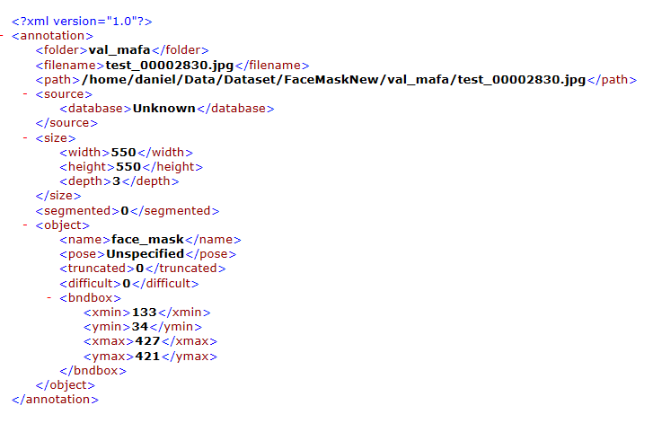
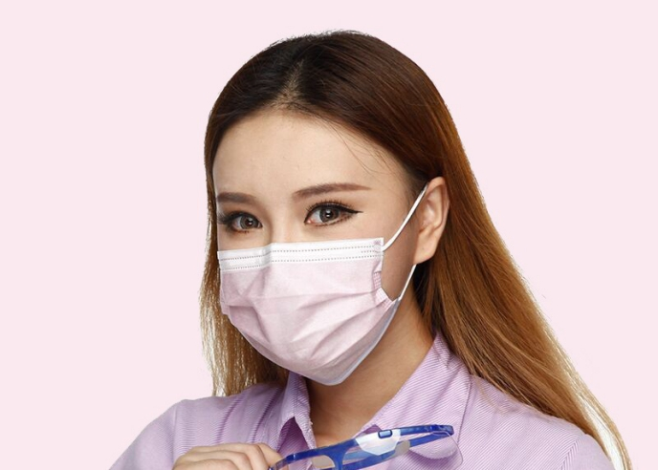
数据集
人脸口罩数据集
训练集 6120张图片
验证集 1839张图片
类别：
face 、face_mask
标签
voc xml文件

Slide 4
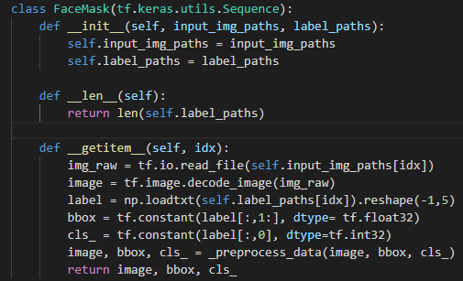
Data loader
xml标注文件 转 txt标注文件
标注文件的每个物体的对应框，转换为
cls_id,x1/w,y1/h,x2/w,y2/h
Data input pipe
Load from disk to cpu(gpu) memory
Data genarator
Load data in sequential
Data transformer(preprocessing)

Slide 5
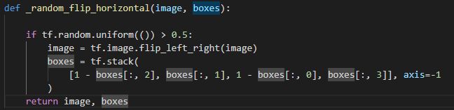
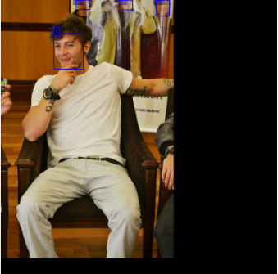
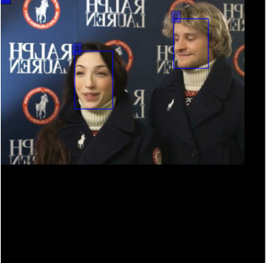
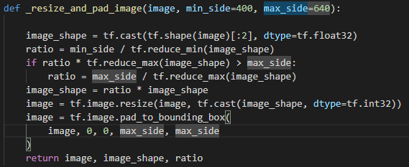
Preprocessing
随机水平翻转
图片缩放为640x640, 保留原图的
宽高比

Slide 6
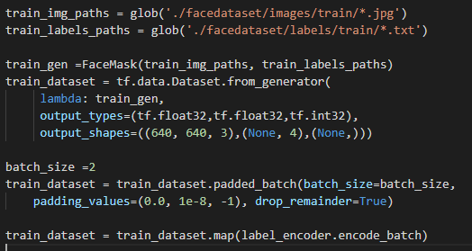
Data loader(cont'd)
Data genarator
specifies how to load data in
sequential
Dataset.from_generator
specifies data type
Dateset.padded_batch
specifies how to load data in batch
image: padding 0.
bbox: padding 1e-8
cls_id: padding -1
Encoder Anchor box
images outputs:(batch_size,640,640,3)
labels outputs:(batch_size,tolal_anchors,5)
Maybe coding simple and clean, but tons of bugs!!!

Slide 7
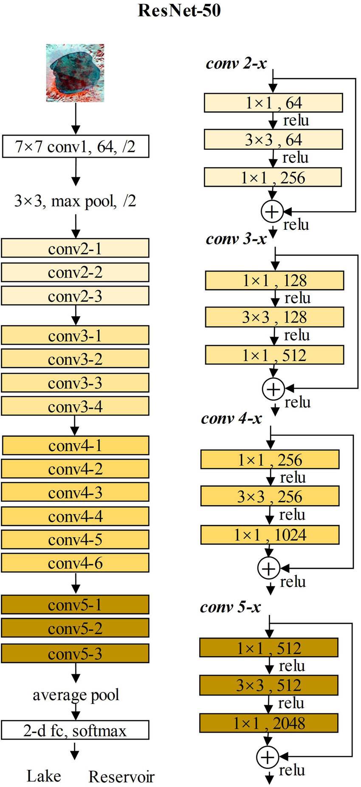
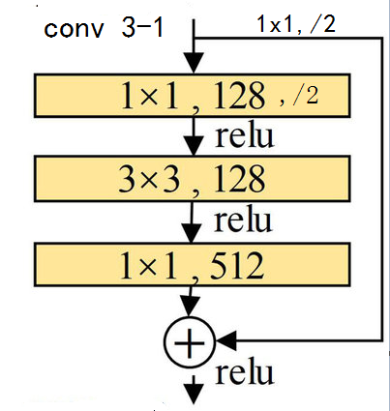
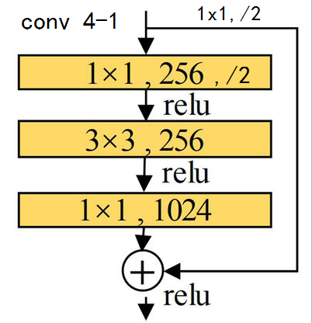
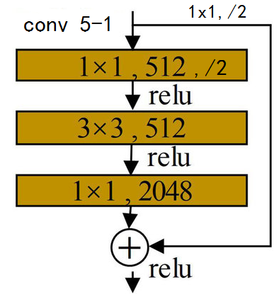
Model Architecture
Backbone
Resnet50(w/o classification head)
Downsampling
conv2-x strides 4 （No downsampling）
conv3-x strides 8
conv4-x strides 16
conv5-x strides 32

Slide 8

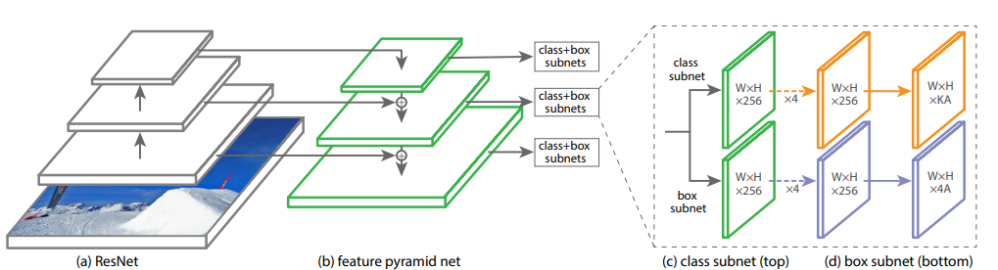
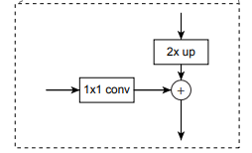
FPN
p7 /128
p6 /64
c5 /32
p5 /32
c4 /16
p4 /16
c3 /8
p3 /8
Multi-scales feature map 、receptive field
Top-down pathway 、lateral connection
Feature fusion（semantic、locational）
5 scales feature maps 、strides (8, 16, 32, 64, 128)

Slide 9
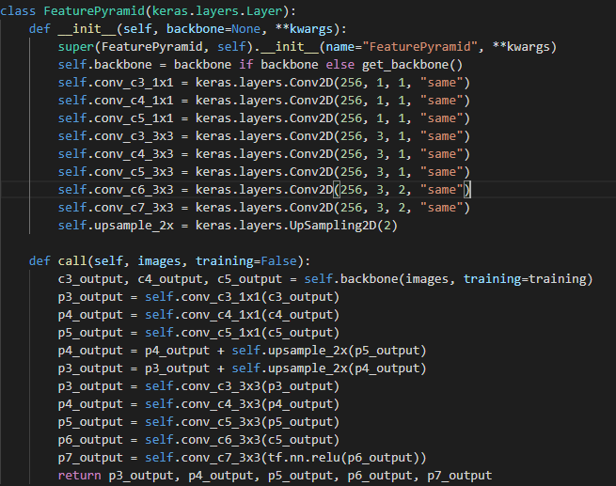
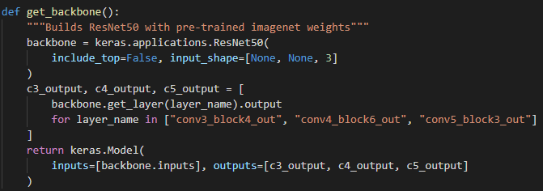
FPN(cont'd)
Backbone outputs 3 stages features maps
lateral connection (1x1, 256)
Feature fusion (Upsampling, elements add)
Outputs (3x3 conv, 5 scales feature maps)

Slide 10
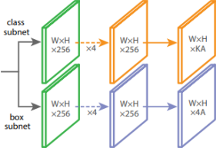
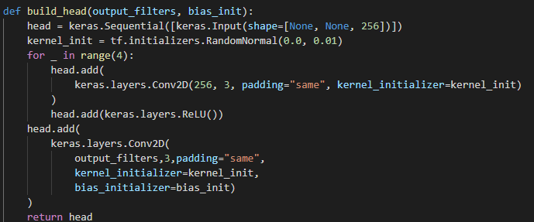
Heads
Two Seperate heads
Classes classification heads
Box regression heads
No shared layers(weights) in heads
Fully conv. subnets
4 conv. layers (3x3 conv.used here,
but 1x1 is also good)
1 output layer(matchs the dimension
of anchor box labels)
Heads shared among different
stages feature maps

Slide 11
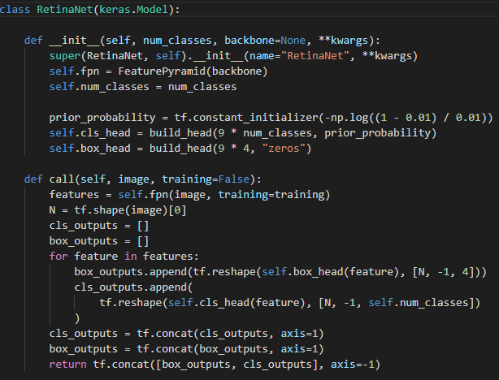
Heads(cont'd)
Classes classification heads
5 stages feature maps, each outputs
(batch_size, H, W, classes_num* anchor_num)
totals (batch_size, 76725, classes_num)
Box regression heads
5 stages feature maps, each outputs
(batch_size, H, W, 4* anchor_num)
totals (batch_size, 76725, 4)
Outputs concat.
(batch_size, 76725,classes_num+4)

Slide 12
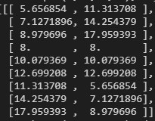
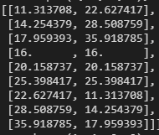
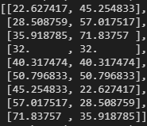
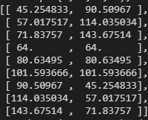
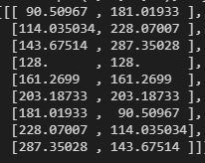
Anchor box
Aspect ratios
[0.5, 1, 2.0]
Scales
[2**0, 2**1/3, 2**2/3]
5 stages feature maps
p3 shape:[80,80], strides:8 （batch_size, 80, 80, 9, 4）
p4 shape:[40,40], strides:16 （batch_size, 40, 40, 9, 4）
p5 shape:[20,20], strides:32 （batch_size, 20, 20, 9, 4）
p6 shape:[10,10], strides:64 （batch_size, 10, 10, 9, 4）
p7 shape: [5,5], strides:128 （batch_size, 5, 5, 9, 4）
Totals 76725 (batch_size, 79725,4)

Slide 13
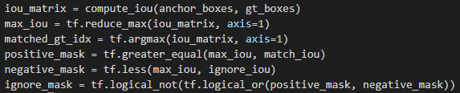
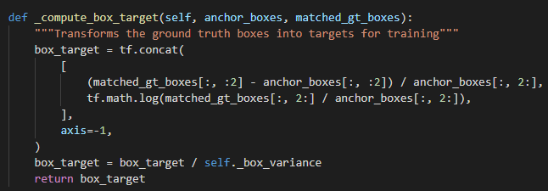
Encode Anchor labels
Computes IoU of anchor boxes and g.t. boxes
iou_matrix shape: (anchor_nums, gt_box_nums)
pos. anchor(sample) IoU > 0.5 (box regression)
neg. (sample) IoU < 0.4
ign. 0.4 < IoU < 0.5 (ign. both in cls. and reg.)
Assigns each anchor for classification
only pos. can assigns to f.g.(classes_id)
neg. anchor to b.g(-1), ign. to -2
Assigns each anchor for regreesion
each anchor is encoded with the maximum
IoU of g.t.boxes
in fact, only pos. is needed
all anchors is encoded in this code

Slide 14
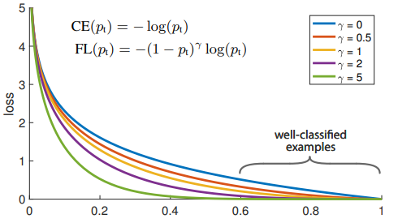
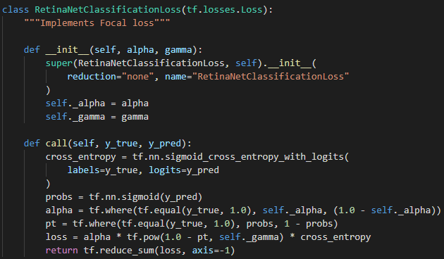
Losses
Losses imbalance (clf. or reg. 、 cls.)
Classification loss(focal loss)
most samples are b.g and easy(loss is small),but still
contribute large part of loss,
focus on non-easy b.g. samples
Regression loss (smooth L1)
Only use pos. samples(IoU>0.5)
Very few nums.

Slide 15
Result
单击此处添加正文

Slide 16
Concept is clean, but training is the art!

