Slide 1


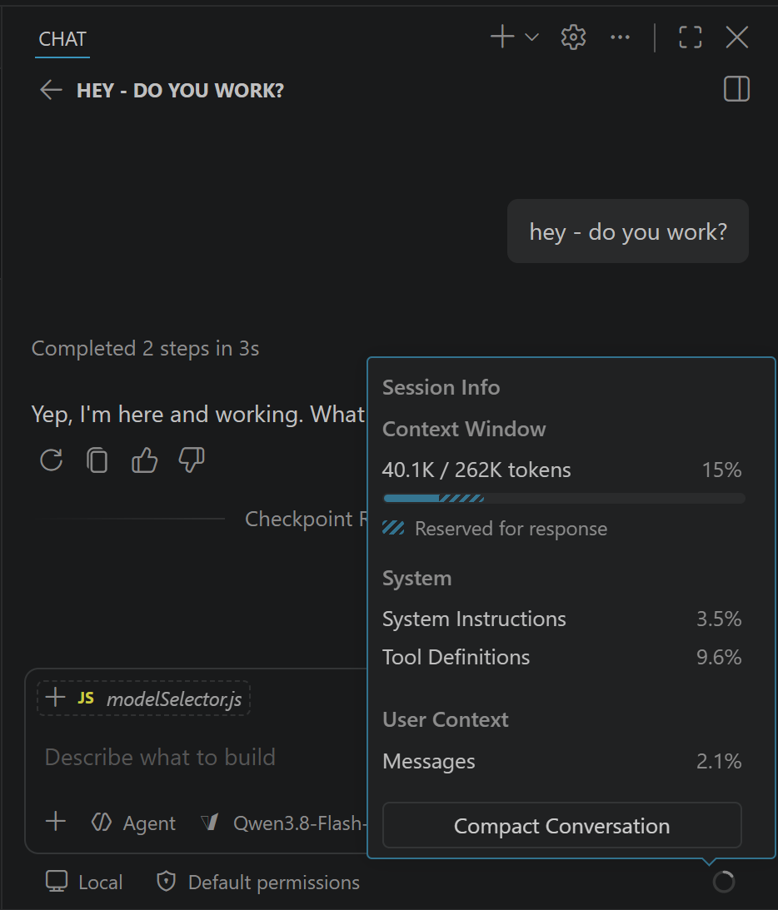


?
Qwen, DeepSeek, Nvidia, GLM, Kimi, …

Slide 2




Qwen, DeepSeek, Nvidia, GLM, Kimi, …
, …

Slide 3


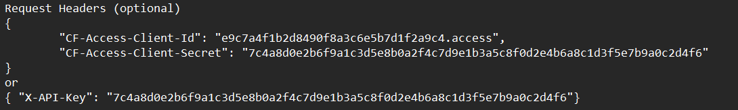
vLLM
(Security: API-Key)
Proxy
(Security: http headers)

Slide 4

Model id
Config
Models?
Model ids
Ctx Window
Qwen, DeepSeek, Nvidia, GLM, Kimi, …
, …

Slide 5

System & User prompts + session history + tools
System & User prompts
+ session history + tools
Reply, thinking, tool calls
Reply, thinking, tool calls
It’s your server – why follow Microsoft’s content policies?

