Slide 1
Sign Classification With cuda-convnet
Andrey Gavel

Slide 2

cuda-convnet
Convolutional Neural Network
C++/CUDA
Requires GTX 4xx, 5xx, or Tesla equivalent
Interface through python scripts
http://code.google.com/p/cuda-convnet/

Slide 3
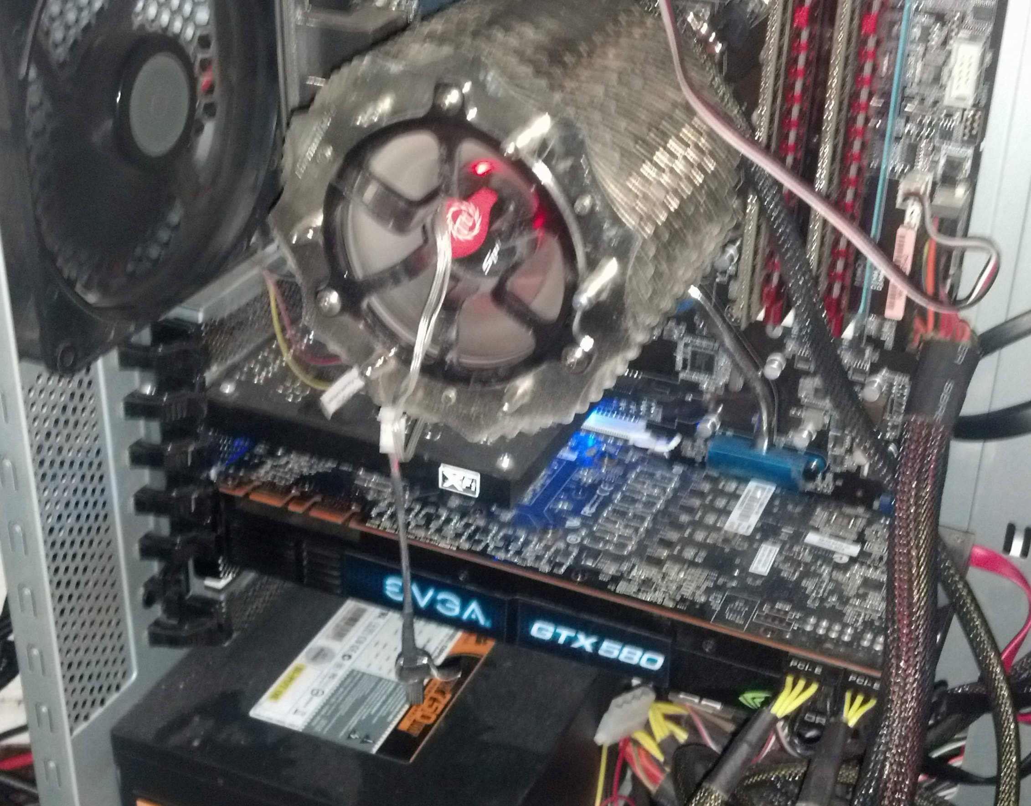
GTX 580

Slide 4

Setting Up the Environment
Cuda-convnet uses CUDA 4.2
Current version is CUDA 6.0
Decided to go with CUDA 6.0
Setup process
  Ubuntu 13.04 Server
  CUDA 6.0
  Ubuntu-desktop
  Install python
  Install other libraries

Slide 5

Compiling cuda-convnet
Changed some paths
Added dummy c++ file
  #defines for outdated functions
Other small changes
It compiles!

Slide 6

Data Format
Square images
  Size: multiple of 32 for performance
Images broken up into “batch” files
“batches.meta” file for extra info

Slide 7

Batch File
Python pickled object
Fields
  batch_name
  filenames
  num_cases
  data
    2-d array
    Column for each image
    Column contains rgb pixel values
  labels

Slide 8
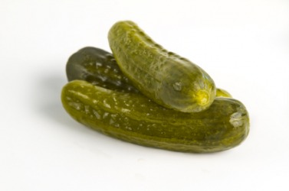
Batch Meta File
Python pickled object
Fields
  num_cases_per_batch
  label_names
  num_vis
    width * height * 3 (rgb)
  data_mean
    array of mean values for each row in data

Slide 9

Sign Images Data Set
Couldn't find US street signs
Found German street signs
  http://benchmark.ini.rub.de/
50,000 images
40 classes
Various conditions
  Time of day
  Weather

Slide 10
Formatting Data
Removed classes with few images
Resized images to 32x32
Wrote python script to partition data
  Reads class info from config file
  Creates batches & meta file
Ended up with
  7 batches
  17 classes

Slide 11
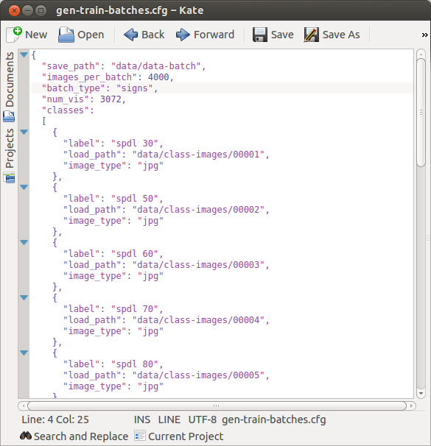
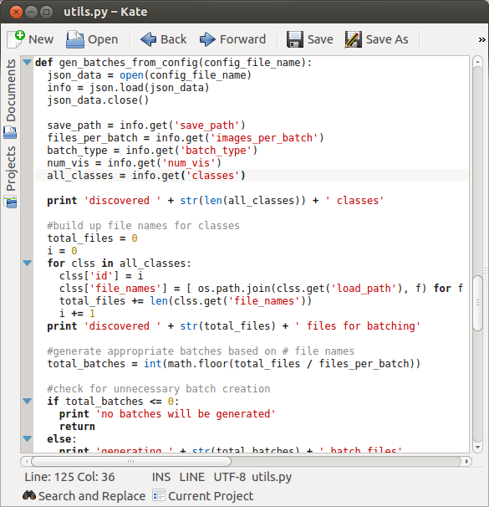
Config File & Python Script

Slide 12
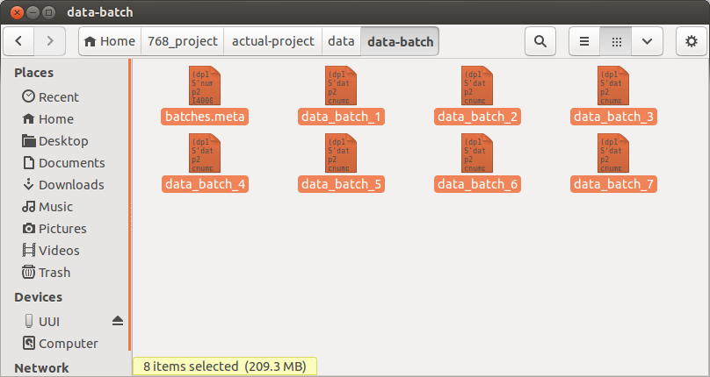
Generated Batch Files

Slide 13
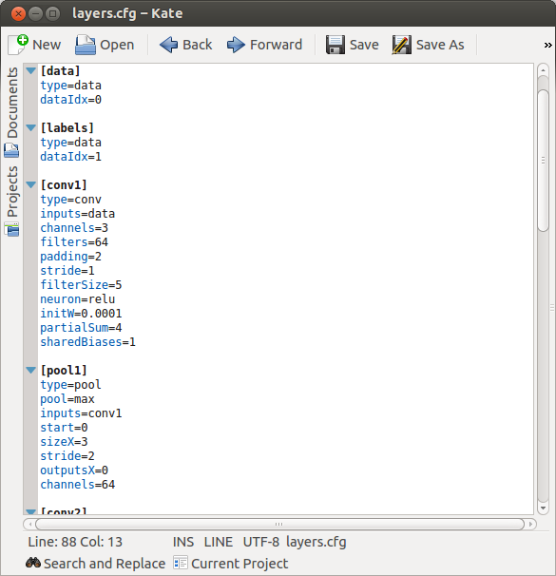
Layer Configuration
Config file for layers in network
  data (input) layers
  data manipulation layers
  cost/probability layers
Layer properties
Initial weights/values
How layers are connected

Slide 14

Training
python convnet.py
--data-path=./data/data-batch
--save-path=./checkpoints
--test-range=1-2
--train-range=3-7
--layer-def=./layers.cfg
--layer-params=./layer-params.cfg
--data-provider=cifar

Slide 15
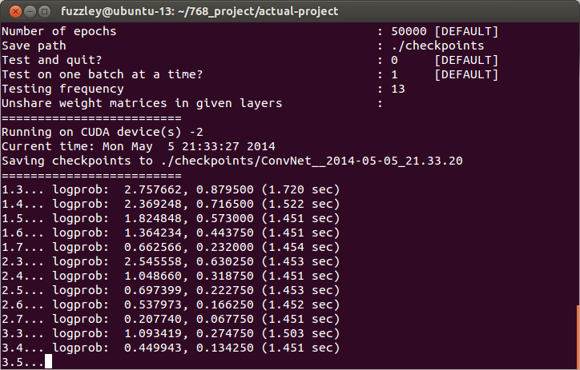
Training Progress
Negative log probability data under model
Classification error rate
Took about 13 minutes

Slide 16

Testing
python convnet.py
--data-path=./data/data-batch
--save-path=./checkpoints
--test-range=1-2
--train-range=3-7
--layer-def=./layers.cfg
--layer-params=./layer-params.cfg
--data-provider=cifar
--test-only=1
-f /path/to/checkpoint/

Slide 17
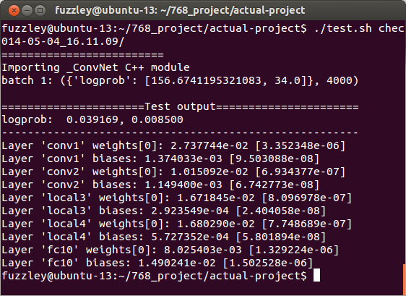
Test Results

Slide 18
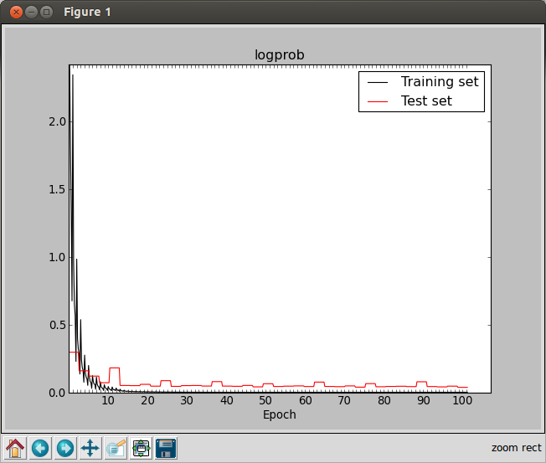
Negative Log Probability
python shownet.py -f checkpoint/ --show-cost=logprob

Slide 19
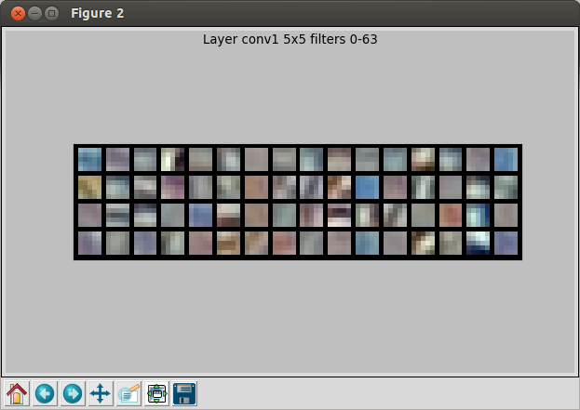
Learned Filters
python shownet.py -f checkpoint/ --show-filters=conv1

Slide 20
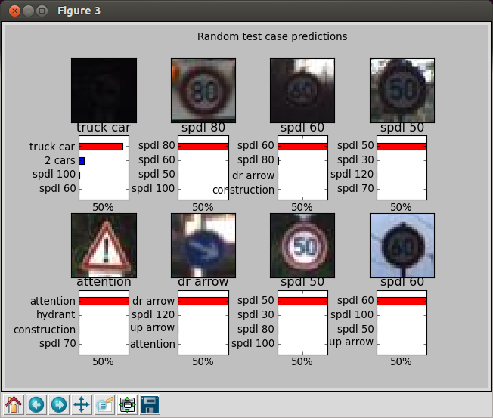
Sample Results
python shownet.py -f checkpoint/ --show-preds=probs

Slide 21
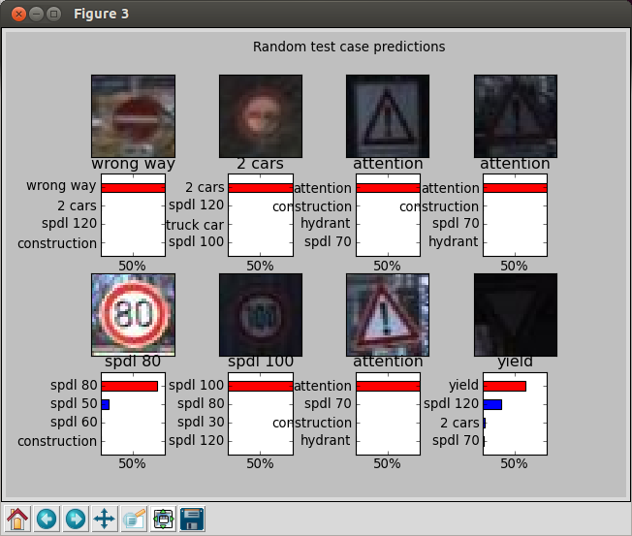
Sample Results (2)

Slide 22
Thank You
Questions?

