Slide 1
CSE109
Computer Programming
Lecture #0

Slide 2
Course Introduction
Course Code : CSE109
Course Title : Computer Programming
L-T-P Structure : 2 0 2
Credits: 03
Nature of Course : Core

Slide 3
Vision of School
To be a globally recognized school through excellence in teaching, learning and research for creating Computer Science professionals, leaders and entrepreneurs of future contributing to society and industry for sustainable growth.

Slide 4
Mission
M1: To provide a learning-based environment on technical concepts applied to real-life situations with measurable outcomes.
M2: To establish connections with the industry for curriculum design, and creating internship cum career opportunities.
M3: To address societal issues related to regional, national and global challenges through meaningful research.
M4: To inspire graduates for pursuing lifelong learning in professional careers.
M5: To develop leadership potential in ethically competent entrepreneurs.

Slide 5
Course Outcomes (COs)
CO1 :: discuss the various approaches towards solving a particular problem using the C language constructs.
CO2 :: apply appropriate control structures and input/output functions to develop structured programs in C for solving moderate-level computational problems.
CO3 :: analyze the impact of function types, recursion, and storage classes on program performance and modularity in C.
CO4 :: infer the usage and significance of pointers, one of the fundamental building blocks of data structures.
CO5 :: categorize the theoretical knowledge and insights gained to formulate and implement working code solutions.
CO6 :: understand the syntax and usage of structures and unions in C, including initialization and data access techniques

Slide 6
Program Outcomes
PO1: Engineering Knowledge: Apply knowledge of mathematics, natural science, computing, engineering fundamentals and an engineering specialization as specified in WK1 to WK4 respectively to develop to the solution of complex engineering problems
PO2: Problem Analysis: Identify, formulate, review research literature and analyze complex engineering problems reaching substantiated conclusions with consideration for sustainable development. (WK1 to WK4)
PO3: Design/Development of Solutions: Design creative solutions for complex engineering problems and design/develop systems/components/processes to meet identified needs with consideration for the public health and safety, whole-life cost, net zero carbon, culture, society and environment as required. (WK5)
PO4: Conduct Investigations of Complex Problems: Conduct investigations of complex engineering problems using research-based knowledge including design of experiments, modelling, analysis & interpretation of data to provide valid conclusions. (WK8).
PO5: Engineering Tool Usage: Create, select and apply appropriate techniques, resources and modern engineering & IT tools, including prediction and modelling recognizing their limitations to solve complex engineering problems. (WK2 and WK6)

Slide 7
Program Outcomes (Cont.)
PO6: The Engineer and The World: Analyze and evaluate societal and environmental aspects while solving complex engineering problems for its impact on sustainability with reference to economy, health, safety, legal framework, culture and environment. (WK1, WK5, and WK7).
PO7: Ethics: Apply ethical principles and commit to professional ethics, human values, diversity and inclusion; adhere to national & international laws. (WK9)
PO8: Individual and Collaborative Team work: Function effectively as an individual, and as a member or leader in diverse/multi-disciplinary teams.
PO9: Communication: Communicate effectively and inclusively within the engineering community and society at large, such as being able to comprehend and write effective reports and design documentation, make effective presentations considering cultural, language, and learning differences.
PO10: Project Management and Finance: Apply knowledge and understanding of engineering management principles and economic decision-making and apply these to one’s own work, as a member and leader in a team, and to manage projects and in multidisciplinary environments.
PO11: Life-Long Learning: Recognize the need for, and have the preparation and ability for i) independent and life-long learning ii) adaptability to new and emerging technologies and iii) critical thinking in the broadest context of technological change. (WK8)

Slide 8
Program Specific Outcomes
PSO1: Demonstrate proficiency in the application of circuit analysis and design in the fields of analogue and digital electronics, signal systems employing microprocessors and control.
PSO2: Develop lifelong understanding in the field of telecommunication/ IOT/ VLSI design/ automation and robotics.

Slide 9
Programme Education Objectives
PEO1: Graduates will establish successful careers by applying the fundamental principles of Computer Science and Engineering to solve real-world computing problems effectively.
PEO2: Graduates will continuously enhance their knowledge and skills through higher education, professional development, research, and self-learning to adapt to evolving technologies.
PEO3: Graduates will demonstrate leadership, teamwork, innovation, and entrepreneurship while developing sustainable computing solutions for society and industry.
PEO4: Graduates will practice professional ethics, effective communication, and social responsibility while contributing positively to organizations and society.

Slide 10
Need of Computer Programming?
The need for computer programming :
Converts human logic into machine-executable instructions
Enables development of software, websites, and mobile applications
Automates repetitive and complex tasks
Solves real-world computational problems efficiently
Controls hardware devices and embedded systems
Facilitates communication between users and computers
Forms the foundation for emerging technologies such as AI, Data Science, IoT, and Cloud Computing

Slide 11
Course Overview & Importance
Course Overview
Computer Programming is a foundational course designed to introduce students to the principles of problem solving and software development using the C programming language. The course emphasizes algorithmic thinking, structured programming, and the implementation of efficient solutions to computational problems. Students will gain hands-on experience in writing, testing, debugging, and optimizing C programs while learning fundamental programming concepts that serve as the basis for advanced Computer Science courses. The knowledge and skills acquired in this course will enable students to develop reliable software solutions and establish a strong foundation for lifelong learning in computing.

Slide 12
Course Overview & Importance(contd.)
Importance
Programming is one of the most fundamental skills in Computer Science and Engineering. It enables students to analyze problems, design logical solutions, and implement them using a structured programming approach. The knowledge of C programming serves as the foundation for advanced courses such as Data Structures, Operating Systems, Computer Networks, Database Management Systems, and Software Engineering. Moreover, proficiency in programming enhances analytical thinking, debugging skills, and computational problem-solving abilities, which are essential for software development, research, competitive programming, and careers in the IT industry.

Slide 13
Course Content
Unit | Broad Topic | Sub-Topics & Key Concepts | Practical Applications
Unit I | Basics and Introduction to C | C character set, Tokens, Identifiers, Keywords, Data Types, Constants, Variables, Operators (Arithmetic, Relational, Logical, Assignment, Conditional, Unary, Bitwise), Special Symbols | Understand the fundamentals of C programming and develop simple programs using basic language constructs.

Slide 14
Course Content
Unit | Broad Topic | Sub-Topics & Key Concepts | Practical Applications
Unit II | Control Structures & Input/Output Functions | Conditional Statements (if, if-else, nested if, else-if ladder, switch), Looping (for, while, do-while), Jump Statements (break, continue, goto, return), Structured Programming, Type Conversion, printf() and scanf() | Develop logical decision-making skills and design structured C programs using control statements and standard I/O functions.

Slide 15
Course Content
Unit | Broad Topic | Sub-Topics & Key Concepts | Practical Applications
Unit III | User-Defined Functions | Function Declaration, Definition and Call, Function Prototypes, Parameter Passing, Call by Value, Call by Reference, Local & Global Scope, Standard Math Library Functions | Learn modular programming techniques and implement reusable, well-structured C programs.

Slide 16
Course Content
Unit | Broad Topic | Sub-Topics & Key Concepts | Practical Applications
Unit IV | Arrays and Pointers | One-Dimensional Arrays, Memory Allocation of Arrays, Array Operations (Insertion, Deletion, Linear Search), Pointer Declaration & Initialization, Types of Pointers, Pointer to Pointer, Pointer to Array | Apply arrays and pointers for efficient data storage, manipulation, and memory access.

Slide 17
Course Content
Unit | Broad Topic | Sub-Topics & Key Concepts | Practical Applications
Unit V | Dynamic Memory Management & Strings | Dynamic Memory Allocation (malloc(), calloc(), realloc(), free()), Memory Leaks, String Declaration, Input/Output, String Library Functions (strcmp(), strcpy(), strcat(), strlen(), etc.) | Develop programs that efficiently manage memory and perform string processing using library functions.

Slide 18
Course Content
Unit | Broad Topic | Sub-Topics & Key Concepts | Practical Applications
Unit VI | User-Defined Data Types | Structures, Nested Structures, Arrays of Structures, Unions, Structure vs Union | Design applications using user-defined data types to represent and manipulate complex data efficiently.

Slide 19
List of Practicals
1. Develop C Programs using Formatted Input/Output Functions
Design simple C programs using printf() and scanf() to perform input, output, and basic arithmetic operations. Demonstrate the use of formatted input/output for effective user interaction.
2. Design Programs using User-Defined Functions
Develop C programs to explore different function prototypes, function definitions, and function calls. Analyze the implementation of modular programming using user-defined functions.
3. Build Applications to Demonstrate Function Calling Mechanisms
Implement programs to compare Call by Value and Call by Reference techniques. Evaluate how different parameter-passing mechanisms affect program execution.

Slide 20
List of Practicals
4. Develop Programs using Mathematical Library Functions
Design applications utilizing standard mathematical functions such as sqrt(), pow(), abs(), ceil(), floor(), round(), and trunc() to solve computational problems.
5. Design Programs using Arrays and Pointers
Develop programs to demonstrate memory allocation of one-dimensional arrays, perform insertion, deletion, and linear search, and analyze the relationship between arrays and pointers.
6. Build Applications using Dynamic Memory Management
Implement programs using malloc(), calloc(), realloc(), and free() to dynamically allocate and deallocate memory. Analyze memory management techniques and identify memory leak scenarios.

Slide 21
List of Practicals
7. Develop String Processing Applications
Design C programs using standard string library functions such as strcmp(), strcpy(), strcat(), strncmp(), strncpy(), and strlen() to perform common string manipulation tasks.
8. Design Applications using Structures and Unions
Develop programs to demonstrate structures, nested structures, and compare structures and unions for representing user-defined data efficiently.

Slide 22
Innovative Pedagogies
Think–Pair–Share + Computational Problem Solving: Students analyze real-world computational problems (student result processing, banking transactions, billing systems, and pattern generation) and collaboratively design efficient algorithms before implementing them using structured C programming concepts.
Case-Based Learning (CBL) + Live Coding Demonstrations: Explore control structures, functions, arrays, pointers, and user-defined data types through live coding sessions and case studies to compare different programming approaches for solving practical problems such as record management, menu-driven applications, and data processing.
Challenge-Based Learning + Mini Programming Project: Design and develop applications such as a Student Information Management System, Contact Management System, Library Management System, Banking Application, or File-Based Record Management System using the C programming language, followed by code review, peer evaluation, and presentation.

Slide 23
Assessment & Evaluation Framework
Academic Activity | Maximum Marks
Attendance | 5
Continuous Assessment (CA) | 25
Mid-Term Examination (MCQ based) | 20
End Term Examination (MCQ+ Subjective) | 50
Total | 100

Slide 24
Course Assessment
CA No. | Assessment Type | Course Coverage | Assessment Description
CA 1 | BYOD-Practical 1 | Unit I–II | Assessment covering the concepts of Unit I and Unit II, including fundamentals of C programming, operators, input/output functions, and control structures. Students will be evaluated based on their understanding and application of programming concepts.
CA 2 | BYOD-Practical 2 | Unit III–IV | Assessment covering functions, arrays, pointers, and related programming concepts. Students will be evaluated on their ability to develop structured and modular C programs for problem-solving.
CA 3 | Test | Unit V–VI | Assessment covering dynamic memory allocation, strings, structures, and unions. Students will be evaluated on conceptual understanding and application of advanced C programming concepts.

Slide 25
Learning Resources
Textbook:
Programming in C – Ashok N. Kamthane, Pearson.
Reference Book:
Programming in ANSI C – E. Balagurusamy, Tata McGraw Hill, India.
C How to Program – Paul Deitel & Harvey Deitel, Pearson.
Relevant Websites :
• Programiz – C Programming Tutorials and Loops
• TutorialsPoint – Format Specifiers, Math Library, Functions, Type Casting
• Learn-C.org – While and For Loops
Audio-Visual Resources :
• Free Video Lectures – C Programming and Data Structures
• YouTube Playlist – Fundamentals of C Programming Video Lectures
Software & Virtual Labs :
• Bloodshed Dev-C++ / Online C Compiler / Virtual Labs (IIIT Hyderabad) / HackerEarth

Slide 26
Placement & Career Relevance
Industry Ready Skills
Develop proficiency in structured programming using the C programming language.
Strengthen logical reasoning, computational thinking, and problem-solving abilities.
Gain hands-on experience in debugging, testing, and optimizing programs.
Build skills in modular programming, memory management, and efficient coding practices.
Prepare for coding interviews, competitive programming, and software development projects.
Industry Applications
Software and Application Development
Embedded Systems and IoT Programming
System Software and Utility Development
Banking, Healthcare, and Business Information Systems
Automation, Scientific Computing, and Engineering Applications
Career Opportunities
Software Developer / Programmer
Software Test Engineer
Application Developer
Embedded Systems Programmer
Technical Support Engineer
Junior Software Engineer
Higher Education
Data Structures and Algorithms
Object-Oriented Programming
Operating Systems
Database Management Systems
Computer Networks
Software Engineering
Artificial Intelligence and Machine Learning
Cybersecurity and Data Science

Slide 27
Revenue Generation &Entrepreneurship Opportunities
Programming-Based Products
Student Management System | Library Management System | Billing & Inventory Software | Contact Management System | File-Based Record Management Applications
Freelancing
C Programming Assignments | Desktop Utility Development | Debugging & Code Optimization | Technical Tutoring | Programming Content Development
Startups
EdTech (Programming Learning Platforms) | Custom Software Development | Automation Solutions for SMEs | Business Management Applications | SaaS-Based Utility Software
Industry Collaboration
Mini Software Development Projects | Industry-Sponsored Programming Assignments | Open-Source Contributions | Consultancy for Basic Software Automation

Slide 28
Innovation, Research & Project Opportunities
Research Areas Structured Programming Techniques Program Analysis & Optimization Memory Management & Pointer-Based Programming Software Development Methodologies | Publications IEEE Conference papers Springer Publications Scopus Indexed Journals Book Chapters
Innovation Programming Learning & Visualization Tools Code Debugging and Analysis Tools Educational Software Applications Automation Solutions using C Programming | Competitions Smart India Hackathon (SIH) Coding Competitions (HackerRank, HackerEarth, CodeChef) Google Solution Challenge Patent Filing

Slide 29
Skill Attainment
Technical Skills C Programming Fundamentals Variables, Data Types & Operators Decision Making & Looping Constructs Functions & Modular Programming Arrays, Pointers & Dynamic Memory Allocation Strings, Structures & Unions Program Testing & Code Optimization | Professional Skills Logical & Analytical Thinking Computational Problem Solving Critical Thinking Debugging & Troubleshooting Team collaboration Technical Documentation Presentation & Communication Skills | Industry-Aligned Competencies Develop structured and modular C programs for real-world applications. Apply control structures and functions to solve computational problems efficiently Implement arrays, pointers, and strings for efficient data processing. Design applications using structures, unions, and dynamic memory allocation. Develop reliable and maintainable software using structured programming principles. Build a strong programming foundation for advanced Computer Science courses and software development. Demonstrate coding proficiency required for internships, placements, and technical interviews.

Slide 30
Student Expectations & Academic Conduct
Attendance & Participation
• Maintain the minimum attendance as per university regulations.
• Actively participate in lectures, live coding sessions, laboratory exercises, quizzes, and classroom discussions.
• Complete pre-class preparation and engage in problem-solving and coding activities during the course.
Assignments & Practical Work
• Submit programming assignments, laboratory exercises, and mini-projects within the prescribed deadlines.
• Write clean, well-documented, and structured C programs following standard coding practices.
• Demonstrate and explain your program logic during practical evaluations whenever required.
Academic Integrity
• Follow ethical programming practices and maintain academic honesty.
• Avoid plagiarism, code copying, and unauthorized use of AI-generated or third-party code submissions.
• Properly acknowledge any external references, libraries, or learning resources used in assignments and projects.
Professional Conduct
• Maintain discipline and professionalism during classroom and laboratory sessions.
• Collaborate effectively in team-based programming activities while ensuring individual contributions.
• Develop a growth mindset by accepting feedback, continuously improving programming skills, and practicing lifelong learning.

Slide 31
Education Revolution

Slide 32
Why EDU-Revolution!!!
  Career Readiness
  Enhance Real World Skills
  Promote Innovation and Creativity
  Foster Industry Relations
  Develop Entrepreneurial Mindset
  Increase Student Engagement and Motivation
  Promote Lifelong Learning

Slide 33
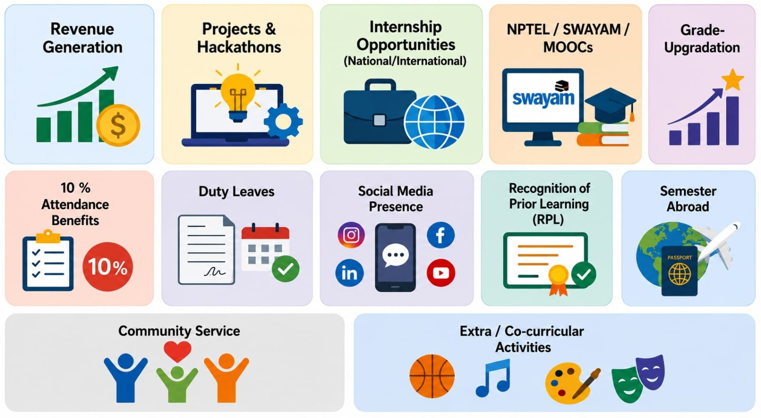
Academic initiatives under EDU Revolution

Slide 34
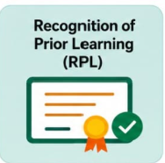
EDU Revolution Benefit Mapped with CSE109
RPL PROCESS:
Application: Through UMS Portal
Submission of Evidence: Upload relevant documents such as: Coursera, NPTEL, edX, or other recognized certifications/ Project reports/ GitHub repositories/
Internship or industry experience certificates/
Workshop.
Document Verification: By Competent Authority
Competency Assessment/Examination: Upon passing in RPL Examination, Student shall be eligible for the RPL Benefit.

Slide 35
Feedback
Feedback Mechanism: It is mandatory for all students to participate in academic improvement processes and fill out all types of feedback regularly throughout the semester.

Slide 36
Week 1 – Lecture 1
Basics and Introduction to C
(The C Character Set)

Slide 37
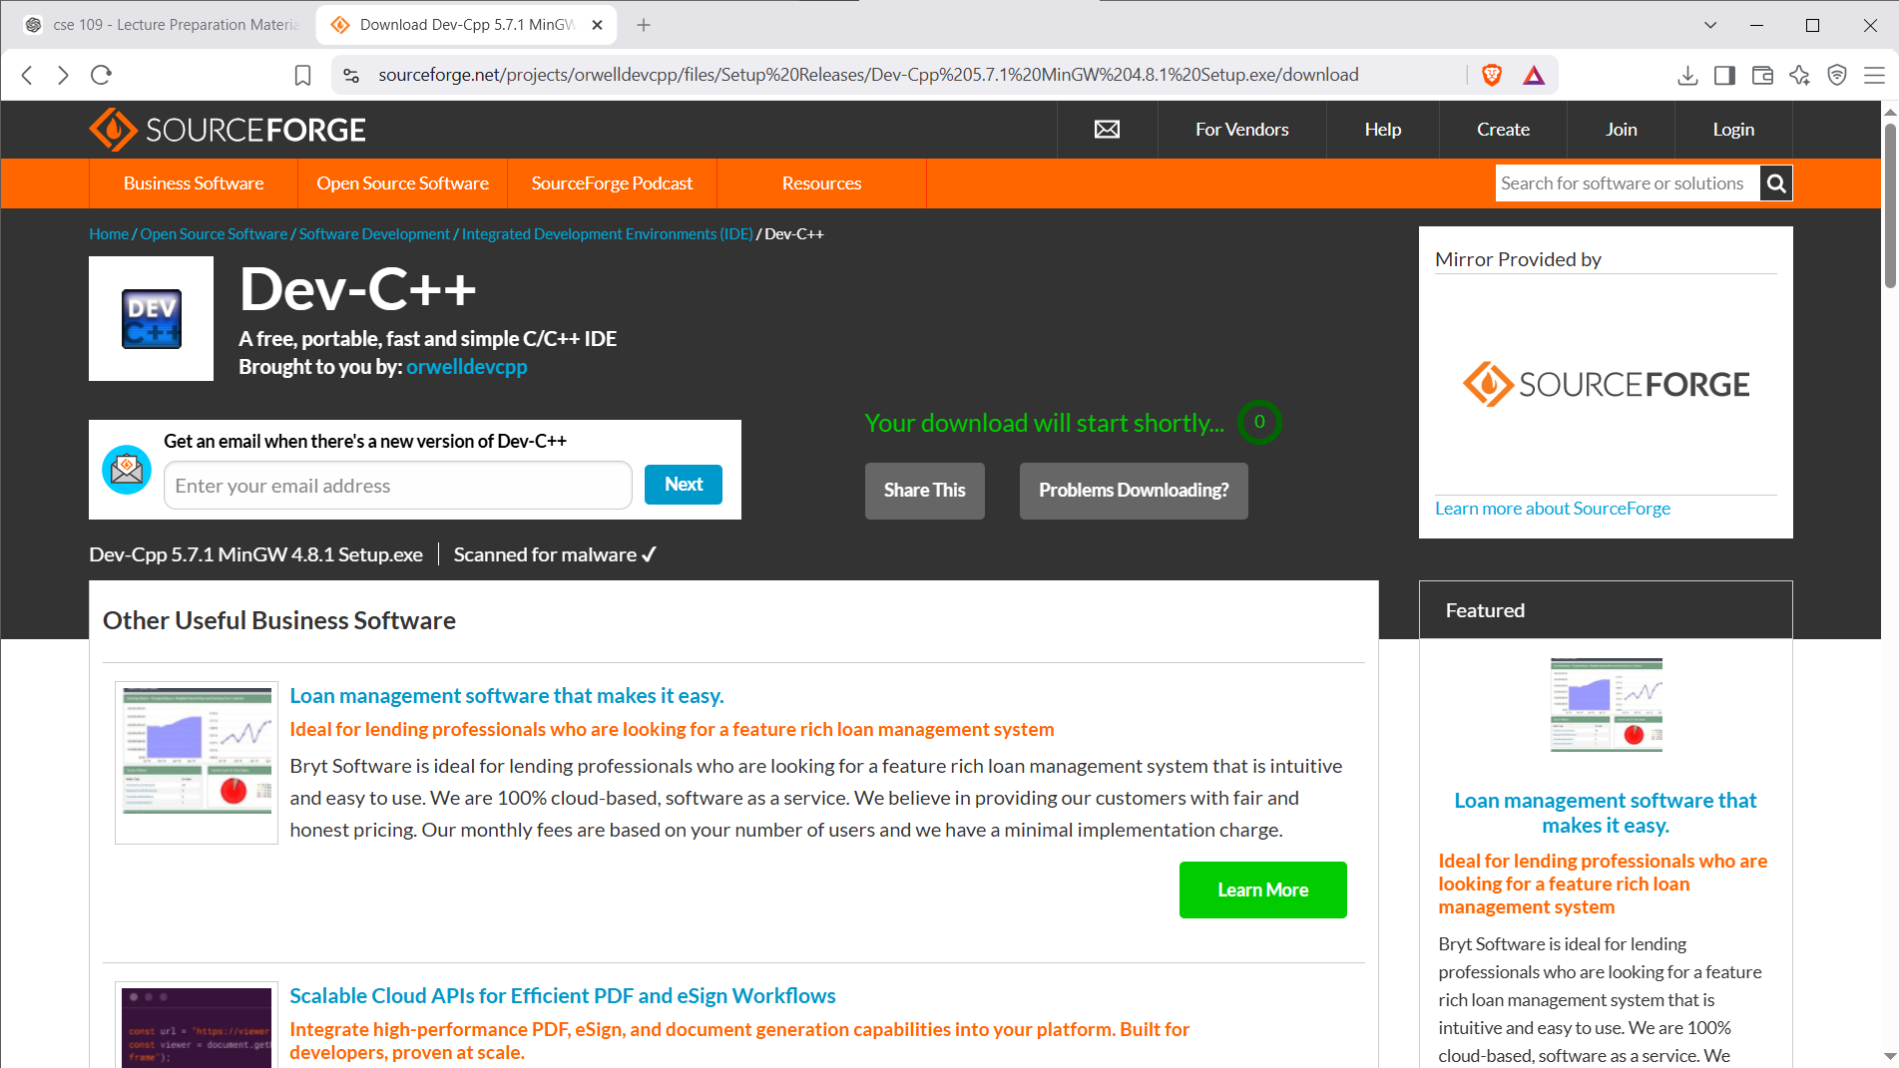
Environment Setup
Search for “dev c++ version 5.7.1 download”
Open the website – ‘sourceforge’ and download the setup file
Execute the setup file (.exe)
Do not change anything, keep the default settings
The application will be installed.

Slide 38
What is the C Character Set?
A character set is the collection of all valid characters used to write C programs.
Categories:
Letters (A–Z, a–z)
Digits (0–9)
Special Symbols (+ - * / = ; {} () etc.)
White Spaces (space, tab, newline)

Slide 39
Letters, Digits & Symbols
Letters: A-Z, a-z
Digits: 0-9
Special Symbols: + - * / % = < > ; , # & () {} []
Whitespace: space, \t, \n

Slide 40
Escape Sequences
\n : New Line
\t : Tab
\\ : Backslash
\" : Double Quote
\' : Single Quote
\0 : Null Character
Example:
printf("Hello\nWorld");

Slide 41
ASCII Values
Each character has a numeric ASCII code.
'A' = 65
'a' = 97
'0' = 48
Program:
printf("%d", 'A');

Slide 42
Identifiers
Rules:
Start with letter or _
Cannot start with digit
No spaces
No special symbols
Case-sensitive
Valid: count1, _roll
Invalid: 1count, total marks

Slide 43
Live Demonstration
1. printf("%d", 'A');
2. printf("Hello\nWorld");
3. printf("Name\tMarks");
4. Compare count1 vs 1count

Slide 44
Summary & Quiz
Summary:
Character Set
ASCII
Escape Sequences
Identifiers
Quiz:
1. ASCII of A?
2. Is _total valid?
3. Difference between 'A' and "A"?

