Slide 1
Invisign
Embedding & extraction of an invisible watermark in an image
Fernando Valdés García
Capstone project · Forensic image watermarking
invisign.com
Notes:
SAY
Good morning. I'm Fernando Valdés, and my capstone is Invisign, a system that hides an invisible, recoverable watermark inside an image, so that when a copy leaks, the owner can tell exactly which copy it was. I'll walk through the problem, how the method works at a high level, what the experiments show, the working product I built around it, and where it sits commercially. It should take about fifteen minutes, and I'm happy to take questions at the end.

Slide 2
THE PROBLEM
When an image leaks, who leaked it?
Organizations constantly share images they own, and copies escape. A confidential photo, a licensed asset, a pre-release still ends up somewhere it shouldn't.
Visible watermarks
Metadata / EXIF tags
Simple hidden marks
Deface the image, and get cropped out anyway.
Stripped the instant a file is re-saved or re-uploaded.
Washed out by re-compression, resizing and blur.
The defenses people reach for first all fail on the journey a leaked image actually takes.
Invisign · Capstone defense
2
Notes:
SAY
Organizations constantly share images they own: studios ship films to cinemas, agencies license photos, platforms seed content to partners. Copies inevitably escape. The trouble is that the obvious defenses all fail on the journey a leaked file takes: a visible watermark defaces the asset and gets cropped out; metadata and EXIF tags are stripped the moment the file is re-saved; and naive hidden marks are destroyed by re-compression and blur. So the question 'who leaked this?' usually goes unanswered.
ANTICIPATED QUESTIONS
Q. Isn't this the same as DRM or access control?
A. No. DRM tries to PREVENT copying. We assume copying already happened and focus on attribution after the fact. They're complementary.
Q. Why not just keep a hash of each copy?
A. A hash breaks under any edit: one changed pixel and it no longer matches. We need something that survives recompression and blur, which is exactly what a robust watermark gives you.

Slide 3
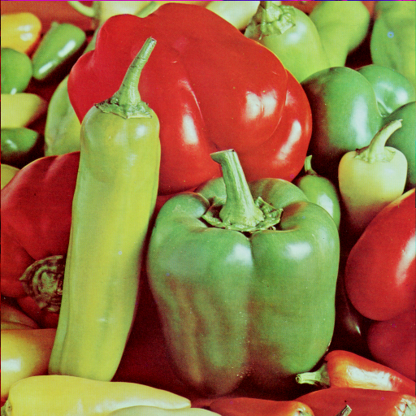

THE IDEA
An invisible mark, woven into the image itself
▪ Invisible. Embedded in the image's underlying structure, not painted on top; the eye can't see it (~50 dB).
▪ Recoverable. The owner can extract the hidden mark back out and confirm it is there.
▪ Survives real edits. Holds up through re-compression, resizing and blur: the rough handling a leaked file gets online.
▪ Per-recipient. A different mark in every copy, so a leak points straight to its source.
→
Original
Marked: looks identical
Same picture to any viewer. A unique invisible signature now lives inside the one on the right.
Invisign · Capstone defense
3
Notes:
SAY
Invisign hides the mark inside the image's underlying mathematical structure rather than painting it on top. Four properties matter. It's invisible, around 50 decibels, where the eye simply can't see it. It's recoverable: we can pull the mark back out. It survives real-world edits like recompression and blur. And crucially it can be different for every recipient, so the mark itself identifies the source of a leak. On the right, the original and the marked version are indistinguishable; that's the actual marked file, not a trick.

Slide 4
WHO IT'S FOR
Built for owners who hold the master copy
Give every recipient a copy with a different hidden mark. When one leaks, match it back to the recipient.
Film studios
Press & stock agencies
Content platforms
A different copy to each cinema: trace a pirated screening to its source.
A per-licensee copy: find who re-distributed a licensed image.
A per-partner copy: identify the partner behind a leak.
Because the owner already holds the original, needing it to extract the mark costs them nothing: it turns leak-tracing into a simple “which recipient matches best?” comparison.
Invisign · Capstone defense
4
Notes:
SAY
The method fits owners who hold the master copy. Give each recipient a copy carrying a different hidden mark; when one leaks, you match the leak against your known marks. Because you already hold the original, the fact that extraction needs the original costs you nothing, and it turns the problem into a simple 'which recipient matches best?' comparison rather than blind detection.
ANTICIPATED QUESTIONS
Q. Extraction needs the original image AND the original watermark. Isn't that a serious limitation?
A. For this use case, no: the owner holds the master by construction, so it's free. It would only be a limitation for blind detection in the wild, which is explicitly not our target.
Q. Why is this a better fit than proving ownership in a dispute?
A. Tracing is closed-set: you compare a leak against your own N marks and take the best match. That's a much easier and more honest problem than proving authorship to a third party, which I'll address on the methodology slide.

Slide 5
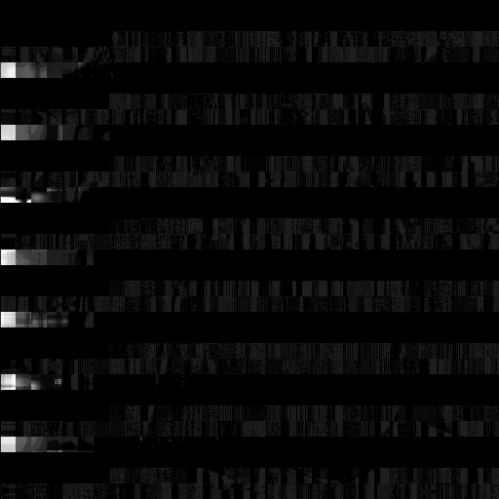
HOW IT WORKS
A tiny nudge to each tile of the image
1
Tile the image
Split the picture into a grid of small 16×16 blocks.
2
Find each tile's “energy”
Each tile has one dominant value capturing its core brightness and structure.
3
Nudge it by the mark
Adjust that value by a microscopic amount driven by the watermark.
4
Reassemble
Stitch the tiles back together; the picture looks unchanged.
The hidden change, amplified ×30 so it's visible. At normal scale, none of it can be seen.
Invisign · Capstone defense
5
Notes:
SAY
At a high level: we tile the image into small 16-by-16 blocks. Each block has one dominant value (think of it as the block's core energy or brightness) that comes from a standard linear-algebra decomposition called the SVD. We nudge that single value by a microscopic amount driven by the watermark, then reassemble. Because we touch only the dominant value, by a tiny amount, the picture looks identical. The image on the right is that change amplified thirty times, just so you can see where it lives.
ANTICIPATED QUESTIONS
Q. Why modify the LARGEST value in each block?
A. It carries the block's low-frequency energy, which compression, blur and averaging all preserve. That's precisely why the mark survives lossy edits.
Q. Your source paper used a Walsh-Hadamard transform first. Where did it go?
A. I removed it deliberately. That transform is orthogonal, and singular values are mathematically invariant under orthogonal transforms, so it cannot change anything this scheme reads or writes. An ablation confirmed identical results within rounding. Removing it means the same output with less computation.
Q. Why 16×16 blocks?
A. It balances the number of blocks (which gives capacity and redundancy) against keeping each block locally coherent so one value represents it well.

Slide 6
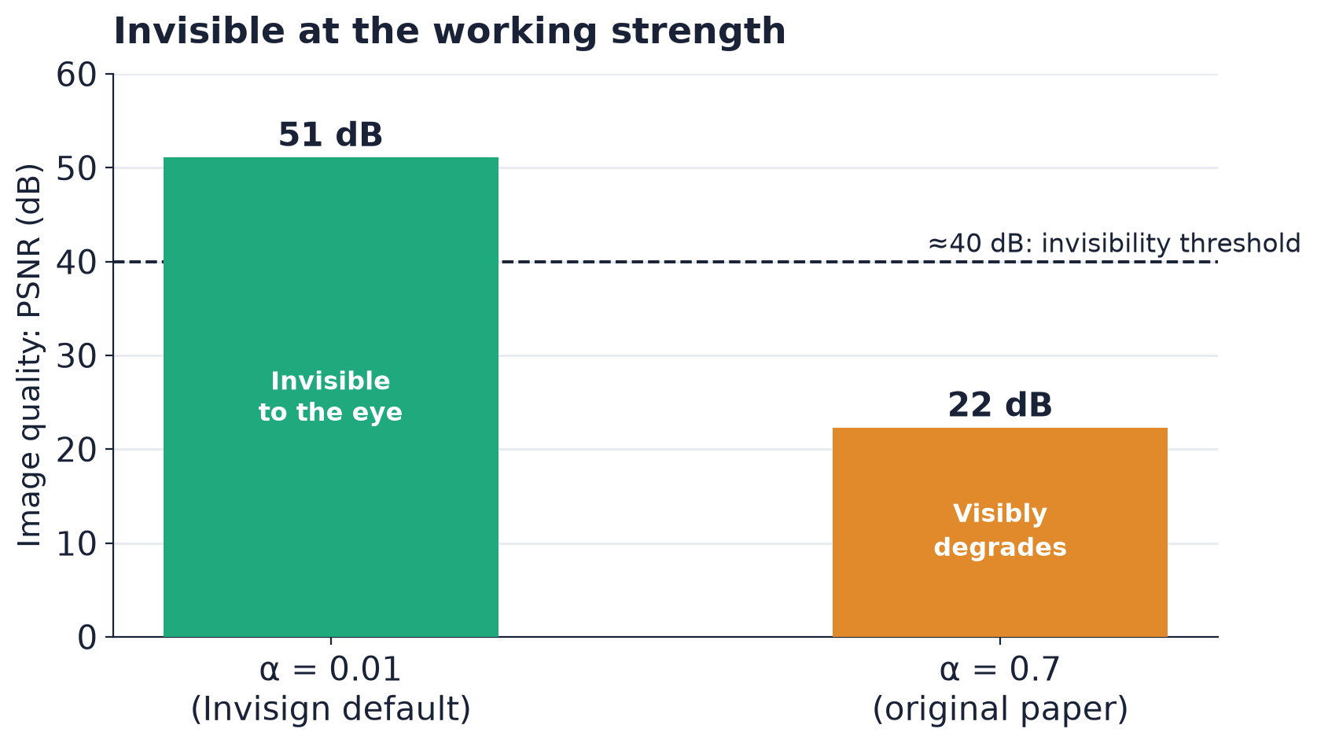
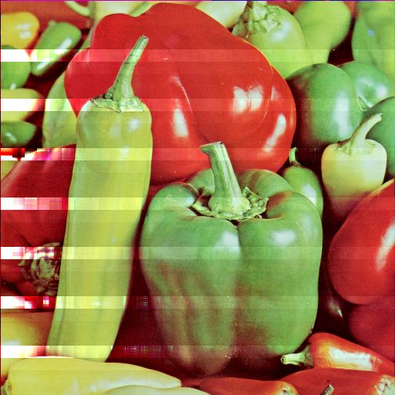
RESULT · IMPERCEPTIBILITY
Invisible at the strength we ship
▪ 51 dB, SSIM 0.999. At the default strength the marked image is mathematically indistinguishable from the original.
▪ Tested on 39 images. The same result holds right across the standard benchmark.
▪ Tunable. Strength can be raised for harsher channels, at a visible cost.
At maximum strength (α = 0.7), faint banding finally appears: the trade-off knob for hostile channels.
Invisign · Capstone defense
6
Notes:
SAY
Invisibility is measured with PSNR: higher is better, and above roughly 40 decibels the human eye can't tell the difference. At our shipping strength we sit at 51 decibels with a structural similarity of 0.999, across all 39 test images: mathematically indistinguishable. Strength is a single knob: crank it to the original paper's value and you do get visible banding, bottom-right; that's our reserve for hostile channels, but it's not what we ship.
ANTICIPATED QUESTIONS
Q. Why exactly α = 0.01?
A. It's the sweet spot. The previous default of 0.00005 was so small the change didn't survive 8-bit rounding, so it embedded nothing recoverable. The paper's 0.7 is robust but visibly degrades the image to 22 dB. 0.01 is invisible at ~51 dB yet recoverable.
Q. What is SSIM and why report it alongside PSNR?
A. PSNR measures raw pixel error; SSIM measures perceived structural change. Reporting both is standard practice so a good score can't hide a perceptual artifact.

Slide 7

RESULT · IT COMES BACK OUT
And the hidden mark comes back out
0.97
→
extract
match score
Near-perfect recovery on a clean copy (1.0 = identical).
Marked image
Recovered mark
Invisign · Capstone defense
7
Notes:
SAY
And it genuinely comes back out. We feed the marked image, plus the original, into extraction and recover the star. Recovery quality is scored with a normalized cross-correlation, where 1.0 is identical; on a clean copy we get 0.97. So both embedding and recovery work at an invisible strength. The natural next question is how that holds up under attack, which is the next slides.
ANTICIPATED QUESTIONS
Q. That 0.97 is on a clean image; what about after attacks?
A. That's exactly what the next two slides cover: it stays strong through geometry, JPEG, blur and noise.
Q. What is normalized cross-correlation, in plain terms?
A. A similarity score between the recovered image and the true mark: 1.0 means identical, 0 means unrelated. It's the standard robustness metric in this literature.

Slide 8
HOW WE TESTED
Measured honestly, on a standard benchmark
▪ 39 standard test images. The USC-SIPI suite used across the watermarking literature: peppers, baboon, boats, portraits.
▪ 8 attacks per image. Rotation, mirror, noise, brightness, JPEG, exposure, blur, pixelation.
▪ Two questions. Is it invisible? (image quality) · Does the mark survive? (recovery match).
A fair yardstick
We don't just count a “match.” For every test we also extract from an unmarked copy and subtract that baseline.
So every result is the genuine lift the watermark adds, not luck or coincidence.
Invisign · Capstone defense
8
Notes:
SAY
I want to be precise about how I measured, because it's easy to fool yourself here. I used the USC-SIPI suite (the 39 standard images the watermarking literature uses) and eight attacks. Here's the subtle part: our extraction rebuilds a watermark-shaped image from the watermark's own structure, so even an unmarked image produces a partial 'match' by construction: a floor of about 0.49. So I never report raw match scores. For every test I also extract from an unmarked copy, put through the same attack, and subtract that baseline. Every number I show is the genuine lift the watermark adds.
ANTICIPATED QUESTIONS
Q. Why is there a ~0.49 match even with NO watermark embedded?
A. Extraction reconstructs using the original watermark's singular vectors, so the output is always watermark-shaped. That's the reconstruction floor; reporting lift over a no-mark control removes it and isolates the real signal.
Q. Is 39 images really enough to draw conclusions?
A. It's the field-standard benchmark, deliberately spanning high- and low-frequency content and a grayscale/color mix. Larger purpose-built sets (BOWS-2's 10,000 images, Kodak) are available to scale the study, and the pipeline already supports them.
Q. Doesn't subtracting a baseline inflate your method's apparent quality?
A. It's the opposite: it's the conservative choice. Raw NCC would look far better (0.8–0.9). Lift strips out everything the method doesn't actually earn.

Slide 9
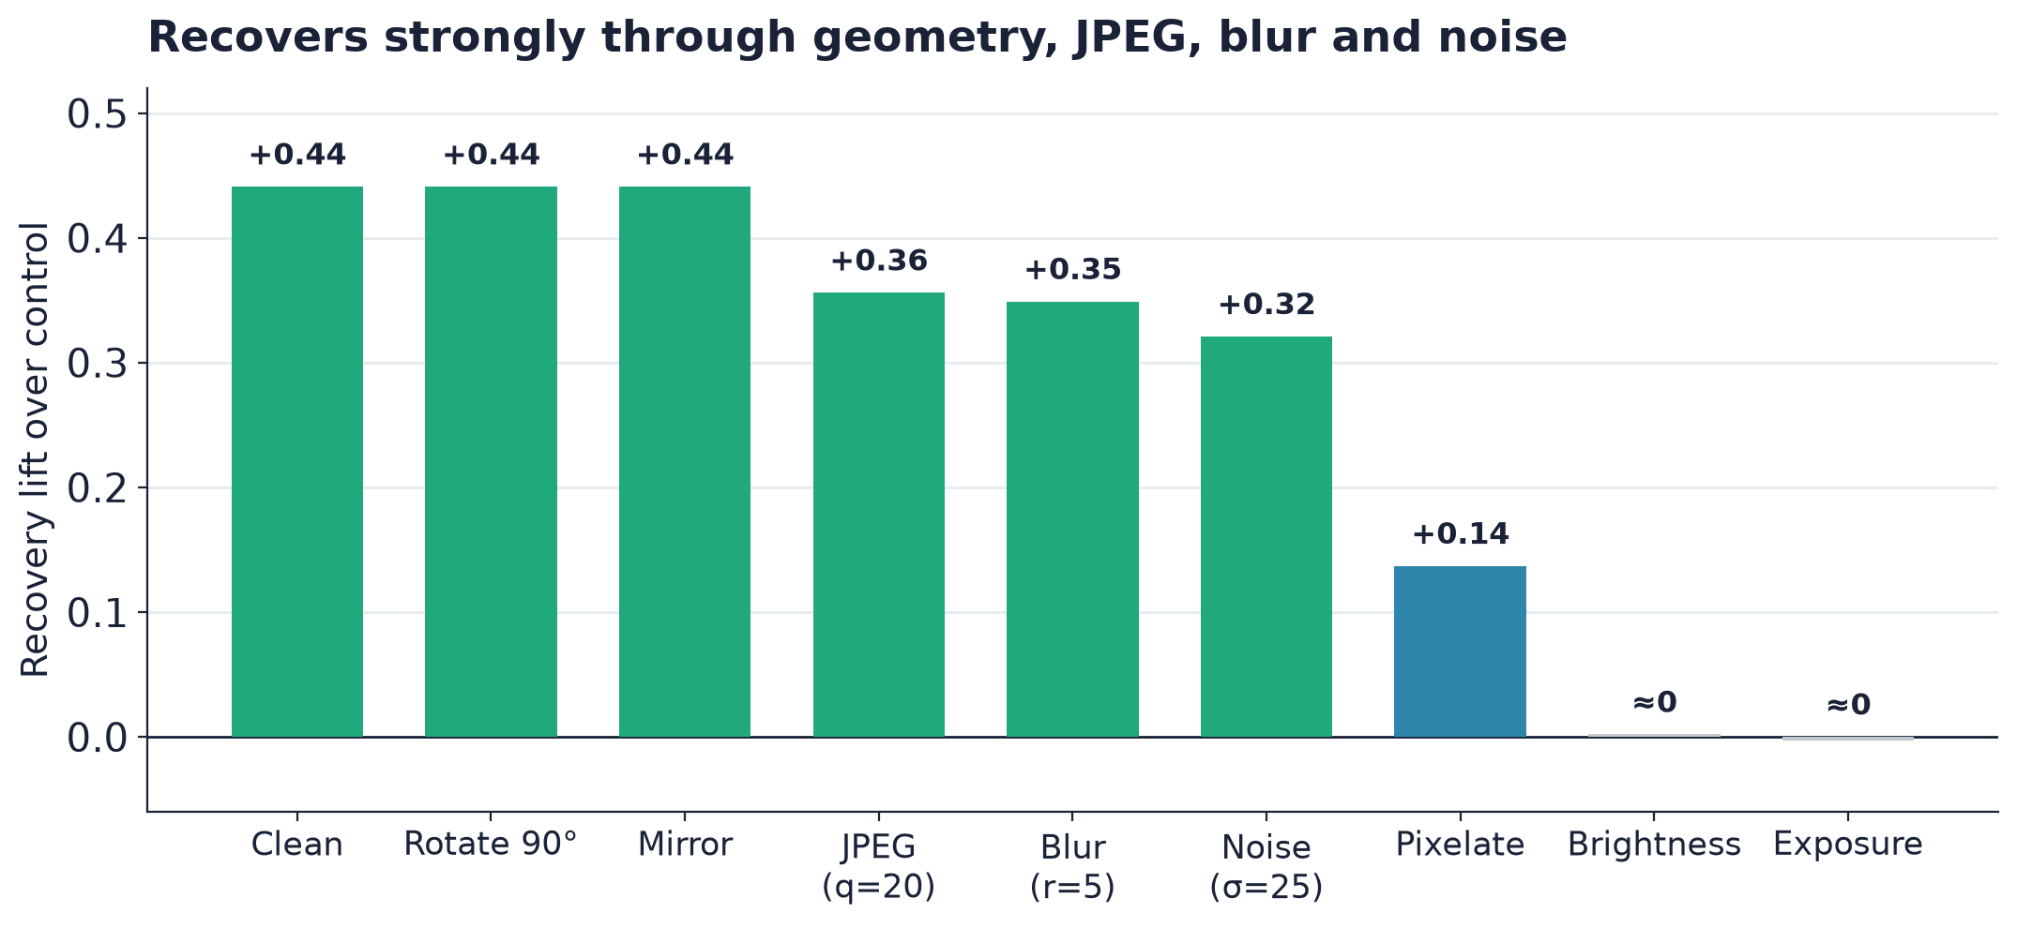
RESULT · ROBUSTNESS
The mark survives the edits that matter
▪ Geometry is free. Rotation and mirroring are fully undone.
▪ Lossy edits survive. JPEG, blur and noise all recover strongly.
▪ Higher = better. Each bar is real recovery above the no-mark baseline.
Invisign · Capstone defense
9
Notes:
SAY
Here's the headline robustness result, shown as lift over the no-mark baseline, so higher is better. Geometry is essentially free: rotation and mirroring are fully undone, because we search the eight rotation-and-mirror orientations and keep the best one. And the lossy edits a real leak imposes (JPEG, blur, noise) all recover strongly. I'll be upfront that the two low bars on the right, brightness and exposure, are the honest weak spot at this strength, and I'm happy to explain why.
ANTICIPATED QUESTIONS
Q. Brightness and exposure are near zero. Isn't that a failure?
A. They're global tone curves that rescale the singular values non-linearly, which breaks our additive model. They recover at higher strength. And because the owner holds the original, a tone-normalization step (histogram-matching the suspect image to the original before extraction) can largely undo these curves as preprocessing, without touching the core method. For still-image tracing the dominant channel is recompression, resize and blur, which we handle, so tone shifts are a secondary, bounded limitation.
Q. How do you undo a rotation without knowing the angle?
A. For the lossless 90-degree and mirror family we simply try all eight orientations and keep the one that matches best; the correct orientation wins naturally.
Q. What about arbitrary angles, scaling or cropping?
A. Not covered by the dihedral search: those need a registration step (feature-based alignment against the original, which we hold). That's a known preprocessing extension, not a change to the watermarking core.

Slide 10
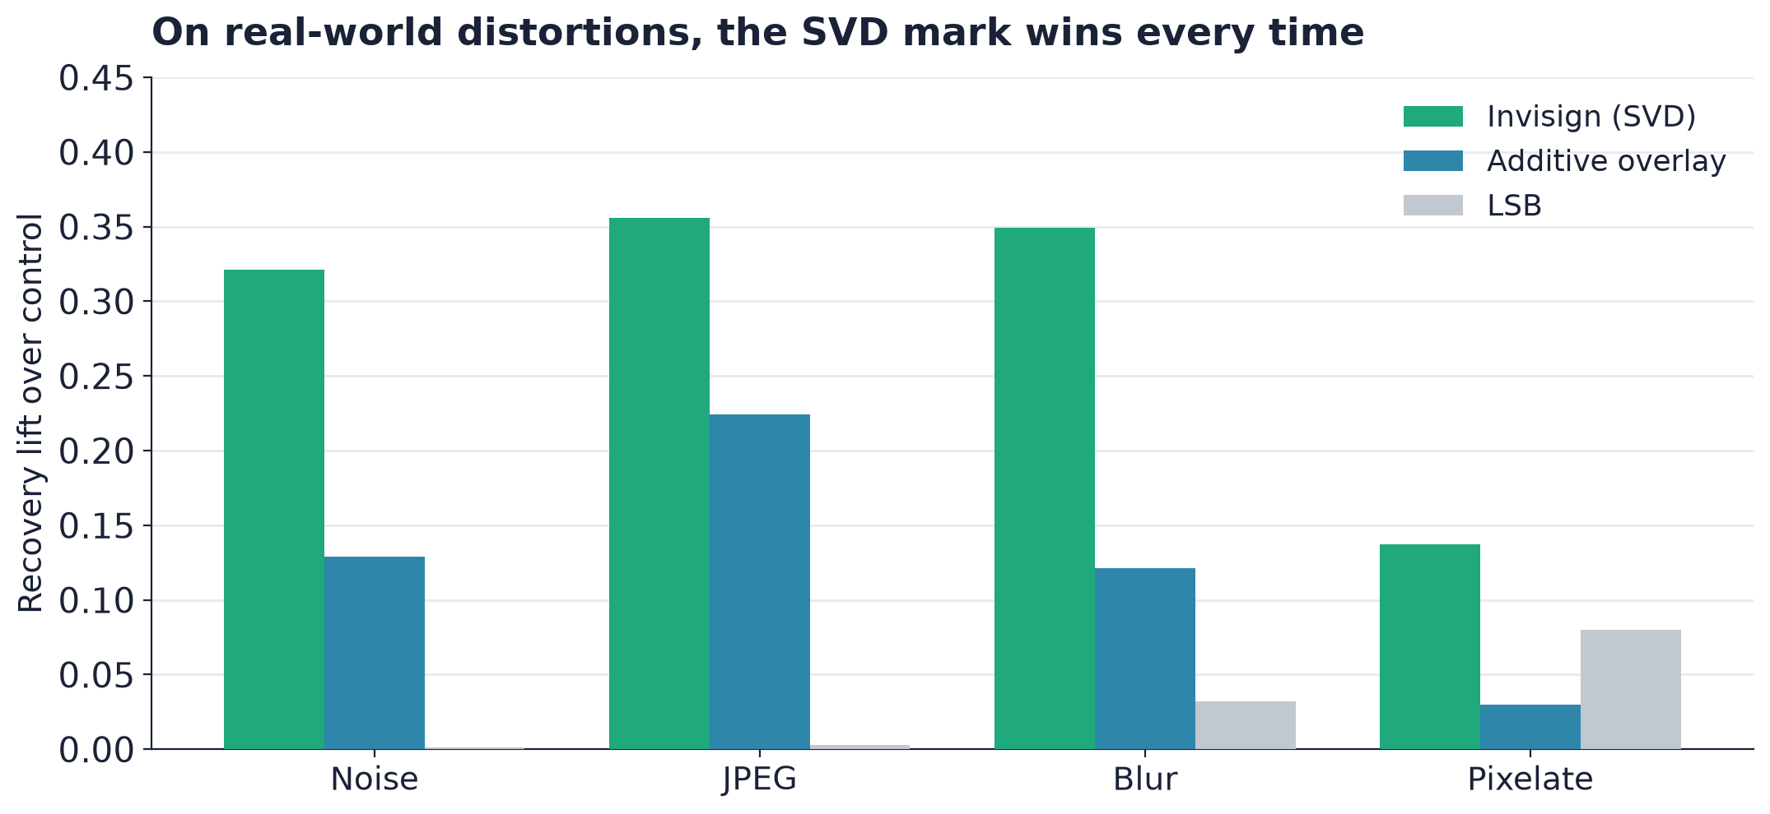
WHY THE CLEVER METHOD
Why not just paste the mark on?
A leaked image is almost never pristine: it has been re-compressed, resized and blurred. That's exactly where simpler tricks fall apart and the SVD mark pulls ahead.
The takeaway
On the distortions a real leak goes through, Invisign recovers the mark when the simple approaches can't.
Invisign · Capstone defense
10
Notes:
SAY
A fair challenge: why not just faintly add the watermark on top and subtract it later? I implemented exactly that, plus the classic LSB method, and ran all three through the same battery. On pristine images the simple overlay is genuinely competitive; I'm not hiding that. But a leaked image is never pristine. On precisely the distortions a leak imposes (noise, JPEG, blur, pixelation) the SVD mark is the only one of the three that survives. That's the specific, honest value of the method: robustness to lossy processing.
ANTICIPATED QUESTIONS
Q. So on clean, geometric and tone attacks the trivial overlay ties or beats you. Doesn't that undercut SVD?
A. On those cases, yes, and I report it openly. The point is that real redistribution is lossy, and that's the one regime where the simple methods collapse and SVD holds. The methods are complementary; SVD earns its place on the attacks that actually occur in the wild.
Q. Why does LSB do so badly?
A. It's blind (it can't subtract the original), so any change to pixel values wipes it, and it has no way to re-synchronize after a rotation.

Slide 11
THE SYSTEM
A complete, working web application
React frontend
Laravel API
Python service
MariaDB
→
→
→
Upload, engrave, extract and review results in a dashboard.
Accounts, file storage and orchestration of the workflow.
The stateless watermarking engine: embed and extract.
Users, images, watermarks and job records.
Containerized with Docker Compose: the whole stack comes up with a single command.
Invisign · Capstone defense
11
Notes:
SAY
This isn't just an algorithm: it's a working application. A React front-end handles upload, engraving, extraction and results; a Laravel API owns accounts, storage and orchestration; a stateless Python service does the actual watermarking math; and MariaDB stores the records. The whole stack comes up with a single Docker Compose command.
ANTICIPATED QUESTIONS
Q. Why split the watermarking into a separate Python service?
A. The math lives naturally in NumPy and OpenCV, so I isolated it as a stateless microservice: it's language-appropriate, independently scalable, and keeps Laravel focused on state and business logic.
Q. Why keep the Python service stateless?
A. It makes it trivially horizontally scalable and easy to reason about; all persistence lives in Laravel and the database.

Slide 12
LIVE PRODUCT
From algorithm to product
01
02
03
04
Register
Upload
Engrave / Extract
Review
Sign in to a private workspace
Add host images and a square logo mark
Embed a mark, or recover one from a suspect copy
See results and match scores in the dashboard
Available as a web app at invisign.com
Invisign · Capstone defense
12
Notes:
SAY
Wrapped in a product: users register into a private workspace, upload host images and a square logo mark, then trigger engravings or extractions and review the results and match scores in a dashboard. It's deployed and running at invisign dot com.

Slide 13
MARKET
A real, growing market for tracing leaks
Digital watermarking spans several segments. Invisign targets forensic tracing: a different mark per recipient, so a leak points back to its source.
Forensic tracing
Brand / copyright
AI-content provenance
Product anti-counterfeit
Who leaked this copy? Invisign's segment. Proven in video, thinner for still images.
Mark plus monitoring of the web for misuse of owned images.
Is this AI-made? The fastest-growing, R&D-heavy segment.
Marks in packaging and labels: a separate physical-goods world.
◀ Invisign
Tailwinds: ever more image sharing online, and AI raising the stakes on provenance and authenticity.
Invisign · Capstone defense
13
Notes:
SAY
Commercially, watermarking is several overlapping segments. Invisign targets forensic tracing: a different mark per recipient. That's a real, monetized segment, most mature in video today and thinner for still images. The tailwinds are strong: ever more image sharing online, and generative AI raising the stakes on provenance and authenticity, both a threat and a driver.
ANTICIPATED QUESTIONS
Q. Why target the smallest slice, still-image forensics?
A. It's underserved precisely because it's hard, and it's the slice my method genuinely fits. Video-forensic is larger but dominated by incumbents; AI-provenance answers a different question entirely.

Slide 14
LANDSCAPE
Where Invisign sits among the players
Player
Medium
Core use case
Relation
Invisign
Still images
Owner-held leak tracing
This project
IMATAG
Images (+video)
Leak tracing + web monitoring
Closest analog
Digimarc
Images, audio, packaging
Broad watermarking platform
Broader incumbent
Verimatrix / NexGuard
Video (cinema, OTT)
Per-copy leak tracing
Same model, video
C2PA · SynthID
Cross-media
AI-content provenance
Adjacent, not competing
Invisign · Capstone defense
14
Notes:
SAY
The closest analog is IMATAG: invisible forensic watermarking for images, plus web monitoring to find the leaked copy, which we don't attempt. Digimarc is the broad incumbent, spanning images, audio and packaging. Verimatrix and NexGuard do exactly our studio-to-cinema model, but for video, which is the proof that the use case is real and monetizable. And C2PA and SynthID are adjacent: they answer 'is this AI-made?' rather than 'who leaked it?'
ANTICIPATED QUESTIONS
Q. How are you different from IMATAG, concretely?
A. IMATAG is the productized, scaled version: embed plus web crawling to find leaks, plus serial capacity. I implement the transparent embed/extract core. Monitoring and capacity are exactly my roadmap, not things I claim today.
Q. If NexGuard already does this for video, why does still-image matter?
A. Different medium, different channel. Stills dominate press, stock and social leaks, and the robustness profile (JPEG, resize, blur) is distinct from video. It's an underserved niche.

Slide 15
ROADMAP
From demonstrator to product
The core works. These are the build-outs that turn it into a full commercial offering:
Web monitoring
Automatically find leaked copies in the wild; today we assume the suspect image is in hand.
Serial capacity & collusion resistance
Carry thousands of distinct coded marks, hardened against recipients pooling copies.
Harder channels
Extend robustness to video and camcorder capture, the dominant real-world leak path.
Invisign · Capstone defense
15
Notes:
SAY
I'm candid that this is a demonstrator, not a finished product. Three build-outs would close the gap. First, web monitoring: automatically finding leaked copies, rather than assuming the suspect image is already in hand. Second, serial capacity with collusion resistance: carrying thousands of coded marks, hardened against recipients pooling their copies to wash the mark out, which needs anti-collusion fingerprint codes like Tardos codes. And third, robustness to harder channels: especially video and camcorder capture, the dominant real-world leak path.
ANTICIPATED QUESTIONS
Q. What exactly is a collusion attack?
A. Several recipients average their differently-marked copies together to erase the per-copy mark. Defeating it needs fingerprinting codes designed for it; that's a known, well-studied area, and it's on the roadmap.
Q. How far is this from being commercially viable?
A. The embed/extract core is solid and honestly measured. The gap to a product is engineering and scope (monitoring, capacity, video), not a fundamental flaw in the method.

Slide 16
IN SUMMARY
What this project delivers
✓
A working invisible watermark
Embeds and recovers a hidden mark at a strength the eye can't detect (~51 dB).
✓
Robust where it counts
Survives geometry, JPEG, blur and noise: the edits a leaked image really undergoes.
✓
Honestly measured
Validated on a standard 39-image benchmark against true no-mark baselines.
✓
A complete product
End-to-end web app, from upload to extraction, deployed at invisign.com.
Invisign · Capstone defense
16
Notes:
SAY
To summarize. Invisign is a working invisible watermark that embeds and recovers at a strength the eye can't see. It's robust where it counts: geometry, JPEG, blur and noise, the edits a leaked image really undergoes. It's measured honestly, against true no-mark baselines on a standard benchmark. And it's a complete, deployed application, not just an algorithm. Thank you. I'd be glad to take your questions.

Slide 17

Thank you
Questions & discussion
Scan to visit
invisign.com
Fernando Valdés García
invisign.com · github.com/fvaldes0109/invisign
Notes:
SAY
Thank you. Questions welcome. The QR code on screen goes straight to the live product at invisign dot com, and the source repository is on screen as well.

