Slide 1
Turtle Pong
By:
Axel A.
&
Franklin V.

Slide 2
Game Description
2 players compete to win the most points. The first to 11 points wins
It similar to a game of ping pong where each player hits the ball towards the opponent.
You win a point when your opponent misses the ball
The ball can bounce of the side walls before it reaches the other player

Slide 3
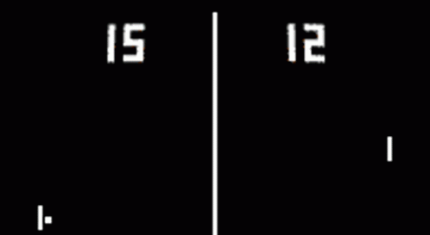

Slide 4
Challenges
Learning a new library: Turtle
Ball movement logic
Environment issues when using the Turtle library

Slide 5
Future Improvements
Enhance
Enhance ball movement logic
Improve
Improve the look of the game board
Difficulty
Increase ball speed as game progresses

Slide 6
Highlights
Great Pair Programming experience
Moving toward being an Autonomous Coder while learning a new library
Enjoying the process (plan, build, test, etc)

Slide 7
Thank You

