Slide 1
Music Trendz
A comparison of Global vs Local music trends
By: Franklin Vanjour

Slide 2
Question
Are the music trends of Sweden similar to the Global music trends?

Slide 3
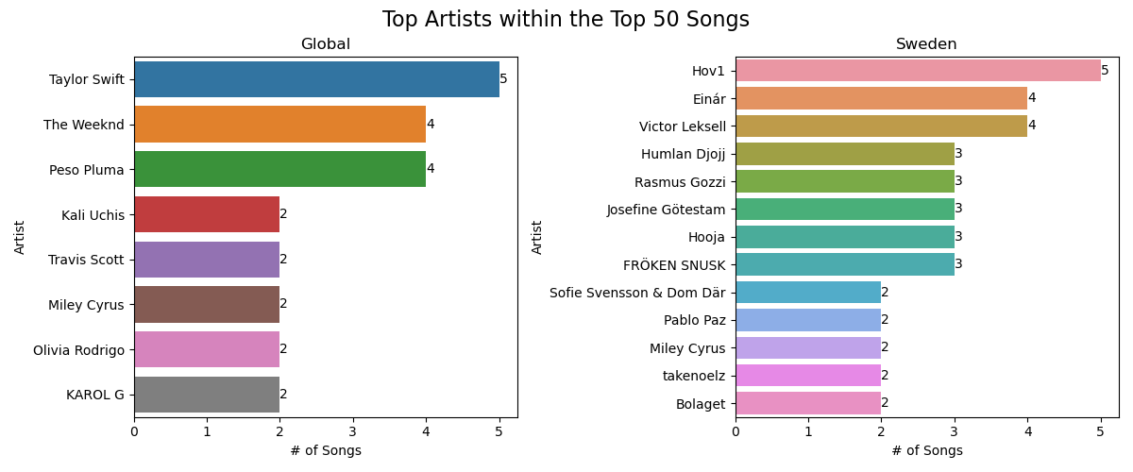

Slide 4
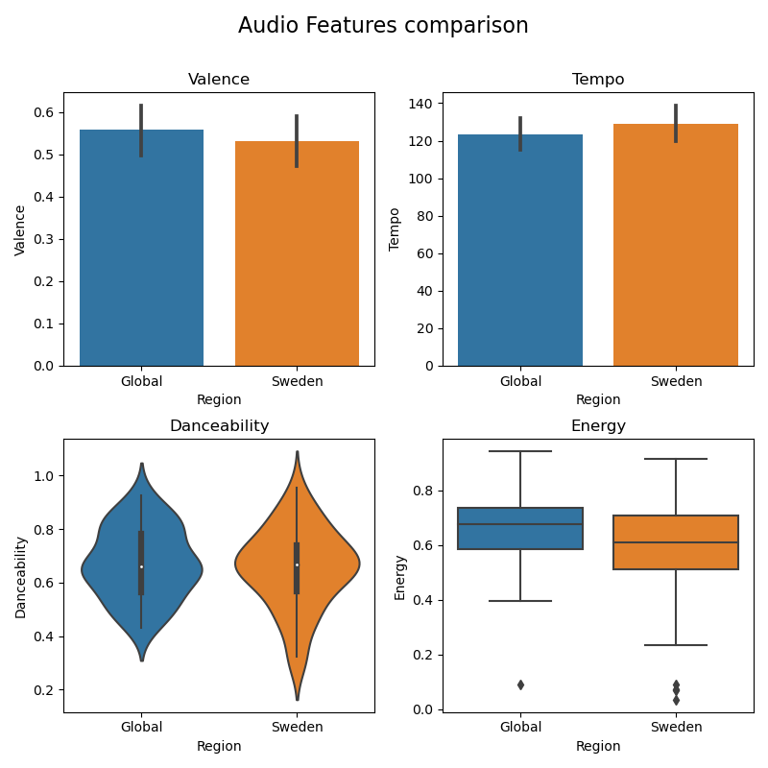

Slide 5
Answer
The artists with most songs in both charts are mostly different
The audio patterns in both charts are mostly similar
Both regions prefer happier music. Global music is slightly "happier" than Swedish music.
Sweden prefers slightly higher tempo music
Both regions prefer similar "danceability". Sweden has higher standard deviation (more variation in preferences)
Sweden prefers slightly lower "energy" music
Based on Spotify Top 50 Charts for Sweden and Global

Slide 6





Highlights
The web application will always show the latest data w.r.t. Sweden vs Global music trends dynamically. No manual updates needed.
Top 50 Songs with..
Song details
Artist details
Album details
Top Artists
Audio Features such as Energy, Tempo, Valence and Danceability
Analysis

Slide 7
Challenges/Learnings
Understanding Spotify API (Spotipy) and fetching data correctly
Learning and implementing Django
Identifying data for a meaningful analysis

Slide 8
Thank You

Slide 9
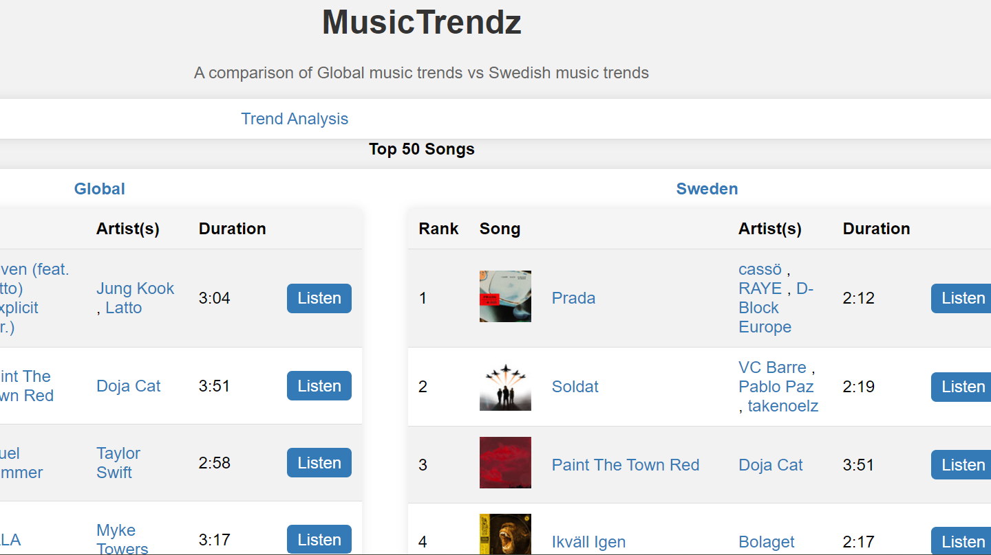
Home Page

Slide 10
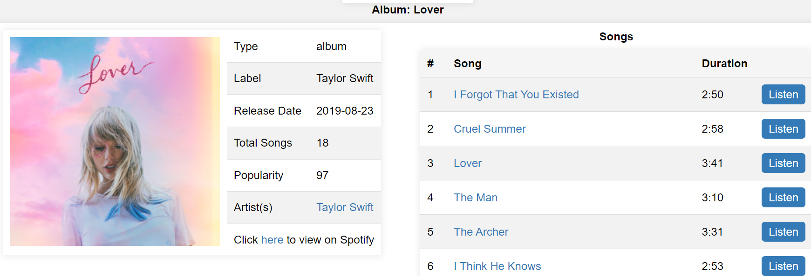
Album Details Page

Slide 11
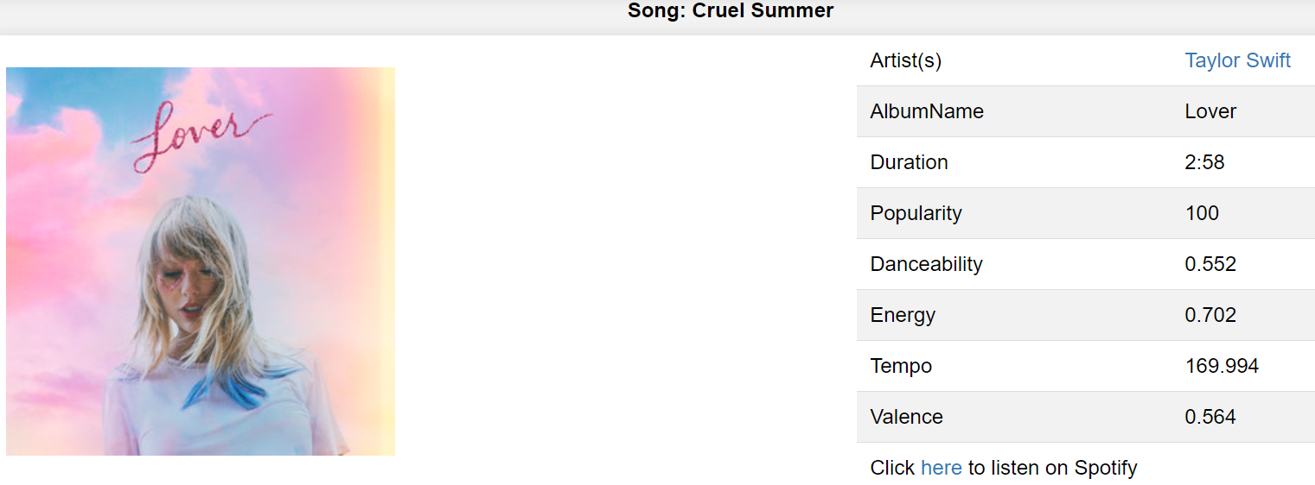
Song Details Page

Slide 12
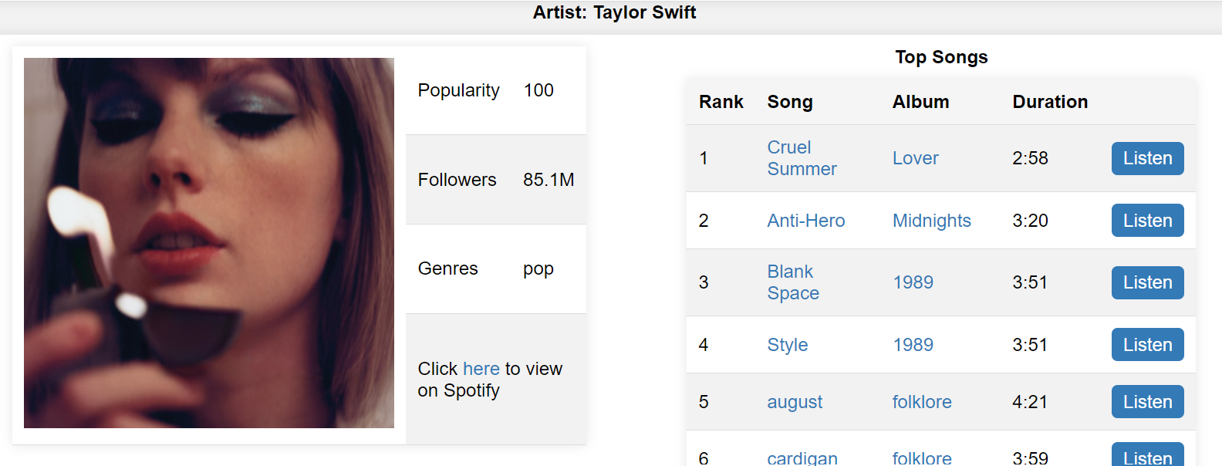
Artist Details Page

