Slide 1
Market Basket Analysis
Actionable Insights: Unveiling Shopping Patterns
By: Franklin Vanjour

Slide 2
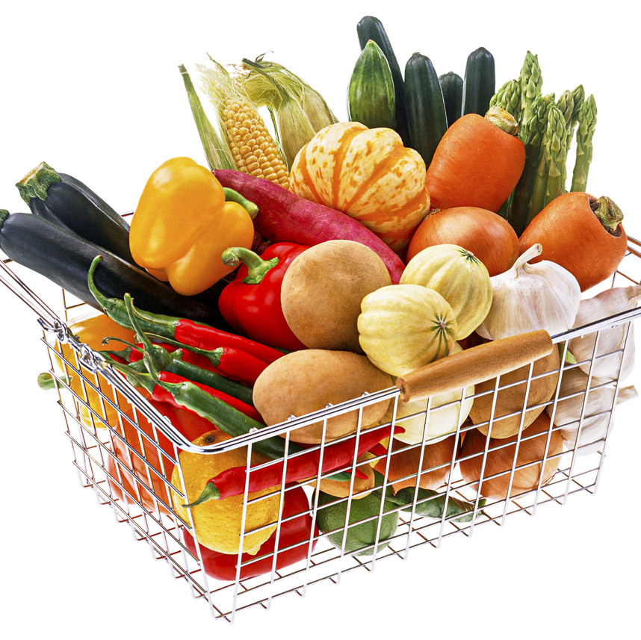
Sam's Online Grocery Store
Sam has an Online Grocery Store
He wants to improve his business by deriving actionable insights from his operational data
Sam requests Frank, a Data Analyst, to help with the Analysis

Slide 3
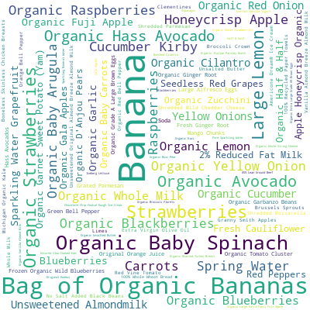
Popular Products
Insight:
Find out the most ordered products.
Action:
Stock up on popular items, promote them more, or bundle them with other products.

Slide 4
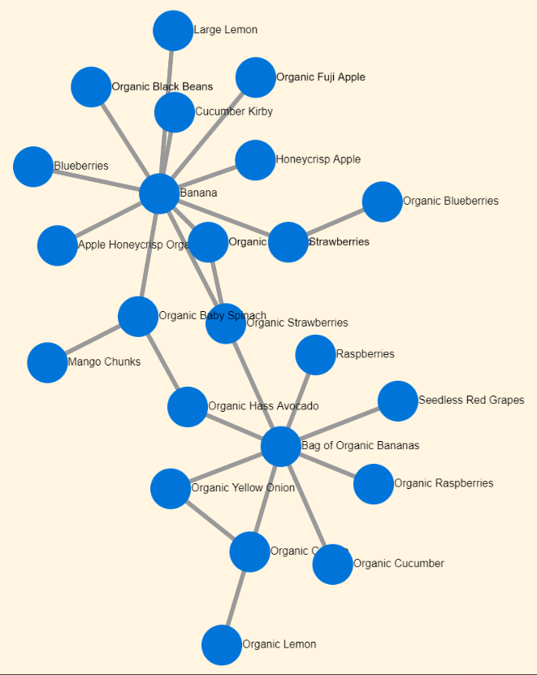
Products Bought Together
Insight:
Discover which products are often bought together.
Action:
Use for cross-selling, bundling, or placing related products closer together.

Slide 5

Product Hierarchies by Order Frequency
Insight:
Identify product categories and subcategories which are most popular among customers.
Action:
Prioritize inventory and marketing efforts towards high-frequency categories and explore potential growth opportunities within less popular subcategories.

Slide 6

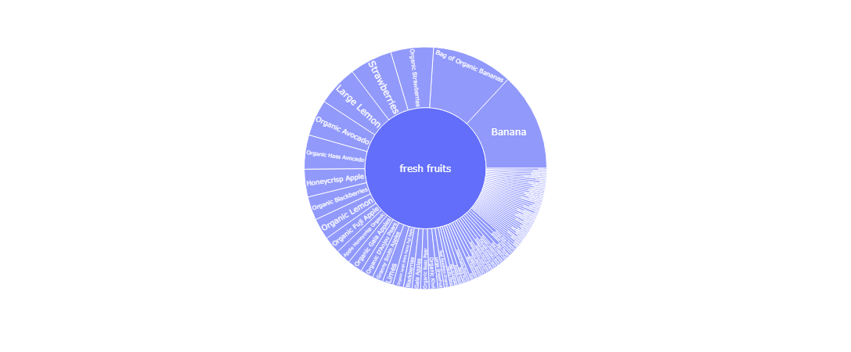
Product Hierarchies by Order Frequency

Slide 7
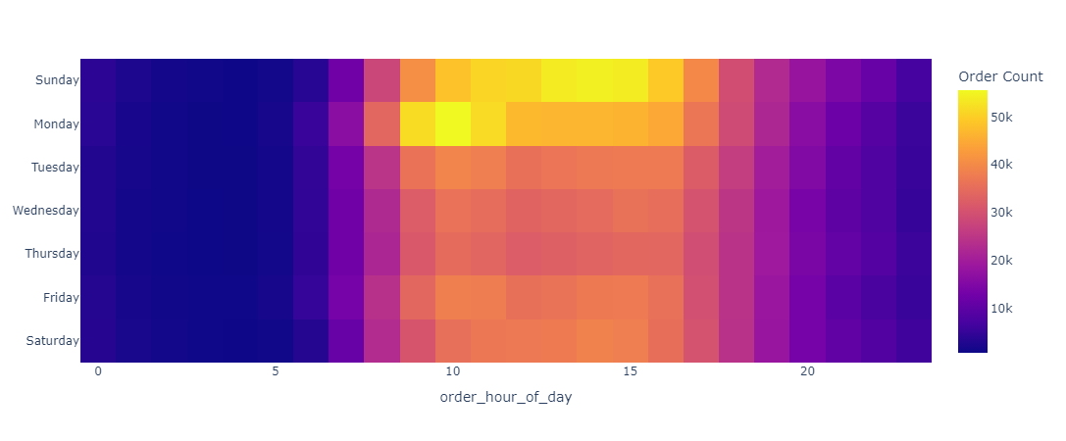
Orders over Time
Insight:
Understand the peak ordering times.
Action:
Staff up during peak times, offer promotions during off-peak hours to balance demand.

Slide 8
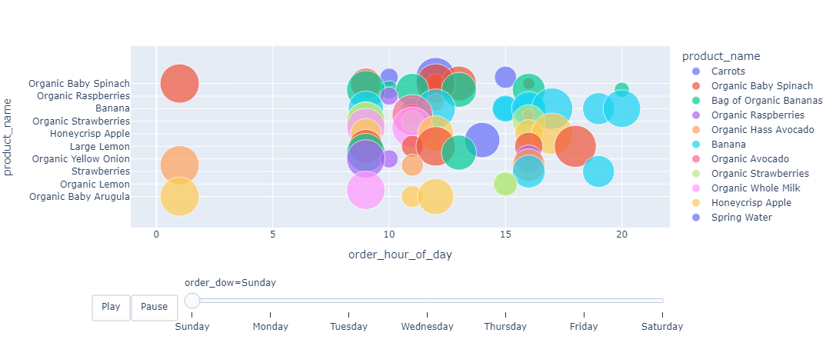
Popularity of Top Products over Time
Insight:
Understand the dynamic shifts in the popularity of top products over time.
Action:
Adapt inventory and marketing strategies based on dynamic product trends.

Slide 9
Highlights / Challenges
Learning new libraries: Plotly and Dash
1
Identifying which:
2
Analysis to perform
Plot to visualize
Resolving memory issues due to:
3
Multiple Interactive Plots
Extremely Large Dataset (32 million rows)

Slide 10
Thank You

