Slide 1

Parallel Algorithm Design: UPC++ Ferdinand Vanmaele

Slide 2
Overview
Introduction to UPC++
Partitioned Global Address Space
Reduction
Distributed objects
Symmetrisation
Avoiding communication
Stencil

Slide 3
Introduction to UPC++
C++11 library that supports Partitioned Global Address Space (PGAS) programming
Similar to OpenMPI in usage (but no in-order delivery of messages)

Slide 4
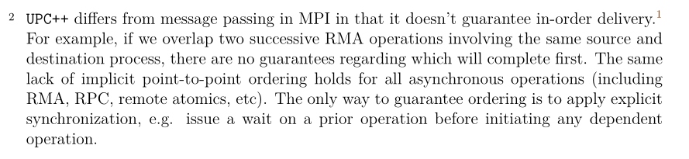
Introduction to UPC++
C++11 library that supports Partitioned Global Address Space (PGAS) programming
Similar to OpenMPI in usage (but no in-order delivery of messages)
https://bitbucket.org/berkeleylab/upcxx/downloads/upcxx-spec-2020.10.0.pdf (1.3 Memory model)

Slide 5
Introduction to UPC++
C++11 library that supports Partitioned Global Address Space (PGAS) programming
Usage similar to OpenMPI (but no in-order delivery of messages)
Single program, multiple data (SPMD) model via processes
Global address space
No implicit communication
Fixed number of processes
Multiple conduits: SMP (sockets), UDP (ethernet), Infiniband, Cray
Here limited to SMP and UDP

Slide 6
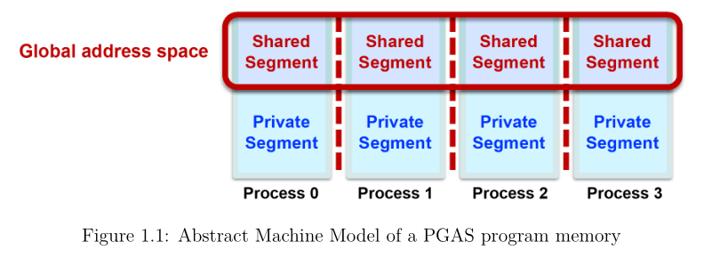
Partitioned Global Address Space

Slide 7
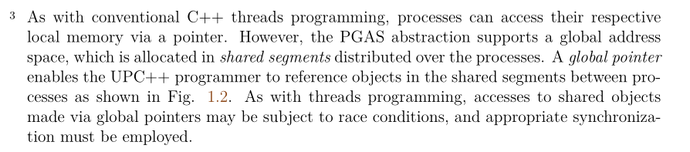
Partitioned Global Address Space
Shared segment accessible through upcxx::global_ptr<T>
Logically consists of raw pointer and an affinity (binding of a location in a shared segment to a process)
Requires synchronization (subject to race conditions)
https://bitbucket.org/berkeleylab/upcxx/downloads/upcxx-spec-2020.10.0.pdf (1.1 Preliminaries)

Slide 8
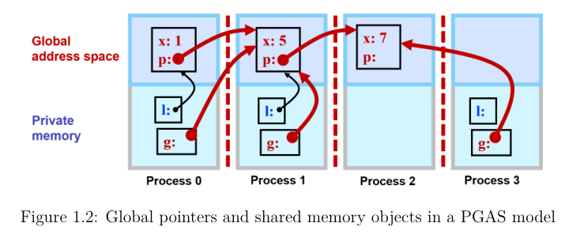
Partitioned Global Address Space

Slide 9
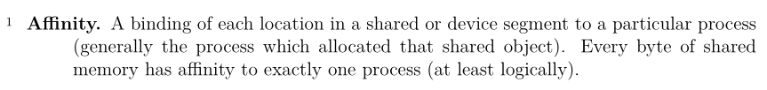
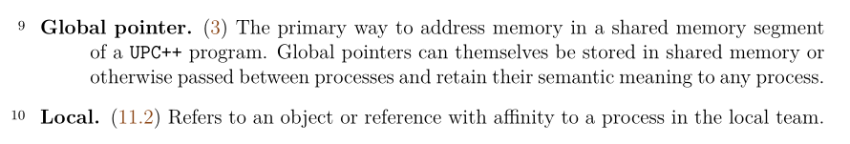
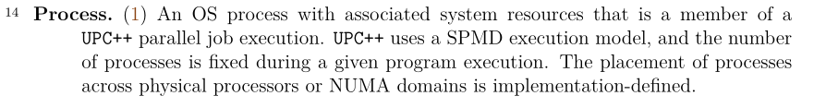
Overview of important terminology (1)

Slide 10
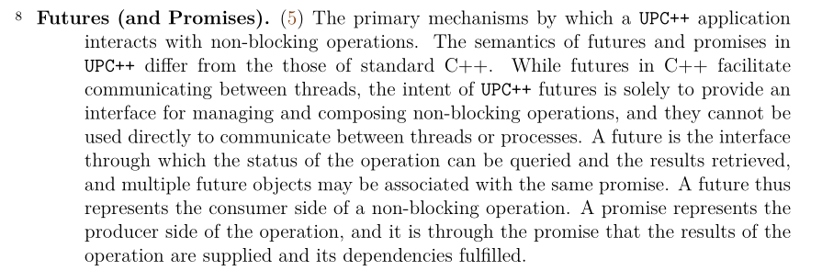
Overview of important terminology (2)

Slide 11
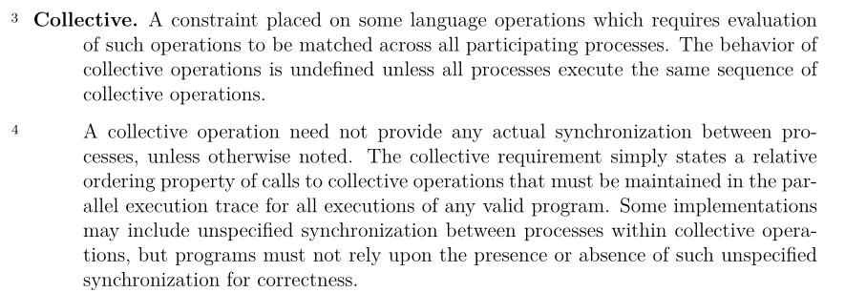
Overview of important terminology (3)

Slide 12
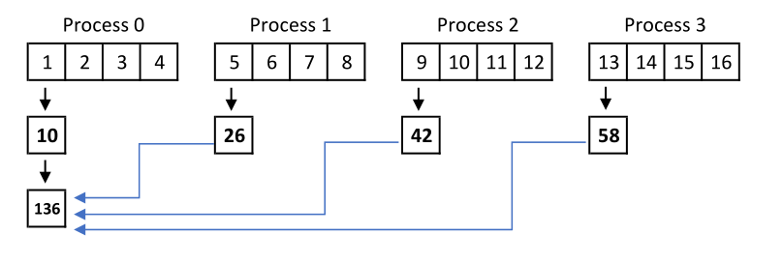
Reduction
Basic hierarchical reduction

Slide 13
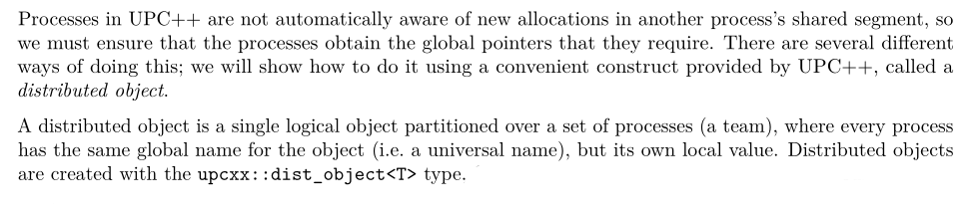
Reduction
Basic hierarchical reduction
Reduce partial sums with upcxx::dist_object<T>
Order is determined by the user (e.g. equivalent to serial order)
https://bitbucket.org/berkeleylab/upcxx/downloads/upcxx-guide-2020.10.0.pdf (Section 5)

Slide 14
// Compute partial sums
double psum(0);
for (int64_t i = 0; i < block_size; ++i) {
psum += u[i];
}
// Assign partial sum to distributed object (universal name, local value)
upcxx::dist_object<double> psum_d(psum);
// Reduce partial sums with dist_object::fetch (communication) on first process.
if (proc_id == 0) {
double res(*psum_d);
// Partial sums for remaining processes (in ascending order).
// Can be done asynchronously, e.g. with .then() and upcxx::when_all().
for (int k = 1; k < upcxx::rank_n(); ++k) {
double psum = psum_d.fetch(k).wait();
res += psum;
}
}

Slide 15
Reduction
Basic hierarchical reduction
Reduce partial sums with upcxx::dist_object<T>
Order is determined by the user (e.g. equivalent to serial order)
Reduce partial sums with upcxx::reduce_one
Non-deterministic order
Simple usage

Slide 16
Reduction
// Create a reduction value for each process
double psum(0);
// Compute partial sums
for (int64_t i = 0; i < block_size; ++i) {
psum += u[i];
}
double sum = upcxx::reduce_one(psum, upcxx::op_fast_add, 0).wait();

Slide 17
Reduction
Throughput
size * sizeof(float) * 1e-9 / time
Benchmarks
upcxx::reduce_one
4 processes per SKL node, 64 processes per KNL node
Averaged over 100 iterations
OpenMP
1 process per node, 4 (SKL) or 64 (KNL) OpenMP threads
OMP_PROC_BIND=true, OMP_PLACES=cores (NUMA-aware)
Higher throughput from lower amount of communication

Slide 18
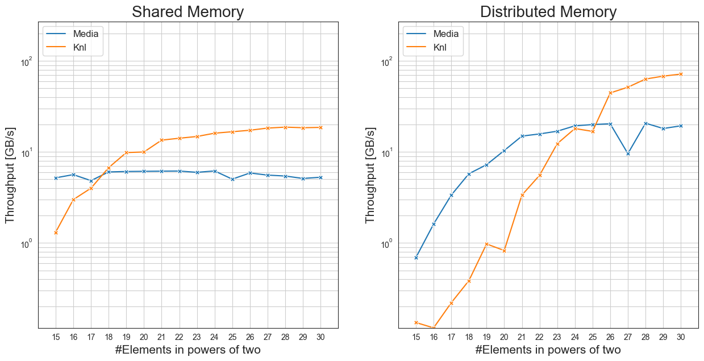

Slide 19
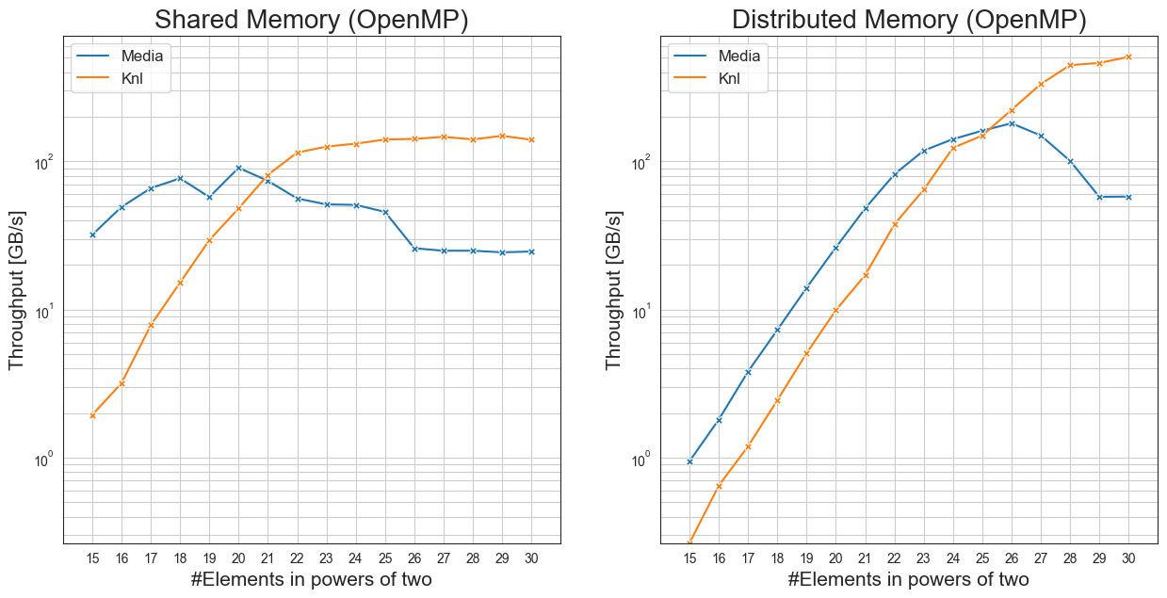

Slide 20
Symmetrisation
Data structures for dense matrix
Row-major (or col-major)
Block matrix for partitioning

Slide 21
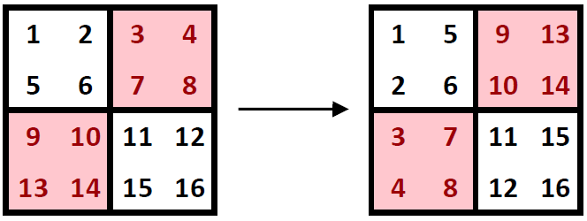
Symmetrisation
Data structures for dense matrix
Row-major (or col-major)
Block matrix for partitioning
Communication between blocks for transposition

Slide 22
Symmetrisation
Data structures for dense matrix
Store diagonal, lower and upper matrix separately
Store elements symmetrically
Lower triangle in col-major order
Upper triangle in row-major order
Symmetrisation as SAXPY operation

Slide 23
Symmetrisation
Data structures for dense matrix
Store diagonal, lower and upper matrix separately
Store elements symmetrically
Lower triangle in col-major order
Upper triangle in row-major order
Symmetrisation as SAXPY operation
Arrays chunked per process:
Diagonal: dim / nproc
Lower triangle: (dim) * (dim-1) / 2 / nproc
Upper triangle: (dim) * (dim-1) / 2 / nproc

Slide 24
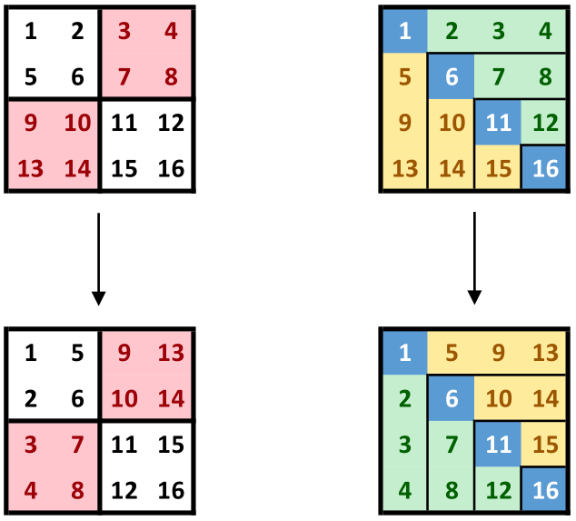
Symmetrisation

Slide 25
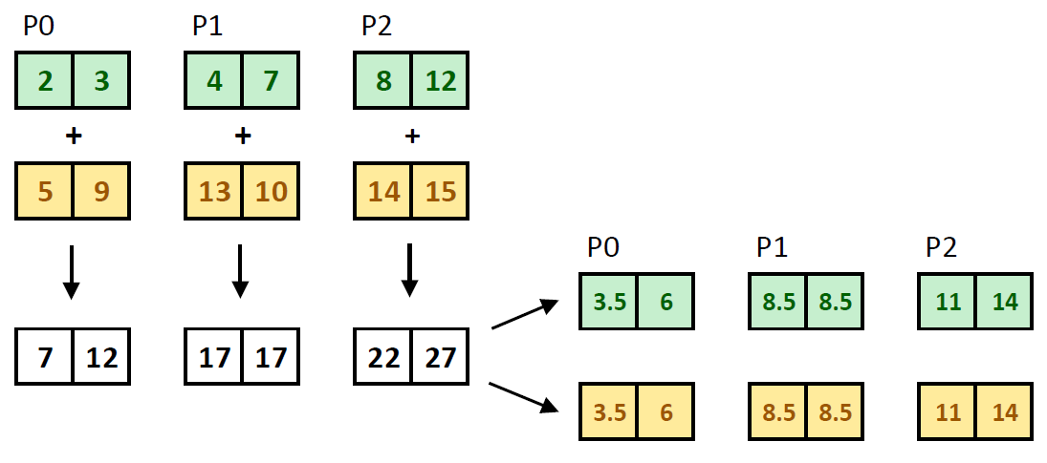
Symmetrisation

Slide 26
Symmetrisation
// Symmetrize matrix (SAXPY over lower and upper triangle). We only require
// a single for loop because lower and upper triangle are stored symmetrically
// (in col-major and row-major, respectively)
for (index_t i = 0; i < triangle_n; ++i) {
float s = (lower[i] + upper[i]) / 2.;
lower[i] = s;
upper[i] = s;
}
upcxx::barrier(); // ensure symmetrisation is complete

Slide 27
Symmetrisation
Throughput
dim * (dim-1) * sizeof(float) * 1e-9 / time
Benchmarks
Process amount chosen as size allowed
e.g. for the KNL cluster, 256 processes for sizes (1 << 10) up to (1 << 14).
No communication
OpenMP
1 process per node with up to 64 (KNL) OpenMP threads per node
Still measurable improvement from lower amount of processes

Slide 28
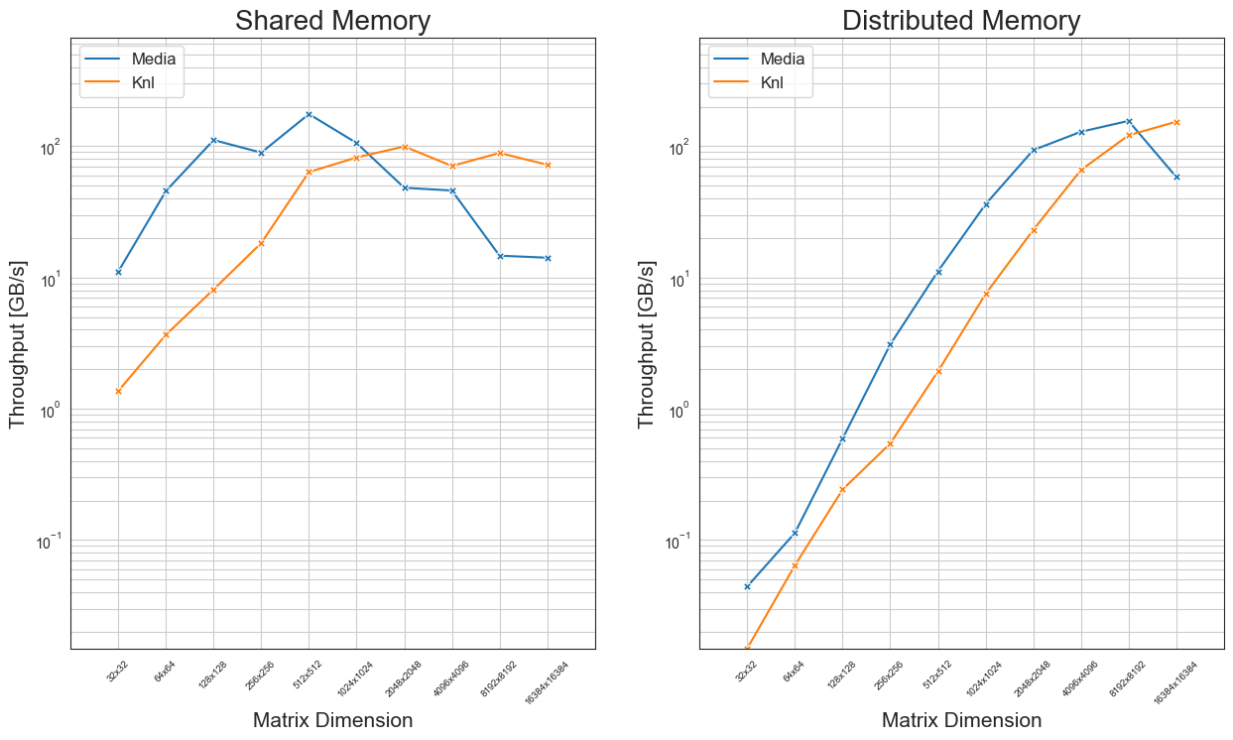

Slide 29
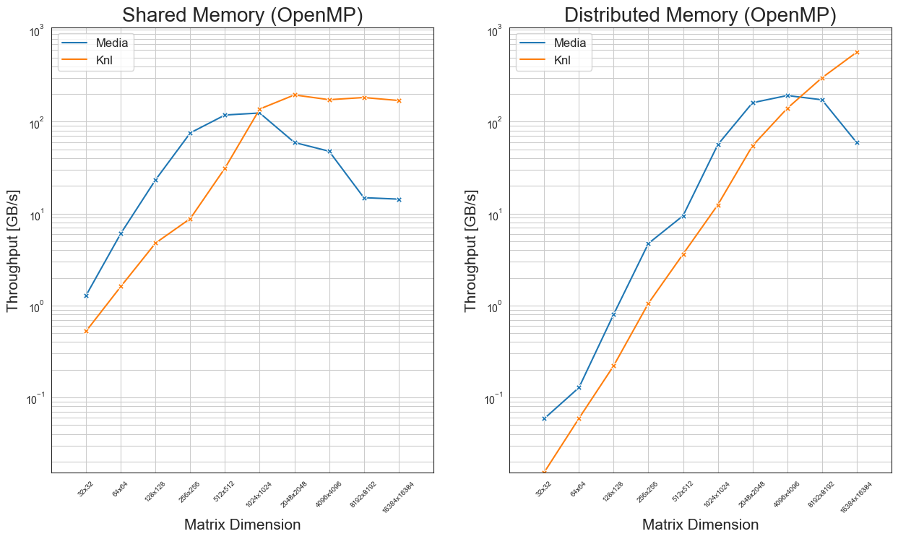

Slide 30
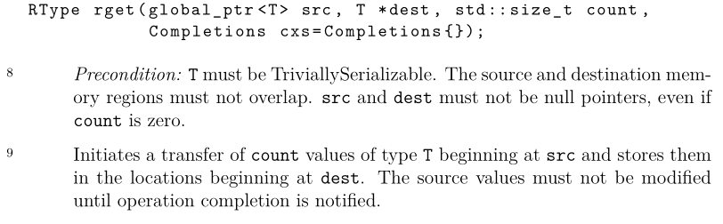
Stencil
Implementation using array padding and ghost cells
Fetch left and right neighbours separately
Synchronize twice in each step
https://bitbucket.org/berkeleylab/upcxx/downloads/upcxx-spec-2020.10.0.pdf (8.2.2 Remote Gets)

Slide 31
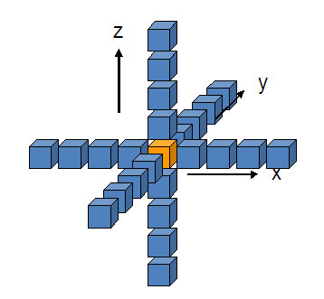
Stencil
Implementation using array padding and ghost cells
Fetch left and right neighbours separately
Synchronize twice in each step
Split blocks in z-direction
https://software.intel.com/content/www/us/en/develop/articles/3d-finite-differences-on-multi-core-processors.html

Slide 32
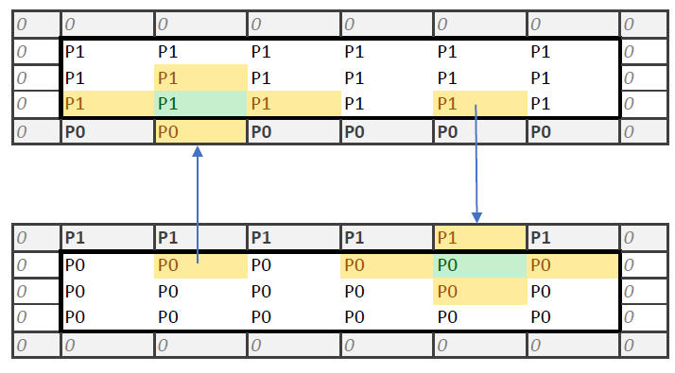
Stencil

Slide 33
Stencil
// As rget does not allow source values to be modified until operation completion
// is notified, first retrieve all right neighbors, then all left neighbors.
if (proc_id != proc_n - 1) {
upcxx::global_ptr<float> input_r = input_g.fetch(proc_id + 1).wait();
upcxx::rget(input_r + n_ghost_offset,
input + n_local - n_ghost_offset,
n_ghost_offset).wait();
}
upcxx::barrier();
if (proc_id != 0) {
upcxx::global_ptr<float> input_l = input_g.fetch(proc_id - 1).wait();
upcxx::rget(input_l + n_local - 2*n_ghost_offset,
input,
n_ghost_offset).wait();
}
upcxx::barrier();

Slide 34
Stencil
Possible improvements
Latency hiding
Compute inner block asynchronously
Use upcxx::dist_object for asynchronous point-to-point
Tiling (x- and y-dimension)
Hybrid implementation: OpenMP for x- and y-tiling, UPC++ for z-tiling
upcxx::local_team (processes corresponding to a physical node, avoid communication)

Slide 35
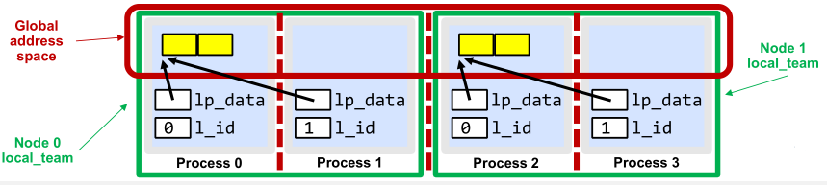
Stencil
Possible improvements
upcxx::local_team

Slide 36
Stencil
Throughput:
Count only elements in input and output array: steps * sizeof(float) * dim_x * dim_y * dim_z * 1e-9 / time
Benchmarks
4 processes per SKL node, 16 processes per KNL node
⚠ Lower dimensions need a smaller amount of processes for correct results.
Parameters: 5 steps, radius 2
Averaged over 100 iterations

Slide 37
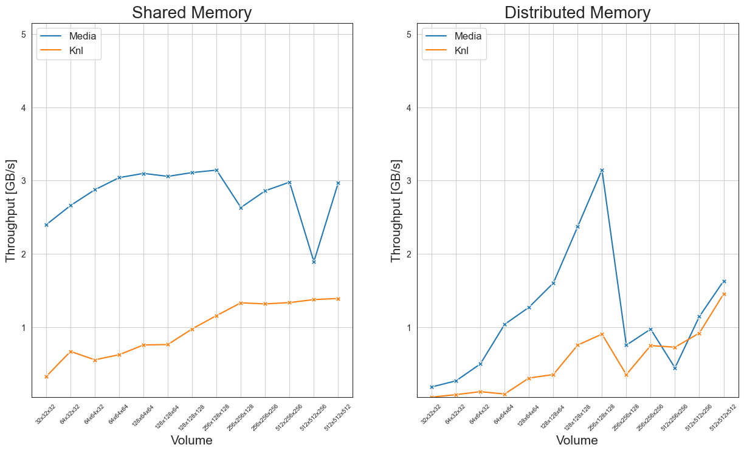

Slide 38
Thank you for your attention! Questions?

