Slide 1

Polynomial Preconditioners Ferdinand Vanmaele

Slide 2
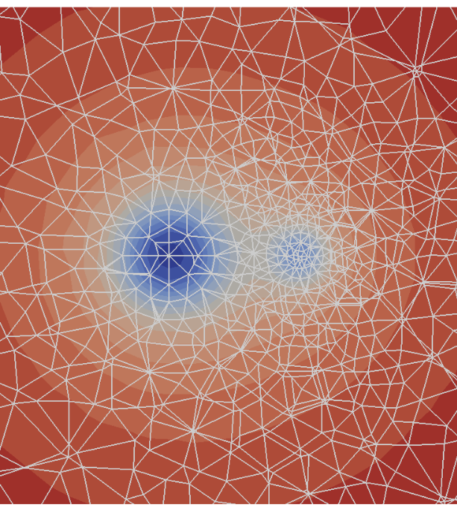

Introduction
Picture from https://conan.iwr.uni-heidelberg.de/data/teaching/finiteelements_ws2017/num2.pdf
Discretization of partial differential equations
Solve $Ax=b$with $A$ matrix of high dimension $n$
Common in science and industry
Fluid dynamics
Astrophysics
Biochemistry
Economics
etc...

Slide 3
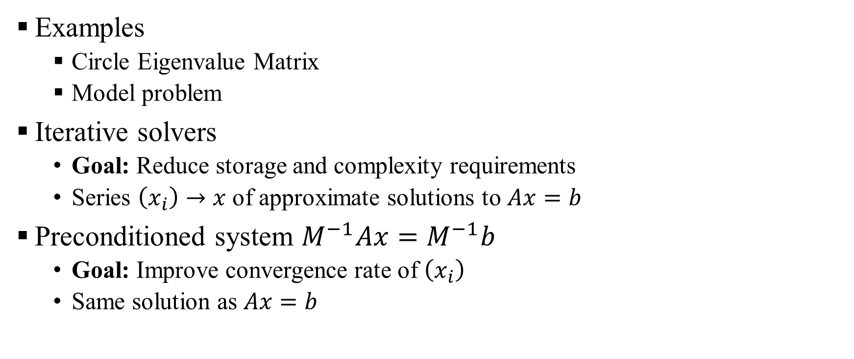
Introduction
Examples
Circle Eigenvalue Matrix
Model problem
Iterative solvers
Goal: Reduce storage and complexity requirements
Series $\left(x_{i}\right)→x$ of approximate solutions to $Ax=b$
Preconditioned system $M^{−1}Ax=M^{−1}b$
Goal: Improve convergence rate of $\left(x_{i}\right)$
Same solution as $Ax=b$

Slide 4
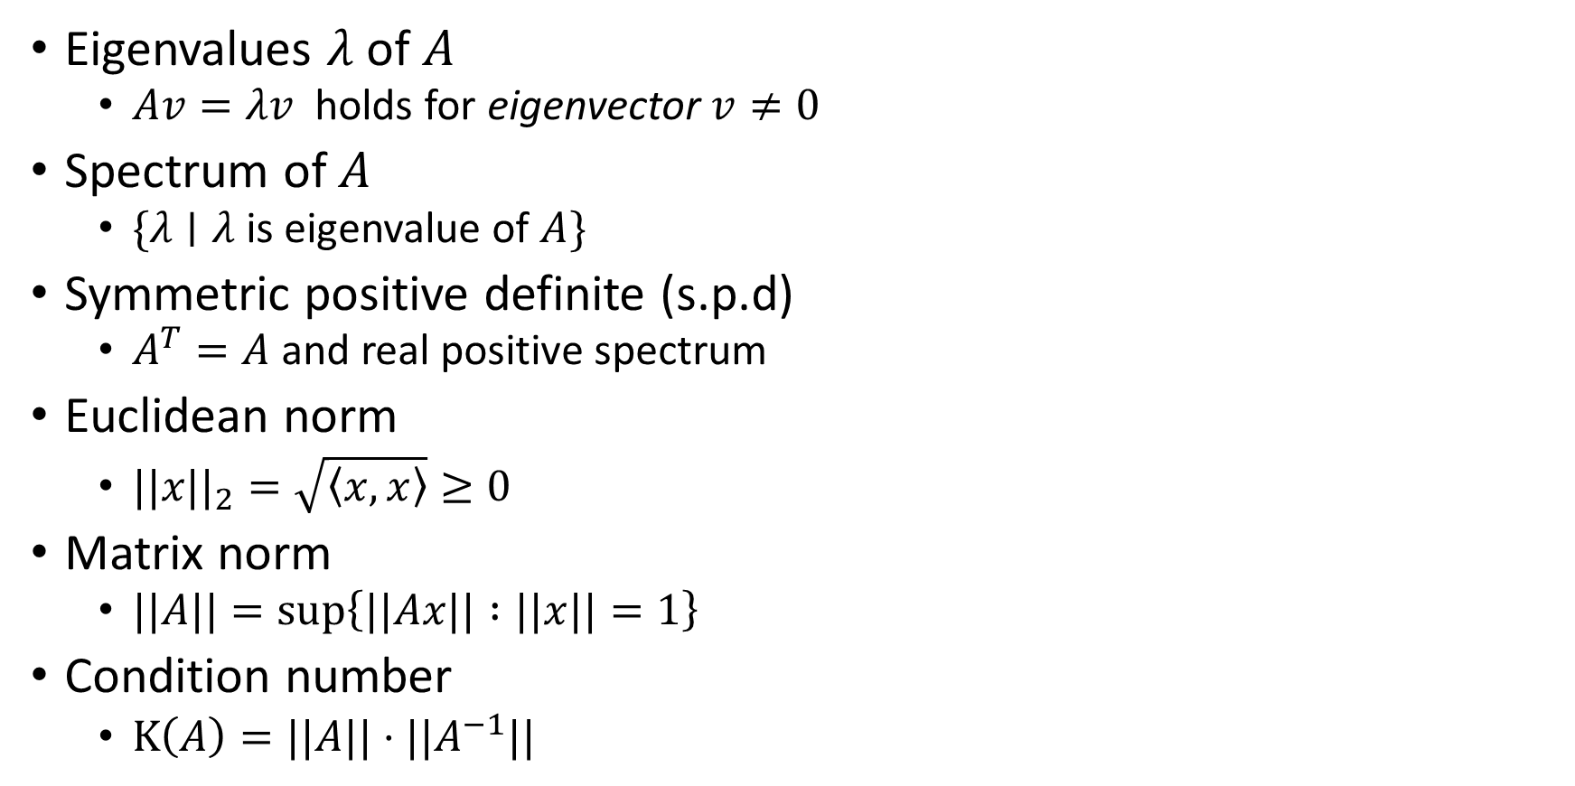
Terminology
Eigenvalues $λ$ of $A$
$Av=λv$ holds for eigenvector $v≠0$
Spectrum of $A$
$\{λ∣λ$ is eigenvalue of $A\}$
Symmetric positive definite (s.p.d)
$A^{T}=A$ and real positive spectrum
Euclidean norm
$||x||_{2}=\sqrt{\left\langle x,x\right\rangle }≥0$
Matrix norm
$||A||=\sup\left\{||Ax|| :||x||=1\right\}$
Condition number
$Κ\left(A\right)=||A||⋅||A^{−1}||$

Slide 5
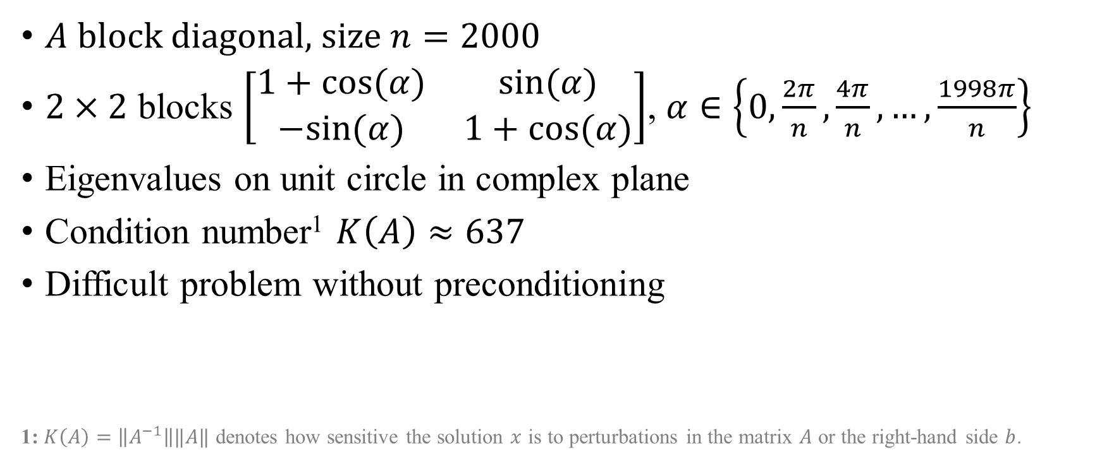
Example: Circle Eigenvalue Matrix
$A$ block diagonal, size $n=2000$
$2×2$ blocks $\left[\begin{matrix}1+cos⁡(α) & sin⁡(α) \\ −sin⁡(α) & 1+cos⁡(α)\end{matrix}\right]$, $α∈\left\{0,\frac{2π}{n},\frac{4π}{n},…,\frac{1998π}{n}\right\}$
Eigenvalues on unit circle in complex plane
Condition number¹ $K\left(A\right)≈637$
Difficult problem without preconditioning
1: $K\left(A\right)=\left\|A^{−1}\right\|‖A‖$ denotes how sensitive the solution $x$ is to perturbations in the matrix $A$ or the right-hand side $b$.

Slide 6
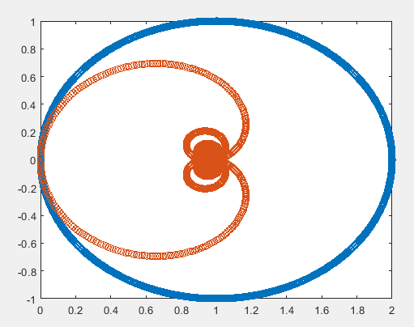
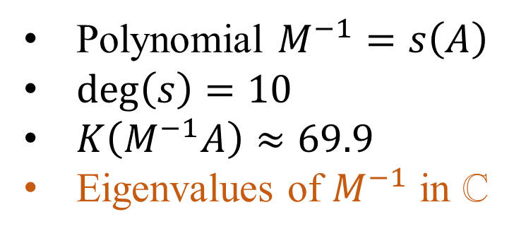
Example: Circle Eigenvalue Matrix
Polynomial $M^{−1}=s\left(A\right)$
$\deg\left(s\right)=10$
$K\left(M^{−1}A\right)≈69.9$
Eigenvalues of $M^{−1}$ in ℂ

Slide 7

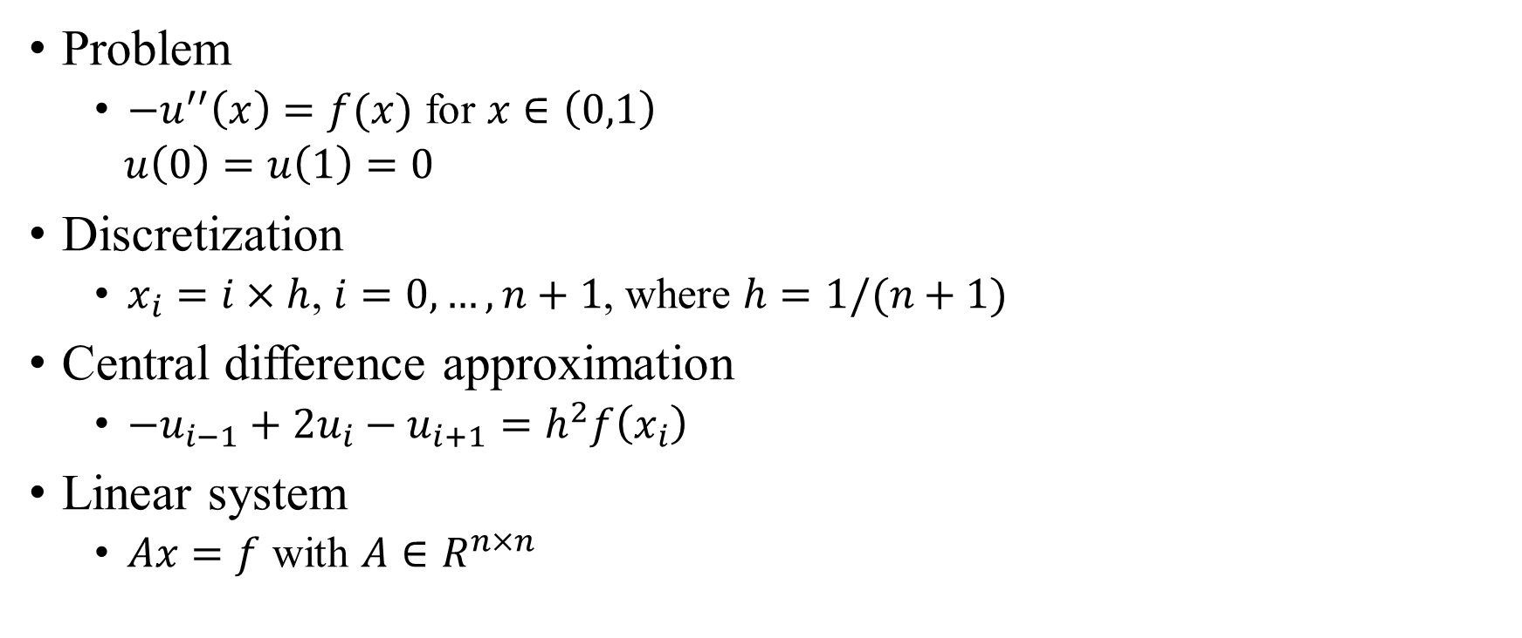
Example: Model problem
Problem
$−u^{′′}\left(x\right)=f(x)$ for $x∈\left(0,1\right)$
$u\left(0\right)=u\left(1\right)=0$
Discretization
$x_{i}=i×h$, $i=0,…,n+1$, where $h=1/(n+1)$
Central difference approximation
$−u_{i−1}+2u_{i}−u_{i+1}=h^{2}f\left(x_{i}\right)$
Linear system
$Ax=f$ with $A∈R^{n×n}$
$$A=\frac{1}{h^{2}}\left(\begin{matrix}2 & −1 & 0 & 0 & 0 \\ −1 & 2 & −1 & 0 & 0 \\ 0 & −1 & 2 & −1 & 0 \\ 0 & 0 & −1 & 2 & −1 \\ 0 & 0 & 0 & −1 & 2\end{matrix}\right)$$

Slide 8
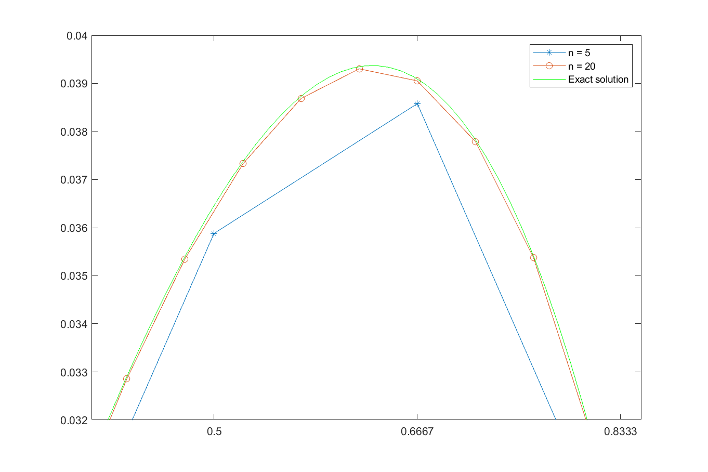

Slide 9
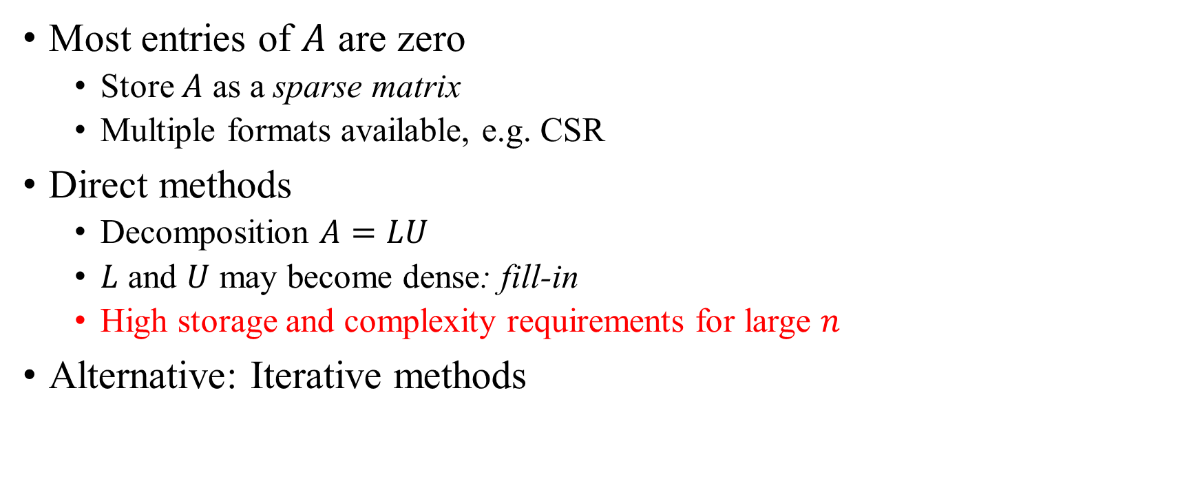
Iterative solvers
Most entries of $A$ are zero
Store $A$ as a sparse matrix
Multiple formats available, e.g. CSR
Direct methods
Decomposition $A=LU$
$L$ and $U$ may become dense: fill-in
High storage and complexity requirements for large $n$
Alternative: Iterative methods

Slide 10
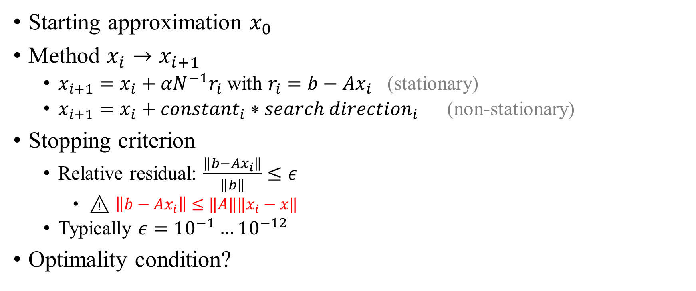
Iterative solvers
Starting approximation $x_{0}$
Method $x_{i}→x_{i+1}$
$x_{i+1}=x_{i}+αN^{−1}r_{i}$ with $r_{i}=b−Ax_{i}$ (stationary)
$x_{i+1}=x_{i}+constant_{i}∗search direction_{i}$ (non-stationary)
Stopping criterion
Relative residual: $\frac{\left\|b−Ax_{i}\right\|}{\left\|b\right\|}≤ε$
⚠ $\left\|b−Ax_{i}\right\|≤‖A‖‖x_{i}−x‖$
Typically $ε={10}^{−1}…{10}^{−12}$
Optimality condition?

Slide 11
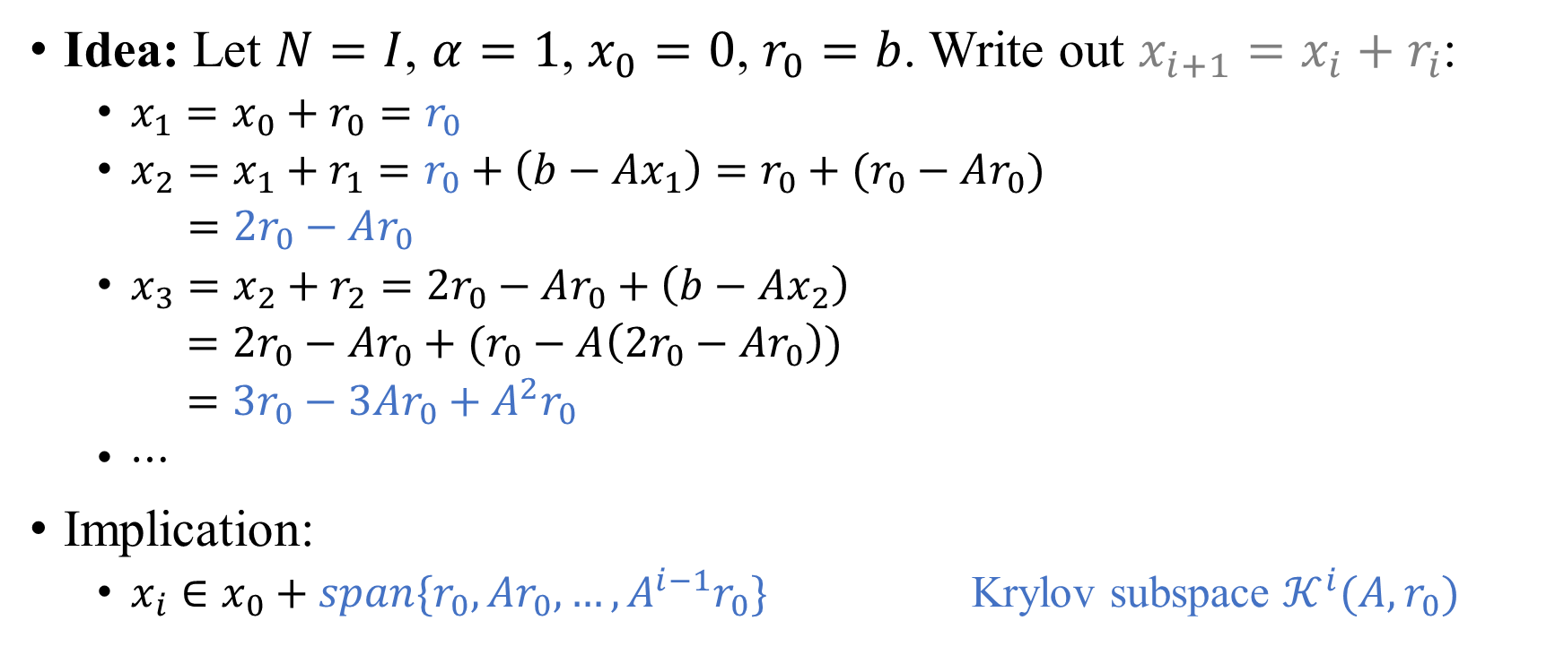
Iterative solvers
Idea: Let $N=I$, $α=1$, $x_{0}=0$, $r_{0}=b$. Write out $x_{i+1}=x_{i}+r_{i}$:
$x_{1}=x_{0}+r_{0}=r_{0}$
$x_{2}=x_{1}+r_{1}=r_{0}+\left(b−Ax_{1}\right)=r_{0}+(r_{0}−Ar_{0})$
$=2r_{0}−Ar_{0}$
$x_{3}=x_{2}+r_{2}=2r_{0}−Ar_{0}+\left(b−Ax_{2}\right)$
$=2r_{0}−Ar_{0}+(r_{0}−A\left(2r_{0}−Ar_{0}\right))$
$=3r_{0}−3Ar_{0}+A^{2}r_{0}$
$⋯$
Implication:
$x_{i}∈x_{0}+span\{r_{0},Ar_{0},…,A^{i−1}r_{0}\}$ Krylov subspace $𝒦^{i}(A,r_{0})$

Slide 12
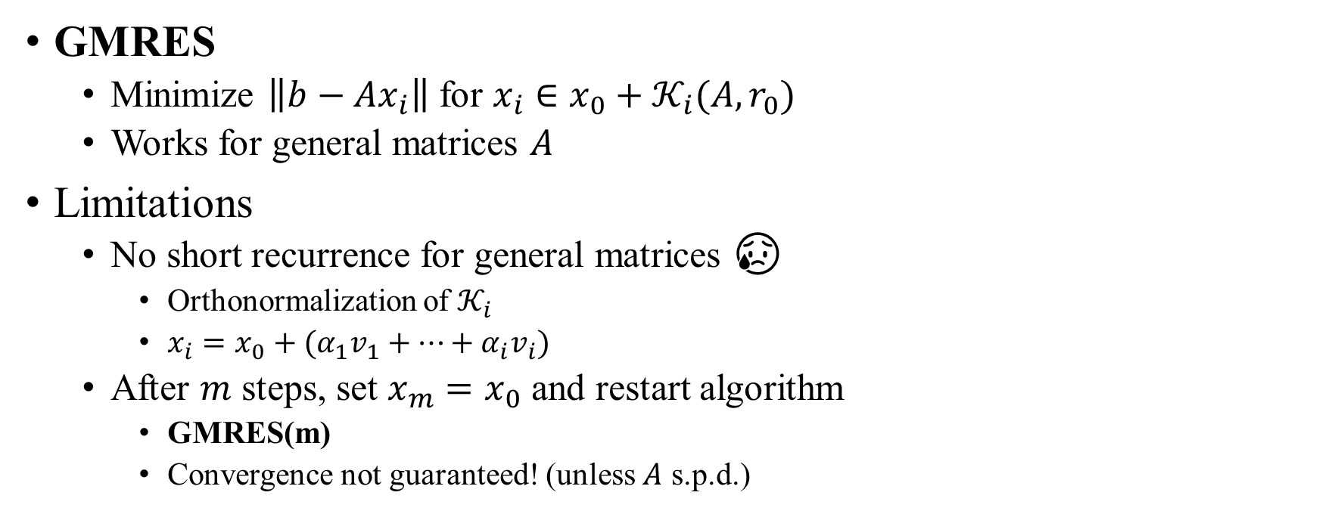
Iterative solvers
GMRES
Minimize $\left\|b−Ax_{i}\right\|$ for $x_{i}∈x_{0}+{\text{𝒦}}_{i}(A,r_{0})$
Works for general matrices $A$
Limitations
No short recurrence for general matrices 😥
Orthonormalization of ${\text{𝒦}}_{i}$
$x_{i}=x_{0}+(α_{1}v_{1}+⋯+α_{i}v_{i})$
After $m$ steps, set $x_{m}=x_{0}$ and restart algorithm
GMRES(m)
Convergence not guaranteed! (unless $A$ s.p.d.)

Slide 13
Iterative solvers
Building blocks
Vector updates (SAXPY)
Easy to parallelize ✔
Inner products
Parallelization: synchronization between all processes 🙄
Sparse matrix-vector products (SpMVs)
Parallelization: synchronization between neighbours 😊
Matrix-matrix product
Determine preconditioner (before iteration start, later)

Slide 14
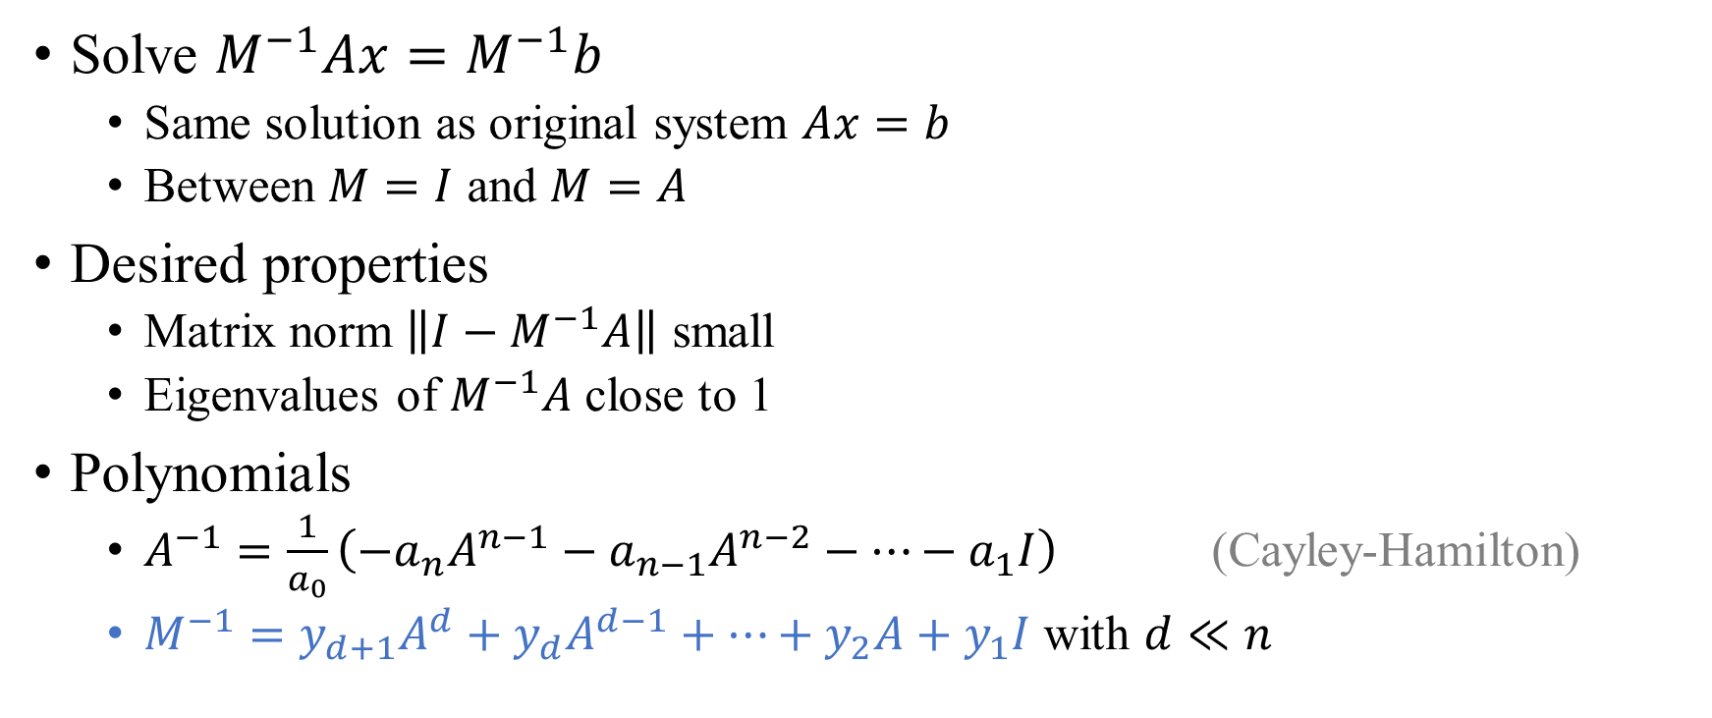
Preconditioning
Solve $M^{−1}Ax=M^{−1}b$
Same solution as original system $Ax=b$
Between $M=I$ and $M=A$
Desired properties
Matrix norm $\left\|I−M^{−1}A\right\|$ small
Eigenvalues of $M^{−1}A$ close to 1
Polynomials
$A^{−1}=\frac{1}{a_{0}}\left(−a_{n}A^{n−1}−a_{n−1}A^{n−2}−⋯−a_{1}I\right)$ (Cayley-Hamilton)
$M^{−1}=y_{d+1}A^{d}+y_{d}A^{d−1}+⋯+y_{2}A+y_{1}I$ with $d≪n$

Slide 15
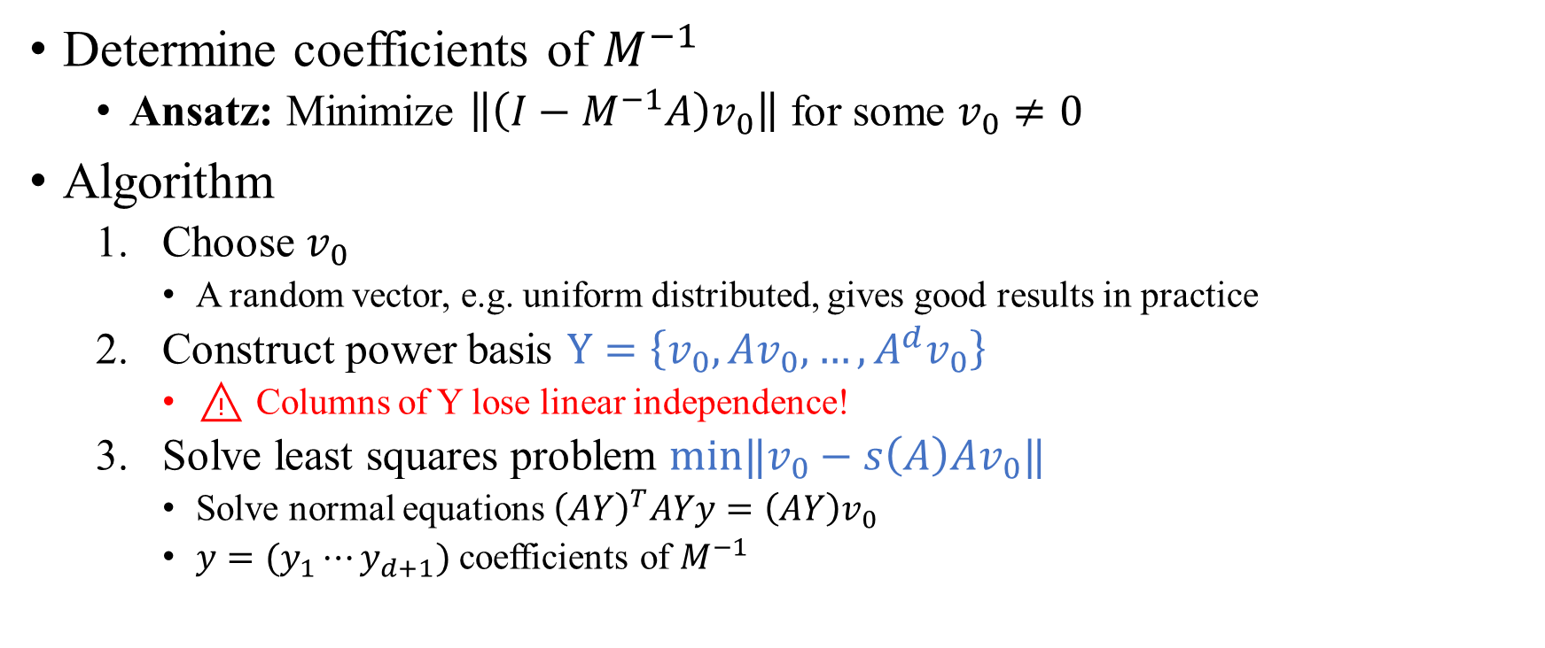
Preconditioning
Determine coefficients of $M^{−1}$
Ansatz: Minimize $\left\|\left(I−M^{−1}A\right)v_{0}\right\|$ for some $v_{0}≠0$
Algorithm
Choose $v_{0}$
A random vector, e.g. uniform distributed, gives good results in practice
Construct power basis $Y=\left\{v_{0},Av_{0},…,A^{d}v_{0}\right\}$
⚠ Columns of Y lose linear independence!
Solve least squares problem $min‖v_{0}−s\left(A\right)Av_{0}‖$
Solve normal equations ${\left(AY\right)}^{T}AYy=\left(AY\right)v_{0}$
$y=(y_{1}⋯y_{d+1})$ coefficients of $M^{−1}$

Slide 16
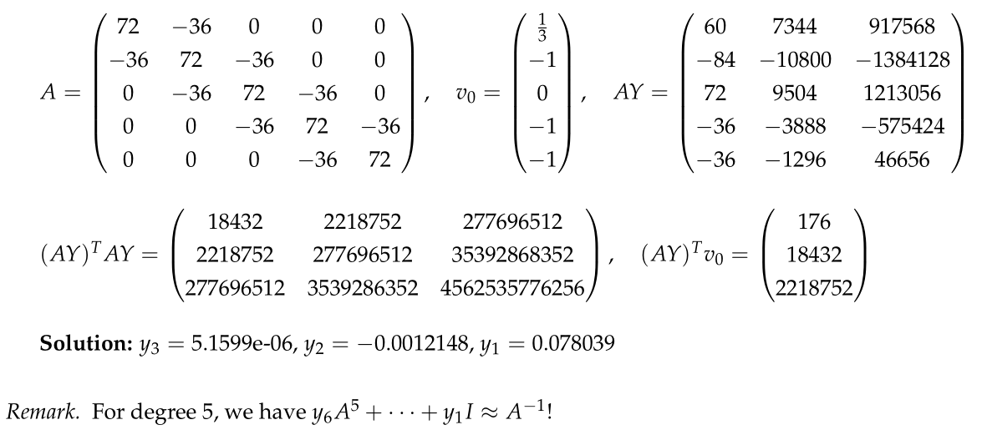

Example: Model problem ($n=5)$

Slide 17
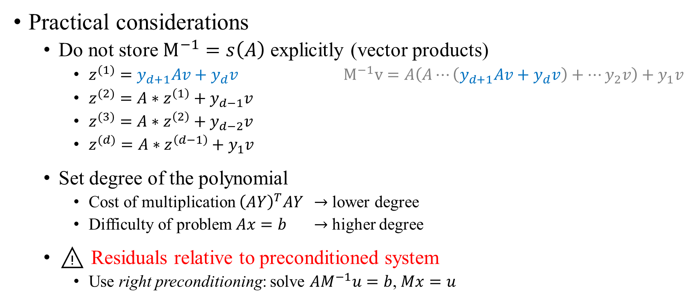
Preconditioning
Practical considerations
Do not store $M^{−1}=s\left(A\right)$ explicitly (vector products)
$z^{(1)}=y_{d+1}Av+y_{d}v$ $M^{−1}v=A\left(A⋯\left(y_{d+1}Av+y_{d}v\right)+⋯y_{2}v\right)+y_{1}v$
$z^{(2)}=A∗z^{\left(1\right)}+y_{d−1}v$
$z^{(3)}=A∗z^{\left(2\right)}+y_{d−2}v$
$z^{(d)}=A∗z^{\left(d−1\right)}+y_{1}v$
Set degree of the polynomial
Cost of multiplication ${\left(AY\right)}^{T}AY$ $→$ lower degree
Difficulty of problem $Ax=b$ $→$ higher degree
⚠ Residuals relative to preconditioned system
Use right preconditioning: solve $AM^{−1}u=b$, $Mx=u$

Slide 18
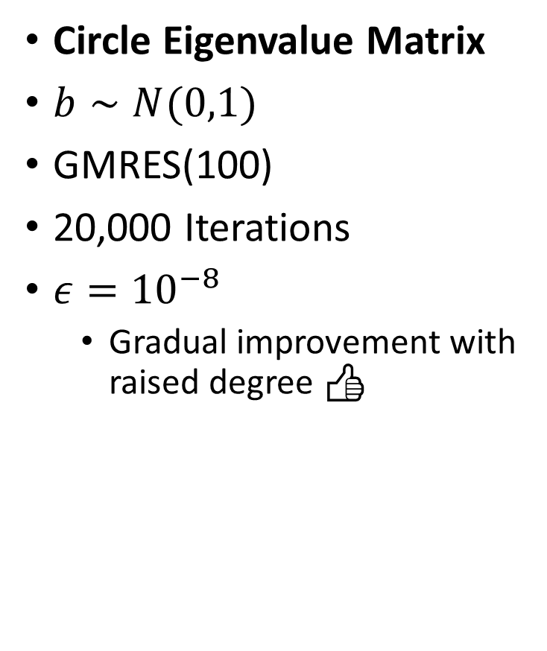
Circle Eigenvalue Matrix
$b∼N(0,1)$
GMRES(100)
20,000 Iterations
$ε={10}^{−8}$
Gradual improvement with raised degree 👍

Slide 19
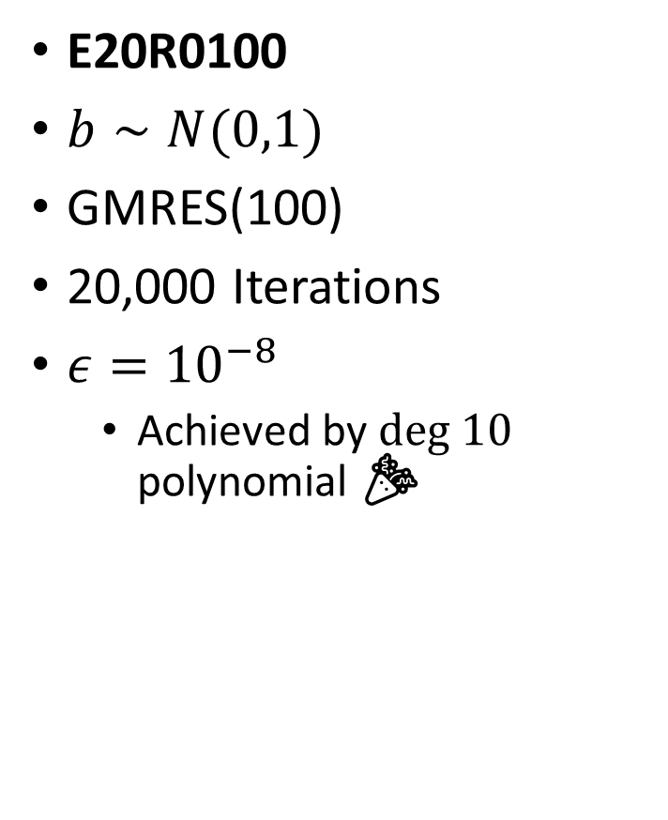
E20R0100
$b∼N(0,1)$
GMRES(100)
20,000 Iterations
$ε={10}^{−8}$
Achieved by $deg 10$ polynomial 🎉

Slide 20
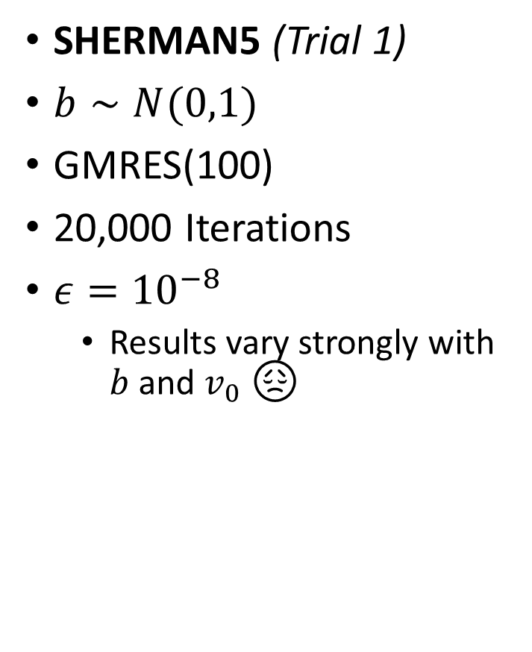
SHERMAN5 (Trial 1)
$b∼N(0,1)$
GMRES(100)
20,000 Iterations
$ε={10}^{−8}$
Results vary strongly with $b$ and $v_{0}$ 😞

Slide 21
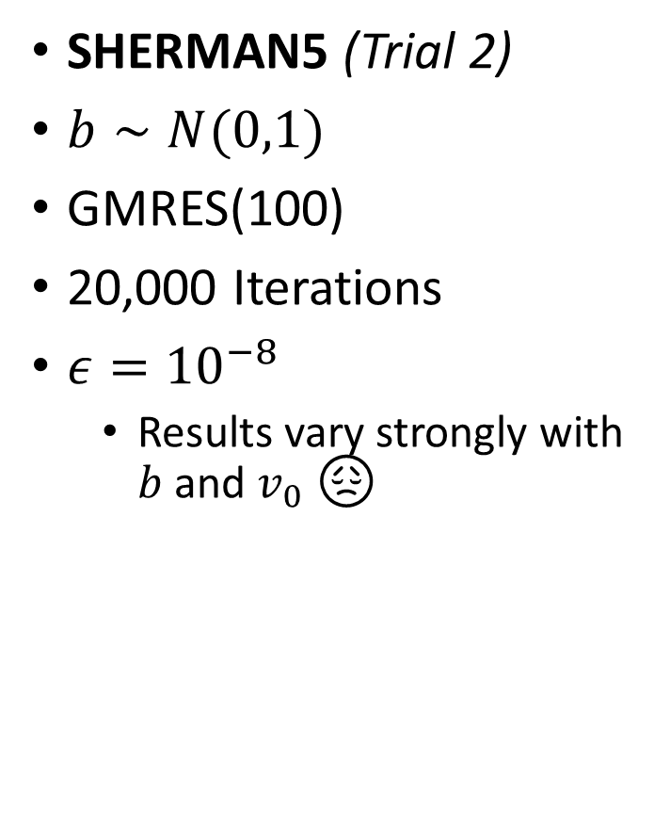
SHERMAN5 (Trial 2)
$b∼N(0,1)$
GMRES(100)
20,000 Iterations
$ε={10}^{−8}$
Results vary strongly with $b$ and $v_{0}$ 😞

Slide 22
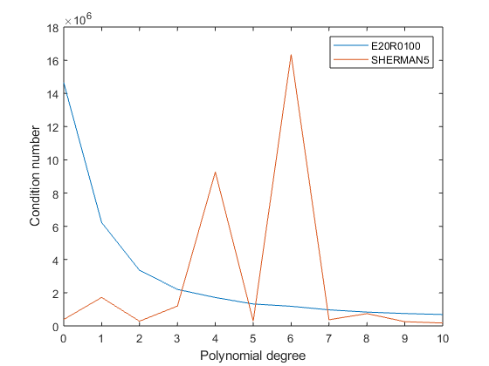

$K(s(A)A)$ (estimated)
1 order of magnitude improvement for most problems
Erratic for SHERMAN5 🙈

Slide 23
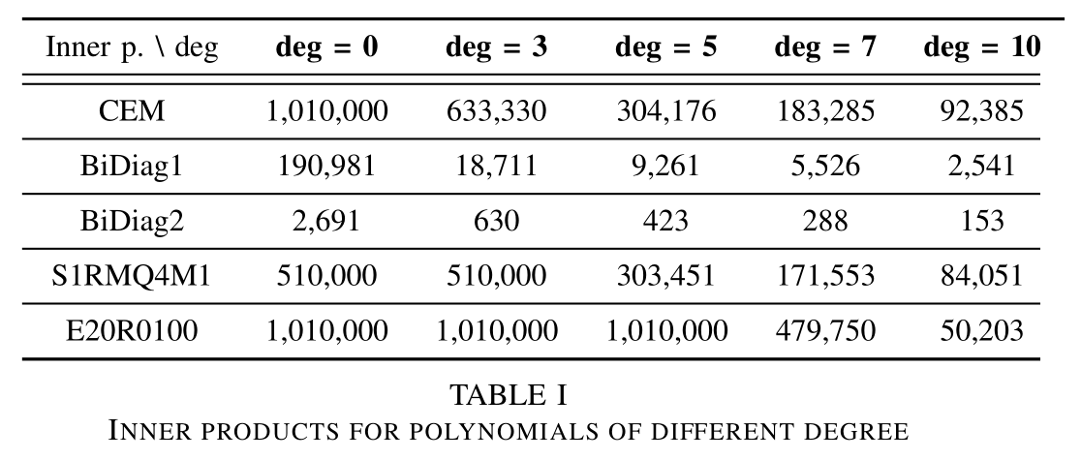
Parallelization

Slide 24
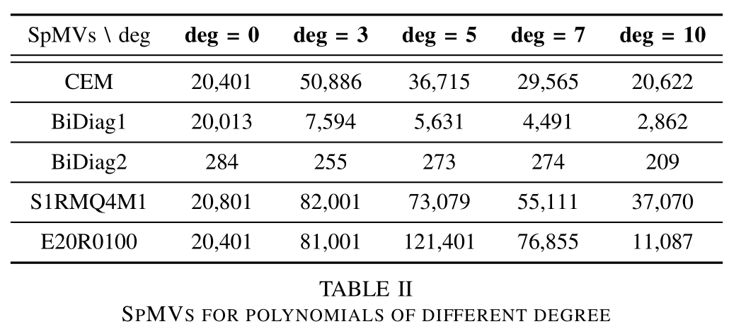
Parallelization

Slide 25
References
Iterative Methods for Sparse Linear Systems https://www-users.cs.umn.edu/~saad/IterMethBook_2ndEd.pdf
Templates for the Solutions of Linear Systems: Building Blocks for Iterative Methods https://www.netlib.org/templates/templates.pdf
Polynomial Preconditioned GMRES to Reduce Communication in Parallel Computing https://arxiv.org/abs/1907.00072
Seminar report ☺ https://github.com/fvanmaele/polynomial-preconditioning

Slide 26
Thank you for your attention! 🤗

