Slide 1
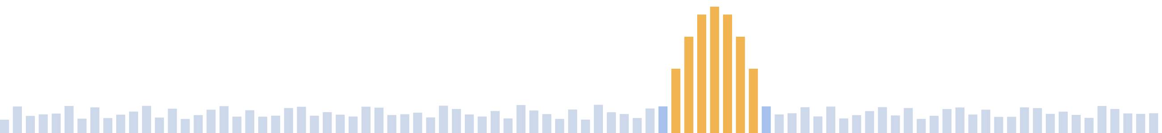
fcfb
A split fast-convolution filter bank for the TRX-duo
Wideband analysis on a Zynq-7010 FPGA · channel synthesis on the host PC
Franco Venturi, K4VZ · October 2026

Slide 2




What fcfb is — and why
One wideband analysis filter bank runs on the board; the host reconstructs individual receivers from it. The expensive full-rate DSP happens once, in the FPGA; the flexible per-channel work runs on a commodity PC.
One capture, many receivers
Channels defined on the host
Flexibility in software
Modest hardware
A single wideband bank on the board; the host pulls as many channels as the link budget allows.
Centre frequency, bandwidth, Kaiser filters and demodulation — all chosen at runtime.
New modes and receivers are host code, not an FPGA gateware rebuild.
An inexpensive Zynq-7010 board paired with an ordinary host PC.
fcfb — split fast-convolution filter bank for the TRX-duo · Franco Venturi, K4VZ
2

Slide 3
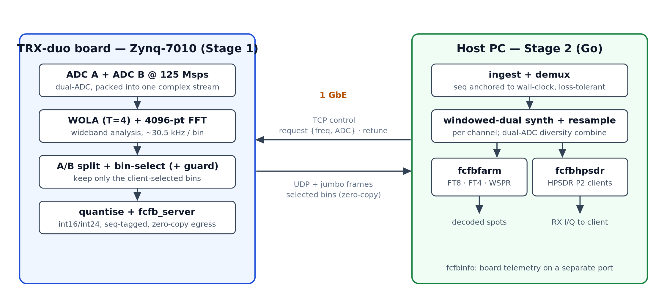
Two systems: board + host
fcfb — split fast-convolution filter bank for the TRX-duo · Franco Venturi, K4VZ
3

Slide 4
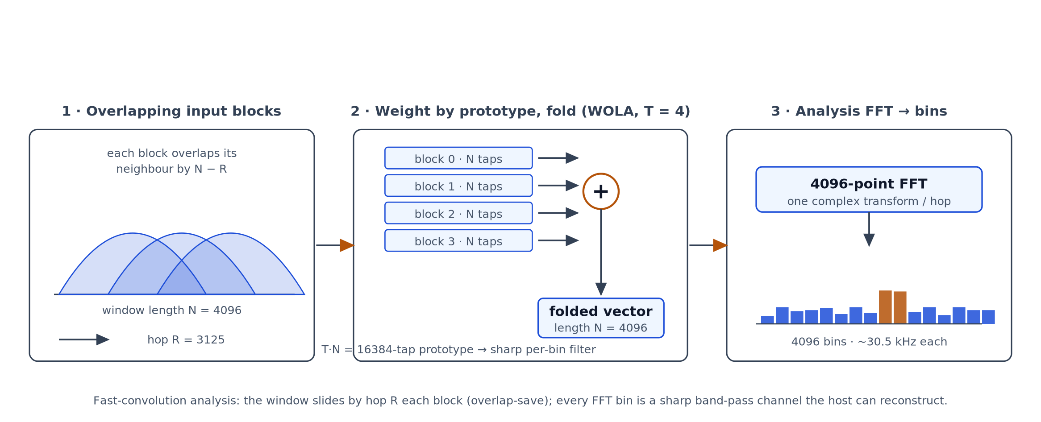
The analysis engine: overlap-save + WOLA
fcfb — split fast-convolution filter bank for the TRX-duo · Franco Venturi, K4VZ
4

Slide 5
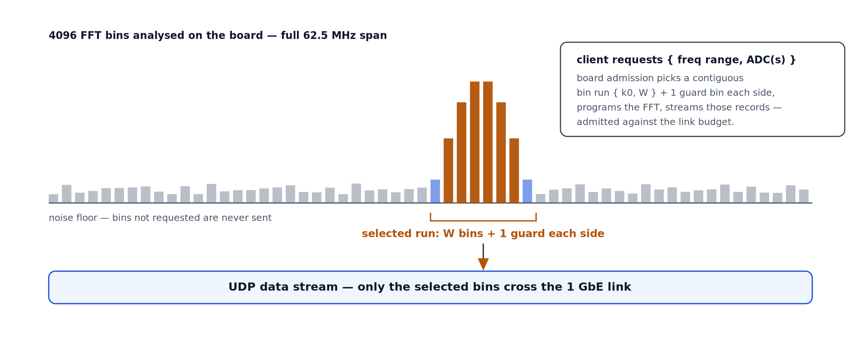
Ship only the bins the host needs
fcfb — split fast-convolution filter bank for the TRX-duo · Franco Venturi, K4VZ
5

Slide 6



Constraints we had to overcome
1 GbE throughput
Zynq-7010 resources
Clock constraints
The link cannot carry the full-rate dual-ADC spectrum. The real wall is per-datagram packet rate, not line rate: at a 1500-byte MTU a record must fit one unfragmented datagram (≤ 242 int24 bins) — fragment it and loss sets in.
A small, inexpensive part. The WOLA prefilter is folded to its storage floor (NB = T+1) — the largest analysis bank that fits the 7010's block RAM.
The analysis FFT runs at the full 125 Msps ADC rate: a 125 MHz datapath with 2× and 3× clock domains driving the complex-multiply FFT in step.
fcfb — split fast-convolution filter bank for the TRX-duo · Franco Venturi, K4VZ
6

Slide 7
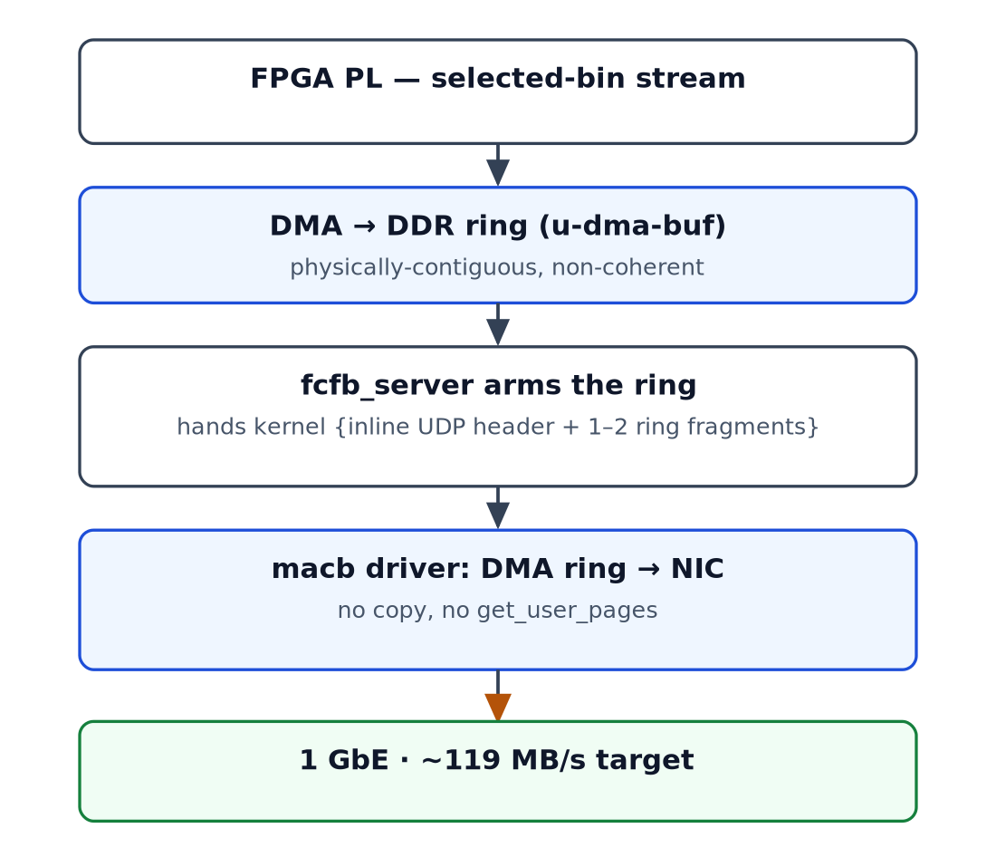
Network: jumbo frames + zero-copy UDP
Zero-copy moves the ceiling from the packet-rate wall to raw GbE line rate: W ≈ 500 bins on one ADC (~506 theoretical, wmax 512 just above) streams loss-free at ~99% of 1 GbE — ≈ 15.3 MHz. Both ADCs: 250 bins each.
Why 24-bit bins: the wideband bank carries the whole band's dynamic range through one quantiser. 16-bit samples would hold the on-wire floor near −90 dBc and limit reconstruction; 24-bit keeps quantisation below the ~−102 dBc fixed-point ceiling — at 3 bytes per bin.
Jumbo + zero-copy: the macb driver ships with jumbo disabled; a kernel patch enables MTU 3980. A second patch DMAs each datagram straight from the ring — no copy, no get_user_pages — breaking the ~30k packets/s wall so the fixed 40k/s sustains at line rate (~119 MB/s).
fcfb — split fast-convolution filter bank for the TRX-duo · Franco Venturi, K4VZ
7

Slide 8



The host applications
fcfbfarm
Decoder farm
fcfbhpsdr
openHPSDR Protocol-2 server
fcfbinfo
Board telemetry
Reconstructs many channels from the one board stream and runs jt9 (FT8/FT4) or wsprd (WSPR) on UTC-aligned windows — many receivers over a single stream session.
Presents the board to piHPSDR, Thetis or linhpsdr as one or more radios; the client picks each DDC's centre frequency, sample rate and ADC at runtime.
A one-shot query for die temperature, supply voltages, FPGA part and loaded gateware — answered on a separate port, safe to run mid-stream.
One zero-dependency Go package → single static binaries for Linux, Windows and macOS; the synthesis kernel is embedded, so nothing else ships.
fcfb — split fast-convolution filter bank for the TRX-duo · Franco Venturi, K4VZ
8

Slide 9
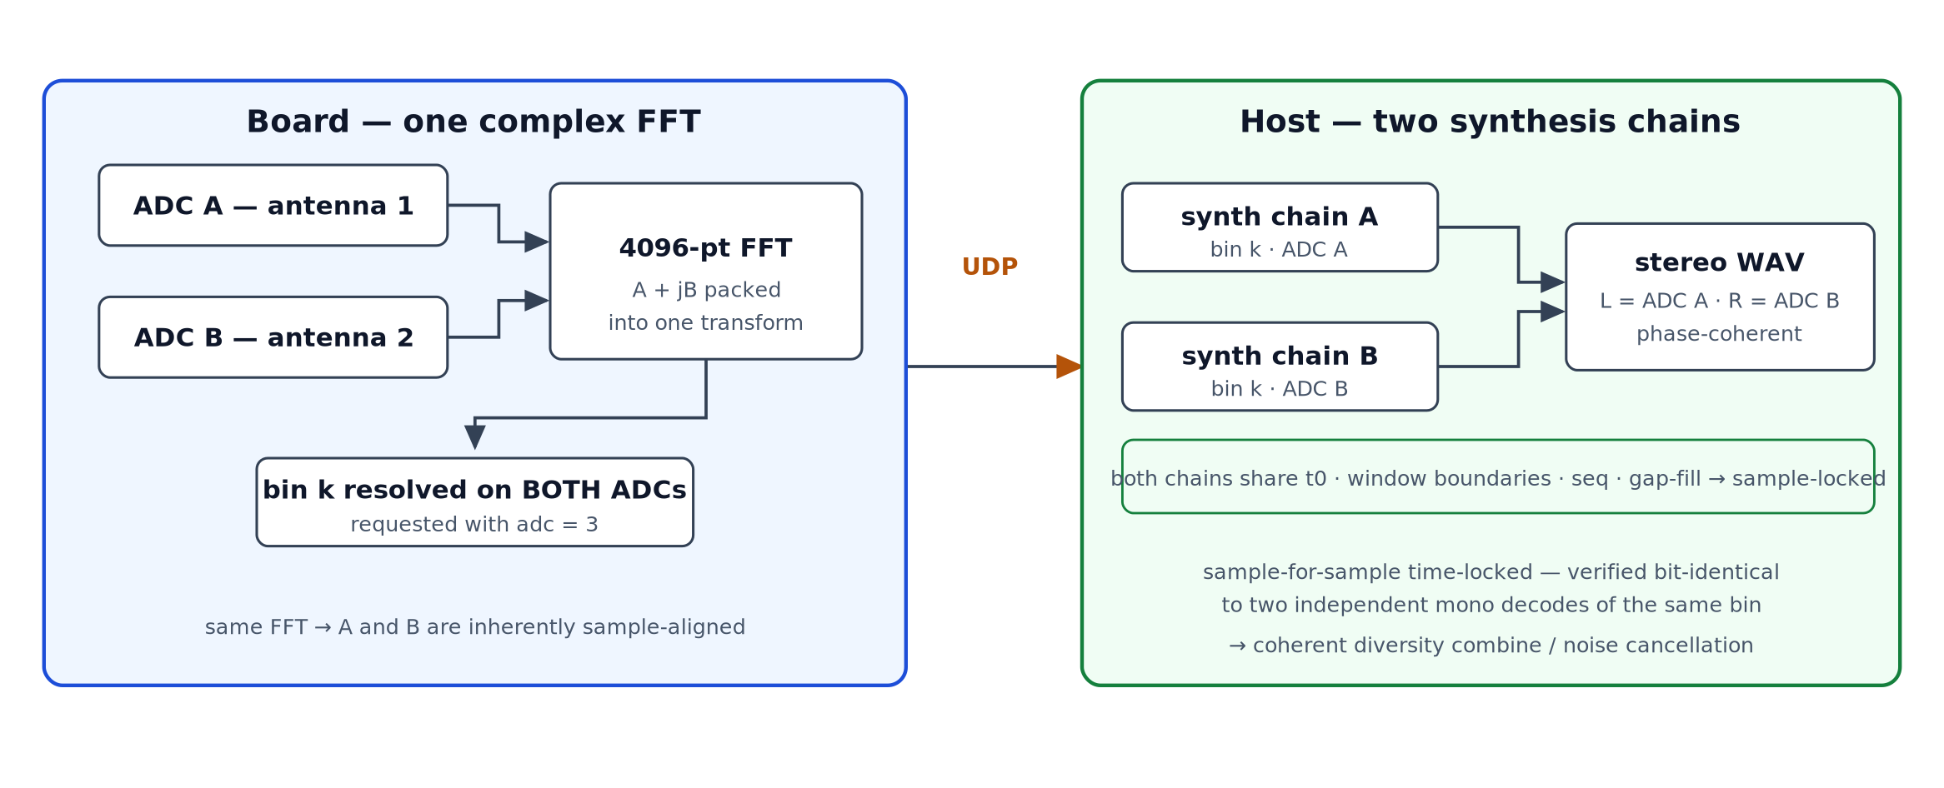
Diversity reception
fcfb — split fast-convolution filter bank for the TRX-duo · Franco Venturi, K4VZ
9

