Slide 1
Molecular Subtypes of Major Depressive Disorder (MDD)
Large-scale plasma proteomics in UK Biobank
Goal: biologically grounded subtyping of MDD
Focus on immune, metabolic, and mitochondrial pathways

Slide 2
Why This Study Matters?
MDD is clinically and biologically heterogeneous
Current treatments ignore underlying biology (e.g., symptoms)
Proteomics enables unbiased, scalable disease stratification
Move toward biology-based patient stratification for precision psychiatry

Slide 3
Data & Cohorts
~2,923 plasma proteins (UKB plasma proteomics; Olink)
Discovery: 1,403 MDD cases + 4,209 controls
Replication: 2,927 MDD cases + 8,781 controls
Extensive clinical and technical exclusions to create a clean discovery cohort
Controls matched and filtered with same criteria

Slide 4
Clustering Approach: HYDRA
Semi-supervised clustering: cases vs controls
Learns how cases differ from controls
Then finds heterogenous subgroups within MDD cases
Confounders adjusted (age, sex, batch, center, etc.)
Tested k =2-10 → Optimal solution: 3 clusters (validated with null simulations)

Slide 5
Key Result: Three Molecular Subtypes of MDD
Subtype C1: Hypo-mitochondrial depression
Subtype C2: Immuno-metabolic depression
Subtype C3: Hyper-mitochondrial depression

Slide 6
Subtype C1 – Hypo-mitochondrial (~33-41% of cases)
↓ Mitochondrial proteins and oxidative phosphorylation
↓ Synaptic and intracellular transport proteins
Long-term synaptic depression pathways
Longest duration of depression
Higher alcohol intake
Minimal immune activation
Interpretation: Energy failure + impaired synaptic maintenance → chronic depression course

Slide 7
Subtype C2 – Immuno-metabolic Depression (~33-41% of cases)
↑ Inflammatory markers (CRP, TNF, IL6/JAK-STAT)
↑ BMI, lipids, glucose, HbA1c
↑ Complement and innate immune pathways
↑ Metabolic dysregulation
Higher binge eating and self-harm rates
Brain changes in hippocampus and accumbens
Interpretation: Classic inflammatory / metabolic depression — biologically distinct and potentially druggable

Slide 8
Subtype C3 – Hyper-mitochondrial (~33-41% of cases)
↑ Mitochondrial and OXPHOS proteins
↑ Cell-cycle and Myc-target activity
Adaptive immune signaling (T/B cell pathways)
↓ IL2 and IL6 (opposite of C2)
Shortest depression duration
Fewer comorbidities
Relatively preserved brain structure
Interpretation: Elevated mitochondrial activity may be compensatory or protective

Slide 9
Validation & Robustness
Replicated in independent cohort
Null simulations confirm non-random clustering
Positive control: Rheumatoid arthritis

Slide 10
Blood Biomarkers & BMI
BMI and CRP strongly differentiate subtypes
C2 consistently highest across:
CRP
Triglycerides
HbA1c
LDL
Take-home: peripheral blood captures biologically meaningful MDD subtypes

Slide 11
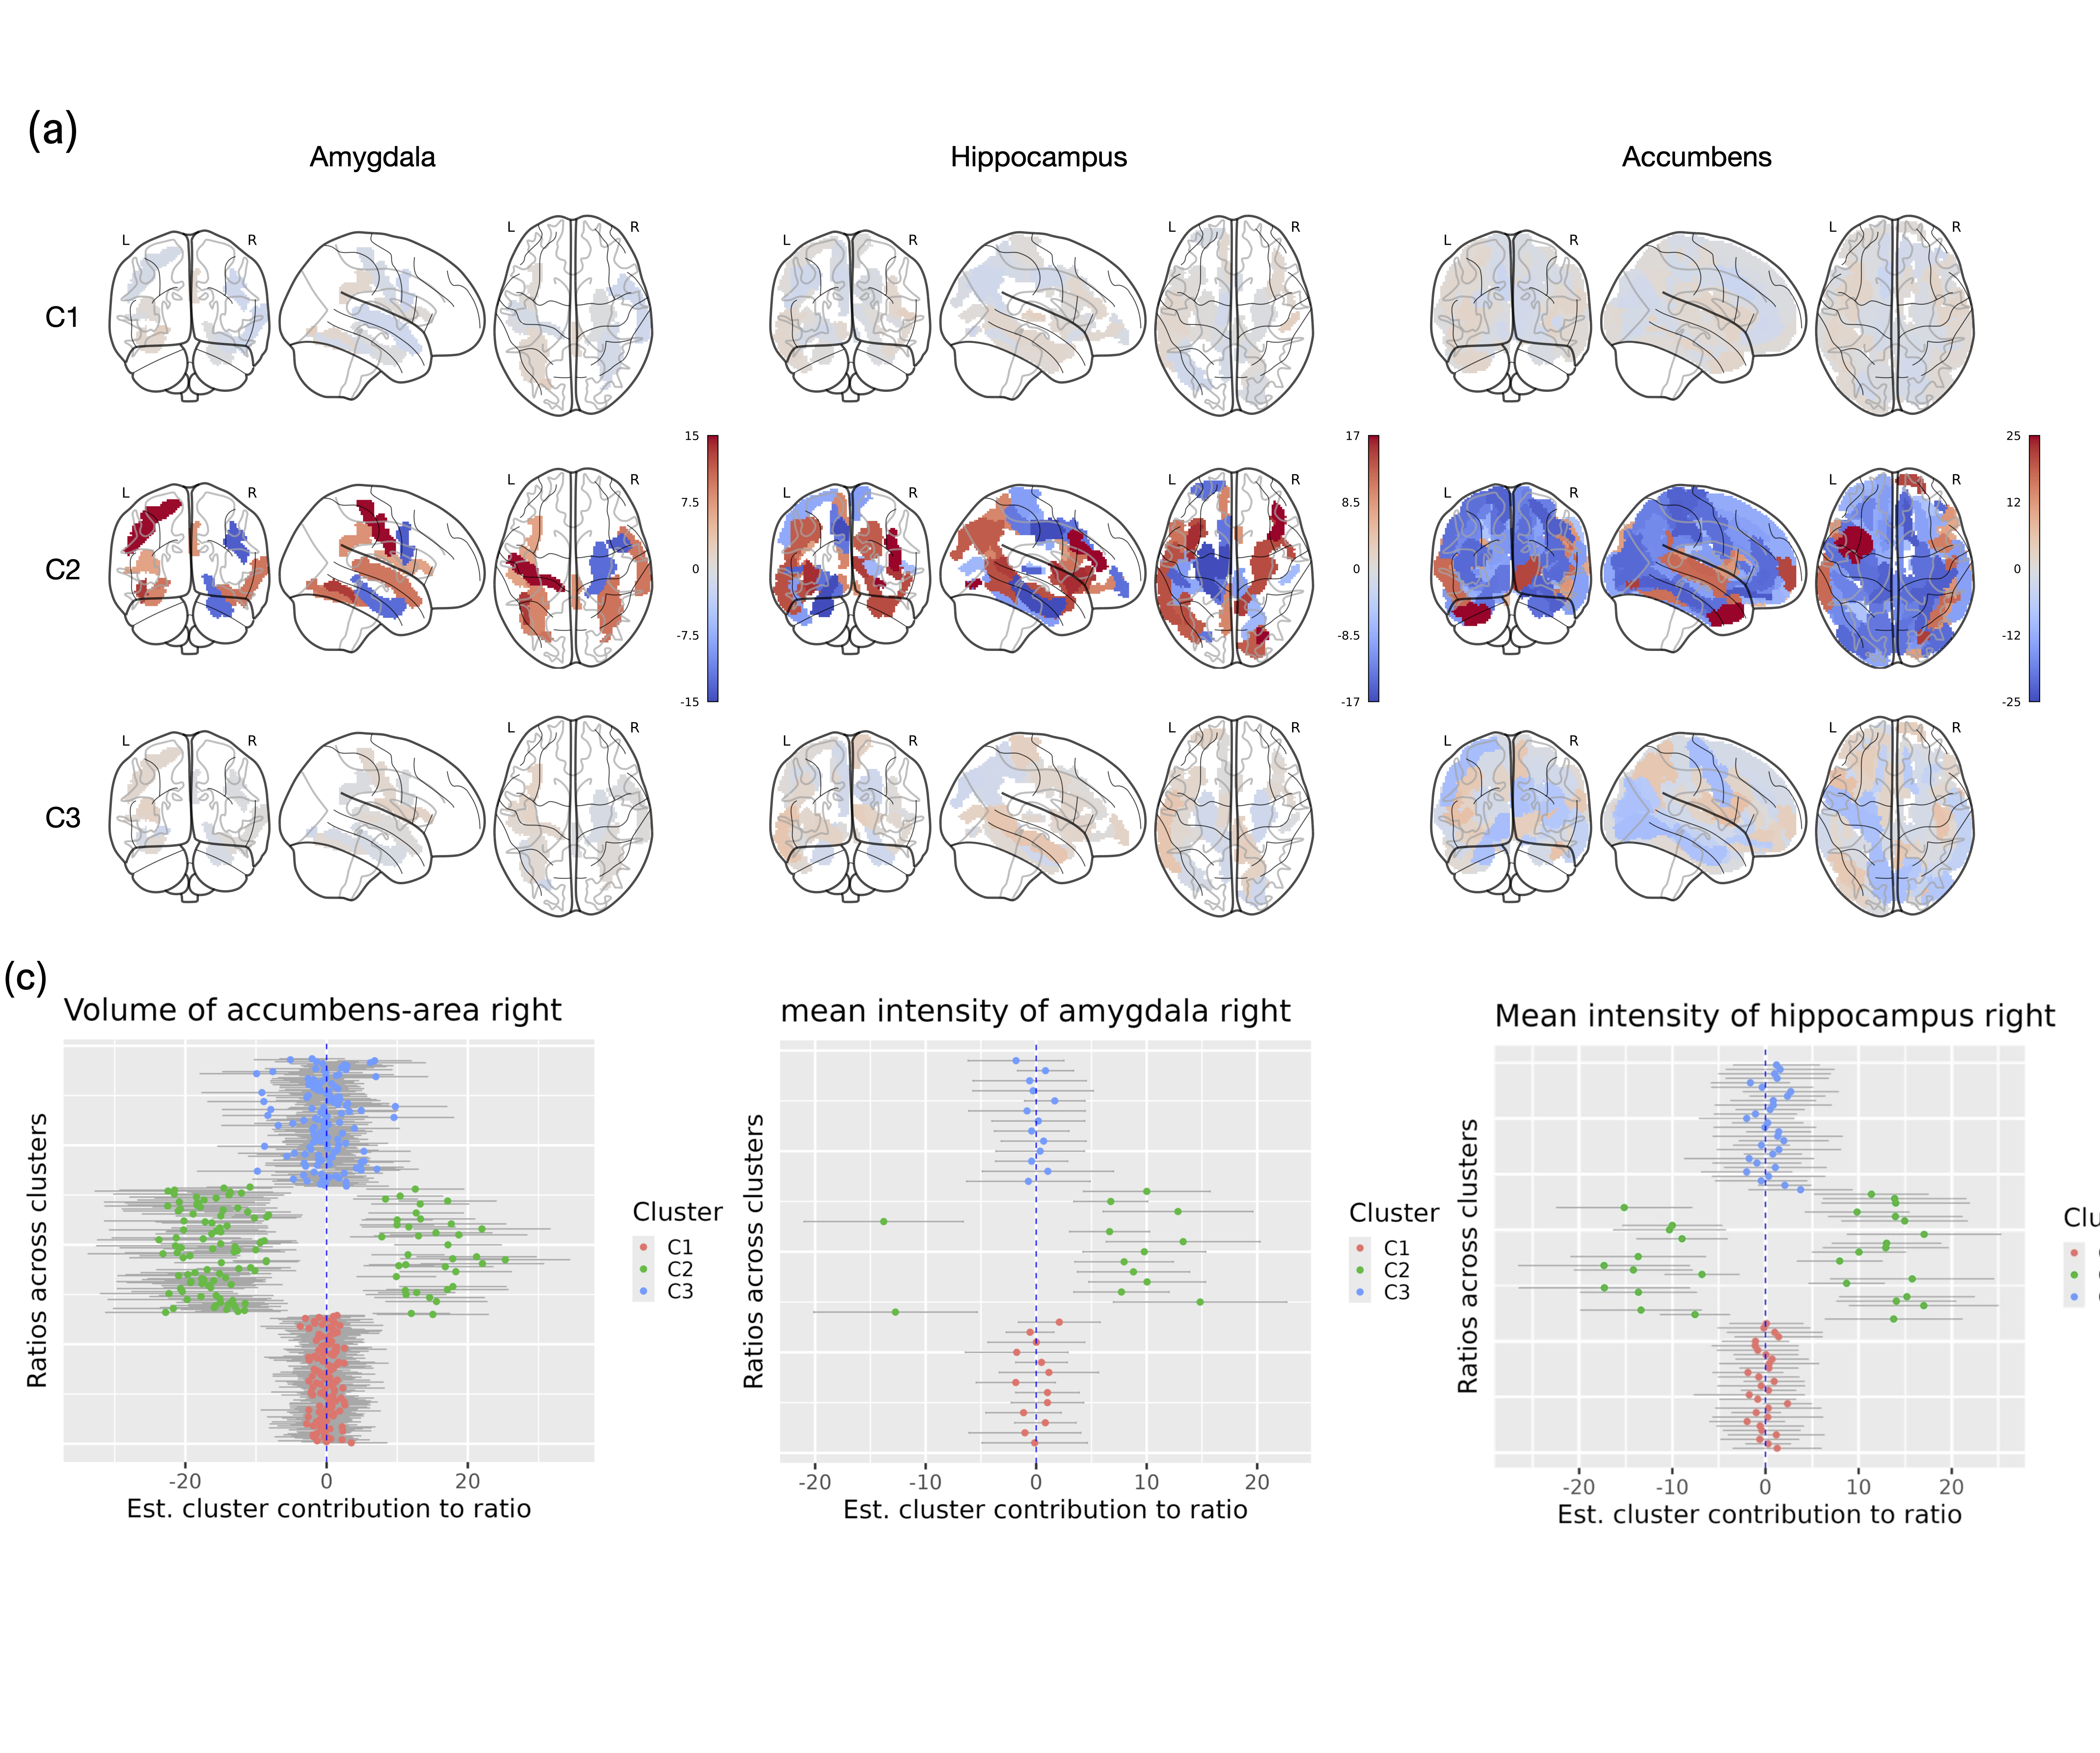
Imaging Findings
C2 shows reduced T2* in hippocampus & accumbens
Suggests inflammatory/metabolic impact on reward & emotion circuits
Imaging effects are modest but directionally consistent

Slide 12
Predicting Subtypes from Blood (Translational angle)
Nested random forest using top 20 proteins
Performance (AUC):
~0.83 (discovery)
~0.81 (replication)
Key markers (predictors): BCL2L1, MANF, CRKL, IRAK4

Slide 13
Big Picture Takeaways
MDD is not one disease – at least consists of 3 biologically distinct subtypes
Immune, metabolic, and mitochondrial axes are central
Blood-based stratification enables precision psychiatry
Implications for trials, drug targeting, and patient selection

