Slide 1
GRACE - The Gravity Recovery and Climate Experiment
The GRACE mission - National Aeronautics and Space Administration (NASA) and Deutsche Forschungsanstalt für Luft und Raumfahrt (DLR)
GRACE data
Gravity variations studied by GRACE

Slide 2

Terrestrial Water Storage and GRACE
Methodology:
Signal decomposition – time series
Xlong – long-term component
Xlin – linear trends
Xinter – inter-annual variability
Xseas – seasonal cycle
Xsub – subseasonal residuals

Slide 3
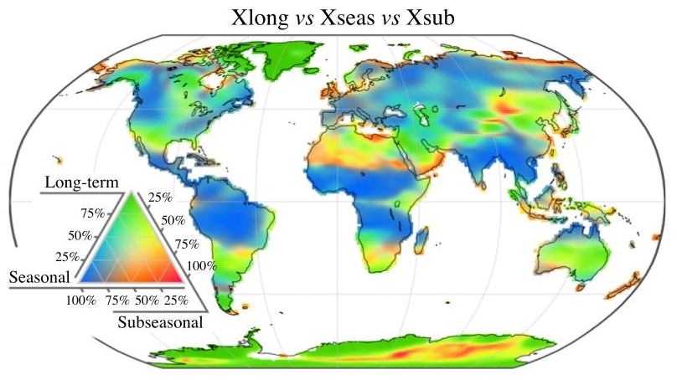
Terrestrial Water Storage and GRACE

Slide 4
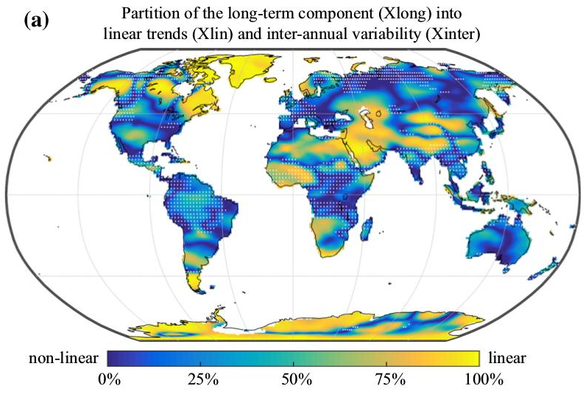
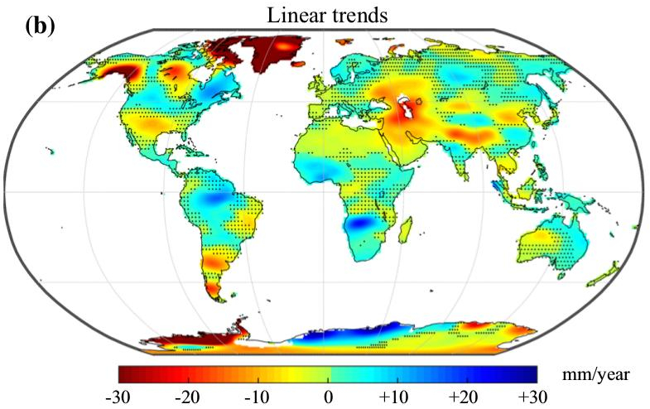
Terrestrial Water Storage and GRACE
Linear trends

Slide 5
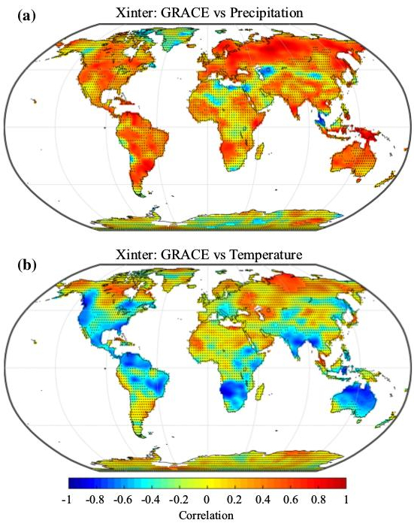
Terrestrial Water Storage and GRACE
Inter-annual anomalies

Slide 6
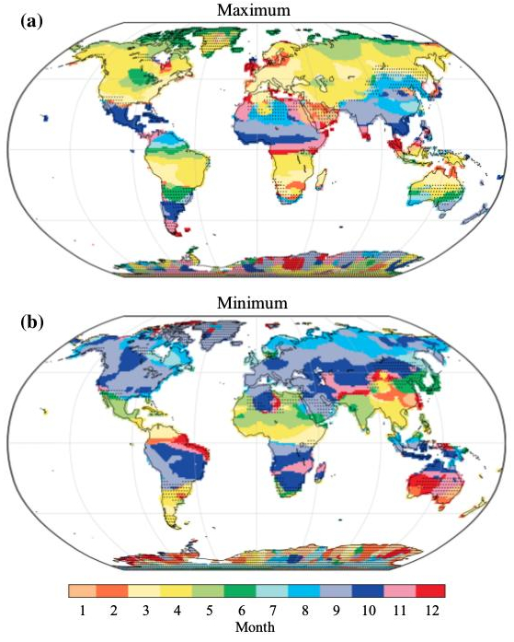
Terrestrial Water Storage and GRACE
Seasonal cycle

Slide 7
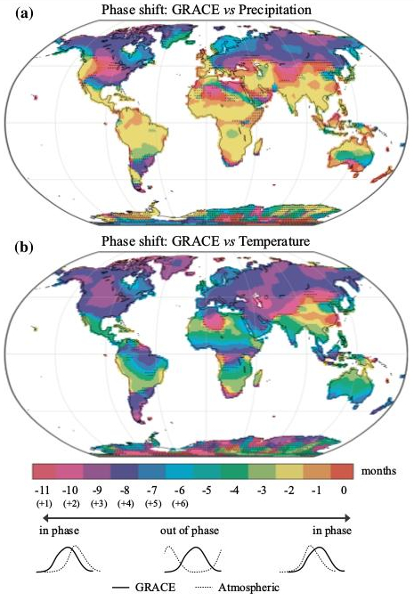
Terrestrial Water Storage and GRACE
Seasonal cycle

Slide 8
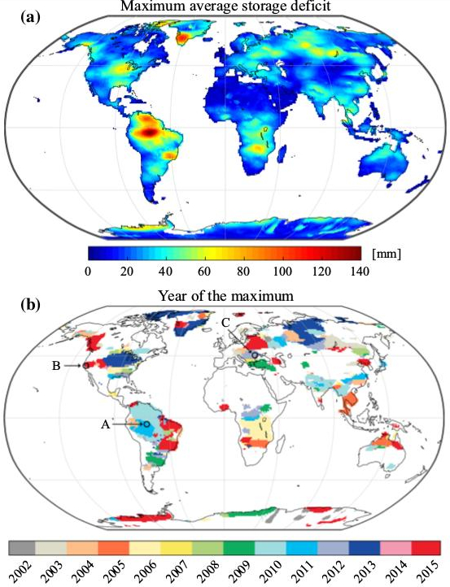
Droughts

