Slide 1
Cruise Ship Data
From data.world

Slide 2
Data
Source: BranDON TELLE (data.world)
Zip: bradon-telle-cruise-ship-locations.zip 39Meg
Files: output_daily_ship_locations.csv 72Meg (shape 503207, 15)
output_cities.csv 56k (shape 518, 7)
output_ships.csv 51k (shape 276,16)
Range: 2003 to JUn-2017

Slide 3
Ships LOCATIONS cities (any null data)
name 0 (PK)
callsign 0
wiki 9
imo 46
mmsi 49
cruise_line 36
major_cruise_line 0
year_built 55
class 127
gross_tonnage 38
decks 110
capacity 66
length 93
vessel_type 46 next
flag 47
home_port 85
ship_name 3130 (PK)
callsign 0
major_cruise_line 3130
date 0
meters_traveled 0
lat_start 0
lon_start 0
lat_end 0 (LBL)
lon_end 0 (LBL)
in_port 0
stopped_minutes 0
num_periods 0 (wave?)
port_city_id 1228 (FK)
port_city_name 1228
port_city_country 1823
id 2 (PK)
city 0
country 4
country_code 4
lat 2
lon 2
location 2

Slide 4
Vessels
Passenger 1.9k
Passengers ship 35K
Icebreaker drop
Research drop
Ro DROP Roll On-Roll Off. A ferry type vessel TYP. RAMP
NULL drop

Slide 5
ALL Vessels Limit Vessels
ALL Vessels 160meg checkpoint.csv (358K entries)
PASS. VESSELS 140MEG checkpoint.CSV (142K ENTRIES w/dropNA)

Slide 6
Models and partition/feature start
Quick and dirty, selected GradientBoostingRegression
Need two models, one for Lat, one for lon
One train_test_split can split for both models
Also kfold with cross_val_score
features = ['date','meters_traveled','lat_start','lon_start','in_port','stopped_minutes','num_periods','year_built', 'gross_tonnage', 'decks', 'capacity', 'length’ ]
## not DATE, multiple dates do not lend to single DB

Slide 7
NEXT EDA
Only remove NULLS necessary for the model
Is there leakage
More ways to visualize, I want to walk through the data visually

Slide 8
Further Questions (see tableau next)
# a) travel lifespan -- think early, middle, recent (tracking and/or distribution)
# b) rank different carriers
# c) predict congestion (at ports)
# d) predict density distribution
# e) predict increased traffic trend ## any hypothesis 2018
# F) Drill into “OTHER” represented as INDEPENDENTS

Slide 9
https://public.tableau.com/profile/fred.gras#!/vizhome/cruise-ShipStoppedTime/ShipStoppedTime
(limited to only Jan 2017 data)

Slide 10
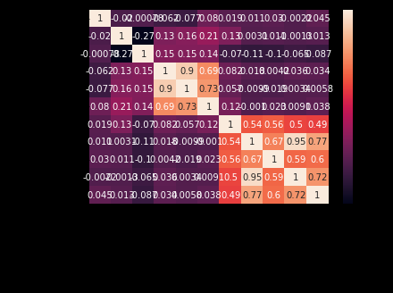

Slide 11
S3::/cruise-dir
Now contains files to serve as SQL (learn this)
like Intro_to_SQL Bootcamp did theirs
What about capability to run app-like generated quarries from browser

Slide 12
MODEL AND predict
Questions:
What is ship’s avG. performance
Is it highly or under utilized?
What is ship’s longevity? (come and go or missing data)
What is density of ships/travelers? (where, when, why)
What is 2017 travel prediction? (trend)
Can another source augment this DATA? (stock, travel cost, diesel)

