Slide 1
Voice Dev: Amazon v. Google
Vern Hockney, LAUT AG SDC 2019
Notes:
Today we will explore:
What, generally, is voice
Why would we develop for voice v. why would a customer use voice
How do customers interact with a voice device and what types of devices are available
Then the good, nerdy stuff
And if there is time, a discussion on architecture considerations with an example
But first, what are you going to do with all the money you make with your voice apps. Since we live on the Bodensee, there is really only one options ...
[ Slide Change ]

Slide 2

Notes:
But seriously, let’s go back to the beginning, to the man who is essentially responsible for what we are talking about today …

Slide 3
The computer programmer is a creator of universes for which he alone is the lawgiver. No playwright, no stage director, no emperor, however powerful, has ever exercised such absolute authority to arrange a stage or field of battle and to command such unswervingly dutiful actors or troops.
- Joseph Weizenbaum – Creator of ELIZA
Notes:
This is a quote from the man who developed what is generally considered the first ‘chatbot’, named ELIZA, and set us on the journey to voice.
[ Read Aloud ]
My bachelors degree is in philosophy, and the question of who is responsible for technical programs is interesting to me.
Joe seems to answer this question by implicating the developer.
So let’s look at Eliza … [ Slide Change ]

Slide 4
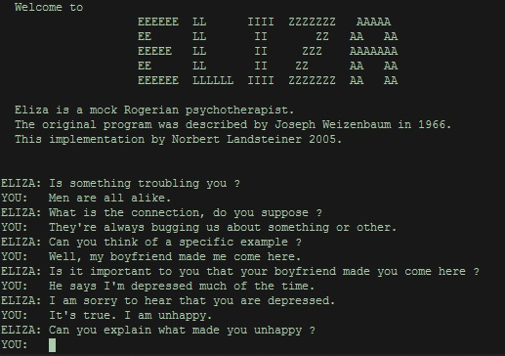
Notes:
Pretty Impressive!
ELIZA essentially parroted back what the user said similar to a bad movie psychiatrist. But some people developed quite close associations with the machine and divulged very personal information to it.
Enough History, Voice is great, right. Nothing ever goes wrong, We should probably use it for everything we possibly can, right? [ Slide Change ]

Slide 5
Notes:
[ Wait to End ]
Yup. Nothing will ever go wrong.
So Why would we use Voice?
[ Slide Change ]

Slide 6
What is Voice
Another channel for obtaining information and completing tasks
Alternative (not replacement) way of interacting with an app
Notes:
Think of when phones first began to do more than just make phone calls and before the advent of mobile first design. At this point, voice is in a similar state.
[ Read Bullets ]
So why would we use it as consumers and as developers.
[ Slide Change ]

Slide 7
Why Voice
Hands (possibly eye free) task completion
Non-mentally intensive tasks
Private/Semiprivate environment
More personal feel?
Notes:
As developers, we need to keep these WHYS in mind when we are developing an application for voice.
So How will customers interact with our voice application or a voice device in general. Luckily I have found a 100% real life example from our office.
[ Slide Change ]

Slide 8
Notes:
100% Real
But seriously, how will people interact.
[ Slide Change ]

Slide 9


Consumer Interaction Expectations
Notes:
Mode 1: Conversational
Mode 2: Commands
Context Dependent, app dependent, customer dependent, mood dependent, cultural dependency, age dependent.
So what types of devices are available
[ Slide Change ]

Slide 10
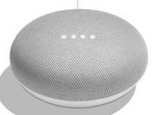
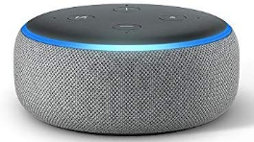
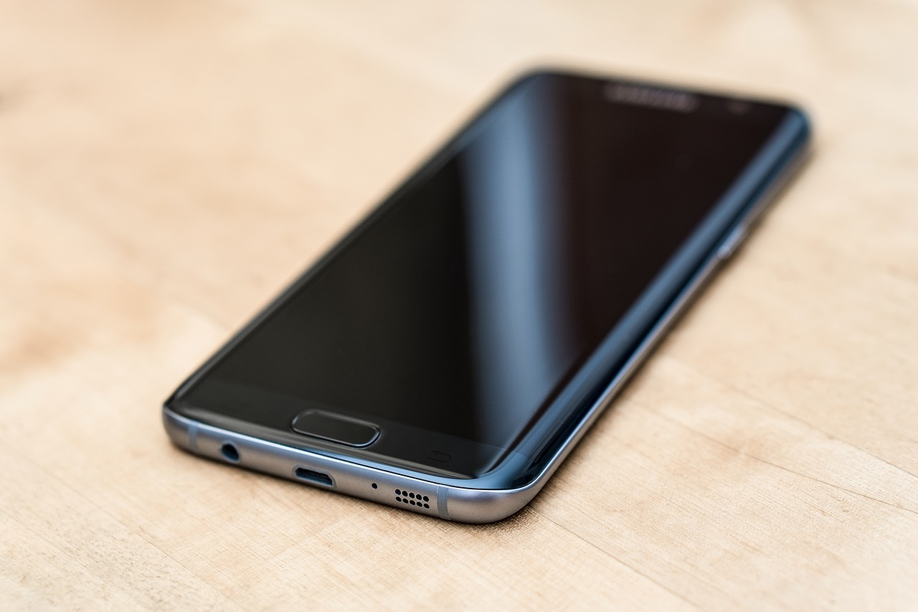
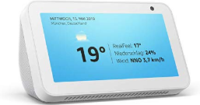
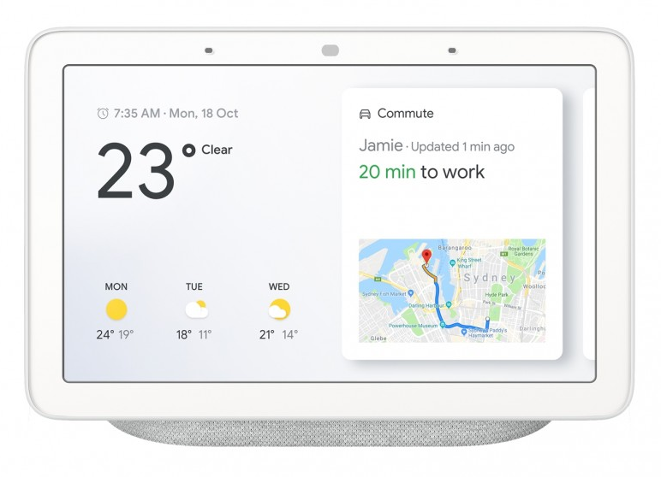
Devices
Notes:
[ Talk about devices ]
Now on to the nerdy stuff. Starting with a quick discussion about security.
[ Slide Change ]

Slide 11
Security
Benefits and dangers of GDRP
Amazon and Google Retaining Data/Transcripts
New attack surface (user danger)
ALWAYS ON!

Slide 12
Consumer Level Differences
Google
Amazon
Natural invocation
Benefits from other services
All in one assistant (trigger apps, redirect to web)
Native on (all) Android phones
Device Handoff
Conversation Driven
Formalized invocations
Purchase oriented (?)
Skill based functionality (stays contained)
Can integrate with phones
Action Driven

Slide 13
Languages Available
Google
  Java and javascript Liberaries
Amazon
  Java, javascript, python Liberaries
  Javascript is missing some functionality (like verification)

Slide 14
Hosting
Google
  Firebase or Self-hosting
  Not many docs to help with self-hosting
Amazon
  AWS Lambda or Self-hosting
  Docs for self-hosting are less than stellar
  Requires an (Amazon) valid SSL cert
Must Validate Requests!

Slide 15
Skill Management
Google
  ‘gactions’ CLI
  GUI web console
Amazon
  ASKCLI
  SMAPI
  GUI web console

Slide 16
NLP/AI
Google
  3rd party integrations possible (dialogflow)
  Self-management through SDK
  Ability to Train through dialogflow
Amazon
  Proprietary
  No easy integrations with 3rd party NLPs

Slide 17
Data Storage
Google
  Data passed through session, context
  Persistent User Storage
Amazon
  Session storage
  Persistent User ID, but must manage data in own database

Slide 18
Documentation
Google
  Prose Documentation
  Developer Documentation
  Lots of examples
Amazon (DON’T)
  Verbose with long explanations
  Some technical docs, but well hidden
  Not many examples

Slide 19
Both
Can complete transactions (sell items)
Offer account linking
Support multimodal design
Offer Beta Testing (Google also offers Alpha Testing without validation)
Notes:
[ After Text ]
So now that you know what the differences are between the two technologies, what are the major design and architectural decisions to make when creating an app.
[ Slide Change ]

Slide 20
Design Principles
Design for lowest order device first (voice only)
Higher order devices offer additional/augmented features
  Shorter text, visual elements
Design for conversation
Handle errors gracefully
Cater to returning users when you can
Notes:
[ After Text ]
Now for some overarching architectural considerations for structuring the app
[ Slide Change ]

Slide 21
Architectural Considerations
Don’t duplicate your website/software
Go for low hanging fruit
Develop for both at the same time
Separate out as much business logic as possible from the apps
  If you have to do it in one app, you probably have to do it in the other too.
Get used to an uncomfortable development environment
Notes:
[ After Text ]
So how does it feel to develop a voice app? I can’t explain the indescribable feeling of finishing an app and knowing it works, so let me show you.
[ Slide Change ]

Slide 23
To Boldly Go
Current state of voice applications
Is there a need for voice at all?
Is there a market for (good) voice apps?
Where I see the future of voice

Slide 24
Articles on Voice
Voice for Alzheimer’s Patients
The First ‘Voice’ App
How Do Children See Voice Assistants
Alexa Always on Hack from 2018
Masquerading Attacks
Someone Else Receiving Your Transcripts
Actions Being Arbitrarily Invoked

Slide 25
Resources
ELIZA on the Web (interactive)
Amazon Developer Console
Amazon Documentation
Amazon Tech Documentation
Amazon Alexa Github
Google Developer Console
Google Actions Documentation
Google Central Reference for Actions (tech docs entry point)
Slides and Codes for this talk on Github:
fvhockney/sdc2019

Slide 26
Credits
Devices Images – screen grabs from web
Eliza – Wikipedia
Cat Meme – screen grab from knowyourmemes
Videos – Youtube
Rest – Pixabay

