Slide 1
From ddd to DDD
data-driven development
Domain-driven Design
An on-going journey
Thibaud Desodt - @tsimbalar
Notes:
Add some kind of climbing the mountain images ?

Slide 2

What this is about
Me, myself and I
Code
Architecture
Learning process
Notes:
It’s about me …
My experience
The steps in my learning process
But it can be useful for you ☺
Learn from my mistakes ☺
A bit about code, a bit about architecture, mostly about the learning process

Slide 3


Where it all started
Notes:
Graduated
OO Java
Learnt a bit about Design Patterns
Not much about real software engineering
Internship on the MS stack

Slide 4
PRESENTATION
E-commerce site
ASP.NET / C#
Back-office site
“classic” ASP / VbScript
BUSINESS LOGIC
Stored Procedures
T-SQL
Data
Tables
DATA
Notes:
End of study internship
E-commerce web apps / web agency … I was employee n°3 :P
Frontend / backend + shared db
Frontend = ASP.NET 1.1 / WebForms
Backoffice = ASP classic with VbScript
SQL Server db
“We use Stored Procedures because it’s more efficient”
I’ll skip over the (lack of) proper engineering practices (SourceSafe, shared db for developments, no CI … )
The process :
Design most of the relational model up front (but very inspired / copy-pasted from previous e-commerce projects)
Update it sometimes when needed
Create (lots of) stored procedures for every possible action
It works ok
You work mostly alone
You can fit everything in your head
It’s the initial version and everything is fresh in your head
It’s hard :
Adding new stuff in db model : translations
T-SQL :-/
Automated tests !
Most tables:
Make sense only to admin (catalogue / category administrations)
Make sense only to web site (cart, user info)
Have a mixture of both … (article with flag “published” etc)
Patterns/anti patterns :
- Database integration
You tend to over-engineer things / find workaround to avoid changing things because changing is hard … and there are no automated tests :-/
TODO : a db model with lots of tables ?

Slide 5
And it was …
Not super pleasant
VbScript
T-SQL
Fragile
No automated tests
Tight coupling
Schema -> Stored Procs -> Website / admin site

Slide 6

… but it worked “well enough”!
Customer value
Happy customer
Fast delivery of features
Reasonable perf
Easy to work on
1 feature ≈ 1 stored procedure

Slide 7
... in that context
Working alone on project
Version 1 of the product
Well-defined requirements
Tight interactions with customer
Simple domain
= ideal greenfield project

Slide 8
A few years later …
Similar approach, different context

Slide 9
B2B SOAP services
Customer-facing web apps
Internal Catalogue app
That excel sheet nobody understands
3000+ Stored Procedures
T-SQL
Data
800+ Tables
Quotation app
Admin CRUD app
This scripts that runs every night
Reporting App
Bob running random SQL queries
Notes:
Years later , other company
“the shared database”
One single database + replicated copies in several places. (actually, another db “metadatabase” with info about the database … version schema etc)
+ tools to actually manage the db
The source of truth, shared between app.
The database committee: change requestes are analyzed and accepted or rejected monthly …
Dev Db Version > Prod version …. Synchronization for deployments
It totally sucks !
Db changes requested by Business Analysts

Slide 10
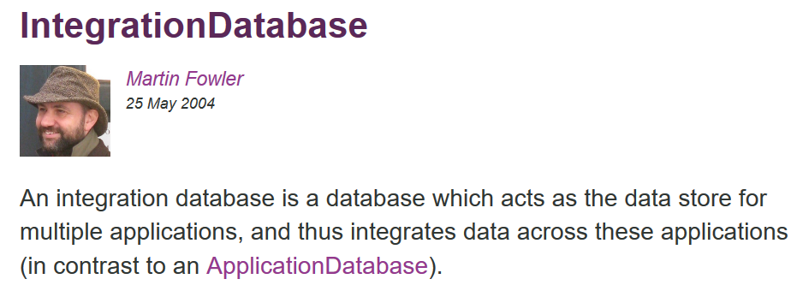
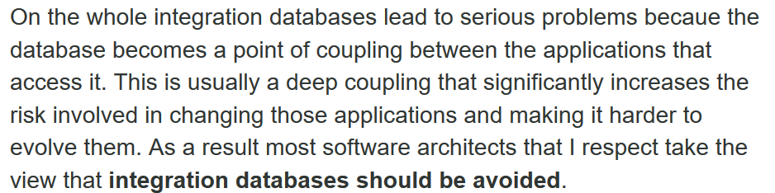
(…)

Slide 11
A different context
60+ developers spread across the globe
Many different systems accessing the database
Db replications
Team of 20 DBAs
The “database” committee
The “database” change process
The “meta-database”
All that stuff …
… to solve technical problems
… introduced by technical people
… with no value

Slide 12
Many issues
Evolution is impossible / hard
Testing is hard
Versioning / collaboration is hard
Performance is meh

Slide 13
“the” solution ….
Team of 20 DBAs
The “database” committee
The “database” change process
The “meta-database”
Technical solutions
… to solve technical issues
… introduced by bad technical decisions
… with no value to the users
= Accidental complexity

Slide 14
Many issues
Database first … not impossible but :
Evolution can be hard
Testing is hard
T-SQL is not very nice
Versioning / collaboration
Lots of accidental complexity when adding cross-cutting concerns

Slide 15
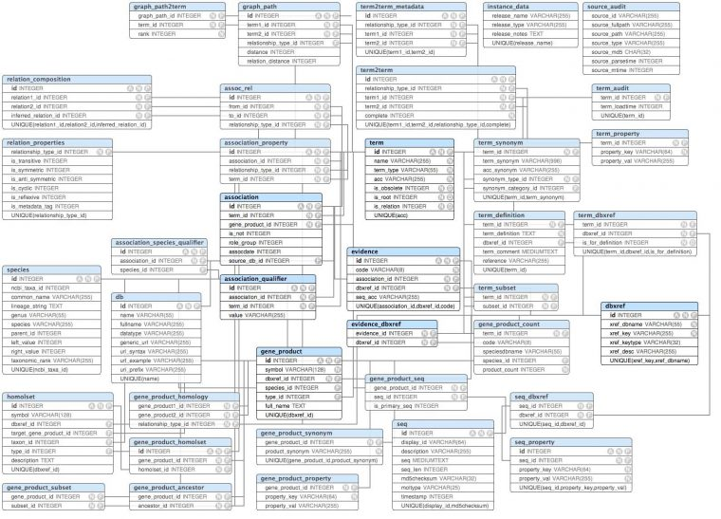
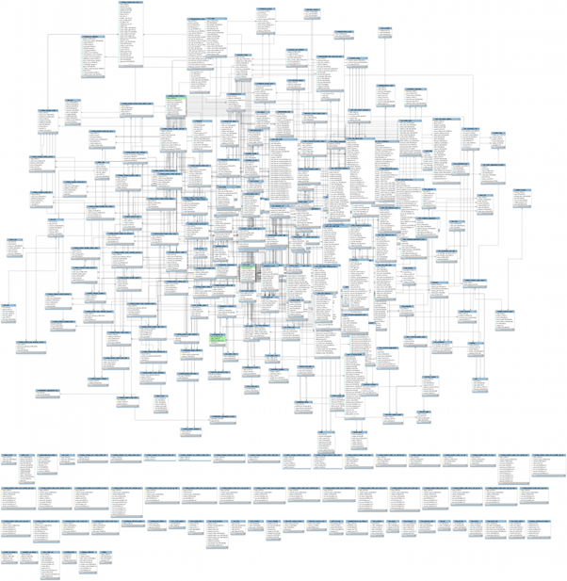
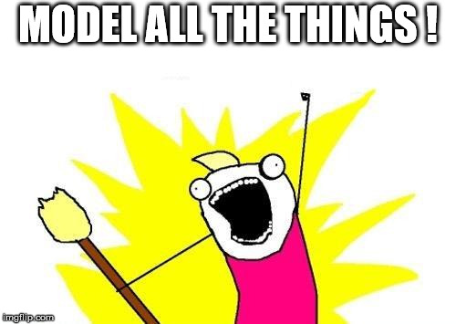
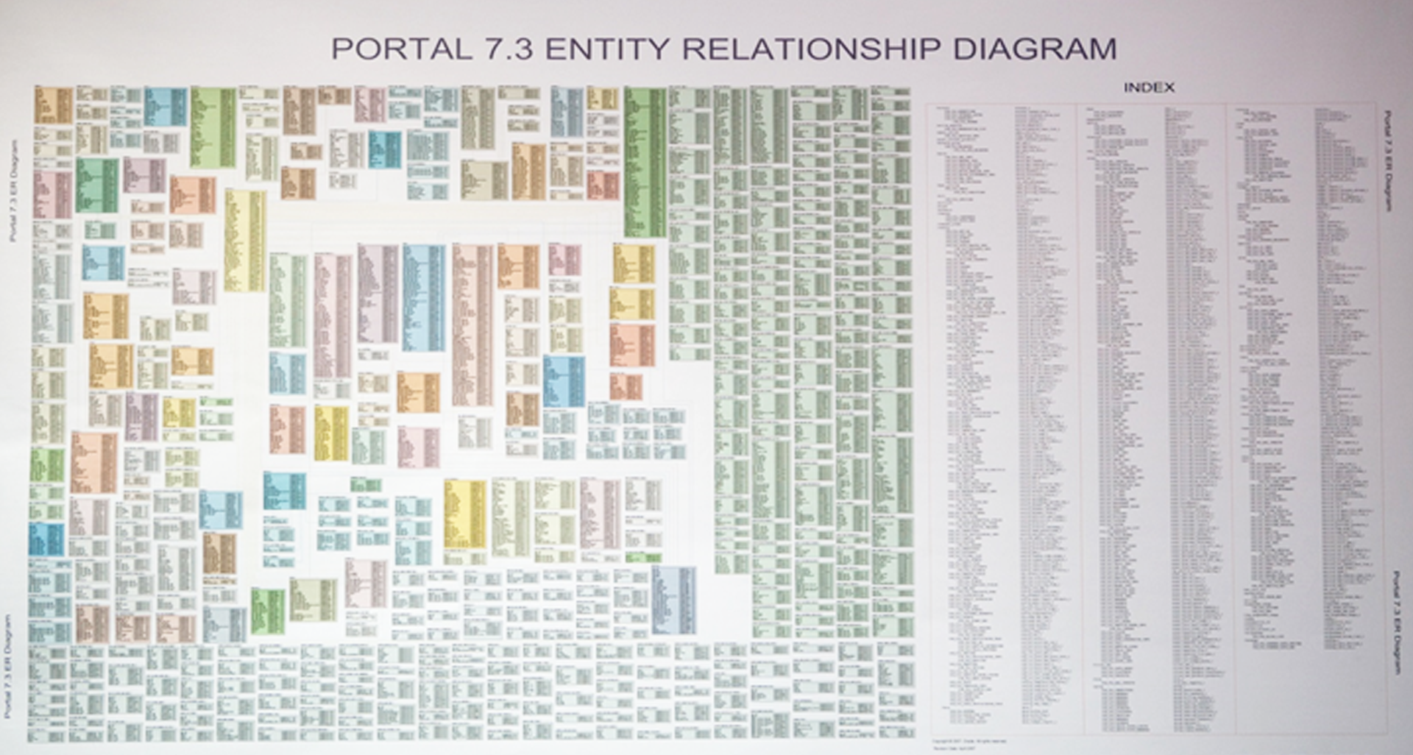

Slide 16
Strategies : table clusters
Isolate tables and define which ones belong to you
Convention to ignore some fields
Cut the dependency graph
It can be hard in a “normalized” database
Notes:
Deliberate effort / need to communicate it to other team members

Slide 17
From db-first to model-first
Get the logic out of the database
We want automated testing
We want expressive code

Slide 18
ORM
Entity Framework
Generate DbContext / DbSets from the Db
“Entities” are pretty much DTOs / mapping from table (actually they are generated !) + annotations ...
Logic in the code (yay) …
… in the controllers U_U
Hard coded Entity Framework
Lazy-loading : terrible perf
In controllers …. Like the demo code from MSDN ☺
Notes:
Other company … what I found when I arrived there
MVC app
Property containers

Slide 19
“clean separation”
“services” ~ application services
Repositories
POCO entities + mapping configuration + db schema generated from there
Request/Response
Those are really transaction script
It works ok, it’s straight forward
… but leads to lots of duplication (validation / re-validation just to be sure … )
All properties are get/set .. Need to be careful = Anemic Domain Model
Unit of Work
DI-friendly / test friendly
Struggling with object graphs that have cycles !
Notes:
Great for querying … the updates are meh

Slide 20
“Aggregates” + “Aggregate roots”
Object graphs are small on purpose and deliberately cut
One entry point for aggregate (aggregate root)
-> this works well for Write side .. Painful for queries (we want to express complex queries, with JOINs all over the place for views)

Slide 21
Splitting Reads and Writes
Projections for Reads
Entities for Writes
Still using the same underlying DbContext, but deliberately hiding things from the Write side
Repository vs Query services
Repository only have a few methods getById / getByCode / Add + use change-tracking + UnitOfWork for transaction …
QueryService are richer and return DTOs (no change tracking)
Actually even different instances of Db Context for Reads and Writes
Notes:
Can actually share the DbContext but split it in 2 interfaces …

Slide 22
Enforcing invariants
Entities vs Persistence model
Use EF tracking
… without EF constraints (getters/setters), empty constructor etc
Entity.FromState() … called from Repos
New Entity() (+param validation) called from AppServices
Repo.GetById() … entity.DoThis() … UnitOfWork.Save()
Easy to test for entities
Impossible state impossible to represent (or almost :p)
Logic is mostly in the Entities

Slide 23
Publishing notifications
Other downstream systems need information
Entity actions generates Domain Events (stored locally)
AppService publishes those events (RabbitMq) for external consumers

Slide 24
Conclusions
Context is king
Right tool for the right job

