Slide 1
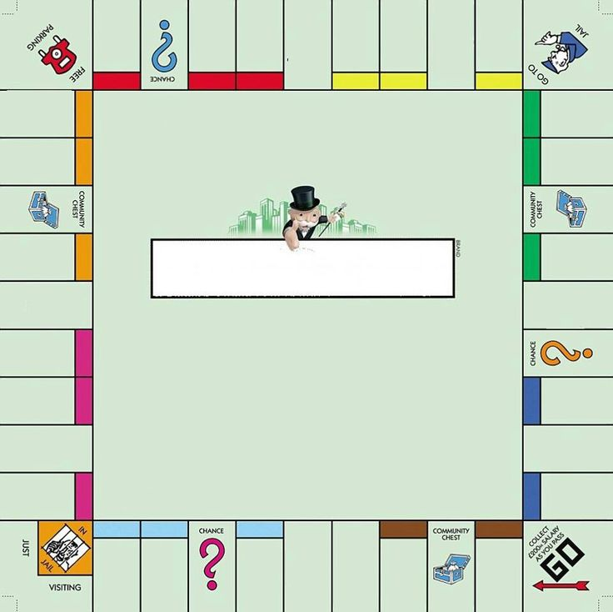





₩
₩
₩
₩
₩
₩
₩
₩
220
220
240
200
260
260
150
280
OMOA
AVENUE
SULA
AVENUE
SALVA VIDA
AVENUE
LA PAZ
AVENUE
VALLE DE
ANGELES
AVENUE
PICO
BONITO
AVENUE
CABAÑAS
RAILROAD
S.A.N.A.A
₩
₩
ATLANTIDA
AVENUE
UTILA
AVENUE
300
200
PICACHO
AVENUE
GUANAJA
AVENUE
₩
₩
300
180
FORESTA
AVENUE
MONOPOLY
₩
₩
ROATAN
AVENUE
320
180
₩
₩
MINING
RAILROAD
BANANA
RAILROAD
200
200
₩
JARDINES
AVENUE
160
MERENDON
AVENUE
CORTES
AVENUE
₩
₩
350
140
WAR
TAX
₩
₩
E.N.E.E
100
150
₩
₩
CLARION
AVENUE
LA CEIBA
AVENUE
400
140
SWINFORD
RAILROAD
INCOME
TAX
PANACAM
AVENUE
LANCETILLA
AVENUE
LA QUINTA
AVENUE
TRUJILLO
AVENUE
OLANCHITO
AVENUE
PAY
₩
₩
₩
₩
₩
₩
₩
120
100
100
200
200
60
60

Slide 2
Brown properties
OLANCHITO AVENUE
TRUJILLO AVENUE
Rent:
₩
2
Rent:
₩
4
Mortgage Value:
₩
30
Mortgage Value:
₩
30
Light blue properties
LA QUINTA AVENUE
LANCETILLA AVENUE
PANACAM AVENUE
Rent:
₩
6
Rent:
₩
6
Rent:
₩
8
Mortgage Value:
₩
50
Mortgage Value:
₩
50
Mortgage Value:
₩
60

Slide 3
Pink properties
CLARION AVENUE
MERENDON AVENUE
JARDINES AVENUE
Rent:
₩
10
Rent:
₩
10
Rent:
₩
12
Mortgage Value:
₩
70
Mortgage Value:
₩
70
Mortgage Value:
₩
80
Orange properties
FORESTA AVENUE
PICACHO AVENUE
ATLANTIDA AVENUE
Rent:
₩
14
Rent:
₩
14
Rent:
₩
16
Mortgage Value:
₩
90
Mortgage Value:
₩
90
Mortgage Value:
₩
100

Slide 4
Red properties
OMOA AVENUE
SULA AVENUE
SALVA VIDA AVENUE
Rent:
₩
18
Rent:
₩
18
Rent:
₩
20
Mortgage Value:
₩
110
Mortgage Value:
₩
110
Mortgage Value:
₩
120
Yellow properties
LA PAZ AVENUE
V. ANGELES AVENUE
PICO BONITO AVENUE
Rent:
₩
22
Rent:
₩
22
Rent:
₩
24
Mortgage Value:
₩
130
Mortgage Value:
₩
130
Mortgage Value:
₩
140

Slide 5
Dark blue properties
CORTES AVENUE
LA CEIBA AVENUE
Rent:
₩
35
Rent:
₩
50
Mortgage Value:
₩
175
Mortgage Value:
₩
200
Green properties
UTILA AVENUE
GUANAJA AVENUE
ROATAN AVENUE
Rent:
₩
26
Rent:
₩
26
Rent:
₩
28
Mortgage Value:
₩
150
Mortgage Value:
₩
150
Mortgage Value:
₩
160

Slide 6
Services
E.N.E.E
S.A.N.A.A
1 utility : 4 times roll
1 utility : 4 times roll
2 utilities: 10 times roll
2 utilities: 10 times roll
Ferrocarriles
SWINFORD RAILROAD
MINING RAILROAD
CABAÑAS RAILROAD
Rent:
₩
25 x RR owned
Rent:
₩
25 x RR owned
Rent:
₩
25 x RR owned
Mortgage Value:
₩
100
Mortgage Value:
₩
100
Mortgage Value:
₩
100
BANANA RAILROAD
Rent:
₩
25 x RR owned
Mortgage Value:
₩
100

