Slide 1
ACS as the Framework for Integrating Offline Data Reduction in ALMA
Steve Harrington, NRAO

Slide 2
What is a Task?
For our purposes, a task is:
  A concise process which starts up, performs some processing, and then shuts down
  It may or may not require additional services from the ALMA Common Software (ACS) framework
  It should be able to run, at least in a locally hosted manner, whether or not ACS services are present
  It requires input data in the form of (a set of) parameters

Slide 3
What is a Parameter Set?
For our purposes, a Parameter Set is:
  A grouping of individual parameters which collectively are used as input to a particular task
  Individual parameters may be of various types, e.g. string, int, double, boolean, arrays of these simple types, etc.
  Parameters may have default values, constraints (e.g. max/min), list of (enumerated) valid values, associated help text, etc.

Slide 4
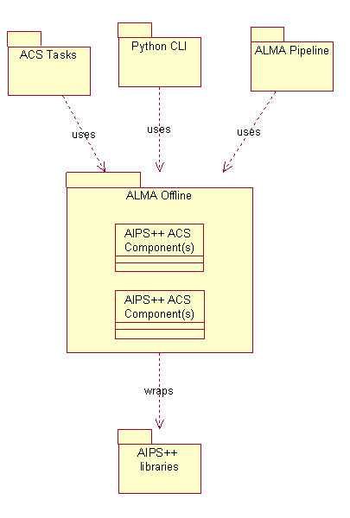
The big picture

Slide 5
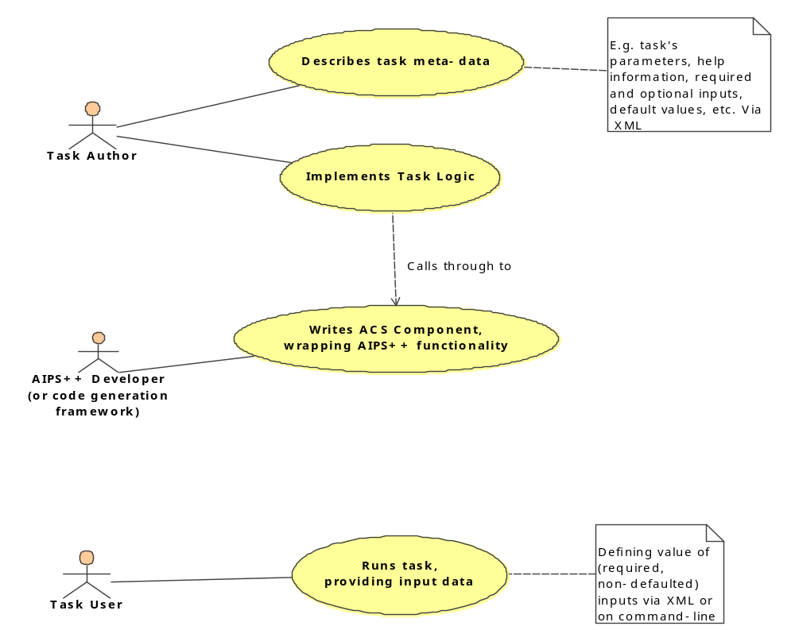
Task Use Cases

Slide 6
Task meta-data (XML) written by Task author
<psd:pset>
<!– XML header info omitted for brevity -->
<name>Simple Sample Task</name>
<comment>simple example of a task</comment>
<param xsi:type="psd:string">
<name>msname</name>
<required>true</required>
<prompt>e.g. myvladata.ms</prompt>
<help>name of output ms</help>
</param>
<param xsi:type="psd:double">
<name>centerfreq</name>
<required>true</required>
<prompt>e.g. 1.489 GHz</prompt>
<help>frequency of data to extract</help>
</param>
<param xsi:type="psd:int">
<name>iterations</name>
<required>false</required>
<prompt>short help goes here</prompt>
<help>verbose help goes here</help>
<default>10</default>
<max>12</max>
<validValues>
<value>10</value>
<value>11</value>
<value>12</value>
</validValues>
</param>
</psd:pset>

Slide 7
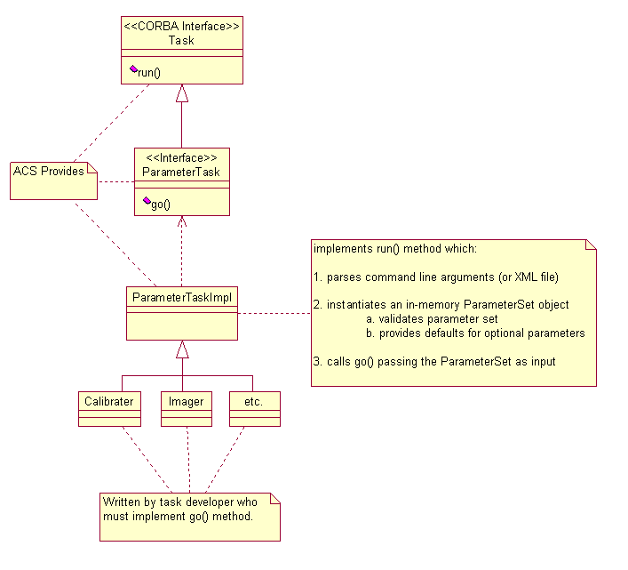
Task Implementation – who does what

Slide 8
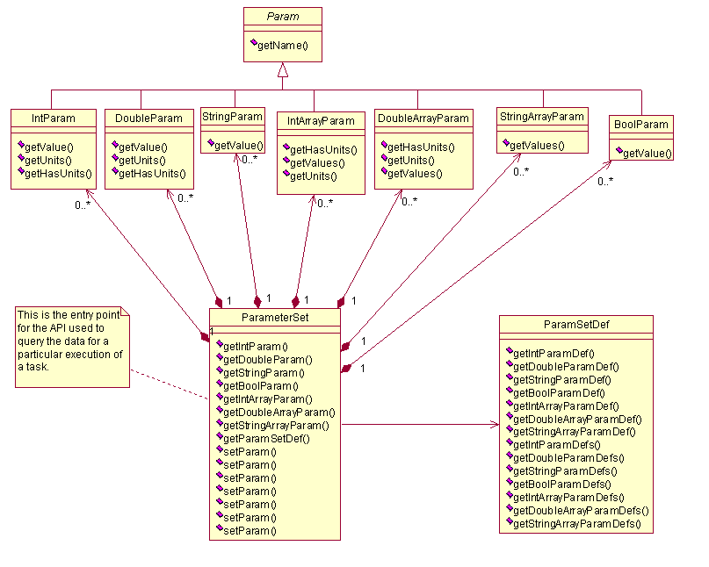
In-memory model of Parameter Set

Slide 9
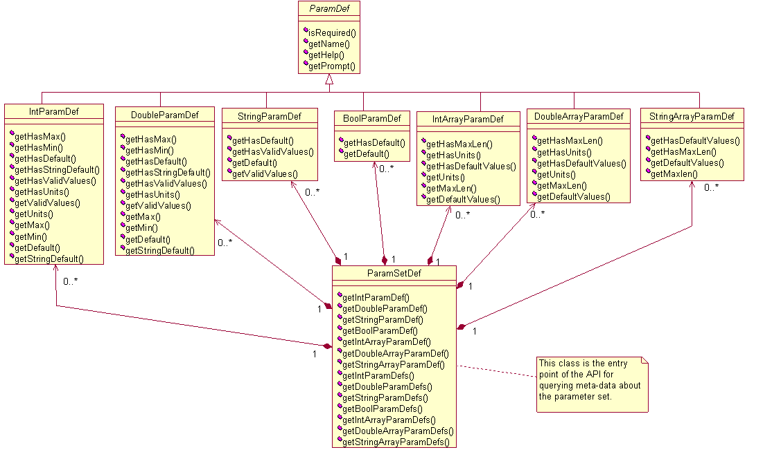
In-memory model of Parameter Set Definition (Meta-data)

Slide 10
Example of a Task’s go() implementation
void cleanImpl::go(ParameterSet& pset, TaskServices& taskServices)
{
// instantiate an AIPS++ imager component
ImagerComp comp;
// instantiate an AIPS++ record for the imager component’s parameters
Record aipsParamSet(comp.getParams());
// convert the ParameterSet passed to go() by ACS Task logic into an AIPS++ Record
// conversion involves querying ParameterSet and setting items in AIPS++ Record
convertPset(pset, aipsParamSet);
// set the AIPS++ imager component’s parameters with the AIPS++ record from above
comp.setParams(aipsParamSet);
// call the clean method on the AIPS++ imager component
comp.clean();
}

Slide 11
Running a Task
For the Task User, running a task involves:
  simply executing a command at the command prompt
Input Parameters:
  passed as name=value pairs on the command line, e.g.
  simpleTask iterations=10 msname=test intArray=1,2,3
  Can also be passed in via an XML file; command-line parameters are transformed into XML so XML is used in all cases

Slide 12
Running a Task – what happens?
Parameters from the command-line are parsed and converted into XML (unless XML is provided)
Two XML docs, one written in advance by Task Author (i.e. task meta-data), one created (or provided) at run-time (i.e. run-time values), are then validated against two corresponding XML schemas
If validation succeeds, go() method is invoked which does the Task’s work. Otherwise, an error describing the problem(s) is generated.

Slide 13
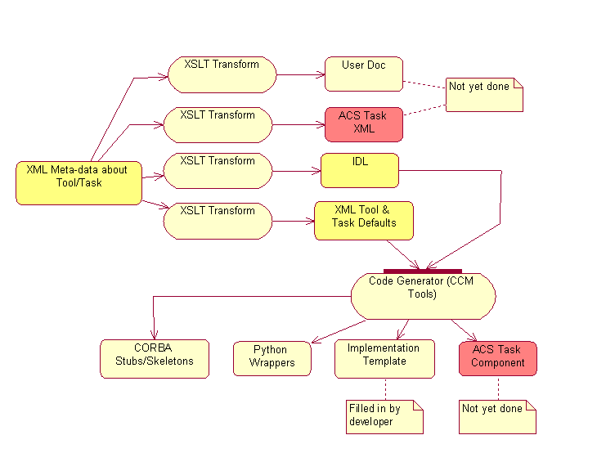
Offline team: future direction

Slide 14

Questions?

