Slide 1
The ALMA Common Software (ACS) as a basis for a distributed software development
G.Raffi, G.Chiozzi (ESO), B.Glendenning (NRAO) Follows ADASS 2000:
  ALMA Computing Challenges by B.Glendenning

Slide 2
ALMA Project in Summary
64 12-m antennas (25 microns, 0.6”)
Array configurations:150m-10 Km
Near S.Pedro de Atacama, Chile at 5000m
Imaging capability over 10-0.35mm range
10 receiver bands
compact array (several ~8m antennas)
very high resolution correlator

Slide 3
ALMA Project Set-up
Preliminary design - Phase 1, up to end 2001
Construction Phase - Phase 2, 2002-2010
  with interim operations starting at end of 2005
3 equal partners: Europe, Japan, North America
  with Europe and North America together since 1999
3 prototype antennas: ready Spring 02- Spring 03
  to be tested at VLA site for final selection
Cost 750 M$

Slide 4
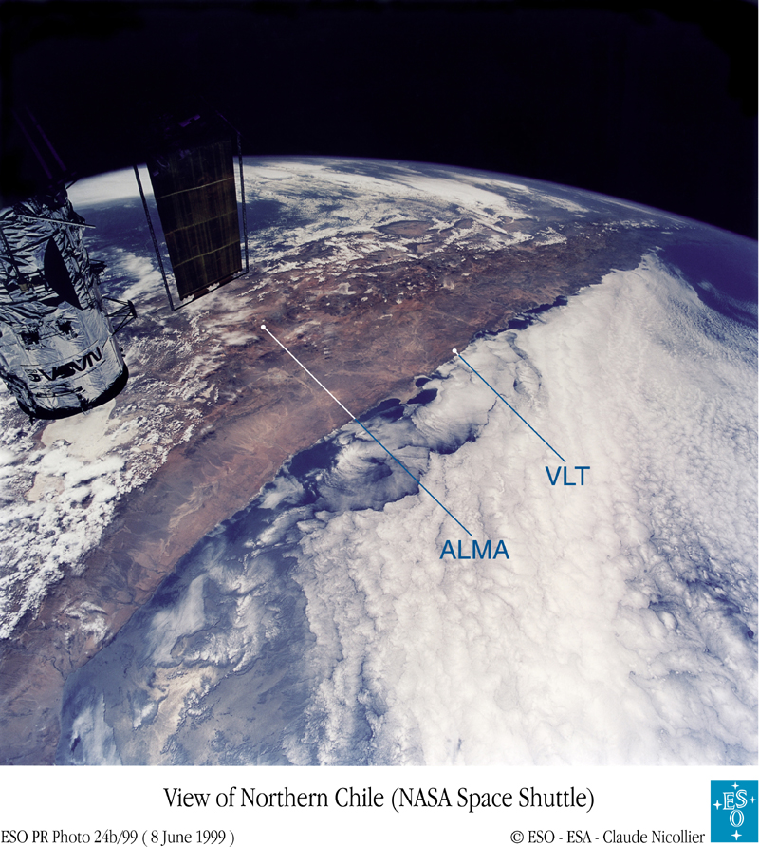

Slide 5
ALMA design phase
Top-down:
Science Software Requirements (SSR)
High-level analysis and design
Bottom-up:
Software for prototype antennas & test correlator
Common infrastructure:
ALMA Common Software (ACS)
Software engineering practices

Slide 6
ALMA Computing Subsystems
Control, Correlator (input: 96 Gb/s per antenna)
On-line Pipeline, Off-line Data Reduction, Telescope Calibration
Archiving (Data rate >10MB/s - 300 TB/year)
Observing Preparation, Scheduling
  Automatic operation, including images
  planned breakpoints to take decisions

Slide 7
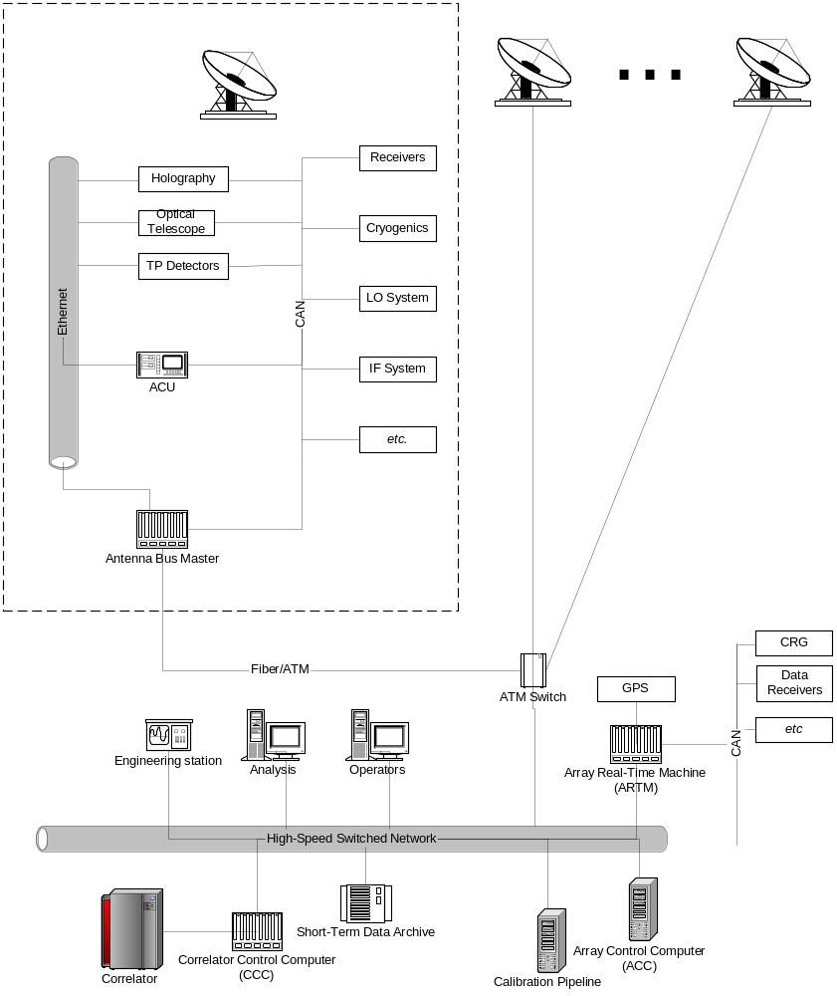
ALMA Computer architecture

Slide 8
ALMA Common Software (ACS)
  Common full framework, not only few libraries (for a very distributed group) (e.g. EPICS)
  Well tested software that avoids duplication
  Makes upgrades and maintenance reasonable
  Achieves incremental development via Releases
  Achieves standardisation offering environment with design patterns (rather than rules).
  Common configuration control/installation procedures
  It worked on a comparable size project: the VLT

Slide 9
ACS software status
Decided to start from existing product, to make use of CORBA experience
Collaboration with JSI-Ljubliana to further develop existing system built for High Energy Physics
Prototype Release 0 (tested on Kitt-Peak12 m antenna)
First Realease 1.0 (Sept.01)
  In use in Test Interferometer Software (TICS) prototype
  Being integrated with Test Correlator software

Slide 10
ACS Distributed Object (DO)
3 tier model: DO- Property-Characteristics
DO: base class for any physical/logical Device
  (e.g. temperature sensor, motor)
Each DO has Read only or R/W Properties
  (e.g. status value, position - control/monitor points)
Characteristics of Dos and Properties
  (Static data in Configuration DB, e.g. units, ranges, default values)
JavaBeans (client side- automatically from DO IDL)

Slide 11
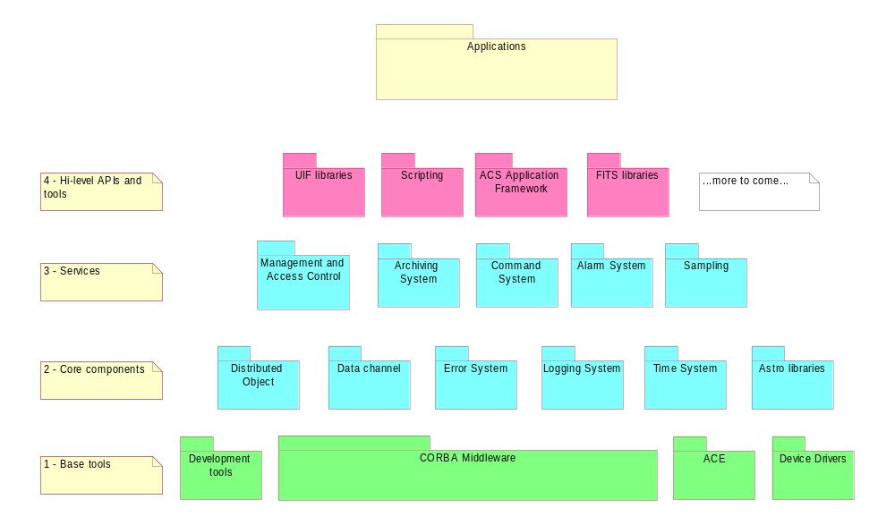
ACS Architecture

Slide 12
ACS platforms
CORBA middleware: TAO (& ACE), Orbacus
  Makes use of CORBA services
Operating system: Linux
Languages: C++, JAVA, Python (TCL)
Real-time: VME,VxWorks (Phase1), CAN bus
Unified Modeling Language (UML)
DB2 being evaluated as configuration DB
Communication: Gigabit Ethernet to antennas

Slide 13
ALMA software development
ACS incremental development via Releases every 6 months (Applications yearly)
Science software to be developed in two main phases (ready for 2006 and 2010)
Subsystems to be done by development teams at different sites
Implies sharp increase in level of effort

Slide 14
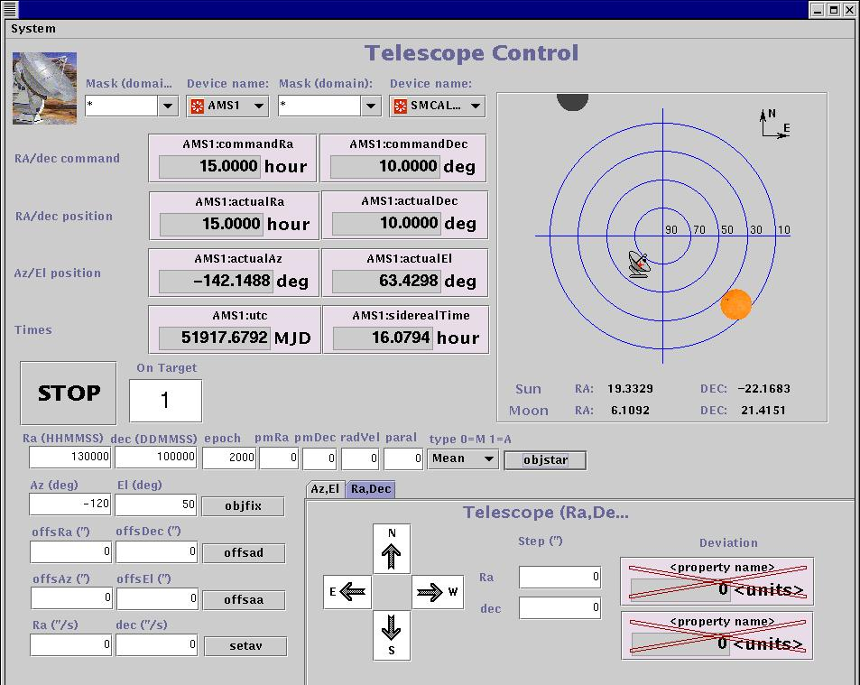
Kitt Peak test (Dec.00):
Pointing /tracking with 12 m Radio + optical tel.

Slide 15
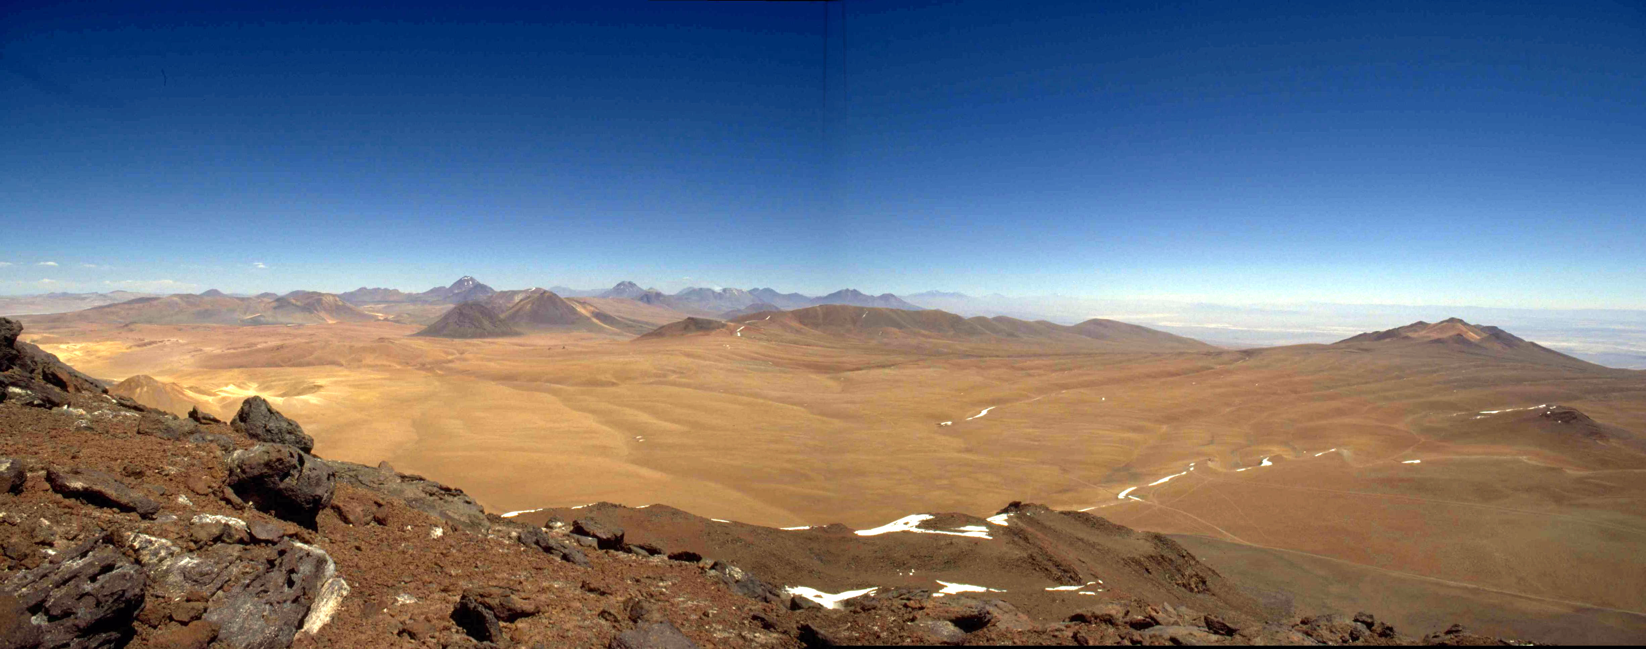
ALMA Sites: Chajnantor www.eso.org/projects/alma www.alma.nrao.edu/development/computing

