Slide 1
ACS
Common Software for the ALMA Project
G.Chiozzi, B.Gustafsson, B.Jeram, P.Sivera – ESO
M.Plesko, M.Sekiranja, G.Tkacik, J.Dovc, M.Kanduc, G.Milcinski, I.Verstovsek, K.Zagar - JSI
Notes:
You have already seen in the previous presentation (THAT 004, Distributed Control System for Test Interferometer of the ALMA Project) what the ALMA project is.
In this presentation we are going to describe the ALMA Common Software (ACS) that is under development as a set of common software component to be used for the development of any ALMA subsystem.
This work is responsibility of an international team mainly based at ESO and in tight collaboration with the JSI in Ljubljiana.
A part from the authors of the paper, we want to thank here the essential contributions to ACS from other members of the ALMA SW community.

Slide 2
Contents
Why a common software?
What are the key ideas in ACS?
What is the Architecture of ACS
How are we going to go on?
How can you get more information
Notes:
In the presentation we will try to explain:
Why did we decide that a Common Software was essential for the development of ALMA
How did we got to the current architecture
What this architecture actually is and which are the key component
How are we going to go on
We will finally provide some conclusions and pointers to resources to get more information on ACS and, more in general on the ALMA project.

Slide 3
ALMA Common Software (ACS)
  ALMA project is highly distributed:
  many sites and many “development cultures”
ACS aims at providing an answer to the following needs:
  common full framework, not only few libraries (for a very distributed group) (e.g. EPICS)
  well tested software that avoids duplication
  make upgrades and maintenance reasonable
  incremental development via Releases
  standardisation offering environment with design patterns (rather than rules).
  common configuration control/installation procedures
  It worked on a comparable size project: the VLT
Notes:
The ALMA project is characterized by the fact of being an highly distributed effort, with many sites and many “development cultures” involved. The Computing Group is scattered across 3 continent and many more institutes.
Early in the ALMA project it was decided that an ALMA Common Software (ACS) would be developed as a way to provide to all partners involved in the development a common software platform. The original assumption was that some key middleware like communication via CORBA and the use of XML and JAVA would be part of the project. It was intended from the beginning to develop this software in an incremental way based on releases, so that it would then evolve into an essential embedded part of all ALMA software applications. In this way we would build a basic unity and coherence into a system that will have been developed in a distributed fashion.
The ALMA Common Software (ACS) is a comprehensive framework on top of the operating system, offering a complete environment and structures at the base of application software developments. ACS is meant to be a general system, based on available middleware (CORBA) and the easy embedding of languages like Java and Python.
We believe that the use of a common software layer in a very geographically distributed development situation will be the best way to enforce the use of common constructs. ACS shall provide a well tested platform that embeds standard design patterns (much better than a set of written rules) and avoids duplication of effort. At the same time this will provide a platform where upgrades can be incorporated and brought to all developers. It will also standardize the underlying architecture of software modules, making maintenance affordable.
This approach worked very well for the VLT Project and the VLT Common Software has been presented already in the past editions of this conference.

Slide 4
ACS start-up: Summer 1999
Preliminary discussions on ACS objectives and structure:
  VLT experience
  New technology: CORBA
Decided to start from existing product, to make use of CORBA experience.
Collaboration with JSI-Ljubliana to further develop existing system built for High Energy Physics (ICALEPCS ‘99, Trieste).

Slide 5
ACS Architecture
Applications
4 - Hi-level APIs and
UIF libraries
Scripting
ACS Application
FITS libraries
...more to come...
tools
Framework
3 - Services
Management and
Archiving
Command
Alarm System
Sampling
Access Control
System
System
2 - Core components
Distributed
Data channel
Error System
Logging System
Time System
Astro libraries
Object
1 - Base tools
Development
CORBA Middleware
ACE
Device Drivers
tools
Notes:
This package diagram has been extracted from the ACS Architecture document and summarizes the status of ACS 1.0 with the respect to the foreseen final architecture.
Most of the components of ACS1.0 (blue continuous line) were already present as prototypes in ACS 0.0. In this release they have been cleaned up, improved and extended, based on the feedback coming from the Kitt Peak test and the first users. These components can be considered stable and, although some features are still missing, and should not be subject to major changes in the future.
The Application Framework package is only sketched. Many design patterns are implicit in the architecture of the DO and MACI components, but SimpleClient is the only development up to now. Being highly incomplete we have marked it with a dotted line.
Magenta color is used to mark the completely new components. They can be considered almost prototypes and feedback will be extremely useful.
The development of the Error System is mostly complete, but it has not been extensively used up to now. In the next months (for ACS 1.1), it will be used extensively inside ACS 1.0 basic packages themselves.
The data channel (essentially the CORBA Notification service) is used by logging. Support classes to make easier to use it need still to be developed.
Other packages, like Time System and Python, have been developed for TICS and will be integrated inside ACS in the next months.

Slide 6
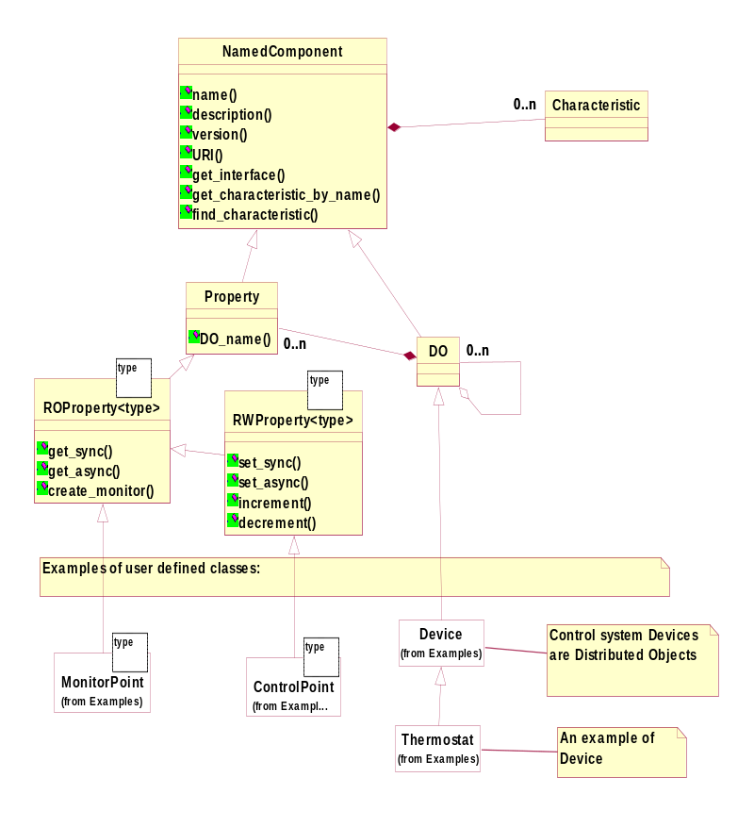
DO-Property-Characteristics
DO: base class for any physical/logical Device
(e.g. temperature sensor, motor)
Each DO has Properties
(e.g. status value, position - control/monitor points)
Characteristics of Dos and Properties
(Static data in Configuration DB, e.g. units, ranges, default values)
ABeans
Notes:
Mention SOSH meeting at ICALEPCS ‘99.
Synchronous and asynch access. Callbacks.
Monitors.

Slide 7
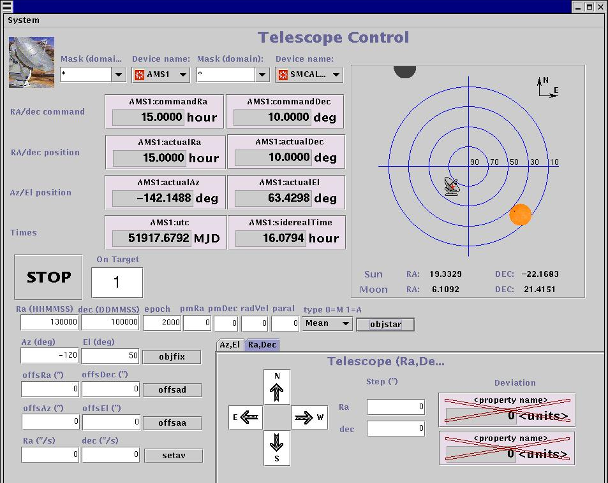
UIF Libraries
Kitt Peak test (Dec.00):
Pointing /tracking with 12 m Radio + optical tel.
Notes:
Almost 100% visual generation.
Only development of “Dartboard”

Slide 8
ACS Status
Oct. 2000: ACS v.0.0 (Prototype)
Dec. 2000: KP test
Sep. 2001: ACS Architecture Document
Sep.2001: ACS 1.0
In use in Test Interferometer Software (TICS) prototype
Being integrated with Test Correlator software
Feb. 2002: ACS 1.1 (support for TICS)
Sep. 2002: ACS 2.0
We plan an incremental release every 6 months
Notes:
The exact contents of ACS 1.0 (as for any other future release), will be agreed with the user’s community. In this specific case with the TICS team.
At the beginning of 2002 we plan also to have a further review of ACS Architecture. We think that at that time the experience accumulated in the usage of ACS for TICS development will allow to critically analyze the current ACS Architecture document and to identify the parts that need to be re-thought and changed.
We plan to collect comments in February, reply just after ACS 1.1 release and have the review soon after.
This would give time to use some outcomes of the review already for ACS 2.0.
ACS 2.0 is scheduled for September 2002.
The details contents will be agreed with the users just after ACS 1.1 release, but we have already a list of items that are expected to find a place there.
Among these the most important is for sure the implementation of a new Configuration Database, to replace the VLT real-time database. Most of the design activity for ACS 2.0 will go into this work.
It is also important to work on the Alarm System and on the Command System, as foreseen in the ACS architecture. ACS 2.0 will have to contain prototypes for these packages.
ACS is now strongly oriented at supporting the development of Control System applications. This is still the higher priority, due to the TICS tests, but also data flow and management applications will start to be prototyped and ACS will have to provide support for this.
The ACS Architecture will have to be extended to cover these new requirements and ACS 2.0 will provide prototypes for the newly identified components.
A session on “ACS future architectural choices” is scheduled for Friday. In this session we will propose some topics and we will collect arguments for discussion.
If possible, the Architecture review beginning of next year will include also the discussion of new sections to be added to the document as a consequence of these new requirements and prototypes will be then implemented for ACS 2.0.

Slide 9
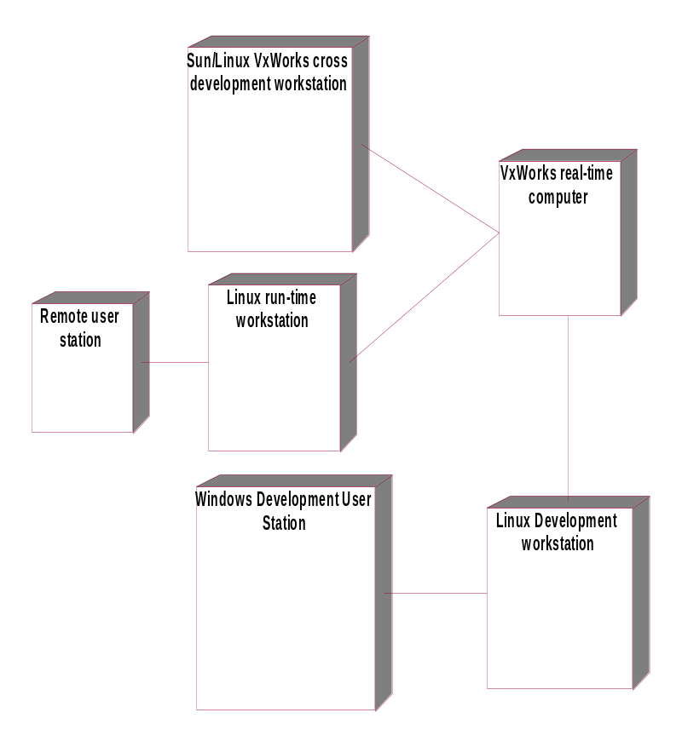
Supported Platforms
Operating system: Linux, SUN OS, (MS-Windows)
Real-time: VME,VxWorks (Phase1), CAN bus
Languages: C++, JAVA, Python, (TCL)
CORBA middleware: TAO (& ACE) (C++), Orbacus (Java), Omniorb (Python), CORBA services.
Unified Modeling Language (UML)
DB2 being evaluated as configuration DB
Notes:
The platforms and development environments supported by ACS are decided for each release, based on the requests coming from the user’s base.
Our main development platform is Linux, while real time systems run under VxWorks.
For example ACS 1.1 will provide complete support for:
Linux (RH 7.2) development and run time
Cross development for VxWorks (Tornado 2.0.2) from SUN workstations (Solaris 2.8), upload on VxWorks run time and debugging
An almost complete support for development and run time on SUN is available and will be used by the ACS team for testing, debugging and profiling using the Rational Pure tool suite (Purify, Pure Coverage…), not available under Linux.
Development of Java applications takes place on Windows platform using the IBM Visual AGE Java 3.5 RAD (Rapid Application Development) tool. Java applications can run both on Linux and Windows (currently SUN is not supported).
Future releases of ACS will also support small-footprint run time only installations.
An MS-Windows version of most ACS core components is used at JSI for development and testing.

Slide 10

ALMA Sites
Chajnantor
www.eso.org/projects/alma
www.alma.nrao.edu/development/computing
www.eso.org/~gchiozzi/AlmaAcs
http://kgb.ijs.si/KGB/
Notes:
List the other papers at the conference:
THAT004: TICS
THAP005: CORBA Services
THAP025: Abeans for TINE
THCT004: CSML

Slide 11
Conclusion
Developed keeping in mind the needs of astronomical and accelerator control projects
Can easily run on many platforms
Open source (GPL licence)
Free development tools and ORBs
We think that many other projects can use ACS
A wider user’s base can provide valuable feedback

Slide 12
Extra slides
The following pages contain some extra slides that we do not plan to show at the conference, but that could be useful.

Slide 13
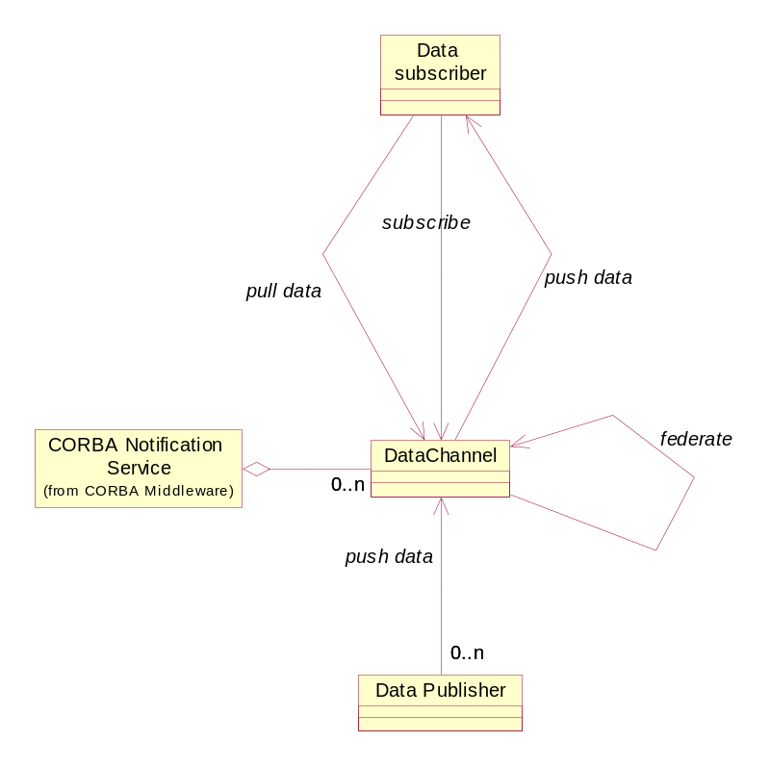
Data Channel

Slide 14
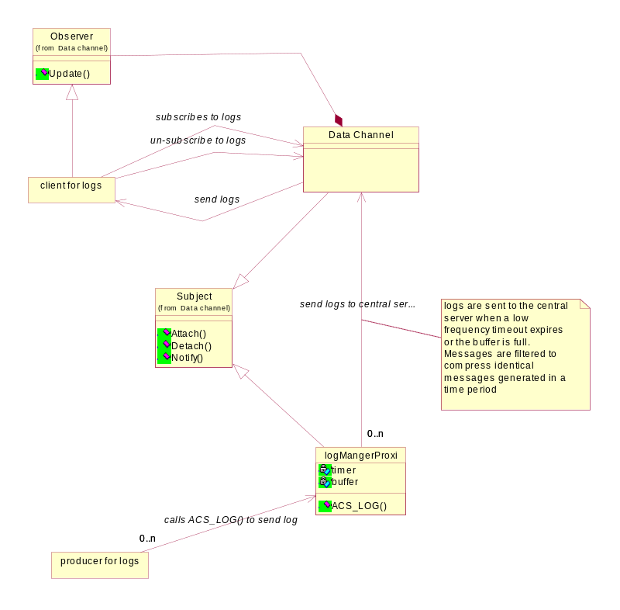
Logging

Slide 15
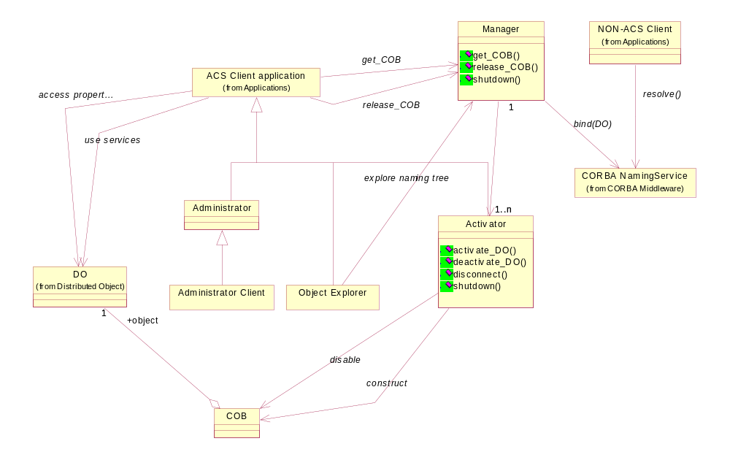
Management and Access Control

Slide 16
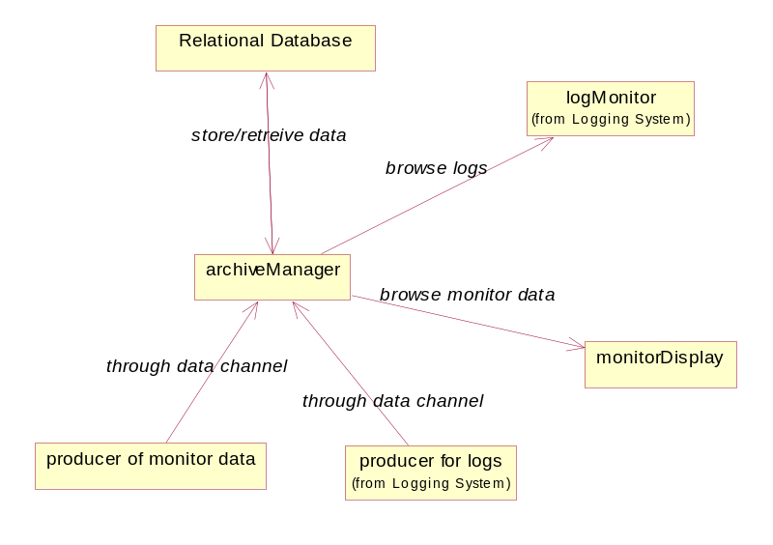
Archiving System

Slide 17
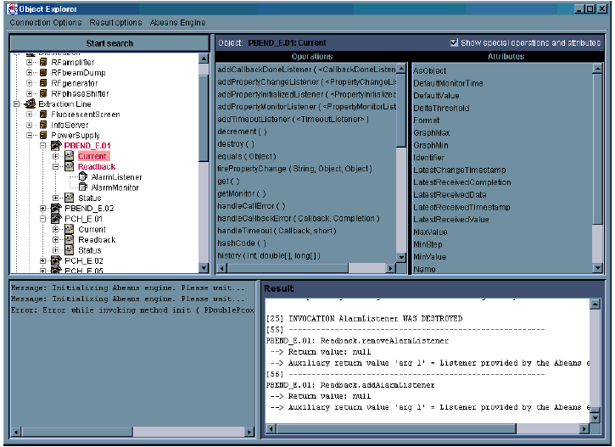
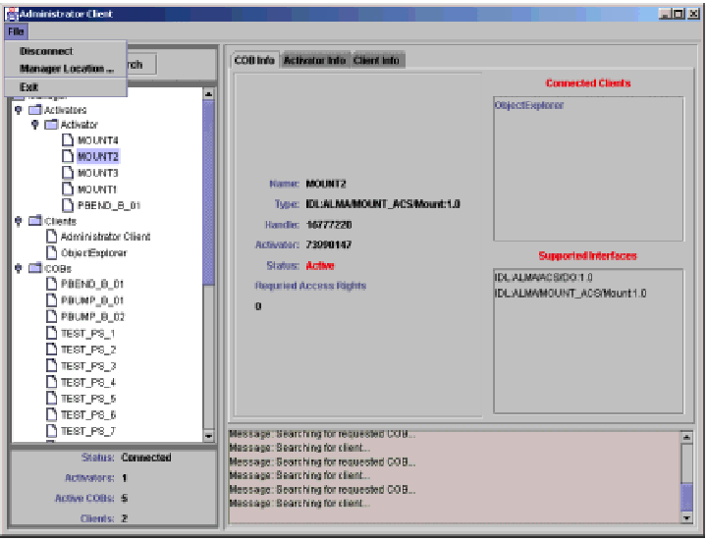
OE and Admin Client
Notes:
This slide shows the user interface of the Object Explorer (left) and Administrator Client (right), that will be demonstrated afterwards.
Object Explorer (OE) is a generic tool used for low-level inspection of objects in ACS. It can be used as a debugging or testing tool by the developers and maintainers of a system.
Administrator Client (AC) for Management and Access Control Interface (MACI) is a standalone Java program that uses the MACI IDL to:
Display the information about CORBA objects on the local network. This includes MACI defined objects, such as Activators and Managers as well as BACI defined objects, such as COBs. Both currently active COBs and potentially active COBs (i.e. COBs that the Manager is able to bring online on request) are displayed.
Interact with the MACI Manager through IDL Administrator interface, by receiving notifications about other clients and activators in the system from the Manager.
Administrator Client is separate from Object Explorer. This reflects the strong de-coupling between MACI and BACI: AC is a MACI client and Object Explorer a BACI client only.
Moreover, the first needs only normal privileges to run, while the second needs administrator privileges.

Slide 18
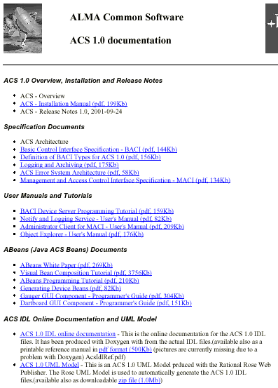
ACS 1.0 Documentation - 1
Major effort in documentation
Introductory documents
(Overview, Installation, Rel Notes)
Specification Documents
User Manuals and Tutorials
Abeans
ACS IDL Online documentation
Notes:
A major effort has been spent in providing good an comprehensive documentation for ACS 1.0.
We are very interested in feedback and suggestion to further improve what provided here.
Part of the work of the next months will be, together with extending ACS modular test coverage, providing examples of code for the most common tasks and design patterns
ACS 1.0 Overview, Installation and Release Notes
These are the first documents to be read when receiving the package.
The Overview provides a general overview of the distribution and in particular of the processes and executables available.
The Installation Manuals guides step by step in the installation and verification of ACS1.0.
The Release Notes describe the current status of ACS and the backward incompatibilities with ACS 0.0. It is an essential reading before porting applications from ACS 0.0.
Specification Documents
The main document in this section is the ACS Architecture, that describes the final architecture ACS aims to it its development. The other documents go in the detail of the most important packages defined/implemented with ACS 1.0
User Manuals and Tutorials
The BACI Device Server Tutorial is an introduction to writing C++ code based on ACS and is a must to read, tugether with the tutorials given in the previous meetings. Then there are a few User Manuals for ACS Logging Service and the tools GUIs
Abeans (Java ACS Beans) Documents
Tutorials and manuals on writing user interface applications with Abeans. Visual Bean Composition Tutorial is the most useful.
ACS IDL Online Documentation and UML Model
HTML Online reference for the ACS IDL interfaces

Slide 19
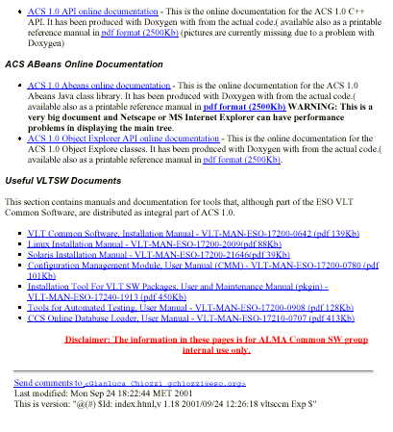
ACS 1.0 Documentation - 2
ACS API Online Documentation
ACS Abeans Online Documentation
Useful VLTSW Documents
See:
ACS_1_0_Linux-CD/Docs
$ACSROOT/man
(online reference, html and man)
Notes:
ACS API Online Documentation
HTML Online reference for the ACS C++ API interfaces.
The IDL interfaces are used by clients and can be accessed by any CORBA-aware programming language.
But in order to develop server-side applications in C++, programmers have to look at this API reference. This describe for example the IMPLEMENTATION of Property classes.
ACS Abeans Online Documentation
HTML Online reference (Java Doc) for the ACS Abeans Java API. All Java classes provides with Abeans are documented here.
Useful VLTSW Documents
The ACS distribution contains a number of development tools shared with the ESO VLT Common Software (cmm, pkgin, tat and others). This section contains the corresponding User Manuals.
The installation CD contains most of the documentation.
The reference pages are also available online after installation in the form of html pages and man pages (in $ACSROOT/man).
More documentation, not specific for ACS 1.0, is available in the ACS Home Page (http://www.eso.org/~gchiozzi/AlmaAcs/index.html), that contains also all documentation distributed with the CD.

Slide 20
How much effort in ACS 1.0?
Source lines of code (for comments add about 10%) for:
  ACS cmm Modules (code developed for ACS)
  Java Abeans (mostly code inherited from ANKA)
SLOC Directory SLOC-by-Language (Sorted)
61730 ACS cpp=61536,sh=129,tcl=28,sed=23,csh=14
188820 Java java=188820
Total Physical Source Lines of Code = 252019
Estimated Development Effort in Person-Years = 66.46
(Basic COCOMO model, Person-Months = 2.4 * (KSLOC**1.05))
Total Estimated Cost to Develop = $ 8977317
(average salary = $56286/year, overhead = 2.4).
Data generated using 'SLOCCount' by David A. Wheeler
http://www.dwheeler.com/sloccount/sloccount.html
More than 2000 pages of printable design/reference documentation
Notes:
This slide shows an approximated count of lines of code for ACS, done using the SLOCCount tool from D.A.Wheeler.
The tool has been directed to count all source lines in the ACS cmm modules and inside the ACS jar files. Comment lines are excluded from the count.
A separate count of C++ comment lines using the countCPP tool shows that comments are about 10% of source code lines.
ACS C++ code has been essentially all developed for ACS and should essentially double once full modular testing coverage will be implemented.
Java Abeans code has been essentially inherited from the Abeans developed by IJS for the ANKA project (probably about 10% to 20% at most has been added or modified during the development of ACS to accommodate for the specific changes required by the ACS IDL interfaces.
The documentation is completely available online as HTML and pdf format.
In total, the printable documentation (pdf files) consists of about:
Intro, design, user manuals, tutorial documents: 300 pages
ACS IDL and API reference manuals (Doxygen): 500 pages
Abeans reference manual (Doxygen): 1300 pages
Documents from VLT SW: 550 pages

