Slide 1

Container-component model and XML in ALMA ACS
Heiko Sommer (ESO), Gianluca Chiozzi (ESO),
Klemen Zagar (Cosylab) and Markus Völter

Slide 2
Overview
CORBA…
log-
service
appli-
cation
appli-
cation
appli-
cation
appli-
cation
naming
service
config
config
CORBA ORBs, Stubs, Skeletons
Notes:
CORBA applications are difficult to develop without further framework assistance
no standardized structure or deployment

Slide 3
Overview
…tamed by ACS…
comp
comp
comp
comp
container
Manager, CDB
container
CORBA ORB
Notes:
ACS container-component model
speeds up development, reduces maintenance
enforces uniform structure in all applications
hides CORBA details

Slide 4
Overview
XML exchange like in web services…
XML
comp
comp
comp
comp
container
Manager, CDB
container
CORBA ORB
Notes:
XML representation of hierarchical data is a welcome addition to CORBA’s data types (for interprocess communications)

Slide 5
Overview
… but with type-safe data access
XML
comp
comp
comp
comp
container
Manager, CDB
container
CORBA ORB
Notes:
using XML normally introduces a lack of static type checking ;
ACS overcomes this by using XML binding classes and special interface mapping techniques.

Slide 6
Container / CORBA
functional component interface generated from CORBA IDL:
Operations with IDL data types as parameters.
CORBA IIOP
ORB
container POA
component
POA (tie)
container
main()
comp
comp
dynamic
impl
lifecycle IF
sealant
comp impl
container
Notes:
left: conceptual view of an ACS container with two components
differences between Java, C++, and Python; richest feature set in Java, will be considered here
CORBA IDL defines the component interface (IDL2Java mapping)
interception of functional calls by the container: “tight container”
<CLICK> - right: sketch of container implementation (not important for application developers)
perhaps explain CORBA usage: (1) startup (ORB, manager), (2) component activation, (3) getting reference to another component using ContainerServices IF
Container startup time of about 1 sec

Slide 7
What’s missing in CORBA?
CORBA architecture favors relatively tight coupling
  data embedded in remotely accessible objects
  only fine-grained data transported by value
CORBA IDL has only limited support for by-value transport of hierarchical data (nested structs, valuetypes)
Serialization format is not suitable for persistence

Slide 8
How about Web Services?
Web Services aim at looser coupling of system components than CORBA
Hierarchical data can be sent in message parameters, coded as XML
XML (WSDL) for data type and interface definition
XML representation of data reusable for persistence
Notes:
Web Services meant as they are typically used: with SOAP protocol
tolerance toward small changes in the data model (e.g. addition of data items, changes in areas that don’t affect the application)

Slide 9
Web Services go too far…
Loss of static type checking
Made for business-to-business communication (“middleware for middlewares”), not within one project that can afford complete builds
client side coding is proprietary to the WS framework
text-based protocol is too inefficient for many kinds of data exchange in our domain
Notes:
Some WS frameworks (such as Apache Axis) allow stub generation from the WSDL interface definition; yet they favor generic mappings over type-safety
optional automatic type checking against WSDL schema at runtime; otherwise just failure to access expected data
WSDL-to-language-mappings are proprietary

Slide 10
XML strings over CORBA
“The Middle Way”
keep CORBA as the underlying middleware
use XML data as string arguments of CORBA IDL-defined operations
data definition in XML schema
coexistence with CORBA binary types
No type safety yet!
XML schema
def
operation1(in string SchedBlock sb)
XML
def
IDL
comp
operation2(out float[] largeBinaryData)
10001100
00110010
comp

Slide 11
Textual XML not type-safe!
<ourFood>
<apple grade=“A”/>
</ourFood>
comp
<myFood>
<pear size=“5”/>
</myFood>
comp

Slide 12
Type-safe XML Representation
generic representation of XML data (string, DOM) always prohibits static type checking
restore type-safety by using generated classes that match the particular XML data (as defined in the XML schema) : XML Binding Classes
Notes:
most technologies that handle XML suffer from absence of static type checking, since XML comes as a generic type (string, DOM, …)
CORBA allows defining coarse-grained, stateless objects (in this it’s a superset of web services)

Slide 13
XML Binding Classes
Type-safe XML Representation
(Java) Binding
Classes
XML schema
<xsd:element
name=“SchedBlock”>
+ Nested Child elements
Binding Class
Generator
(Castor)
1..n
0..1
buildtime
runtime
parse
serialize
XML
XML
string
typed Java
objects
string

Slide 14
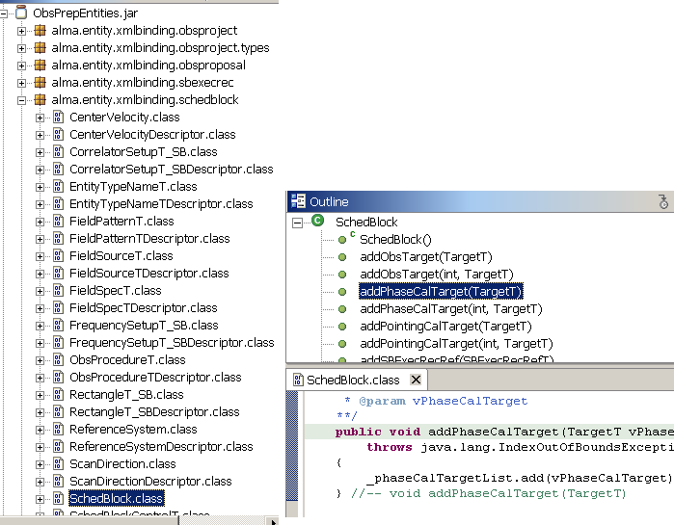

Slide 15
Type-safe XML exchange
Conceptual View
flat-XML interface seen from outside
XML data transported as a string over CORBA
XML
transparent-XML interface:
XML data appears as a tree of native-language binding classes
mapper
mapper
mapper
comp
comp
comp
container
container
between collocated components, binding objects can be sent directly
mapper instantiates binding classes from XML strings and back

Slide 16
1..n
0..1
Operation defined in IDL
Complex data type
defined as XML schema
typedef XmlString SchedBlock;
interface MyComp {
void myOperation(
SchedBlock sb) }
<xsd:element
name=“SchedBlock”>
<xsd:element
name="schedBlockImaging“
type="prj:ImagingProcedureT“
maxOccurs="unbounded" />
</xsd:element>
ref
Generated Java Interface
interface MyComp {
void myOperation(
bind.SchedBlock sb) }
buildtime
runtime
SchedBlock
Binding Class Instances
implements
comp
comp
Client
component
Server
component

Slide 17
Build Process
flat-XML “MyInterface”
XmlEntityStruct
IDL IF
XmlString
IDL IF
CORBA IDL
CORBA IDL
getObsProject
getThatSB()
compiler
typedef
compiler
typedef
XmlString
xmlstring
SchedBlock
ObsProject
;
;
…
…
SchedBlock
transparent-XML “MyInterfaceJ”
ObsProject
ACS IDL
ACS IDL
getThatSB()
getObsProject
()
compiler
compiler
alma.bind.SchedBlock
alma.data.ObsProject
getObsProject
getThatSB()
Makefile mapping info:
Makefile mapping info:
“SchedBlock ->
alma.bind.SchedBlock”
together in one JAR file
together in one JAR file

Slide 18
Design View showing CORBA
flat-XML
functional IF
(CORBA)
impl
impl
stub
(CORBA)
CORBA remoting
skeleton (tie)
(CORBA)
XML
impl
delegates
transparent-
XML IF
(ACS)
skeleton impl
(ACS, dynamic
XML mapper)
delegates
impl
calls
delegates
impl.
client proxy
(ACS, dynamic
XML mapper)
server
component
client
component
client container
server container

Slide 19
Summary
Enable components (different languages) to exchange hierarchical data in a type-safe manner
Container/component model hides the gory details from the components
Fully CORBA compliant (not just for ACS components as clients)

