Slide 1





Integrating the CERN LASER Alarm System with the ALMA Common Software
A. Caproni^{ac}, K. Sigerud^{b}, K. Zagar^{d}
a. ESO, European Organization for Astronomical Research in the Southern Hemisphere
c. CERN, European Organization for Nuclear Research
b. INAF-OATs, Osservatorio Astronomico di Trieste
d. COSYLAB, Control System Laboratory

Slide 2
Atacama Large Millimeter Array
ALMA is a collaboration between Europe, Japan and North America to build a radio telescope in the Chajanantor desert in Chile.
up to 64 movable antennas each of which mounts a 12m wide dish
the configuration varies from 18km to 150m
the receivers covers the range from 30 to 950 Ghz
Atacama Compact Array: twelve 7m telescopes in compact configuration plus four 12m telescopes

Slide 3
ALMA Common Software (ACS)
ACS is a software infrastructure for the development of distributed systems widely used in ALMA from high level application development to the Control Software
based on CORBA
implements its own Component/Container paradigm
widely distributed project: ESO, NRAO, Observatory of Trieste, university of Calgary
IDL, XML, C++, python, java
adopt free software to minimize the programming effort
freely redistributable under LGPL license

Slide 4

Large Hadron Collider Alarm Service (LASER)
LASER is the second generation alarm service developed at CERN for the Large Hadron Collider.
It is a messaging system: collects, stores, manages and distributes information about abnormal situations: the Fault States.
Each Fault State (FS) is identified by a triplet:
the Fault Family (FF): a set of elements of the same kind
the Fault Member (FM): the particular instance of the set
the Fault Code (FC): a code defining the particular problem
A Fault State can be active or inactive

Slide 5
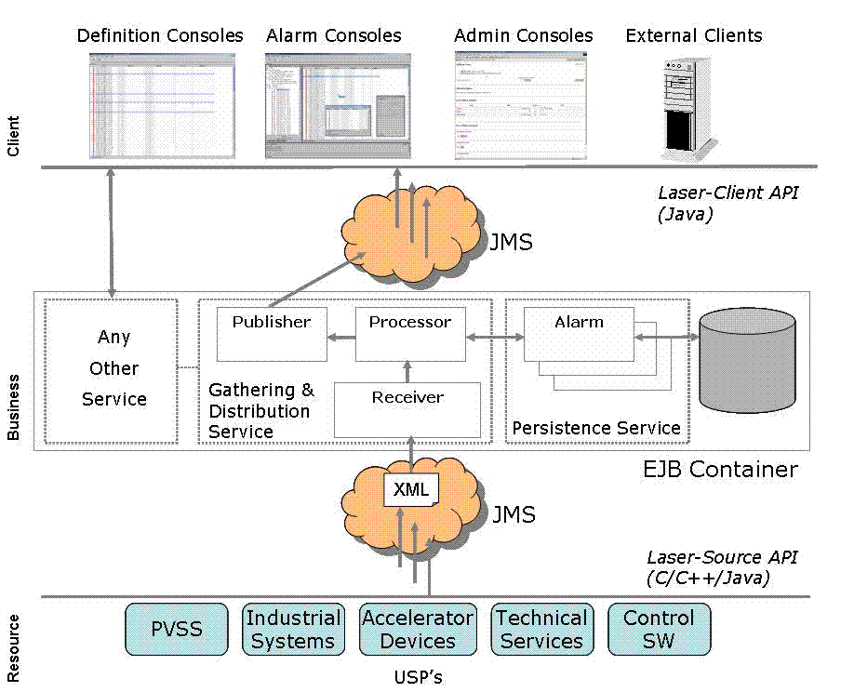
LASER - Overview

Slide 6
LASER – Resource tier
The resource tier is composed of sources of alarms:
different programming languages (java, C, C++)
different platforms
each source has a definite set of FS whose state can be active/inactive
each source sends an heartbeat to the service
categories of alarms
LASER-source API:
allows the sources to send alarms to the business tier
no need of specific knowledge of the alarm service

Slide 7
LASER – An example
String faultFamily=”PowerSupplies”;
String faultMember=”PS3”;
int faultCode=100;
String faultState=FaultState.ACTIVE;
AlarmSystemInterface alarmSource =
AlarmSystemInterfaceFactory.createSource(this.name());
FaultState fs = AlarmSystemInterfaceFactory.createFaultState(
faultFamily, faultMember, faultCode);
fs.setDescriptor(faultState);
fs.setUserTimestamp(new Timestamp(System.currentTimeMillis()));
Properties props = new Properties();
props.setProperty(...);
...
fs.setUserProperties(props);
alarmSource.push(fs);

Slide 8

LASER- Business tier
listen for FS changes and heartbeats
build a complete view of each alarm
reduces or masks alarms depending of:
      the status of the system
      the knowledge of the environment
persist the FS
track and archive the FS changes
authenticate user of the clients
allow the management of the FS without stopping the service
publish alarms to the clients

Slide 9

LASER - Alarm informations
System name
Identifier of the system
Description of the alarm
The cause of the alarm
The action to fix the problem
The consequence of the alarm
The priority of the alarm (4 priorities)
The URL with detailed information
A phone number to call
The location of the source
The name/ID of the responsible person

Slide 10
LASER - Reduction rules
The reduction aims to help the user to easily identify the root cause of a cascade of alarms.
The service has a knowledge of the environment by means of a set of reduction rules.
Node reduction
If a failure in the equipment A trigger a failure in another equipment, B, then the latter is reduced.
Multiplicity reduction
If the number of alarms of the same type is greater then a given threshold then these alarms are reduced and a new alarm is produced

Slide 11







Node reduction

Slide 12
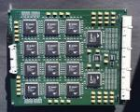
Multiplicity reduction

Slide 13

LASER – Client tier
Composed of java applications that consume the data produced by the business tier.
alarm console
definition console
login and configuration facilities
There is no need to stop the alarm service while administering the system.

Slide 14
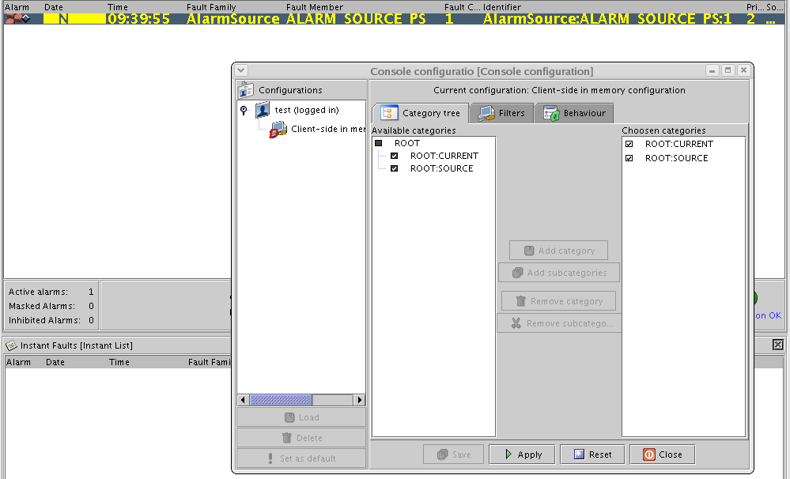
Operator GUI

Slide 15

LASER vs ACS
J2EE
EJB Component/Container
Oracle DB + Hibernate
JMS / JRMI
Netbeans and SWING
Commercial tools
CORBA
ACS Component/Container
XML files (CDB)
CORBA calls and NC
Abeans and SWING
Freely available tools
LGPL

Slide 16
Integration process
Evaluation of the code
    Similarities and differences
    Compatible and incompatible packages
Translation of LASER modules into ACS modules
    ant replaced by make
Let the code compile
    Stub methods returning an exception (implementation on demand)
    Replacement of incompatible tools
Setup of the CDB
Debugging and testing

Slide 17

Map between EJB and ACS Components
LASER EJB demands the core functionalities to POJOs.
We defined a mapping between LASER EJB and ACS IDL defintions in order to demand the same core functionalities to the same POJOs.
one ACS component per each LASER EJB
original POJOs (core) remained untouched
the mapping resulted in a mechanic procedure

Slide 18
Example - LASER
Remote Interface:
interface AlarmSystem ... {
Alarm[] getActiveMultiplicityChildren(String parentId)
...
}
Home Interface (EJB life cycle methods)
Business logic:
{
public Alarm[] getActiveMultiplicityChildren(String parentId) {
return (Alarm[])coreService.getActiveMultiplicityChildren(parentId);
}
...
}
POJO

Slide 19
EXAMPLE - ACS
IDL:
...
struct Alarm {…};
typedef sequence Alarm AlarmSequence;
interface AlarmService : ACS::ACSComponent
{
AlarmSequence getActiveMultiplicityChildren(in string parentId);
...
java implementation:
public class LaserComponent extends ComponentImplBase {
...
public Alarm[] getMultiplicityChildren(String parentId) {
return toAlarmArray(coreService.getMultiplicityChildren(parentId));
}
...
POJO

Slide 20


Communications between the tiers
LASER uses JMS together with Sonic: we have implemented JMS specifications by means of CORBA NC
Each alarm is translated into its XML representation (castor)
The XML is embedded into a JMS text message
JMS implementation publishes the message in the NC
We maintained the same structure of LASER
The developer sends messages through the NC without dealing with CORBA
It is possible to write clients that listen to the NC and take actions independently of the Alarm Service

Slide 21
ACS LASER structure
E₁
E₂
E₃
E₄
E₅
AS
Client_{ACS}
Client₁
Client₂

Slide 22
Considerations
It is possible to inject a third part software in ACS without big changes in the two systems if
They have similar logical structures
Clear interfaces
Only 10% of original code modified: the core runs almost untouched
ACS code is 10% greater then LASER code
Stub methods returning exception was a bad idea

Slide 23
The future
A stable collaboration between ESO/ACS and CERN is established: ACS/LASER will be distributed as LGPL in a future release of ACS.
To make this collaboration effective we need to decouple ACS and LASER:
definition of interfaces
refactoring of the LASER code
definition of CVS policies
definition of the release procedure

