Slide 1
Evolution of the VLT instrument control system toward industry standards
Mario J. Kiekebusch , Gianluca Chiozzi , Jens Knudstrup , Dan Popovic , Gerard Zins
`

Slide 2
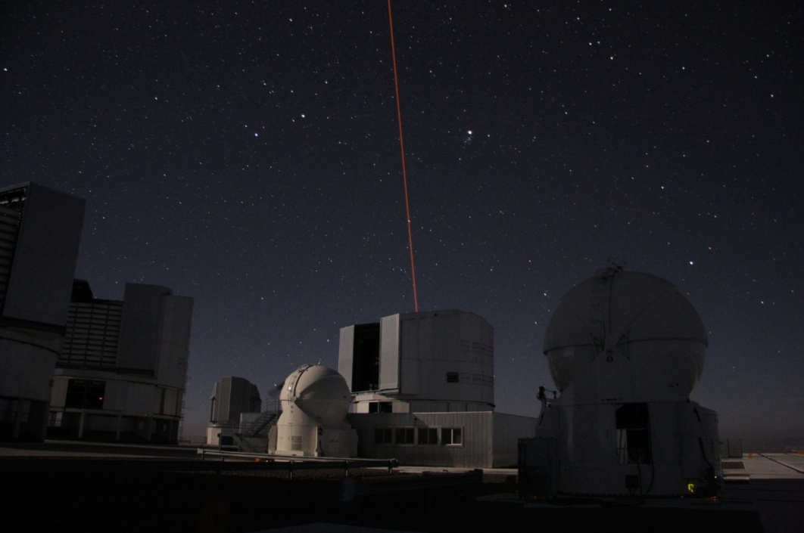
Contents
The VLT Control System architecture
Why is an evolution necessary?
The VLT Instrument Control Software (ICS)
The VLT ICS Extension
The PIONIER instrument
Conclusions

Slide 3
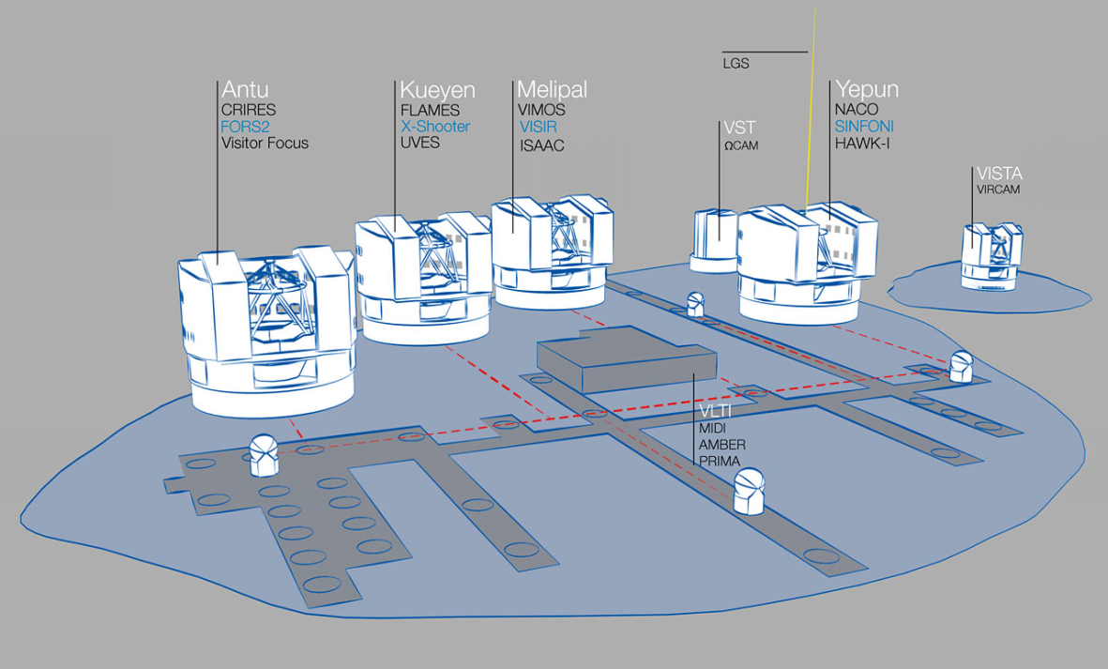
The VLT instruments
Over 20 astronomical
instruments are now
using the VLT control
system.
More than 10 years of
operations.
On-going development:
  Upgrades
  Second generation VLT/VLTI
  instruments (KMOS, SPHERE, MUSE, GRAVITY, MATISSE, ESPRESSO)
  maybe an upcoming third generation…:

Slide 4
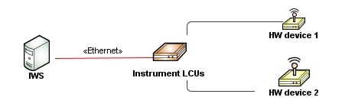
VLT Control System Architecture
The current architecture is based on:
  Linux WS
  VME based Local Control Units connected to the hardware.
Notes:
The hardware architecture of the VLT control system includes an instrument WS running Scientific Linux and one or more LCUs acting as the interface with the hardware devices. An LCU is an autonomous computing unit composed of a set of custom and commercial boards (CPU, digital and analog I/O, serial and motion controllers, etc.) connected through the VME bus. Each LCU has several layers of software most of them developed in house providing the basic services to all VLT applications. This common software includes the message system, local database, time services, motor library and drivers.

Slide 5
Why the evolution is necessary?
in the early nineties, VME technology was the clear choice for implementing HW control for telescopes/instruments
BUT
Technology is advancing fast and obsolescence is becoming an issue.
Custom solutions (hardware and software) are too expensive to maintain.
Many of the old problems are now solved by COTS.
We are now developing 2nd generation instruments and we might have a 3rd generation
We need to build an evolution path from VLT to E-ELT
Notes:
During the conceptual phase of the VLT control system in the early nineties, VME technology was the clear choice for implementing hardware control for telescopes and instruments. This technology had many benefits in performance, reliability and support for long life cycle developments. ESO has developed many specialized hardware and software solutions for this architecture in order to satisfy various requirements coming from the VLT projects.
But the technology is advancing and changing very fast and instrument control systems require to be adapted to industry standards to ensure availability and support for new projects and for replacing failing parts.
In the last ten years, the industrial market (in particular the non hard real-time applications) have been migrating toward less expensive and simpler solutions based on PLCs and fieldbuses. As the consequence, some of our hardware providers have already started to shift their product lines to follow the market trends making it more difficult to ensure the availability and support of our VME based technologies for future instruments and to replace failing parts. A concrete example of this situation happened some years ago when our main vendor for motion control boards announced the discontinuation of the support for the VME interface forcing ESO to embark on the development of a custom-made motion controller with all the associated costs this has implied.
Because ESO is still in the process of developing second generation VLT/VLTI instruments and because we might have even a third generation of instruments coming up, there is a clear need to take measures to alleviate this rising issue by searching for alternatives with lower long term sustainability risks.

Slide 6
VLT instrumentation Software
We have now a solid Application Framework providing a standard and modular architecture for VLT instrument control software:
  Instrument Control Software (ICS)
  Detector Control Software (DCS)
  Real Time Computer (RTC)
  Observation Software (OS)
  Maintenance Software (MS)
  Observer Support Software (OSS)
Notes:
What is today the VLT Instrumentation Software (INS) is the result of the generalization and evolution of the control software developed for the first VLT instruments. The software artifacts created for the first generation instruments such as ISAAC, UVES and NACO together with the experience gained during the first years of operations laid the groundwork to develop incrementally an application framework which has become the basis for the instrument software of many VLT/VLTI instruments.
This application software framework provides the following:
A standard and modular structure for VLT instrument software that defines the building blocks of the instrumentation software.
Common software providing a set of libraries, utilities, rules, definitions and guidelines to support the development of VLT instrumentation software¹.
A Template Instrument to ease the implementation at the early phases of the development process by means of predefined and customizable instrumentation software.
The instrumentation software is subdivided into the following standard INS software packages:
Instrument Control Software (ICS): It controls and monitors instrument devices.
Detector Control Software (DCS): It performs all the tasks to control technical and scientific detector subsystems. It takes exposures for different read-out modes, it handles the image transfer and display, and stores images as FITS files.
Real-Time Computer (RTC): It carries out the data acquisition, reconstruction and control in order to compensate for the atmospheric aberrations.
Observation Software (OS): It coordinates the execution of an exposure for a given observation mode and is the main interface to the instrument control software.
Maintenance Software (MS): It is used for instrument configuration, checking and troubleshooting.
Observer Support Software (OSS): It consists of tools to support the observer in the preparation of an observing block.

Slide 7
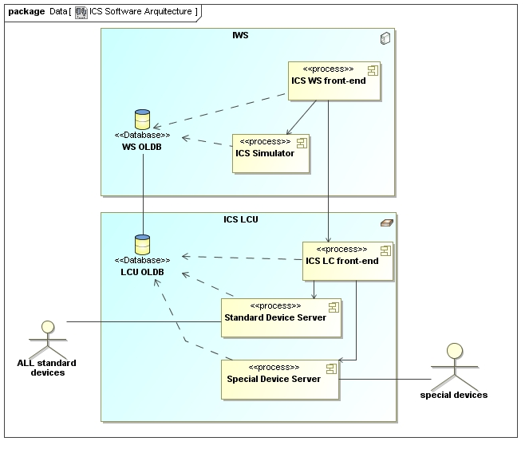
Instrument Control Software (ICS)
Actual architecture
Notes:
ICS is the software system dealing with the control of all devices belonging to an instrument such as filter wheels, calibration lamps, temperature and pressure sensors, shutters, etc., but excluding detectors and real-time computers which are handled by other software packages according to the organization of the VLT instrumentation software.
The ICS is composed of two parts, one running on the instrument WS and the other one running on the LCU.
The ICS WS part includes the following components:
ICS WS front-end Process doing the following tasks:
Controlling the global status of ICS.
Forwarding setup commands to the LCU front-end processes.
Handling and coordinating replies from the LCUs front-end processes.
Retrieving status of all devices.
One additional process which simulates the LCU behaviour.
Graphical Interfaces, automatically generated and customizable for instrument specifics needs.
The ICS LCU part consists of :
ICS LCU front-end server which acts as the front-end for all commands coming from the WS.
Standard Device Manager, a single server dealing with all requests for all standard devices.
Special Device Manager (if required), a single server per device or group of devices of the same type implementing the control of instrument specific software requirements.

Slide 8
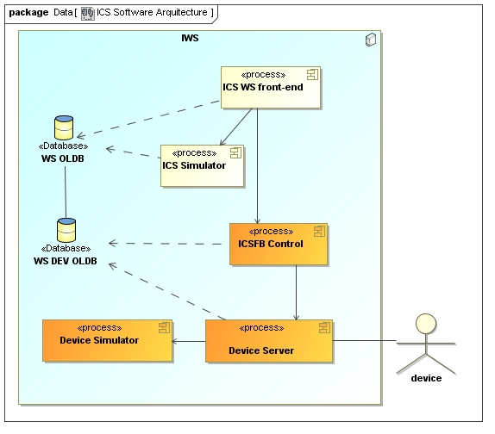
Instrument Control Software (ICS)
Actual architecture
Extension:
no LCU, devices on a fieldbus
Notes:
Architecture of the Extension:
There is one front-end control process (ICSFB Control) acting as the interface between device servers and the ICS WS main process in the same way as in the ICS LCU software. Unlike the ICS LCU part, the ICSFB uses two servers to control each device: Device Server and Device Simulator. This model tries partially to overcome the lack of multithreading support on the VLTSW and promote parallelism between devices.

Slide 9
ICS Fieldbus Extension (ICSFB)
Constraints
Compatibility with actual LCU command and database interface.
Compatibility with current device configuration profile.
E-ELT pathfinder.
Extension:
no LCU, devices on a fieldbus
Notes:
In order to facilitate a seamless integration of the ICSFB into the existing ICS architecture and avoid backward incompatibilities that could affect the operations of actual instruments, we have defined the following constraints:
The ICS extension must be fully compatible with the command interfaces of the ICS LCU.
The technologies to be used should not create a strong impact on the Paranal maintenance.
The ICSFB should be compatible with the present device configuration of the ICS framework.

Slide 10

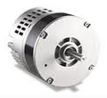


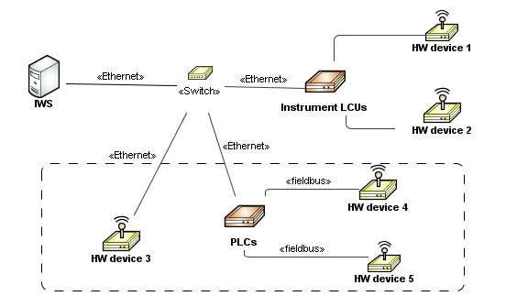
ICS Fieldbus Extension (ICSFB)
Design Principles
Fieldbus independent by using OPC UA communication standard.
Communication interface decoupled from Device Driver.
PLC code as simple as possible.
No difference between standard and special devices.
Direct communication to the Instrument WS when devices support it.
instrsssumen
ICSs
ICSFB instances
ICSFB devices
PLCs
hardware
Notes:
The overall architecture is very flexible and scalable allowing the control of complex VLT/VLTI instruments. One instrument could have multiple ICSs, each one having one or more ICSFB instances.

Slide 11
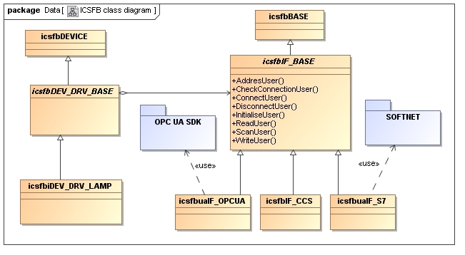
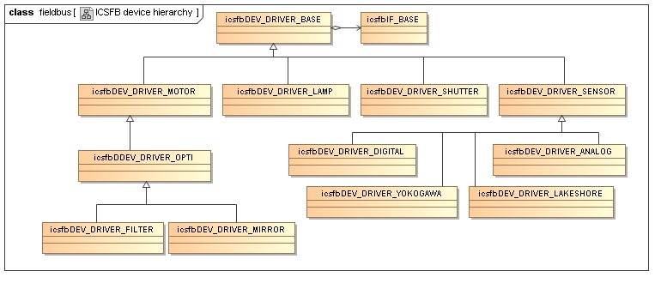
ICS Fieldbus Extension (ICSFB)
Example of ICSFB device hierarchy.
Example of ICSFB class diagram for a Lamp Device
Notes:
The ICSFB code consists of set of C++ classes that provides the basis for the framework and the foundation for implementing software devices, simulators and communication interfaces.
Some of the core classes for the development of device drivers and communication interfaces are presented here.
Communication Interface
ICSFB provides an abstract base class, “icsfbIF_BASE”, that gives the basis for implementing the communication protocol between the device object and the controller. This class has a set of methods that encapsulates the actions needed by any communication interface like for instance connect, disconnect, read and write. For each type of communication protocol supported, a class must be implemented, derived from this class.
Device Driver
The base class allowing the creation of device drivers is “icsfbDEV_DRV_BASE”. This class provides a set of abstract methods to be overridden by child classes adding the user implementations of each device. Following this scheme, all standard ICS commands like setup, status, online, standby, off are mapped into the methods of this class and derived classes should provide the specific implementation. In order not to block the functioning of each device driver while performing an action, there is another set of methods providing information about the status of the actions being executed.

Slide 12
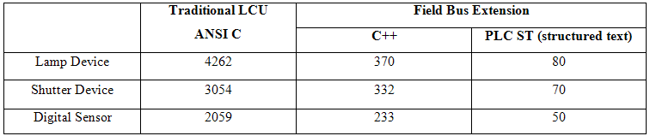
ICS Fieldbus Extension (ICSFB)
Reduced complexity:
  significant difference between the amount of code for the LCU ICS and ICSFB (SLOCC)
  Simple PLC code
Notes:
Although it is probably too early to make evaluations and comparisons between the ICS LCU code and the ICSFB, it is interesting to see some SLOC metrics for both platforms. The table shows the lines of code of a set of devices computed by sloccount
The above shows a significant difference between the amount of code for the LCU ICS and the ICSFB that could be interpreted as a gain in simplicity. However, these are just preliminary results based on a beta version of the ICSFB devices so they are not conclusive.
The low number of lines of code in the PLC is explained by the simplicity of accessing the hardware within the PLC programming language and by the ICSFB principle of moving away the complexity from the low level part reducing it only to the mapping with the hardware and the definition of interface variables for the devices listed above.
(generated using David A. Wheeler's 'SLOCCount'.)

Slide 13
Example of PLC Code for Shutter Control
FUNCTION_BLOCK FB_SHUTTER
VAR_INPUT
END_VAR
VAR_OUTPUT
END_VAR
VAR
(* OPC UA Interface variables *)
bCtrlSwitch: BOOL; (*~ (OPC : 1 : shutter control signal - W) *)
bStatOpen: BOOL; (*~ (OPC : 1 : OPEN status signal - R) *)
bStatClosed: BOOL; (*~ (OPC : 1 : CLOSED status signal - R) *)
bStatFault: BOOL; (*~ (OPC : 1 : FAULT status signal - R) *)
(* Physical signals have to be mapped to DIO Terminal Input/Output variables *)
q_bCtrlSwitch AT %Q*: BOOL; (* Dig OUT for shutter control signal *)
i_bStatOpen AT %I*: BOOL; (* Dig IN for OPEN status signal *)
i_bStatClosed AT %I*: BOOL; (* Dig IN for CLOSED status signal *)
i_bStatFault AT %I*: BOOL; (* Dig IN for FAULT status signal *)
END_VAR
(* Set user status variables to physical inputs *)
bStatFault := i_bStatFault;
bStatOpen := i_bStatOpen;
bStatClosed := i_bStatClosed;
(* Set outputs to user commands *)
q_bCtrlSwitch := bCtrlSwitch;
END_FUNCTION_BLOCK
Notes:
A simplified PLC Function Block (FB) for control of shutters, written in Structured Text (ST). For space saving reasons, the code does not show error handling. The “OPC UA Interface variables” are the variables visible by the Device Server Control Application through the OPC UA interface. The PLC application uses them to set physical outputs or updates them with the states of physical inputs. To open the shutter, the control application would just set variable bCtrlSwitch to TRUE.
Remark to make about how simple the code could be: In this application we decoupled the OPC UA variables from the physical I/O signals in order to be able to add error handling and safety measures if needed. If they were not needed, the complete FB would consist only of the “OPC UA Interface variables” declaration without a single line of code (shown on the next slide). These variables would be mapped to the physical signals.
FYI
PLC conventions:
q_ - output
i_ - input
b* (like in bCtrlSwitch) - “binary” variable.

Slide 14
Example of simplified PLC Code for Shutter Control
FUNCTION_BLOCK FB_SHUTTER
VAR_INPUT
END_VAR
VAR_OUTPUT
END_VAR
VAR
(* OPC UA Interface variables to be mapped to DIO Terminal Input/Output variables *)
bCtrlSwitch: AT %Q*: BOOL; (*~ (OPC : 1 : shutter control signal - W) *)
bStatOpen: AT %I*: BOOL; (*~ (OPC : 1 : OPEN status signal - R) *)
bStatClosed: AT %I*: BOOL; (*~ (OPC : 1 : CLOSED status signal - R) *)
bStatFault: AT %I*: BOOL; (*~ (OPC : 1 : FAULT status signal - R) *)
END_VAR
END_FUNCTION_BLOCK
Notes:
The code consists just of the declaration of the OPC UA variables and their mapping with the physical signals. In the case of Beckhoff TwinCAT software, the mapping is done with the TwinCAT System Manager.
Syntax :
“(*~ (OPC : 1 : comment) *)” is Beckhoff’s way to configure the OPC UA Server running on the Embedded PC (where the PLC code runs).
“AT %Q*: “ means signal to be mapped to a physical output signal (e.g. using TwinCAT System Manager).
“AT %I*: “ means signal to be mapped to a physical input signal (e.g. using TwinCAT System Manager).

Slide 15
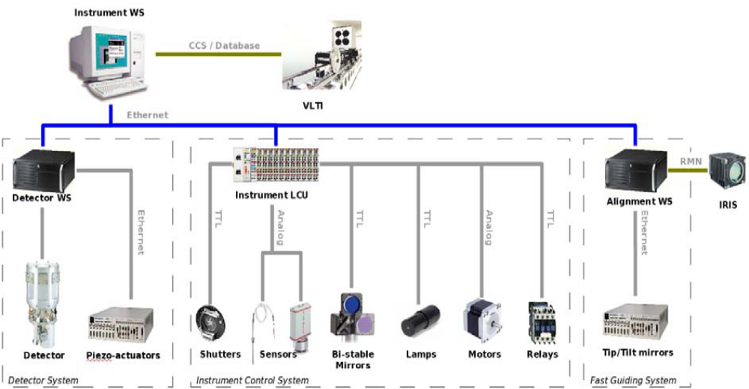
The PIONIER Instrument
The pathfinder: a VLTI Visitor Instrument being developed by Laboratoire d'Astrophysique de Grenoble (LAOG).
Functions to Control
Stepper Motors
Lamps
Shutters
Sensors
Notes:
PIONIER is a VLTI visitor instrument being developed by Laboratoire d'Astrophysique de Grenoble (LAOG) and planned to be commissioned in Paranal at the end of 2010.
Based on the simple control requirements and due to the various constraints on the project like budget, power dissipation and flexibility, LAOG have decided to use COTS components instead of the traditional LCUs.
ESO, through the SDD/CIS department, has established a collaboration agreement with LAOG to develop the ICS extension so that it could be ready on time to be used as the control software for PIONIER. For its part, LAOG has made commitment to contribute in testing and commissioning this software.
PIONIER functions will be controlled by an Embedded PC (CX1030) and several EtherCAT modules like remote IO and stepper motion controllers from the company Beckhoff⁷. The CX1030 is an industrial PC, as well as a PC-based PLC suitable for medium performance control tasks. It hosts a real-time kernel controlling all the distributed I/O components through the EtherCAT fieldbus⁸ and a Windows CE operating system for the non-realtime tasks including the industrial standard OPC UA server.

Slide 16
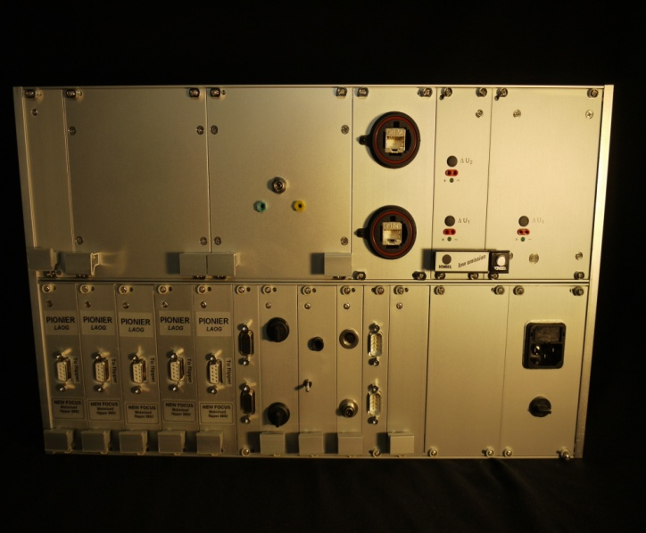
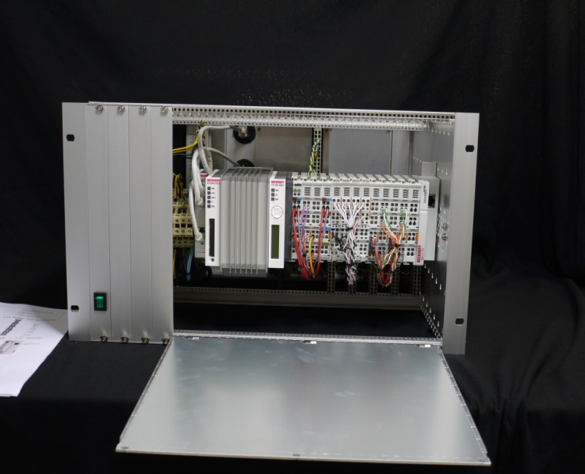
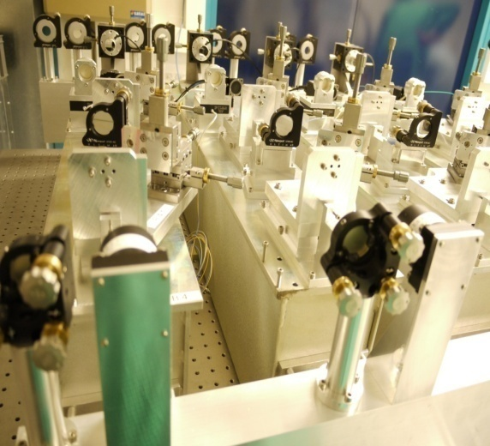
PIONIER Instrument
Technology:
Embedded PC (CX1030) and EtherCAT modules including stepper motion controllers and I/O modules.
  Embedded PC with Windows CE running the OPC UA Server from Beckhoff.
PIONIER
Crate housing
PIONIER
optical table
Notes:
PIONIER functions will be controlled by an Embedded PC (CX1030) and several EtherCAT modules like remote IO and stepper motion controllers from the company Beckhoff⁷. The CX1030 is an industrial PC, as well as a PC-based PLC suitable for medium performance control tasks. It hosts a real-time kernel controlling all the distributed I/O components through the EtherCAT fieldbus⁸ and a Windows CE operating system for the non-realtime tasks including the industrial standard OPC UA server.

Slide 17
Conclusions
We believe that ICSFB can solve the rising obsolescence problem of the VLT instruments and it will allow the field testing of E-ELT technologies.
Official version is planned to be integrated with VLT software release 2011 and therefore available for upcoming VLT instruments.
ICSFB simplifies the coding of devices. The number of lines of code is reduced significantly for the same devices and between old and extended solution.
PIONIER preliminary results indicate that technologies like OPC UA, EtherCAT and PLCs can be used for replacing VME based LCUs at the VLT for most of instrument control requirements.
OPC UA support for Linux is still limited but this is not an issue.
Tested successfully with Beckhoff Embedded PCs (OPC UA) and Siemens PLCs (Softnet for Linux).

Slide 18

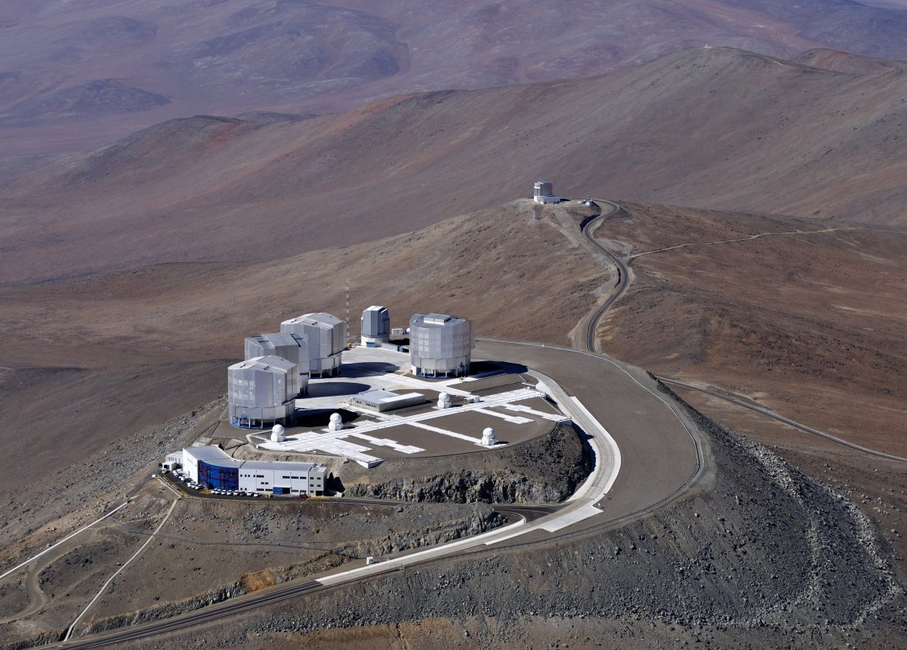
Questions (& Answers)

