Slide 1

ACS
CORBA-based Common Software for the ALMA project
-
4848-05
G. Chiozzi, B. Gustafsson, B. Jeram – ESO
M. Plesko, M. Sekoranja, G. Tkacik, K.Zagar - JSI
Notes:
The ALMA Project has been introduced in the paper 4837-12, Atacama Large Millimeter Array) and this same session contains other two papers describing respectively:
the overall ALMA software Architecture (4848-06, J.Schwarz, G.Raffi).
theALMA Test Interferometer Control Software (4848-07, R.G..Marson, B.Glendenning).
In this presentation we are going to describe the ALMA Common Software (ACS) that is under development as a set of common software component to be used for the development of any ALMA subsystem.
This work is responsibility of an international team mainly based at ESO and in tight collaboration with the JSI in Ljubljiana.
A part from the authors of the paper, we want to thank here the essential contributions to ACS from other members of the ALMA SW community.

Slide 2
Contents
What is ALMA?
Why a common software?
What are the key ideas in ACS?
What is the Architecture of ACS
How are we going to go on?
How can you get more information
Notes:
In the presentation we will try to explain:
What the ALMA Project is
Why did we decide that a Common Software was essential for the development of ALMA
How did we got to the current architecture
What this architecture actually is and which are the key components
How are we going to go on
We will finally provide some conclusions and pointers to resources to get more information on ACS and, more in general on the ALMA project.

Slide 3
ALMA Project in Summary
Joint project between astronomical organisations in Europe and North America (and Japan)
64 12-m antennas (25 microns, 0.6”)
Array configurations:150m-10 Km
Near S.Pedro de Atacama, Chile at 5000m
Imaging capability over 10-0.35mm range
10 receiver bands
very high resolution correlator
Notes:
Being this the first ALMA presentation in the Control Software session I will give a one slide introduction to the project, for the benefit of the people that does not know it and who did not see the introduction in paper 4837-12, Atacama Large Millimeter Array)

Slide 4
ALMA Common Software (ACS)
  ALMA project is highly distributed:
  many sites and many “development cultures”
ACS aims at providing an answer to the following needs:
  common application framework and programming model, not just libraries
  well tested software that avoids duplication
  make upgrades and maintenance reasonable
  incremental development via Releases
  standardisation offering environment with design patterns and their implementation (rather than pure rules).
  common configuration control/installation procedures
  It worked on a comparable size project: the VLT
Notes:
The ALMA project is characterized by the fact of being an highly distributed effort, with many sites and many “development cultures” involved. The Computing Group is scattered across 3 continents and many more institutes.
Early in the ALMA project it was decided that an ALMA Common Software (ACS) would be developed as a way to provide to all partners involved in the development a common software platform. The original assumption was that some key middleware like communication via CORBA and the use of XML and JAVA would be part of the project. It was intended from the beginning to develop this software in an incremental way based on releases, so that it would then evolve into an essential embedded part of all ALMA software applications. In this way we would build a basic unity and coherence into a system that will have been developed in a distributed fashion.
The ALMA Common Software (ACS) is a comprehensive framework on top of the operating system, offering a complete environment and structures at the base of application software developments. ACS is meant to be a general system, based on available middleware (CORBA) and the easy embedding of languages like Java and Python.
We believe that the use of a common software layer in a very geographically distributed development situation will be the best way to enforce the use of common constructs. ACS shall provide a well tested platform that embeds standard design patterns (much better than a set of written rules) and avoids duplication of effort. At the same time this will provide a platform where upgrades can be incorporated and brought to all developers. It will also standardize the underlying architecture of software modules, making maintenance affordable.
This approach worked very well for the VLT Project and the VLT Common Software has been presented already in the past editions of this conference.

Slide 5
ACS start-up: Summer 1999
Preliminary discussions on ACS objectives and structure:
  experience from VLT and other projects
  New technology: CORBA, Java, XML
Decided to start from existing product, to make use of CORBA experience.
Collaboration with JSI-Ljubliana to further develop existing system built for High Energy Physics (ICALEPCS ‘99, Trieste).

Slide 6
ACS Architecture
Applications
ACS Installer
4 - Hi-level APIs and
UIF libraries
Scripting
C++ Application
Java Application
FITS libraries
...more to come...
tools
Framework
Framework
3 - Services
MACI Manager
Activator
Java
Serialization
Archiving
Command
Alarm System
Container
Plugs
System
System
2 - Core packages
BACI
Java
Config DB
Data channel
Astro libraries
Error System
Logging System
Time System
Component
1 - Base tools
Development
CORBA Middleware
ACE
Device Drivers
tools
Notes:
This package diagram has been extracted from the ACS Architecture document and summarizes the status of ACS 2.0 (the release under development) with the respect to the foreseen final architecture.
Most of the components of ACS2.0 (blue boubble) were already present in previous releases. In each release they get cleaned up, improved and extended according to the iterative development process we use in ALMA.
An important role is played by the feedback coming from the applications, like the Kitt Peak test and the TICS control software.
These components can be considered stable and, although some features are still missing, and should not be subject to major changes in the future.
The development of the Error System is mostly complete, but it has not been extensively used up to now.
Some packages, like Time System and Python, have been developed for TICS and will be integrated inside ACS in the next months.

Slide 7
Component-Container Model
A Component-Container based architecture emphasizes Separation of Concerns.
Same idea as .NET, EJB, CCM
Container manages components
  Lifecycle interface (init, start, stop, update)
  Service interface (what component offers)
  Optional: security, persistency, transactions…
Component 1
Component 2
Client
Container
...
Component 3
Notes:
The ACS Architecture is founded on the Component-Container model.
A client (which could itself be a Component residing in another Container) accesses the services of Components via their published service interfaces. Containers provide an environment for Components to run in, with support for basic services like logging system, configuration database, persistency and security. Developers of Components can focus their work on the domain-specific “functional” concerns without having to worry about the “technical” concerns that arise from the computing environment in which their components run.
The division of responsibilities between components and containers enables decisions about where and when individual components are deployed to be deferred until runtime, at which point configuration information is read by the container. If the container manages component security as well, authorization policies can be configured at run time in the same way.
Commercial implementations of the Component-Container model are quite popular (EJB, .NET). A vendor-independent specification, the Corba Component Model (CCM), is under development, but it is not complete, and production implementations do not yet exist. These are rather comprehensive systems, and require a wholesale commitment from developers to use the languages and tools supplied.

Slide 8
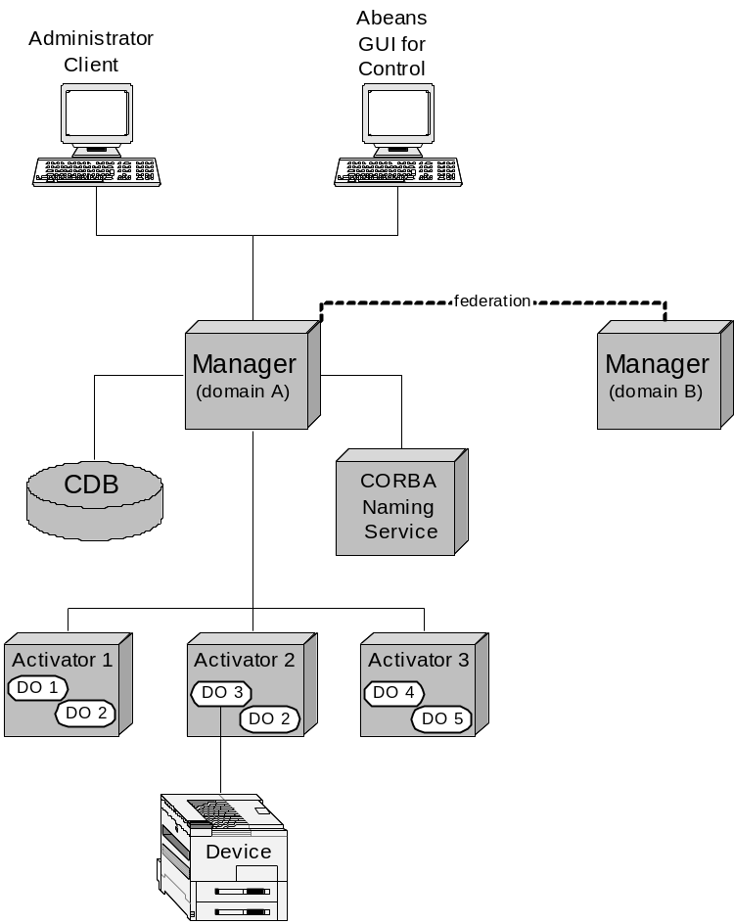
ACS Deployment diagram
Notes:
MACI implements the Container part of the Component-Container model. It is a service that knows about all the Components that together compose the control system and manages their interconnections and lifecycle. MACI has two major elements:
Activators are the C++ Containers. They are deployed locally on all hosts involved in the control system, ranging from real-time local control units to high-performance workstations. Their primary task is preparing the local environment in which DOs (the Components) are created, giving them all the resources they need to perform their tasks, such as CORBA connectivity, connection establishment with other DOs and Configuration Database access.
The Manager, which is set up at one central location that is widely known across the entire system. The Manager is acquainted with all the Distributed Objects and Activators in the system, as well as other resources, such as configuration database and CORBA services. In particular, the Manager closely cooperates with the CORBA Naming Service, in which it publishes all of its acquaintances, making them accessible to non-MACI-aware CORBA software.
Within the scope of MACI, a Component is the Distributed Object (DO).
We are currently designing the Java Containers as the counterpart of Activators and Java Components as the counterpart of Dos.

Slide 9
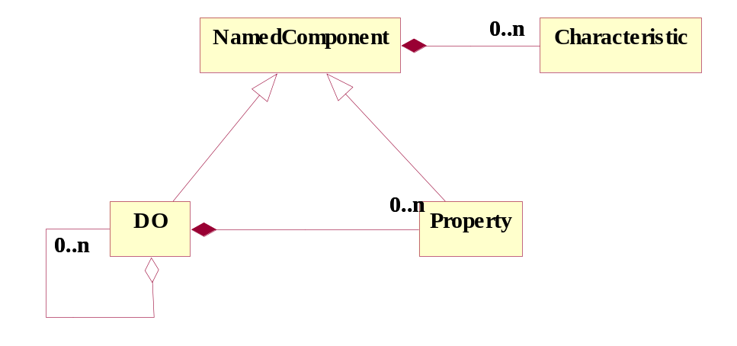
DO-Property-Characteristics
DO: base class for any physical/logical Device
(e.g. temperature sensor, motor)
Each DO has Properties
(e.g. status value, position - control/monitor points)
Characteristics of Dos and Properties
(Static data in Configuration DB, e.g. units, ranges, default values)
ABeans
name()
NamedComponent
0..n
description()
0..n
Characteristic
version()
URI()
get_interface()
get_characteristic_by_name()
find_characteristic()
0..n
DO
Property
0..n
0..n
0..n
DO_name()
type
ROProperty<type>
get_sync()
type
get_async()
create_monitor()
RWProperty<type>
set_sync()
set_async()
increment()
decrement()
Examples of user defined classes:
Control system Devices
type
type
are Distributed Objects
Device
MonitorPoint
(from Examples)
(from Examples)
ControlPoint
(from Exampl...
An example of
Thermostat
Device
(from Exampl...
Notes:
The heart of BACI is a distributed object model.
All common telescope components such as antenna mount, antenna control unit, correlator, etc. are Components defined by means of Distributed Objects (DOs). DOs are implemented as CORBA objects that are remotely accessible from any computer through the client-server paradigm.
Each DO is further composed of Properties. A DO can also contain references to other DOs to build hierarchical structures of components.
Both DOs and Properties have specific Characteristics, e.g. a Property has a minimum, a maximum, units…. The common behavior of DO and Property has been factorized in the Named Component common base class. Notice the programatically characteristics are read-only. For example, all constants related to a Property such as min/max, and description are obtained by clients directly from the Property by means of remote methods - no direct access to the configuration database is necessary.
Values of the Properties are updated asynchronously by means of monitor objects. While there are in principle an infinite number of DO types, for example one for each physical controlled device, there are very few different Property types

Slide 10
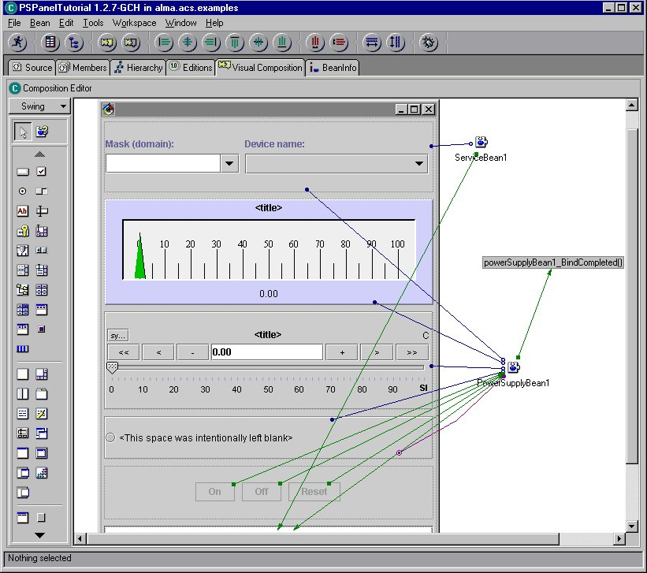
Abeans visual editing

Slide 11
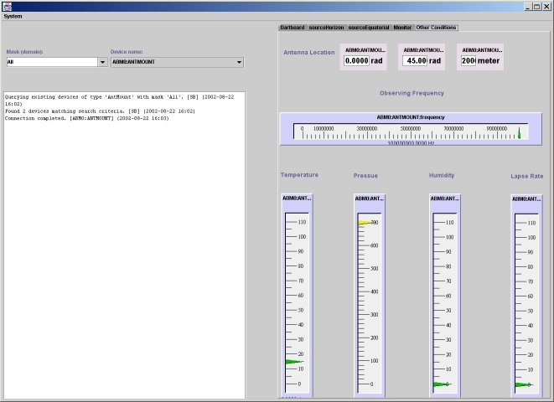
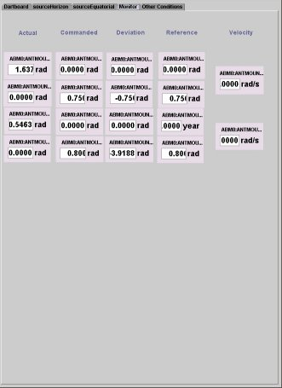
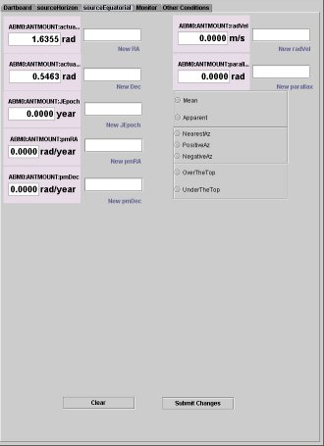
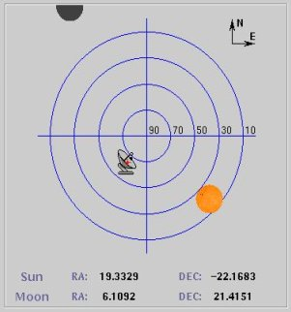
TICS Control Panel

Slide 12
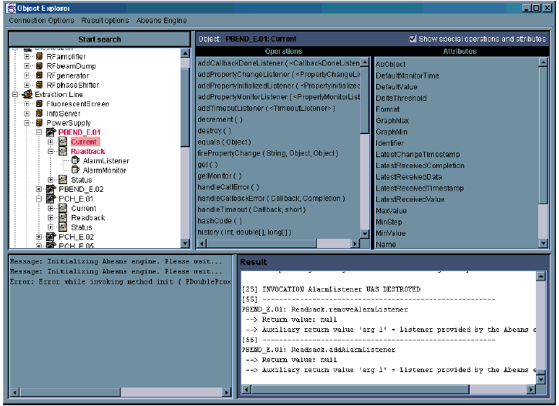
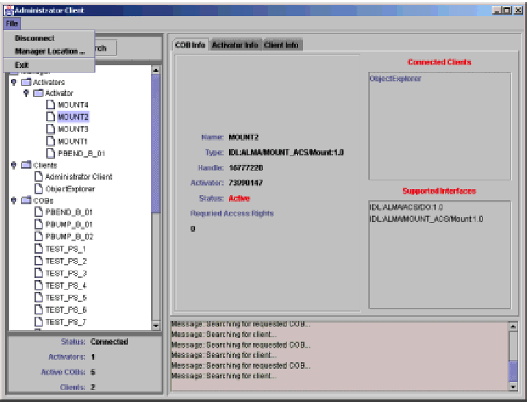
OE and Admin Client
Notes:
This slide shows the user interface of the Object Explorer (left) and Administrator Client (right), that will be demonstrated afterwards.
Object Explorer (OE) is a generic tool used for low-level inspection of objects in ACS. It can be used as a debugging or testing tool by the developers and maintainers of a system.
Administrator Client (AC) for Management and Access Control Interface (MACI) is a standalone Java program that uses the MACI IDL to:
Display the information about CORBA objects on the local network. This includes MACI defined objects, such as Activators and Managers as well as BACI defined objects, such as COBs. Both currently active COBs and potentially active COBs (i.e. COBs that the Manager is able to bring online on request) are displayed.
Interact with the MACI Manager through IDL Administrator interface, by receiving notifications about other clients and activators in the system from the Manager.
These tools are based on basic CORBA features and services, like the usage of Interface Repository, Dynamic Method Invocations, Naminc Service.
But they also exploit the ACS paradigms and Design Patterns, like the DO-Property-Characteristic concept.

Slide 13
Supported Platforms
Operating system: Linux, SUN OS, (MS-Windows)
Real-time: VME,VxWorks (Phase1), CAN bus
Languages: C++, JAVA, Python
CORBA middleware: TAO (& ACE) (C++), Orbacus (Java), Omniorb (Python), CORBA services.
Notes:
The platforms and development environments supported by ACS are decided for each release, based on the requests coming from the user’s base.
Our main development platform is Linux, while real time systems run under VxWorks.
For example ACS 1.1 will provide complete support for:
Linux (RH 7.2) development and run time
Cross development for VxWorks (Tornado 2.0.2) from SUN workstations (Solaris 2.8), upload on VxWorks run time and debugging
An almost complete support for development and run time on SUN is available and will be used by the ACS team for testing, debugging and profiling using the Rational Pure tool suite (Purify, Pure Coverage…), not available under Linux.
Development of Java applications takes place on Windows platform using the IBM Visual AGE Java 3.5 RAD (Rapid Application Development) tool. Java applications can run both on Linux and Windows (currently SUN is not supported).
Future releases of ACS will also support small-footprint run time only installations.
An MS-Windows version of most ACS core components is used at JSI for development and testing.

Slide 14
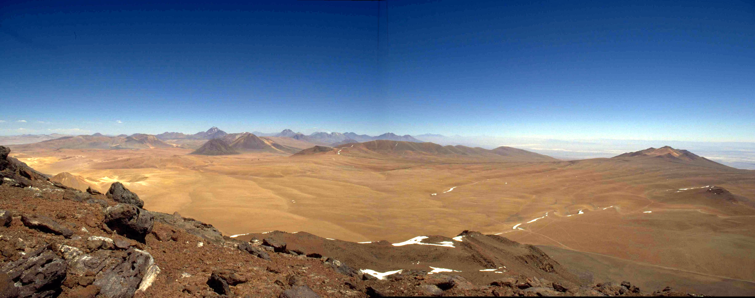
ALMA Sites
Chajnantor
www.eso.org/projects/alma
www.alma.nrao.edu/development/computing
www.eso.org/~gchiozzi/AlmaAcs
http://kgb.ijs.si/KGB/
Notes:
List the other papers at the conference:

Slide 15
Conclusion
Developed based on the experience of both astronomical and accelerator control projects
Can easily run on many platforms
Open source (GPL licence)
Free development tools and ORBs
We think that many other projects can use ACS
A wider user’s base can provide valuable feedback

Slide 16
Extra slides
The following pages contain some extra slides that we do not plan to show at the conference, but that could be useful.

Slide 17
ACS Status
Oct. 2000: ACS v.0.0 (Prototype)
Dec. 2000: KP test
Sep. 2001: ACS Architecture Document
Sep.2001: ACS 1.0
Apr. 2002: ACS 1.1 (support for TICS)
In use in Test Interferometer Software (TICS) prototype
Nov. 2002: ACS 2.0
We plan an incremental release every 6 months
Notes:
The exact contents of each ACS release is agreed with the user’s community (the TICS team being the most important now).
We are also working on a review ofthe ACS Architecture. We think that the experience accumulated in the usage of ACS for TICS development until now will allow to critically analyze the current ACS Architecture document and to identify the parts that need to be re-thought and changed.
ACS is now strongly oriented at supporting the development of Control System applications, given the priority of supporting TICS development. But the development of data flow and management applications is not starting and ACS will have to provide support for this.
The ACS Architecture will have to be extended to cover these new requirements and ACS 2.0 will provide prototypes for the newly identified components.

Slide 18
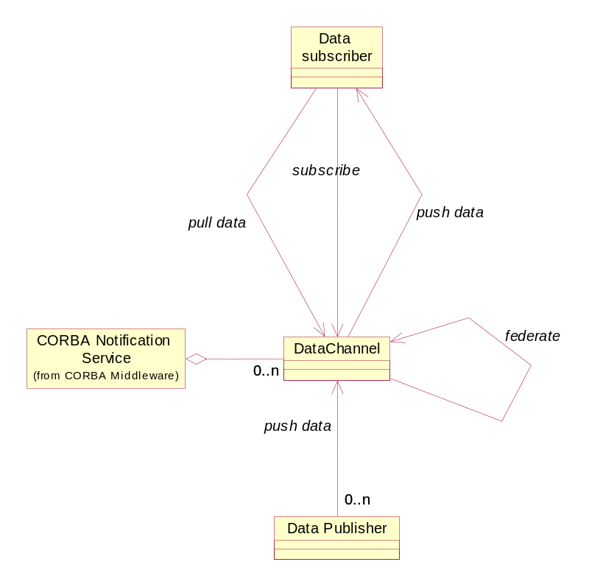
Data Channel

Slide 19
DO
name()
NamedComponent
0..n
description()
0..n
Characteristic
version()
URI()
get_interface()
get_characteristic_by_name()
find_characteristic()
0..n
DO
Property
0..n
0..n
0..n
DO_name()
type
ROProperty<type>
get_sync()
type
get_async()
create_monitor()
RWProperty<type>
set_sync()
set_async()
increment()
decrement()
Examples of user defined classes:
Control system Devices
type
type
are Distributed Objects
Device
MonitorPoint
(from Examples)
(from Examples)
ControlPoint
(from Exampl...
An example of
Thermostat
Device
(from Exampl...

Slide 20
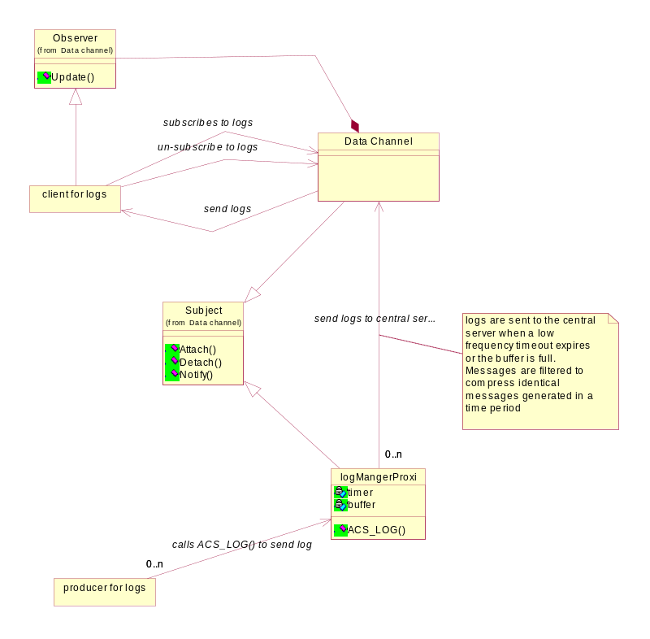
Logging

Slide 21
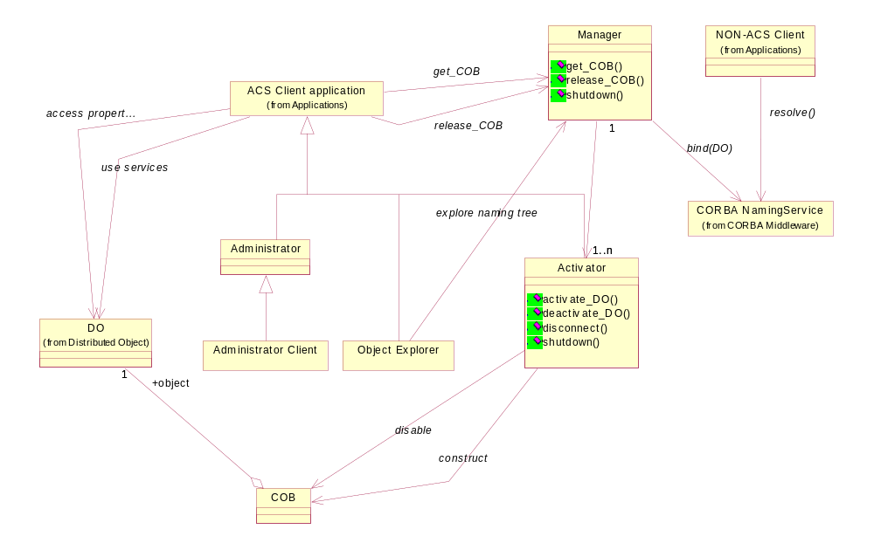
Management and Access Control

Slide 22
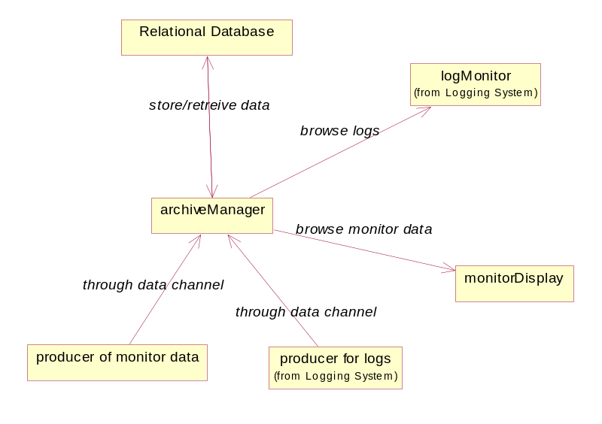
Archiving System

Slide 23
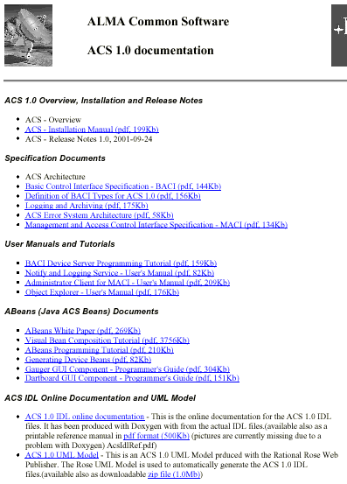
ACS 1.0 Documentation - 1
Major effort in documentation
Introductory documents
(Overview, Installation, Rel Notes)
Specification Documents
User Manuals and Tutorials
Abeans
ACS IDL Online documentation
Notes:
A major effort has been spent in providing good an comprehensive documentation for ACS 1.1.
We are very interested in feedback and suggestion to further improve what provided here.
Part of the work of the next months will be, together with extending ACS modular test coverage, providing examples of code for the most common tasks and design patterns
ACS 1.1 Overview, Installation and Release Notes
These are the first documents to be read when receiving the package.
The Overview provides a general overview of the distribution and in particular of the processes and executables available.
The Installation Manuals guides step by step in the installation and verification of ACS1.1.
The Release Notes describe the current status of ACS and the backward incompatibilities with ACS 1.0. It is an essential reading before porting applications from ACS 1.0.
Specification Documents
The main document in this section is the ACS Architecture, that describes the final architecture ACS aims to it its development. The other documents go in the detail of the most important packages defined/implemented with ACS 1.1
User Manuals and Tutorials
The BACI Device Server Tutorial is an introduction to writing C++ code based on ACS and is a must to read, tugether with the tutorials given in the previous meetings. Then there are a few User Manuals for ACS Logging Service and the tools GUIs
Abeans (Java ACS Beans) Documents
Tutorials and manuals on writing user interface applications with Abeans. Visual Bean Composition Tutorial is the most useful.
ACS IDL Online Documentation and UML Model
HTML Online reference for the ACS IDL interfaces

Slide 24
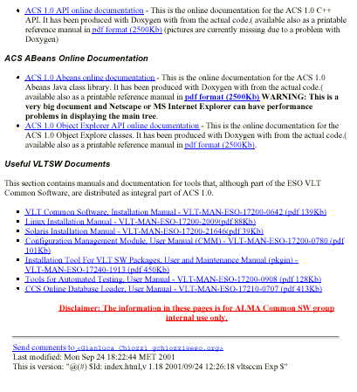
ACS 1.0 Documentation - 2
ACS API Online Documentation
ACS Abeans Online Documentation
Useful VLTSW Documents
See:
ACS_1_0_Linux-CD/Docs
$ACSROOT/man
(online reference, html and man)
Notes:
ACS API Online Documentation
HTML Online reference for the ACS C++ API interfaces.
The IDL interfaces are used by clients and can be accessed by any CORBA-aware programming language.
But in order to develop server-side applications in C++, programmers have to look at this API reference. This describe for example the IMPLEMENTATION of Property classes.
ACS Abeans Online Documentation
HTML Online reference (Java Doc) for the ACS Abeans Java API. All Java classes provides with Abeans are documented here.
Useful VLTSW Documents
The ACS distribution contains a number of development tools shared with the ESO VLT Common Software (cmm, pkgin, tat and others). This section contains the corresponding User Manuals.
The installation CD contains most of the documentation.
The reference pages are also available online after installation in the form of html pages and man pages (in $ACSROOT/man).
More documentation, not specific for ACS 1.1, is available in the ACS Home Page (http://www.eso.org/~gchiozzi/AlmaAcs/index.html), that contains also all documentation distributed with the CD.

Slide 25
How much effort in ACS 1.1?
Source lines of code (for comments add about 10%) for:
  ACS cmm Modules (code developed for ACS)
  Java Abeans (mostly code inherited from ANKA)
SLOC Directory SLOC-by-Language (Sorted)
61730 ACS cpp=61536,sh=129,tcl=28,sed=23,csh=14
188820 Java java=188820
Total Physical Source Lines of Code = 252019
Estimated Development Effort in Person-Years = 66.46
(Basic COCOMO model, Person-Months = 2.4 * (KSLOC**1.05))
Total Estimated Cost to Develop = $ 8977317
(average salary = $56286/year, overhead = 2.4).
Data generated using 'SLOCCount' by David A. Wheeler
http://www.dwheeler.com/sloccount/sloccount.html
More than 2000 pages of printable design/reference documentation
Notes:
This slide shows an approximated count of lines of code for ACS, done using the SLOCCount tool from D.A.Wheeler.
The tool has been directed to count all source lines in the ACS cmm modules and inside the ACS jar files. Comment lines are excluded from the count.
A separate count of C++ comment lines using the countCPP tool shows that comments are about 10% of source code lines.
ACS C++ code has been essentially all developed for ACS and should essentially double once full modular testing coverage will be implemented.
Java Abeans code has been essentially inherited from the Abeans developed by IJS for the ANKA project (probably about 10% to 20% at most has been added or modified during the development of ACS to accommodate for the specific changes required by the ACS IDL interfaces.
The documentation is completely available online as HTML and pdf format.
In total, the printable documentation (pdf files) consists of about:
Intro, design, user manuals, tutorial documents: 300 pages
ACS IDL and API reference manuals (Doxygen): 500 pages
Abeans reference manual (Doxygen): 1300 pages
Documents from VLT SW: 550 pages

