Slide 1
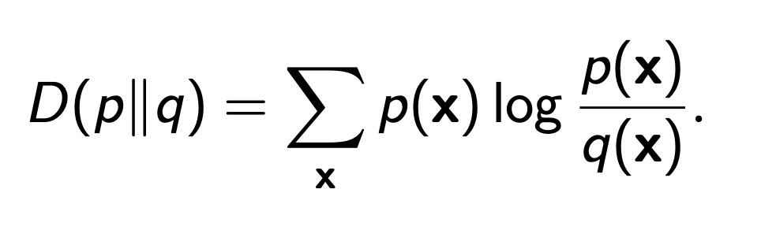
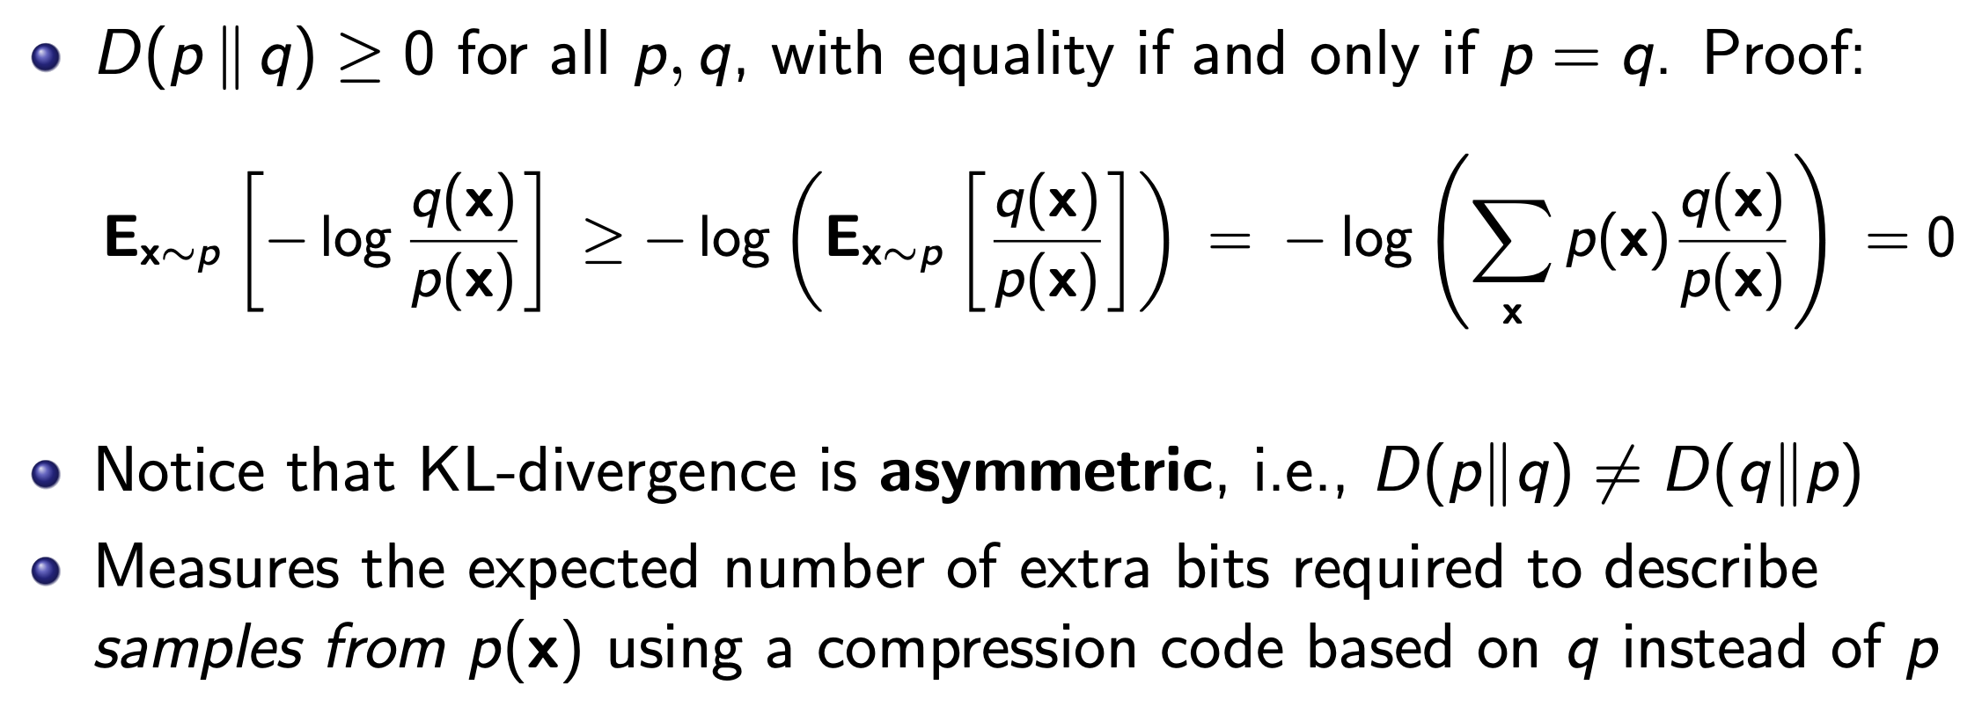
Kullback-Leibler divergence (KL-divergence)

Slide 2
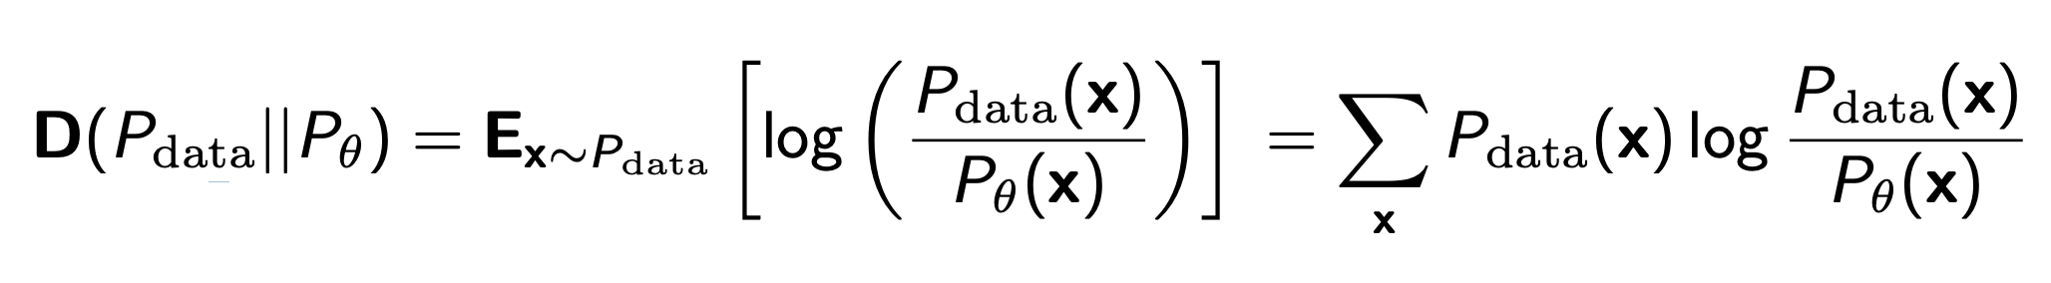
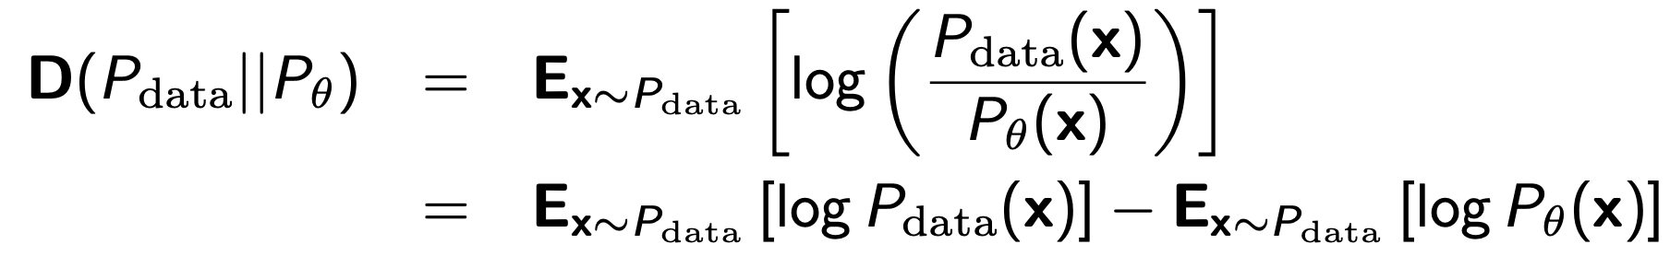
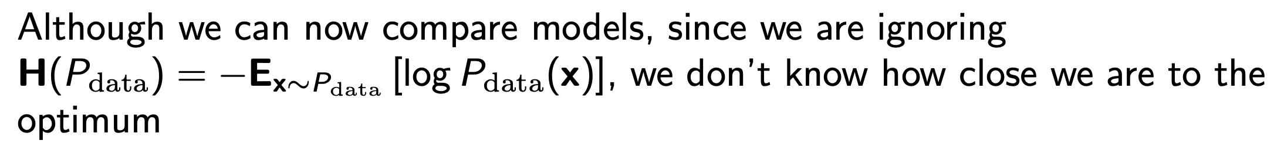
Learning as density estimation
KL-divergence is one possibility we evaluate ”closeness”
Learning Objective

Slide 3
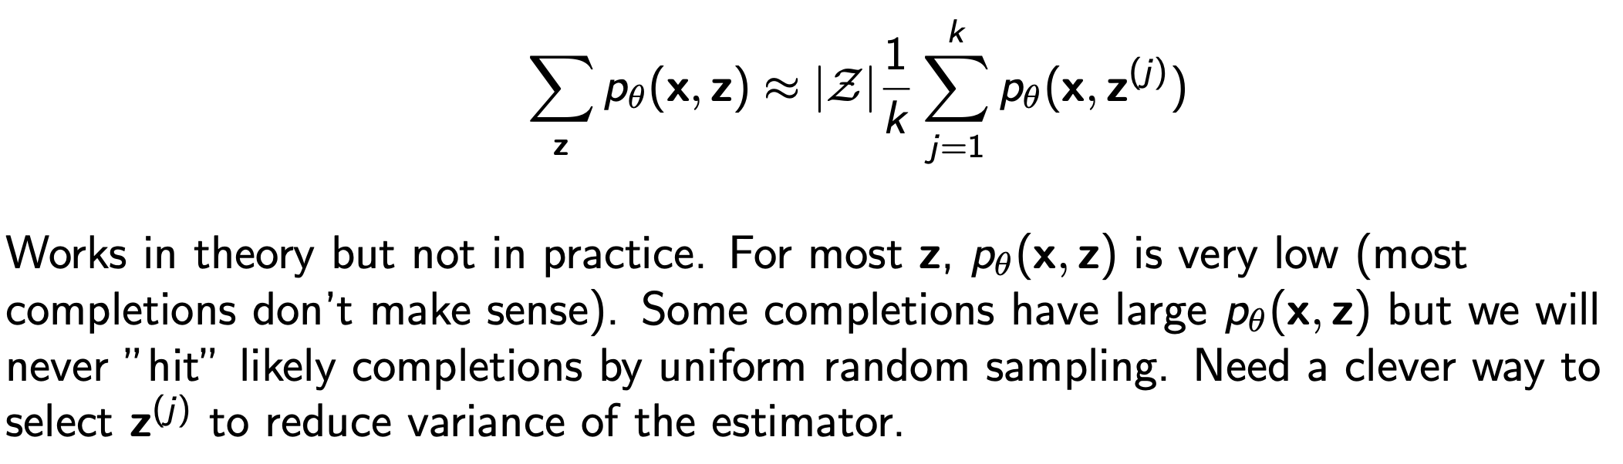
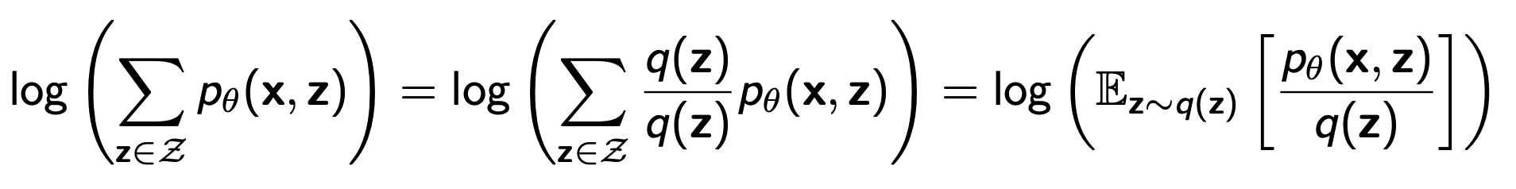
Latent learning / VAE (Variational AutoEncoder)
Naive Monte Carlo :
uniformly sample z value
Importance Sampling :
Sample z from q distribution
Log-Likelihood function for Partially Observed Data is hard to compute:

Slide 4
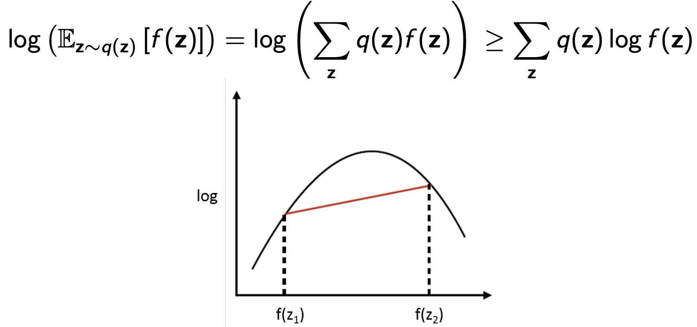
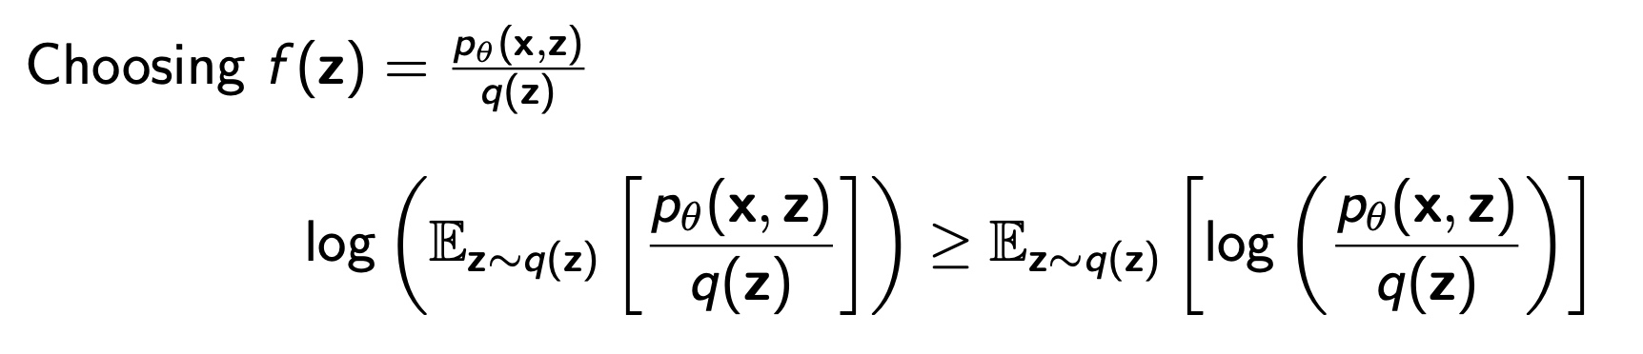
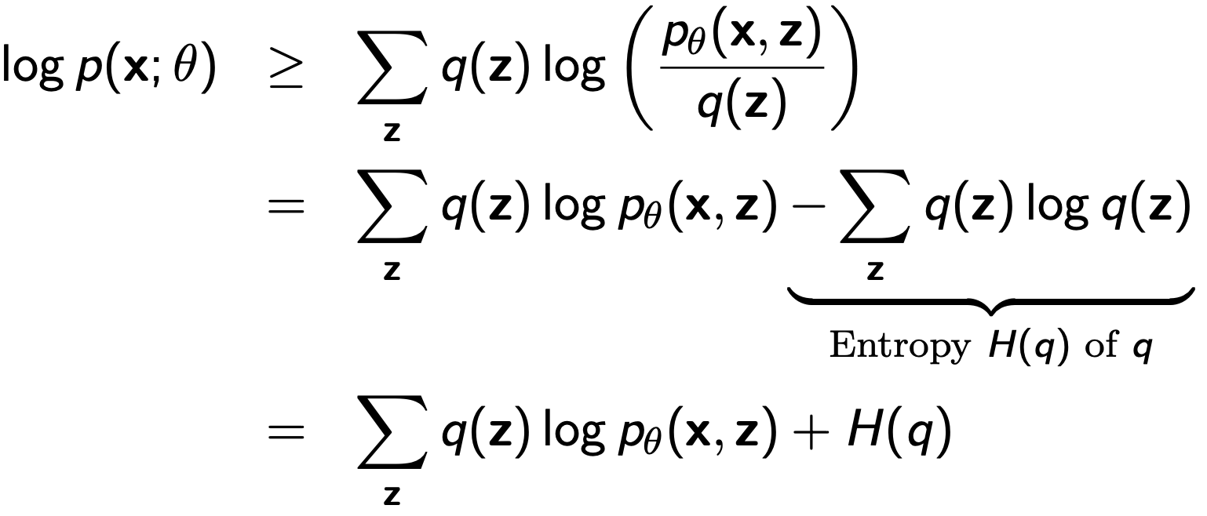
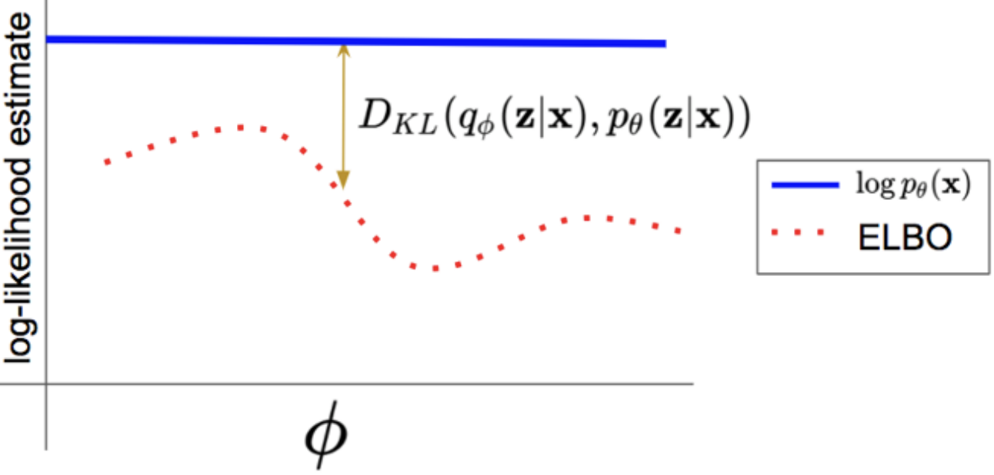
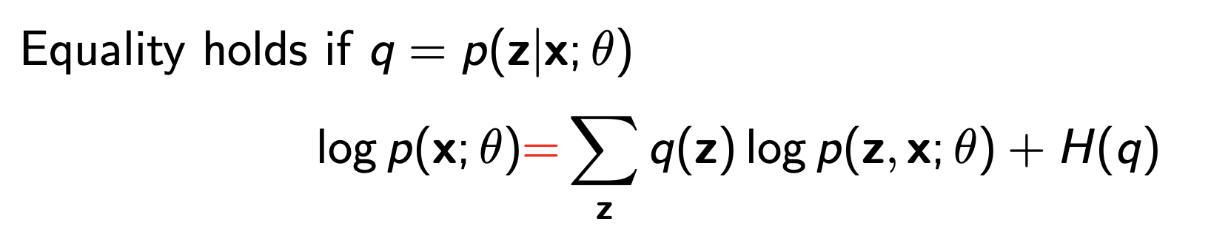
Evidence Lower Bound (ELBO)
Jensen Inequality (for concave functions)
Suppose q(z) is any probability distribution over the hidden variables Evidence lower bound (ELBO) holds for any q:

Slide 5
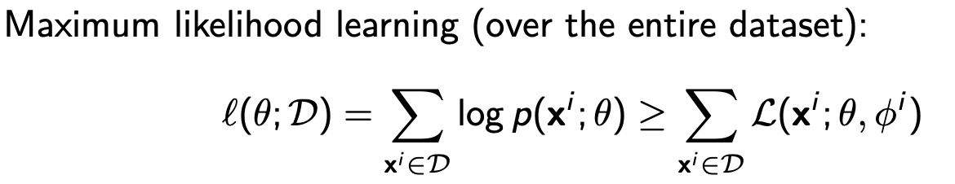
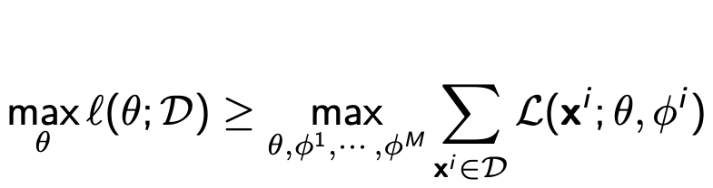
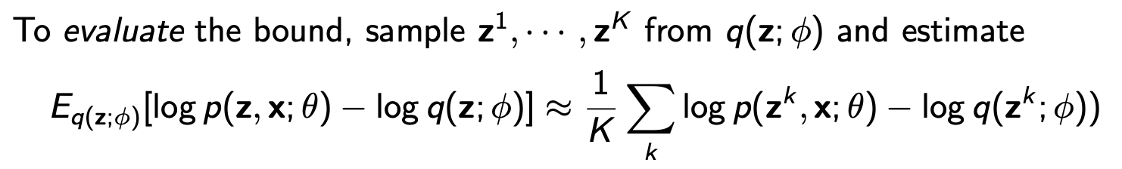

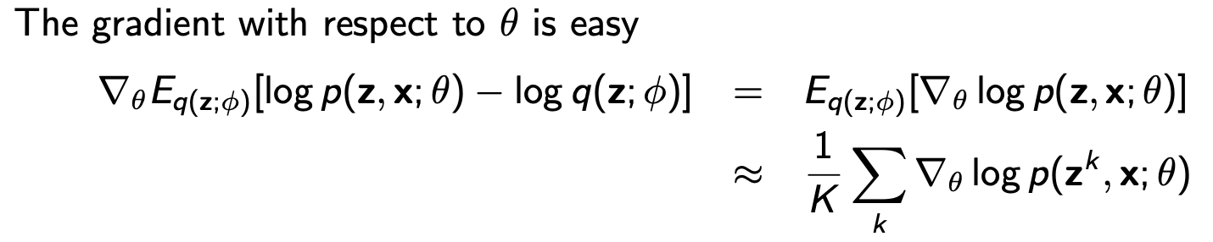
ELBO applied to the entire dataset
Note that we use different variational parameters ϕ_i for every data point x_i , because the true posterior p(z|x_i ; θ) is different across datapoints xi
is more complicated
Reparameterization

Slide 6
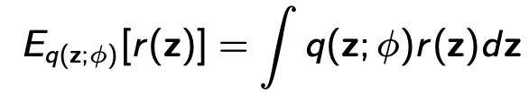
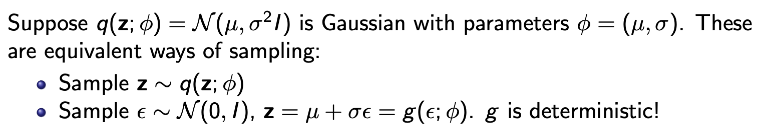
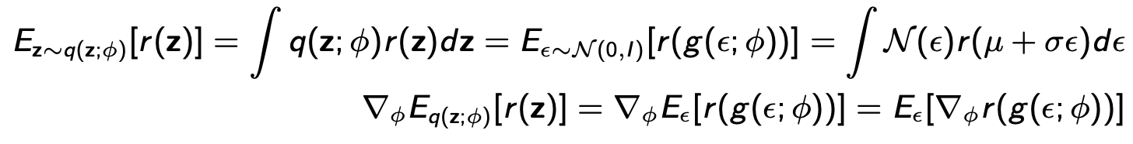
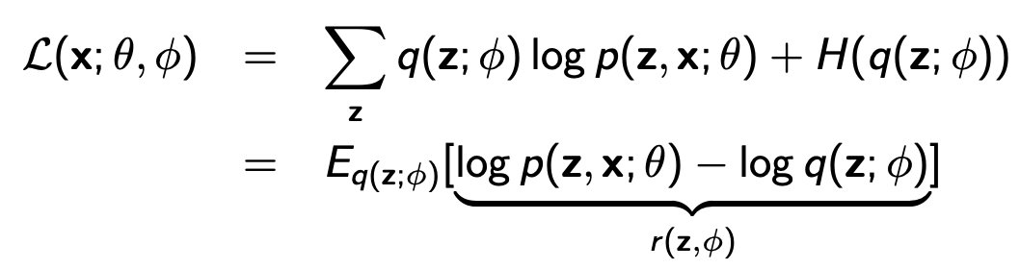
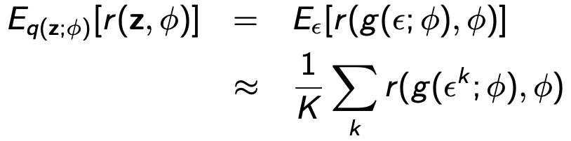
Reparameterization
If z is continuous:
Our Case:

Slide 7
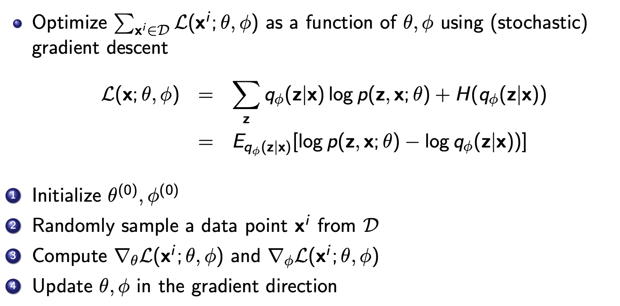
Learning with amortized inference

