Slide 1
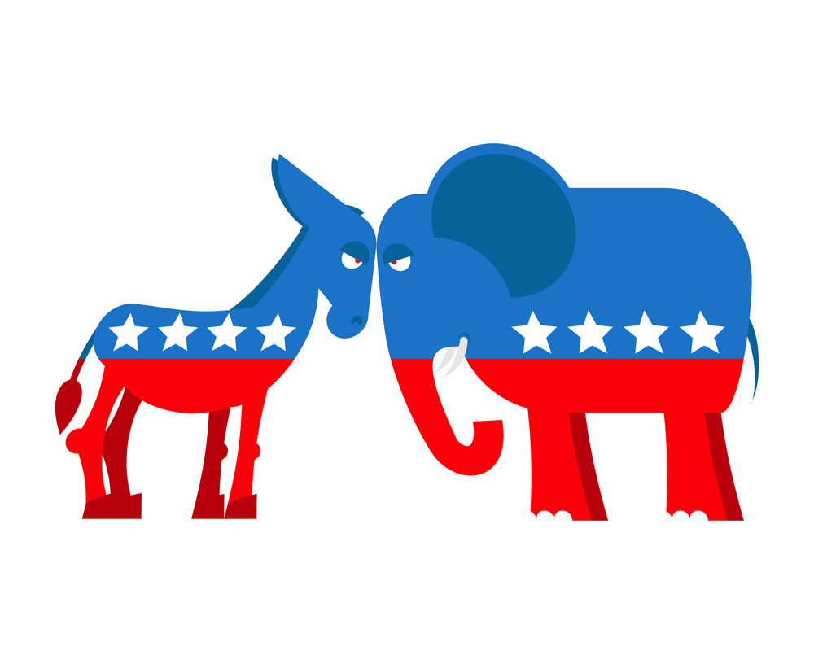
Lobbyists4America
Analysis of US political tweets 2008-2017

Slide 2
Who is this presentation for?
There is an increasing trend of political communication on social media; for campaigners wanting to organise social media persuasion campaigns around certain issues, it’s worth knowing the basics of political tweeting habits in order to know who, how and when to contact
Conversely, if you are working for a political campaign, it’s always good to know how friendly and less friendly politicians engage with social media in order to know how much energy to invest in which social media activities and when

Slide 3

Contents
Questions/hypotheses
Preparing the dataset
ERD diagram
Descriptive statistics
Correlations
Text analysis
Conclusions

Slide 4
Questions I wanted answered
Is a politician’s popularity on Twitter correlated to the frequency of tweeting? There will be obvious outliers, of course (e.g POTUS).
Is there correlation between who the politicians engage with (other politicians/ ”ordinary people”/organisations and think-tanks) and other attributes (party, seniority, follower count)?
Do tweeting habits differ significantly between politicians of different parties?

Slide 5
Starting hypotheses
Politicians that tweet across party lines, i.e., engage directly with their political opponents, are more popular (have a higher follower/retweet count) than politicians that only engage with their own side.
» Useful to know whether it’s worth engaging with political opponents to increase your popularity
Politicians engage with more contentious topics (e.g., immigration/crime/abortion) at certain times (before elections) and express more polarized opinions.
Sentiments for tweets are mostly neutral or slightly positive.
» Useful to know whether it’s worth engaging with political opponents to increase your popularity

Slide 6
Approach
Use statistics on the two tables: tweets and users:
» Find the statistics on user metrics such as RT counts, follower counts, friend counts, etc
» Join the two tables to correlate user metrics to averaged tweet metrics
» Find correlations between given metrics as well as created metrics
Text analysis:
» Word count and frequency analysis
» Sentiment analysis
» Topic modelling using LDA
Creating new metrics:
» Which political parties do the users belong to?
» How often do they mention user belonging to other parties?

Slide 7
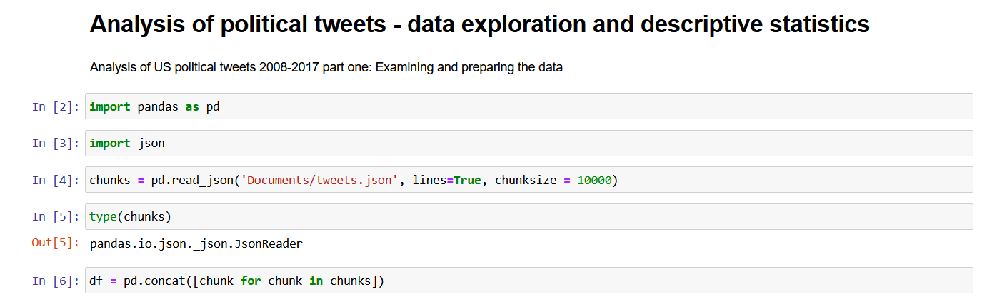
Preparing the dataset
The problems with preparing the dataset had mostly to do with memory and length of computation:
The tweet dataset is very large (>1,200,000 tweets, 31 columns)
The joins can take quite a long time
Part of the metric calculation involved finding the political parties to which the tweeters belong using the Wikipedia API, which can give inconsistent results
Use of SQL is quite difficult for statistics compared to the functionalities offered by pandas library

Slide 8
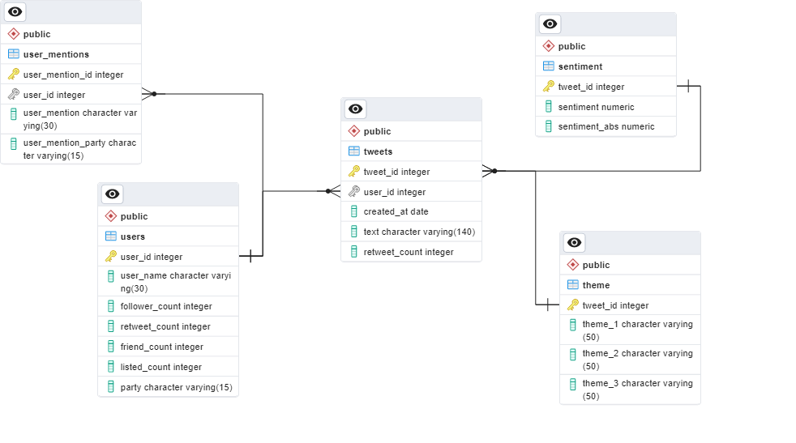
ERD diagram
Created with the PgAdmin ERD tool

Slide 9
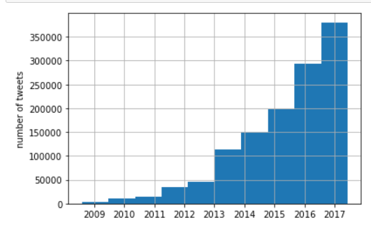
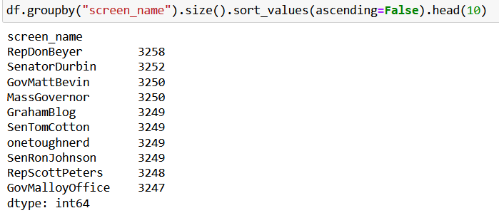
Initial findings
The time range of the dataset:
The most prolific tweeters:
Note the very similar tweet counts for the top ten tweeters!

Slide 10
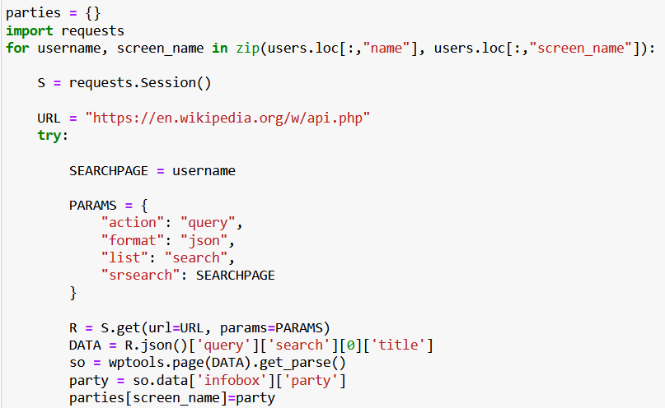
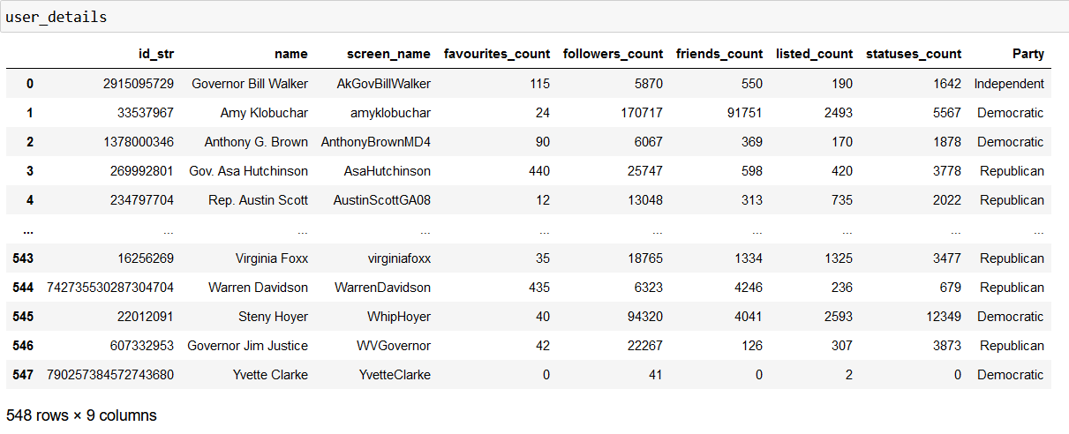
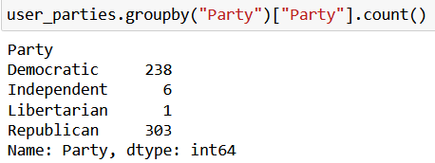
Creating new metrics - 1
The most important created metric: which political party the tweeters belong to

Slide 11
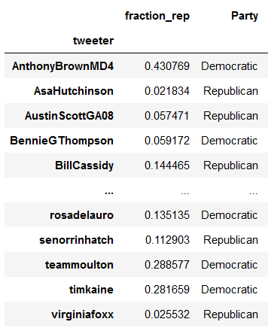
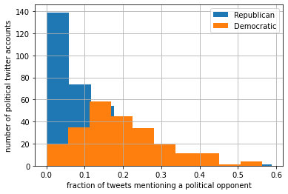
Creating new metrics - 2
Using the newly found metric we can derive another – what fraction of tweets mention a user from an opposing party.

Slide 12
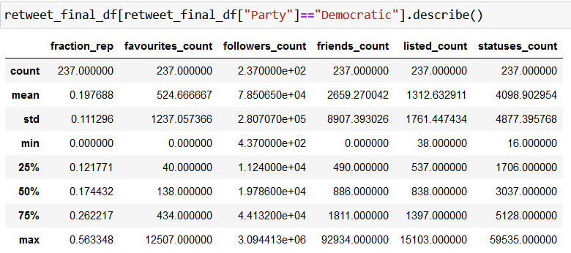
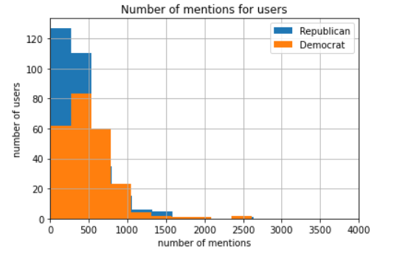
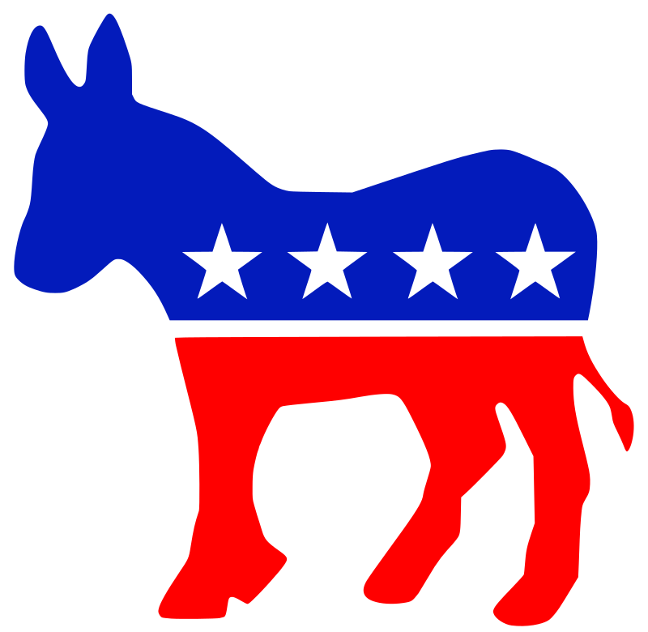
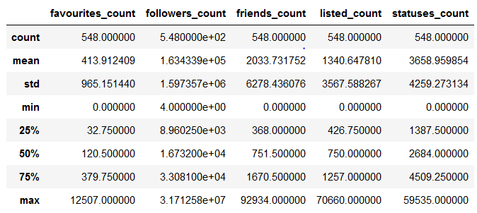
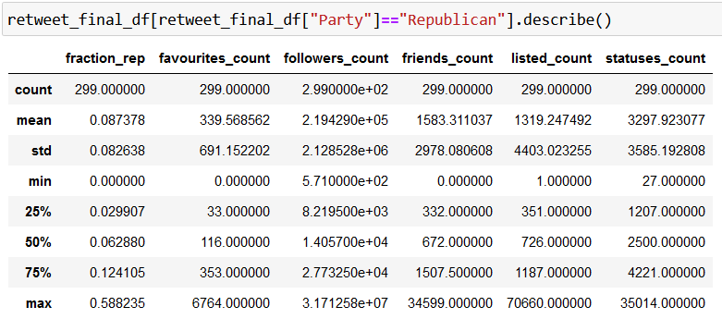
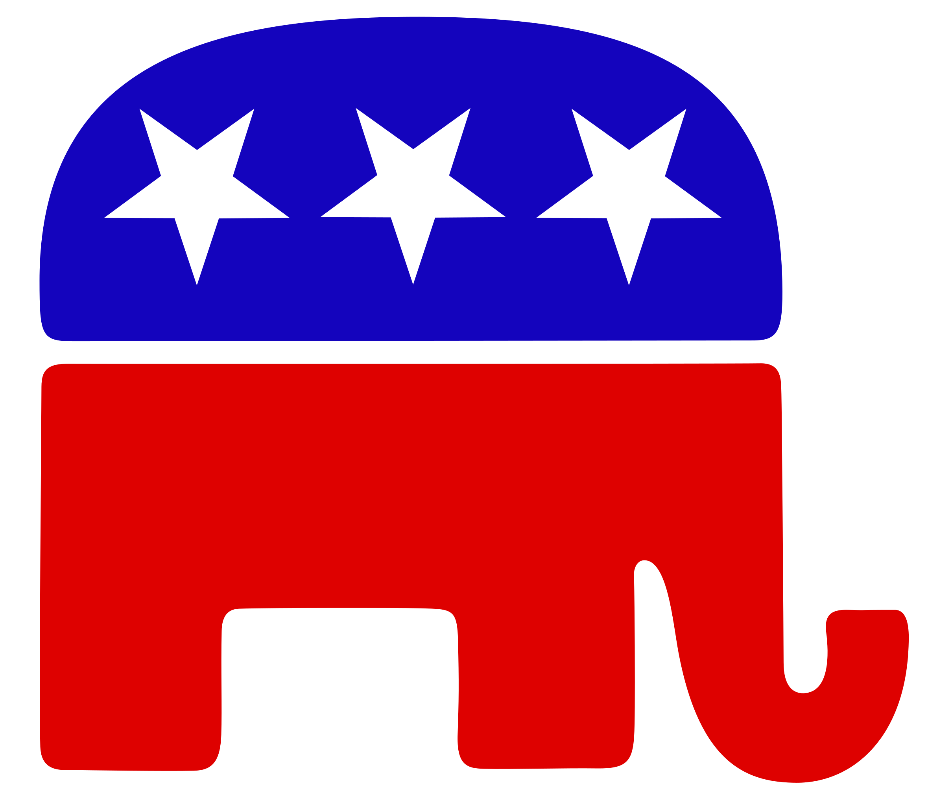
Descriptive statistics
Group by political party
Clearly, Democrats are more likely to mention a Republican in their tweets then Republicans are to mention a Democrat
Follower count statistics are similar, except there are a few Republicans with very high follower counts

Slide 13
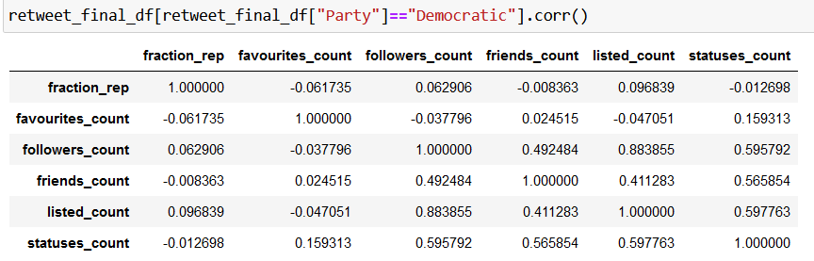
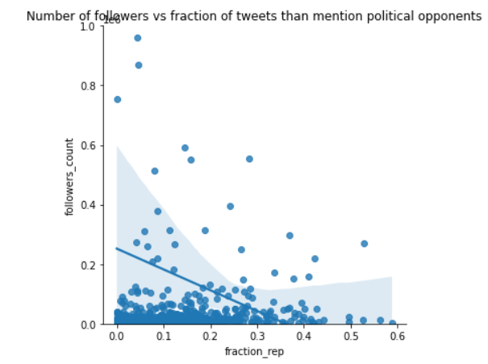
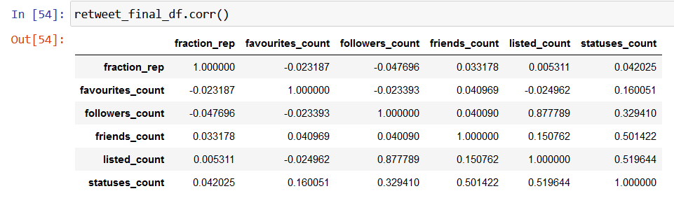
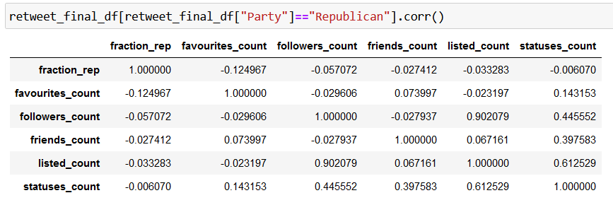
Correlations and relationships
One of my hypotheses has been disproven – there is no correlation between the fraction of mentions that involve a political opponent and any popularity metric!
Another interesting point when examining the differences between parties: no correlation between number of friends and number of followers with Republicans, but a moderate correlation with Democrats

Slide 14
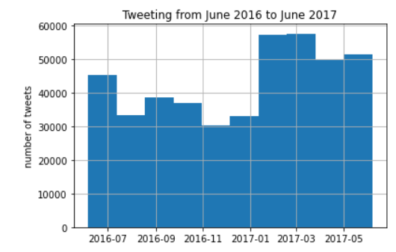
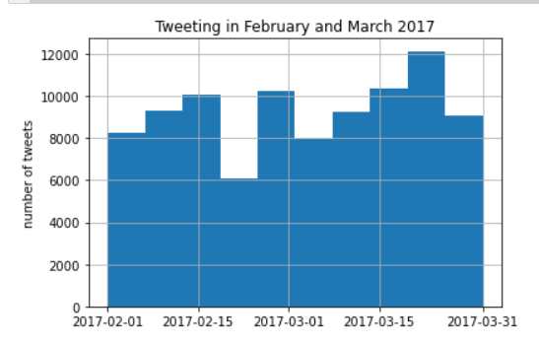
A bit more on the frequency of tweeting…

Slide 15
Text analysis
Using the NLTK module we can use the FreqDist class to find the frequencies of words occurring in the tweets
Certain words stand out (underlined) and this might point us to the priorities of different parties

Slide 16
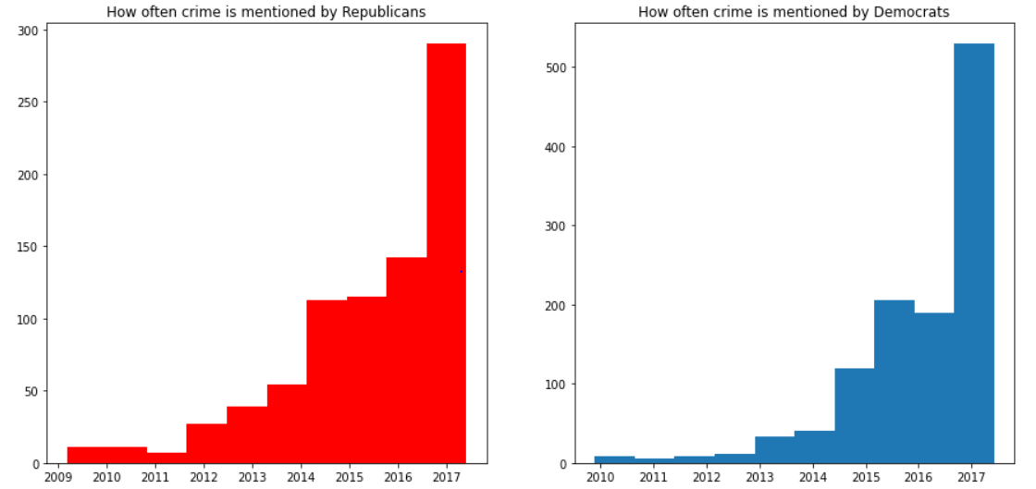
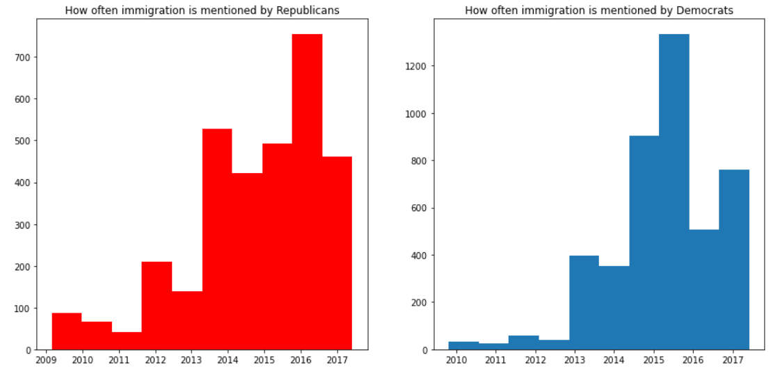
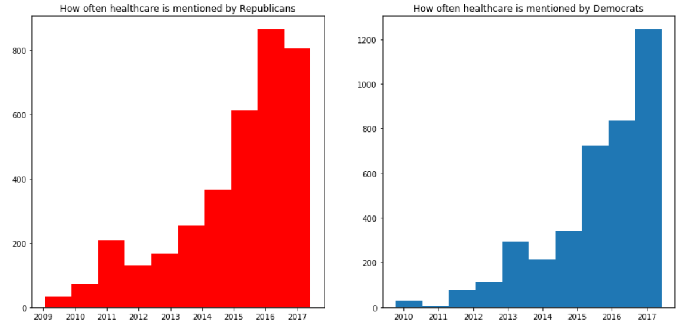
Word usage analysis
Immigration, crime, healthcare – there seems to be some difference as to when they’re mentioned by different parties – immigration distributions seem to be quite different!

Slide 17
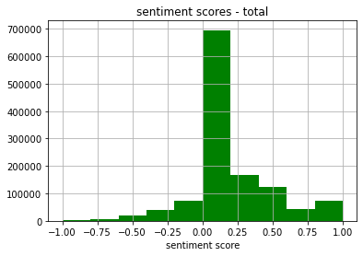
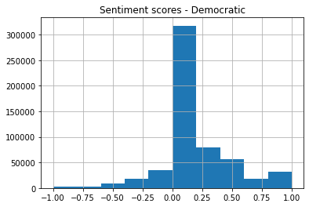
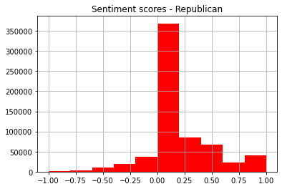
Sentiment analysis
Using the textblob module, we can associate a sentiment to every tweet
We can look at overall sentiments and sentiments across the two parties
The distributions look quite similar and are both neutral and leaning slightly towards positive

Slide 18
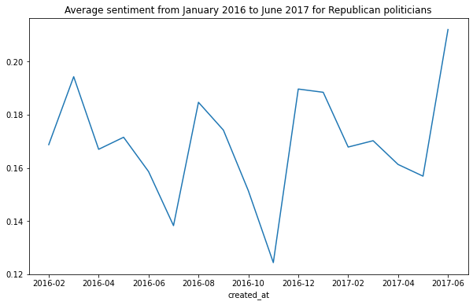
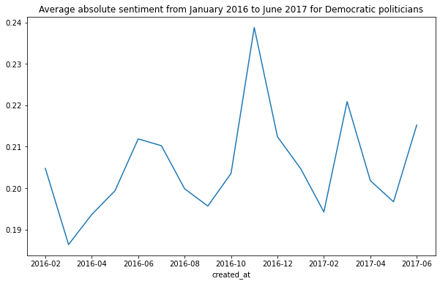
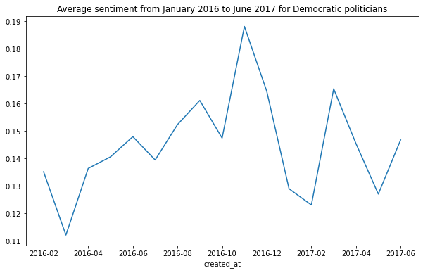
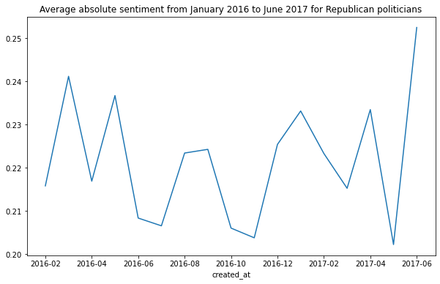
More sentiment analysis + new metric
New metric: absolute value of the sentiment – might be useful to find how strongly different politicians feel about a topic
The average sentiments 2016-2017 for the two parties seem almost like mirror images of each other

Slide 19
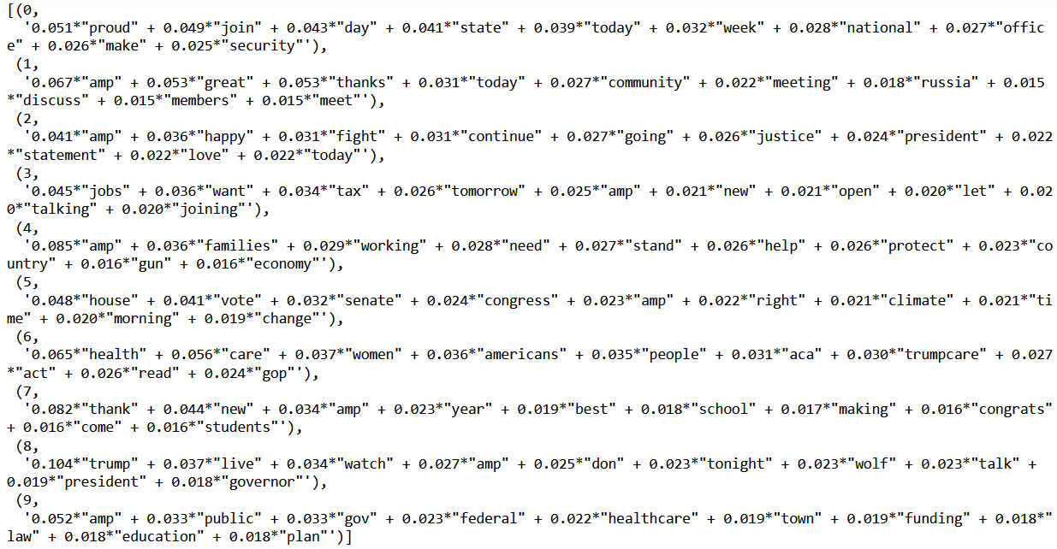
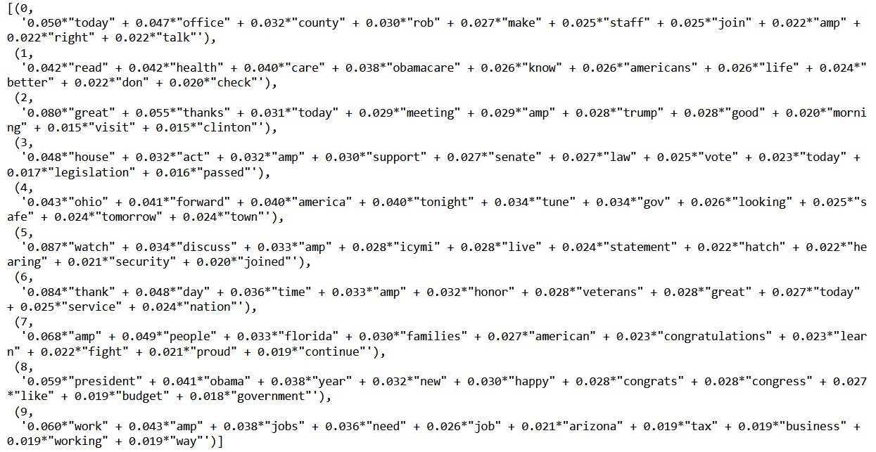
Topic modelling
The topics modelled using the LDA method from the gensim module gives ten topics and we can see that there are certain topics that matter to one party more than the other
Notable: Rep topic 6 (“veterans”), Dem topics 1 (“Russia”) and 5 (“climate”)

Slide 20
Back to our hypotheses
Politicians that tweet across party lines, i.e., engage directly with their political opponents, are more popular (have a higher follower/retweet count) than politicians that only engage with their own side.
FALSE
There was no correlation between the likelihood of mentioning a political opponent. It doesn’t seem that coming out of your “echo chamber” will immediately make you more popular
Politicians engage with more contentious topics (e.g., immigration/crime/abortion) at certain times (before elections) and express more polarized opinions.
PARTIALLY TRUE
While it is true that topics are mentioned more by the two parties at different times and that sentiment also differs at different times between the two, there is no clear correlation between the topics and the sentiment
Sentiments for tweets are mostly neutral or slightly positive.
TRUE
This is clearly true; sentiments always lean towards slightly positive. Nobody wants to hear constant negativity from a politician.

Slide 21
What next?
The most important task – update the dataset with more recent data!
This will make it one order of magnitude larger (at least) so that we can determine correlations more accurately
Behaviour might have changed as more and more people used Twitter to express themselves
Take electoral success metrics into the picture
So far, we’ve been looking at general tweeting habits and which metrics correlate with Twitter popularity; we would like to know which metrics correlate with electoral success (vote share increase/decrease, etc)
Build statistics for each individual political tweeter
With many more tweets at our disposal, we can build a network analysis model that we can use to predict the likelihood of a person tweeting at another person and how likely they are to sound off on a particular topic

