Slide 1



Cost of Poor Quality (CoPQ)_Sep, 2026
$12,340.69
$23,905.08
$11,564.39
 | VH $5,900.36 | VH2 $2,995.66 | VH3 $97.80 | VH4 $3,346.88 | JV $8,443.79 | JV2 $2,607.22 | JVB $513.38
BC Grade
Re-Inspect
Bottom touch-up paint
N/A
N/A
N/A
N/A
N/A
N/A
N/A
ANALYZE KEY ELEMENTS OF EACH CATEGORY
BC GRADE
RE-INSPECT
TOUCH-UP

Slide 2
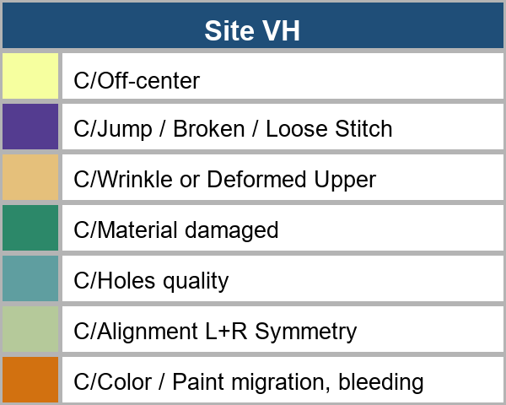
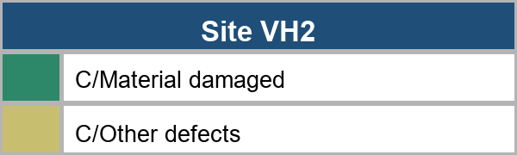
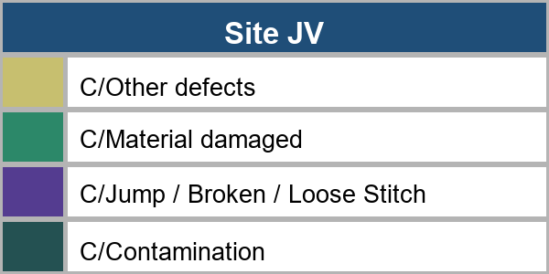
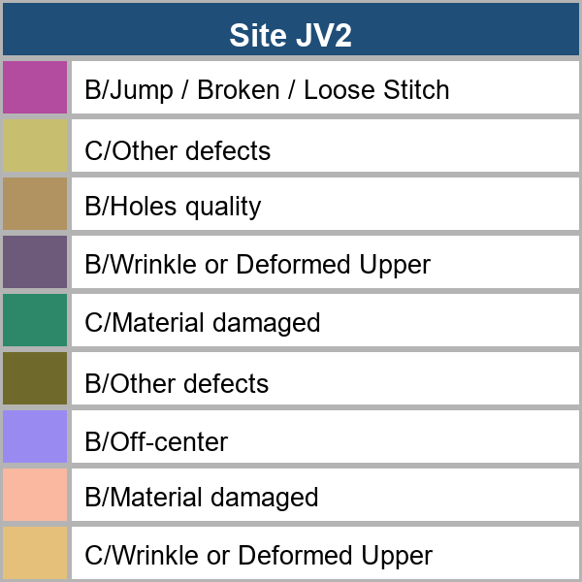
THIS MONTH DETAIL ANALYSIS
CoPQ Analysis
BC GRADE
BY MODEL
BY WORK AREA

Slide 3
CoPQ Analysis
RE-INSPECTION
VH
VH3
JV
JV2
JVB
VH2
ss
$394.07
$97.78
$4.10
$85.29
$241.57
$20.30
$1,229.97
$544.84
$97.80
$580.45
$1,837.15
$513.38
ANALYZE BY MODEL NAME
ANALYZE BY SHOPFLOOR

Slide 4
CoPQ Analysis
TOUCH-UP PAINT
VH
VH2
VH4
$218.13
JV
$3,641.69
$146.00
$10.00
$3,095.89
$2,325.06
$3,333.75
$1,308.72
ANALYZE BY MODEL CODE
ANALYZE BY SHOPFLOOR

