Slide 1
Modeling Mobility with GRU
Team Ghosted
Notes:
Presentation Title

Slide 2



Team Ghosted
Ghosted by 3 Others…
Alex Wan
MS in Data Science
Junyang Jiang
MS in Data Science
Yuki Nishimura
MS in Data Science
Notes:
Introduction

Slide 3
How has COVID-19 affected the mobility of people across the globe?
Impact of COVID-19 on Global Mobility Trends
Mobility Prediction
Notes:
Summary

Slide 4
Impact of COVID-19 on Global Mobility Trends
Notes:
Title of first set of slides

Slide 5
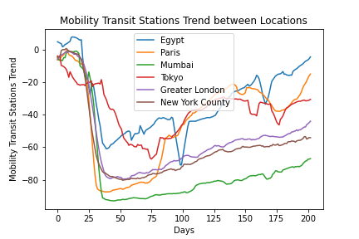
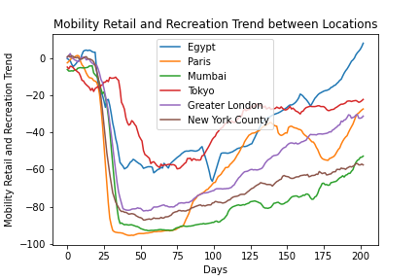
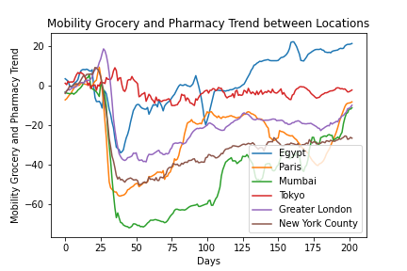
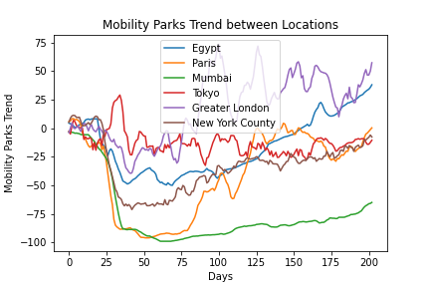
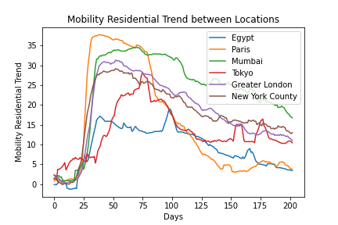
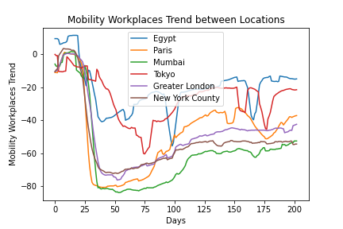
Mobility Trends in Major Locations
We focus on Egypt, France, India, Japan, United Kingdom, and USA, since they are major locations and have few missing values. It seems like some locations have similar trends, while others are quite different (confirmed in next slide)
Transit Stations
Retail and Recreation
Grocery and Pharmacy
Parks
Residential
Workplaces
Notes:
The takeaway of this slide: just an overview of the mobility trends. Some seem to be similar to each other, while others are quite different. Take a closer look in the next slide.

Slide 6
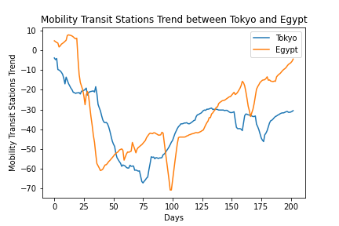
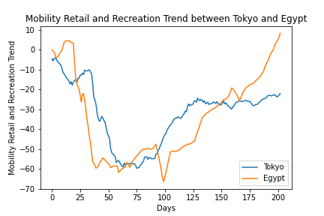
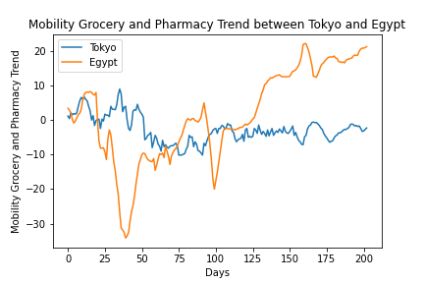
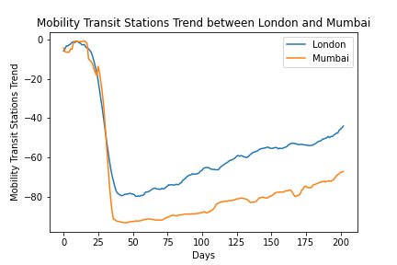
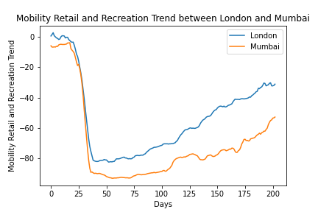
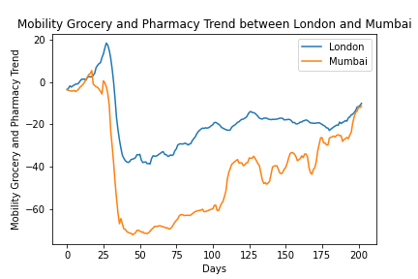
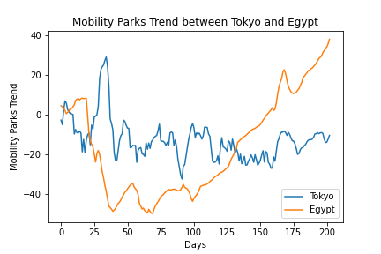
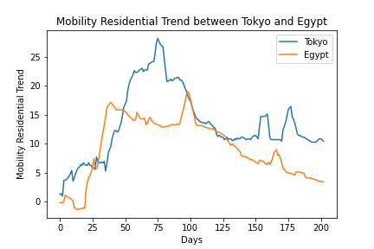
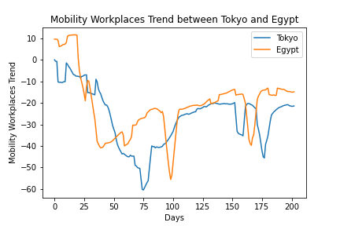
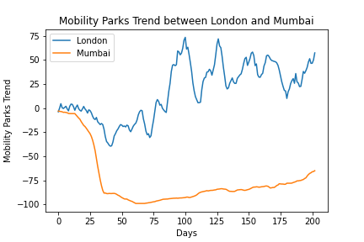
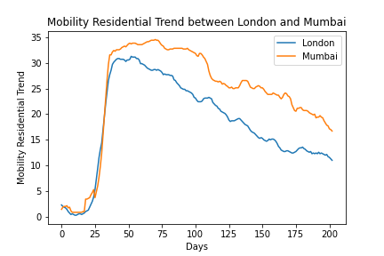
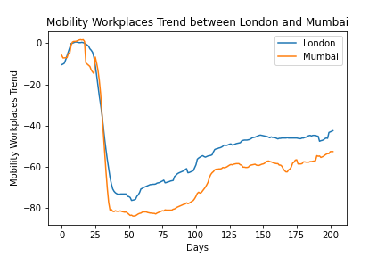
Similarity of Mobility Trends
We measure the similarity of time series using Dynamic Time Warping (DTW) w/squared Euclidean distance.
DTW allows the comparison of multivariate time series.
(the below plots show each mobility trend comparison independently, but in reality mobility trends multivariate time series were compared)
Egypt and Tokyo Distance: 559.618
London and Mumbai Distance:1370.352
Most Similar Locations
Least Similar Locations
Some locations do have relatively similar mobility trends.
(For more specific DTW similarities of mobility trends between each major city, please check the Appendix.)
Notes:
Take away of this slide: some locations have similar mobility trends, while some other have different trends (except for right after covid strikes)

Slide 7
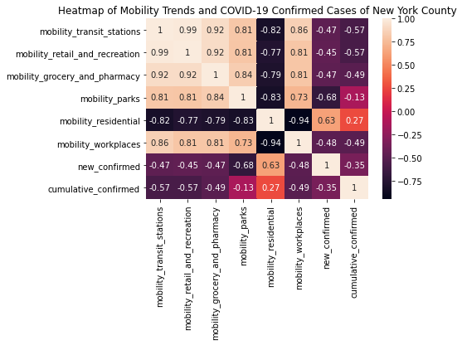
COVID-19 New Cases and Mobility Trends
Ex. New York County
New confirmed COVID-19 cases may have negatively impacted all mobility, except for residential mobility.
(Other locations do have weaker correlation, but COVID-19 cases still seem to affect mobility)
Notes:
Takeaway of this slide: it seems like COVID-19 New Cases and Mobility Trends seem to be correlated to each other in New York. (a weaker correlation in other locations, but still seems to be a good feature to try out to predict mobility trends)

Slide 8
Key Findings
Some locations have similar mobility trends
= mobility trends in some locations could help in predicting mobility trends in other locations
COVID-19 cases seem to affect mobility trends in certain locations
= COVID-19 cases could help in predicting mobility trends
We attempt to validate these findings through modeling mobility
Notes:
Main point

Slide 9
Mobility Prediction
Notes:
Title of first set of slides

Slide 10
Why is mobility prediction important?
Early detection of mobility increases and decreases allow more time for transportation systems and businesses to be prepared
Allows preventive actions to be taken beforehand to reduce COVID-19 outbreaks
Notes:
Title and one column

Slide 11
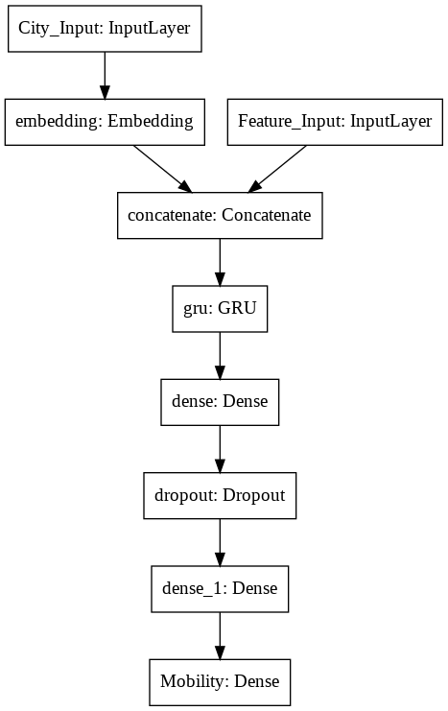
Our Approach
We attempt to predict the 6 mobility trends using a multivariate GRU.
Input of GRU:
- past 50 days of mobility trends
- past 50 days of COVID-19 cases
- past 50 days of weather data
- past 50 days of policy data
Output of GRU:
- 6 mobility trends of the following day
Train Data Period: 2020/2/15 to 2020/7/31
Validation Data Period: 2020/8/1 to 2020/8/10
Test Data Period: 2020/8/11 to 2020/9/10
(Please check Appendix for details)
We use the COVID-19 Open Data and COVID-19 Government Response Data from BigQuery.
(COVID-19 Google Mobility Data was included in the COVID-19 Open Data)
Notes:
Incorporating data from other locations seem to improve the performance of the LSTM

Slide 12
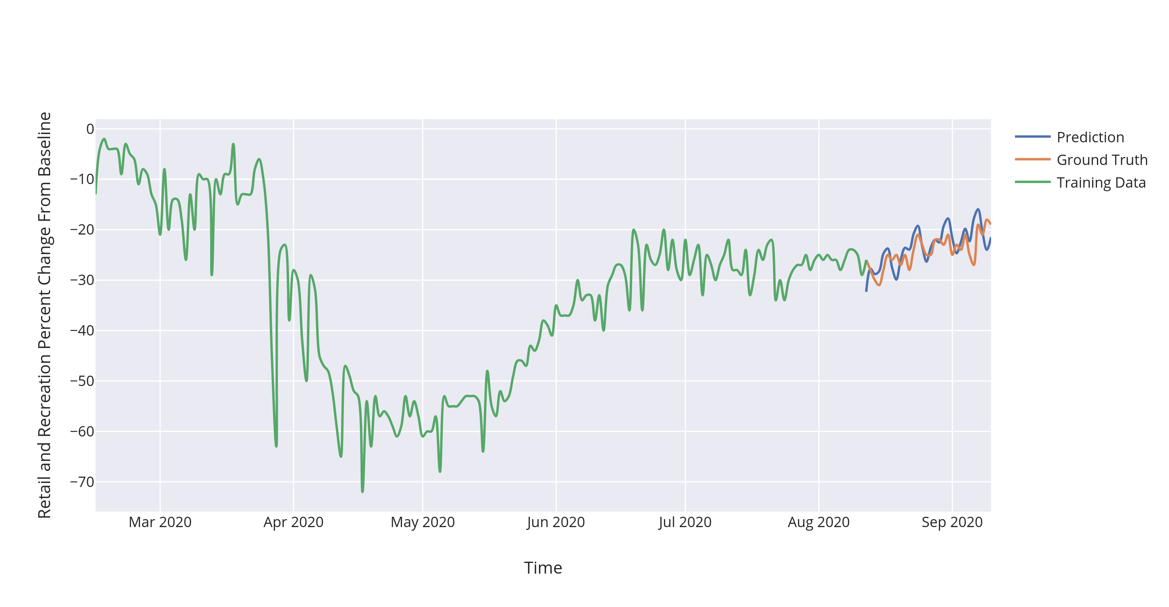
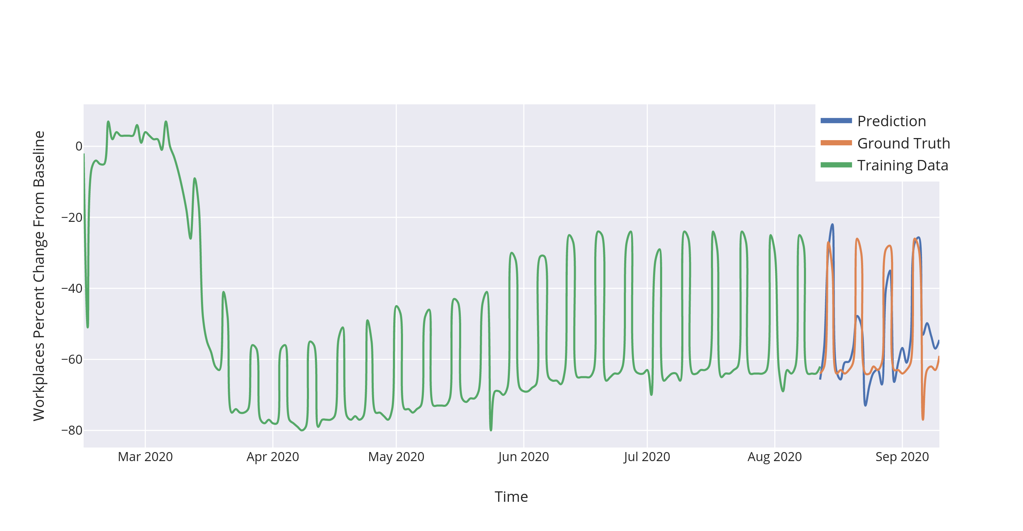
Random samples of our results
Tokyo Retail and Recreation Mobility Prediction
US Workplaces Mobility Prediction
Notes:
Main point

Slide 13
Conclusion and Discussion
We found a possible relationship between COVID-19 and mobility trends, and were able to forecast mobility by building an accurate GRU model
-> Validates our earlier findings/hypothesis about how COVID-19 affects mobility
Our model may have been able to capture similarities between countries within the hidden layers
We used only 6 major locations for analysis and modeling, so there is still much room for improvement in both aspects

Slide 14
Thank you!
Slides borrowed from SlidesMania.com
Notes:
Final slide

Slide 15
Appendix

Slide 16
Similarity of Mobility Trends time series between Major Locations (DTW w/squared Euclidean)
 | Egypt | Paris | Mumbai | Tokyo | London | New York
Egypt | 0 | 749.433 | 1126.082 | 559.618 | 983.372 | 806.360
Paris | 749.433 | 0 | 791.410 | 729.578 | 889.969 | 606.208
Mumbai | 1126.082 | 791.410 | 0 | 1062.144 | 1370.352 | 650.711
Tokyo | 559.618 | 729.578 | 1062.144 | 0 | 812.099 | 730.503
London | 983.372 | 889.969 | 1370.352 | 812.099 | 0 | 740.210
New York | 806.360 | 606.208 | 650.711 | 730.503 | 740.210 | 0

Slide 17
Similarity of COVID-19 New Cases time series between Major Locations (DTW w/squared Euclidean)
 | Egypt | Paris | Mumbai | Tokyo | London | New York
Egypt | 0 | 4545.993 | 6588.306 | 6541.919 | 2931.451 | 4369.360
Paris | 4545.993 | 0 | 6226.918 | 1328.405 | 1568.469 | 1805.624
Mumbai | 6588.306 | 6226.918 | 0 | 9887.494 | 8016.171 | 9878.802
Tokyo | 6541.919 | 1328.405 | 9887.494 | 0 | 1781.535 | 1079.542
London | 2931.451 | 1568.469 | 8016.171 | 1781.535 | 0 | 1341.394
New York | 4369.360 | 1805.624 | 9878.802 | 1079.542 | 1341.394 | 0

Slide 18
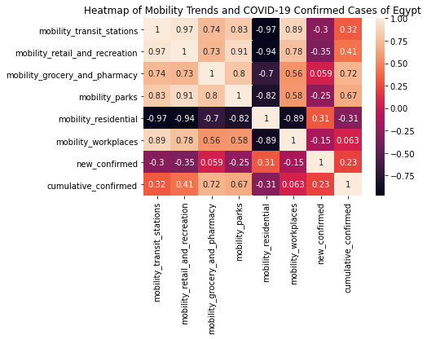
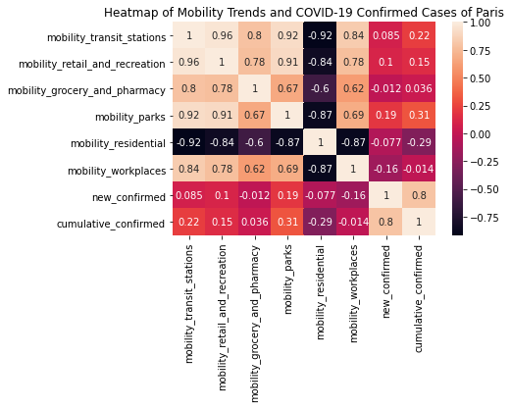
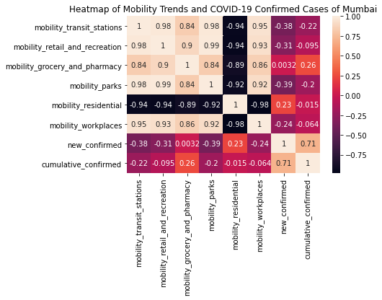
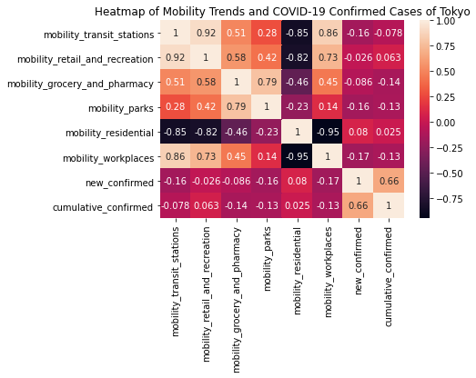
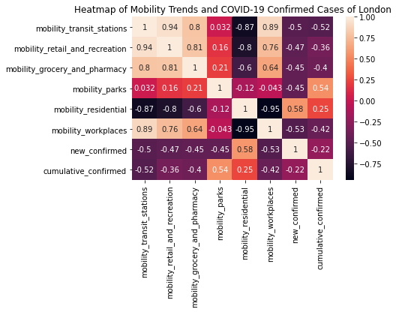
Other COVID-19 New Cases and Mobility Trends

