Slide 1
Linear Algebra
Feiyi Wang

Slide 2
Matrix
Rectangular array of numbers
Identify element in matrix
Identify dimension

Slide 3
Vector
Vector is n x 1 matrix

Slide 4
Matrix Addition and Subtraction

Slide 5
Matrix - Vector Multiplication

Slide 6
Example
x is Heights:
172 cm
80 cm
60 cm
180 cm
y is Weights

Slide 7

Matrix – Matrix Multiplication
$$×$$

Slide 8
Matrix Multiplication Properties

Slide 9
Identity Matrix

Slide 11
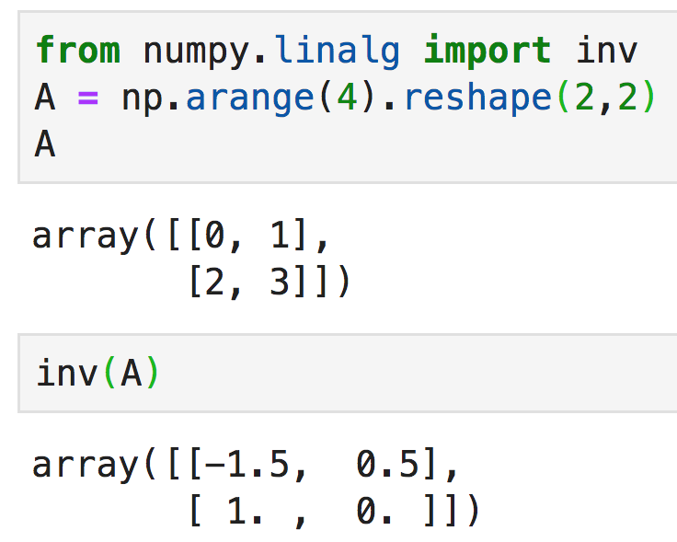
Matrix Inverse
Only square matrix can have inverse
If a square matrix has inverse, then this will hold

Slide 12
Matrix Transpose
A is m x n matrix
Let B be the transpose of A
and B is n x m matrix

