Slide 1
Performance and Scalability Evaluation of the Ceph Parallel File System
Presented by Feiyi Wang
Co-authors: Mark Nelson (Inktank), Sarp Oral, Scotty Atchley, Sage Weil (Inktank), Bradley W. Settlemyer, Blake Caldwell, Jason Hill
Notes:
Know the subject?

Slide 2
Introduction
Oak Ridge Leadership Computing (OLCF)
Jaguar, served by Spider 1 (2008), 240 GB/s, 10 PB, serving more than 26,000 clients. 192 OSS and 1, 344 OSTs
Titan, to be served by Spider 2 (2013), 1TB/s, 32 PB (after RAID)
Both Spider 1 and 2 are used for scratch I/O. HPSS is used for archival storage.
New technology evaluation: Ceph for HPC?

Slide 3
Ceph Overview
Ceph is a distributed storage system designed for scalability, reliability and performance.
The system is based on a distributed object storage service called (RADOS).
Data objects are distributed across Object Storage Devices (OSD), using CRUSH, a deterministic hashing function that allows flexible placement policies.
CephFS builds distributed cache-coherent file system on top of RADOS.
Ceph metadata servers store all metadata in RADOS objects; Ceph can adaptively adjust the distribution of namespace across a pool of metadata servers.

Slide 4
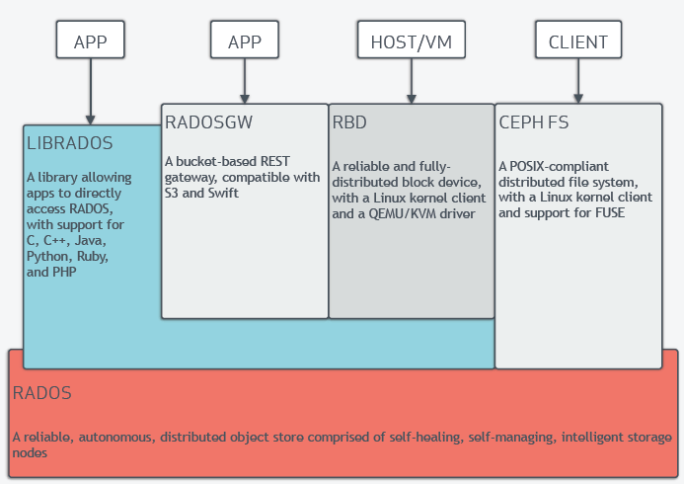
Ceph Architecture

Slide 5
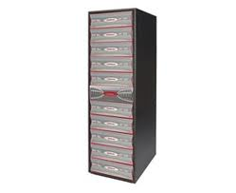
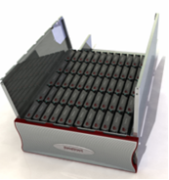
Testbed Environment
DDN SFA10K as storage backend
SFA10K organizes disks into various RAID levels by two active-active RAID controllers; each RAID controller has two RAID processors; each RAID processor has a dual-port IB QDR cards.
200 SAS drives and 280 SATA drives in 10 disk enclosures. Exported as 56 RAID 6 groups.
The storage rack is driven by 4 server hosts with IB QDR connections.

Slide 6
Test Methodology
Our strategy is bottom up. Along I/O path, we establish first the expected theoretical performance, then the observed performance. After tuning efforts, we finally establish the baseline performance at that level.
Generally, we expect performance loss as we move up; The degree of the loss is an indication of how well the system is engineered.
Three key components:
Block devices
Local/back-end file system
Storage network
Parallel File system

Slide 7
Baseline Performance
IB QDR theoretical maximum is around 3.2GB/s, in practice, we observed 3.0 GB/s. With 4 IB QDR connections, we are inline with DDN’s theoretical maximum: 12 GB/s.
Block-level:
Each LUN is a RAID 6 (8+2) array – 8 data disks and 2 parity disks
Write-back cache on has a major impact on SATA RAID group (288 MB vs. 955 MB/s), a minor impact on SAS RAID group (1.12 GB vs. 1.4 GB/s)
Aggregate performance: we observe 11 GB/s for 28 SATA LUNs or 20 SAS LUNs
We conclude that 11 GB/s as baseline performance number, and limitation comes from RAID controller performance.
Notes:
IP over IB: Ceph uses BSD socket, we use IPoIB for networking. The IPoIB over IB QDR can transfer data at around 2.7 GB, it is in the neighborhood of 11 GB/s. Given the performance we observed at both RADOS and File system, we say, IP over IB is not a bottleneck in this case.

Slide 8
RADOS Scaling (1)
4 Servers, 4 Clients, 4MB I/O
We observed period of high performance followed by period
of low performance or outright stalls across different backend file systems
(1) TCP auto-tune enabled
Jim Schutt: “ … unfortunate interaction between the number of OSDs/server, number of clients, TCP socket buffer autotuning, the policy throtter, and limits on the total memory used by TCP stack”
(2) TCP auto-tune disabled
Notes:
Solution (1) net/ipv4/tcp_moderrate_rcvbuf
Solution (2) Ceph manually controller the buffer size.

Slide 9
RADOS Scaling (2)
(a) Scaling OSD per server
(b) Scaling OSD servers
(a) Through experimentation, we observed that number of concurrent operations
are critical to archive high throughput. The graph shows 32 concurrent 4MB objects in flight.
All tests are performed with replication set to 1.
(b) 4 OSD servers, each with 11 OSDs. The perfect scaling would give us aggregate read
at 6616MB/s and write at 5640 MB/s; We are observing a loss of 13.6% and 16.0% respectively.

Slide 10
File System Level: A Different Story
Bottom line: though we have obtained reasonable performance at RADOS level, it did not translate into
file system level performance, at all.

Slide 11
Improving RADOS
osd_op_threads, 7.3% and 9% improvement
journal_aio, 11.5% and 16.3% improvement
Other probed parameters: no tangible and repeatable impacts

Slide 12
Improving Ceph File System Performance
We observed significant performance impact
due to client side CRC32. More so on write then read.
Inktank has since implemented SSE4 instruction
based CRC32 for Intel CPU.
To improvement IOR read performance:
(1) Increase read-ahead cache on client side
(2) Inktank investigated heavy lock contention
during parallel compaction in Linux memory
manager.

Slide 13
Summary
Ceph is still under rapid development, and our results shows that. In between versions, large performance swings. Comparing to CephFS, RADOS is much more stable.
Through tuning efforts, we are able to observe Ceph perform at about 70% of raw hardware capacity at RADOS level and 62% at file system level.
Ceph performs “metadata + data” journaling, which maybe fine for host system with locally attached disks, but hurts in SFA10K-alike hardware, where block devices are exposed through IB over SRP protocol.

