Slide 1
RTFlow: realtime multi-agent framework
RT.Assistant Sample
LLM API
Prolog Query Engine
Device audio
WebRTC
App
Code Gen
Query
Voice
OpenAI Realtime Voice API
Agents
Data
Bus
Agent broadcast channel
Flow input channel
Flow
(async state machine)

Slide 2
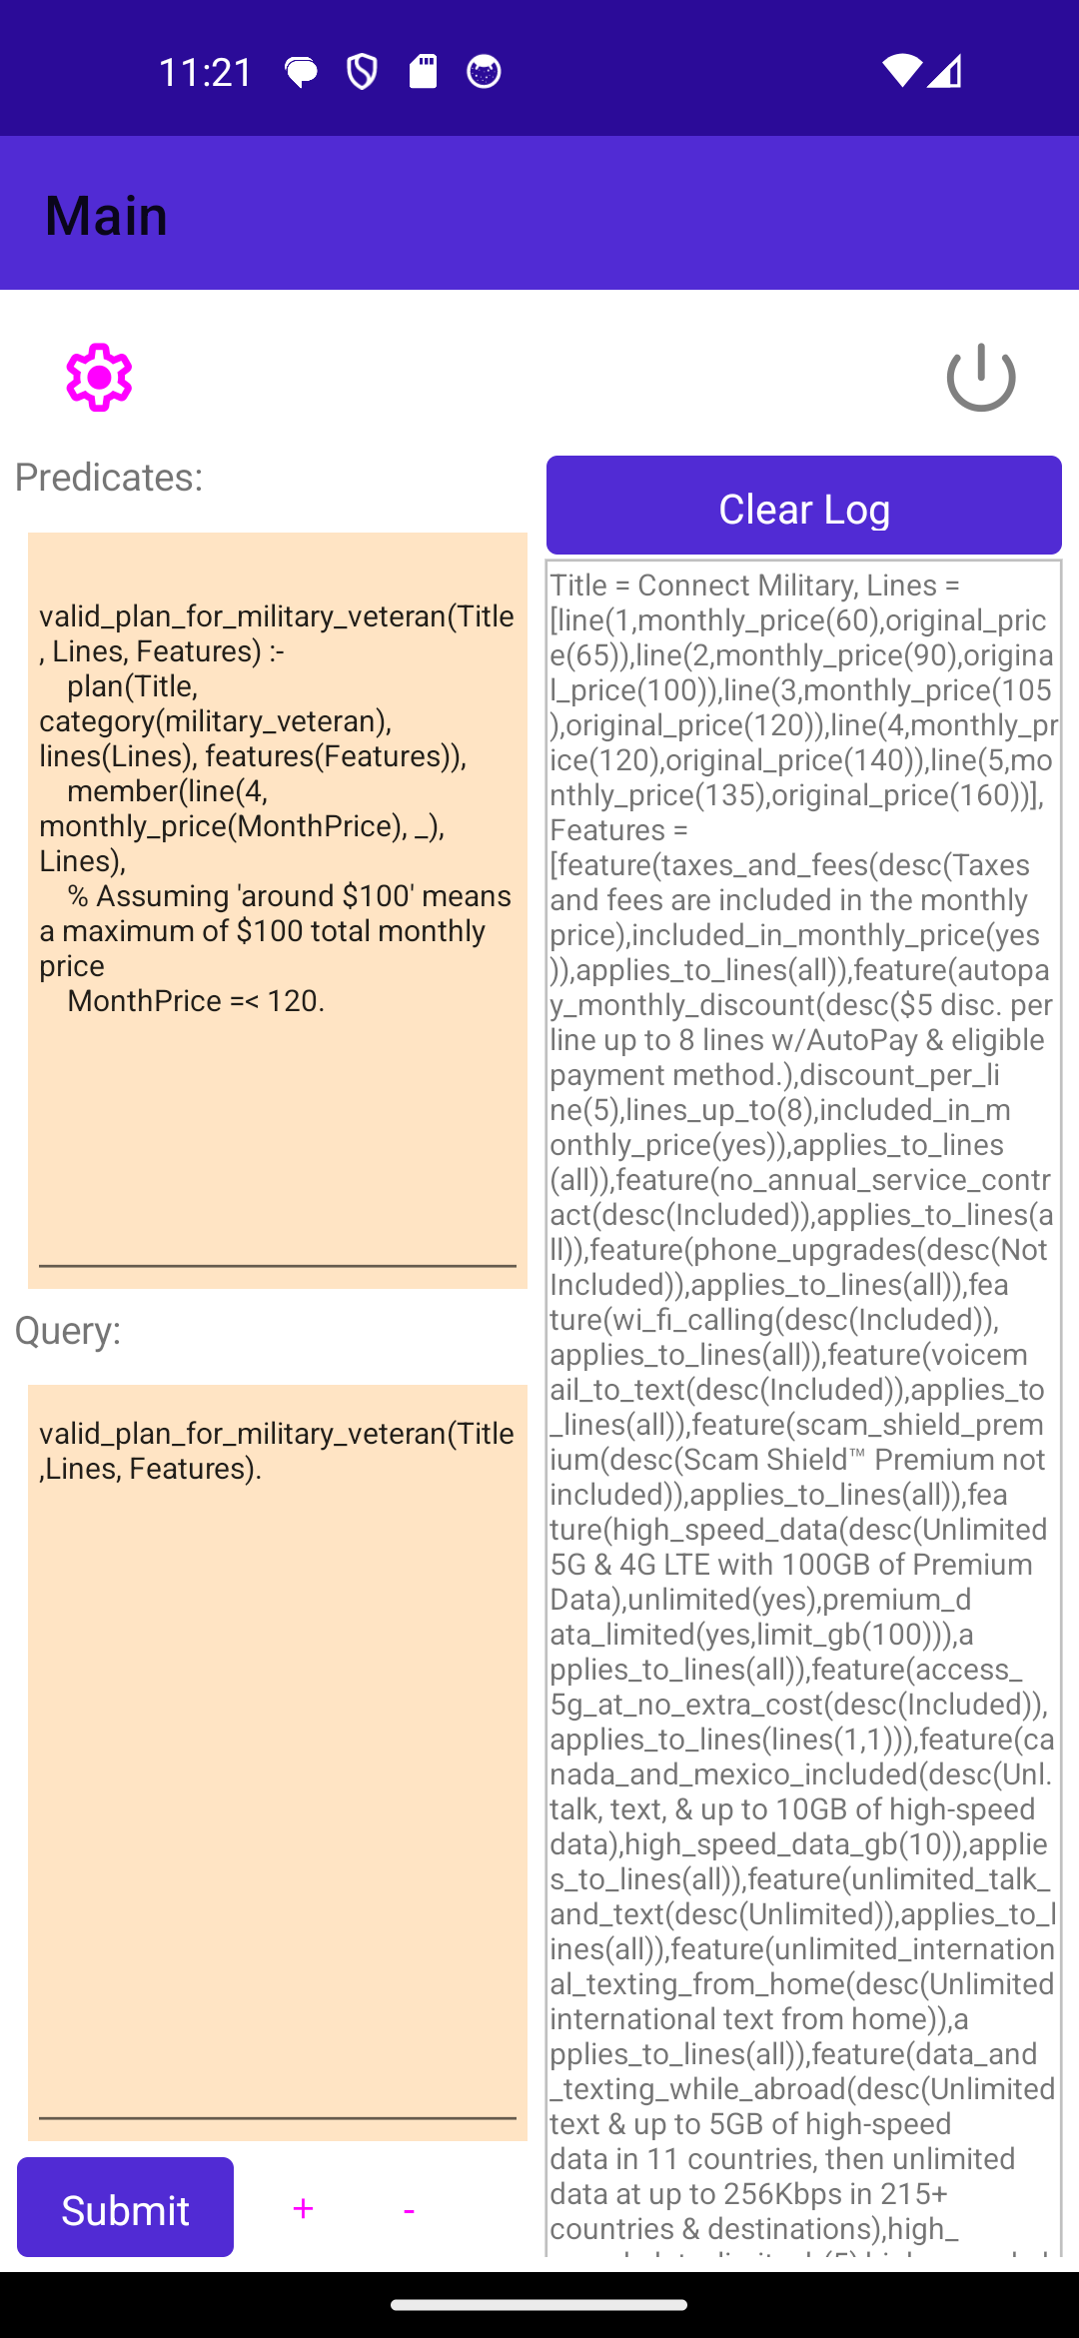
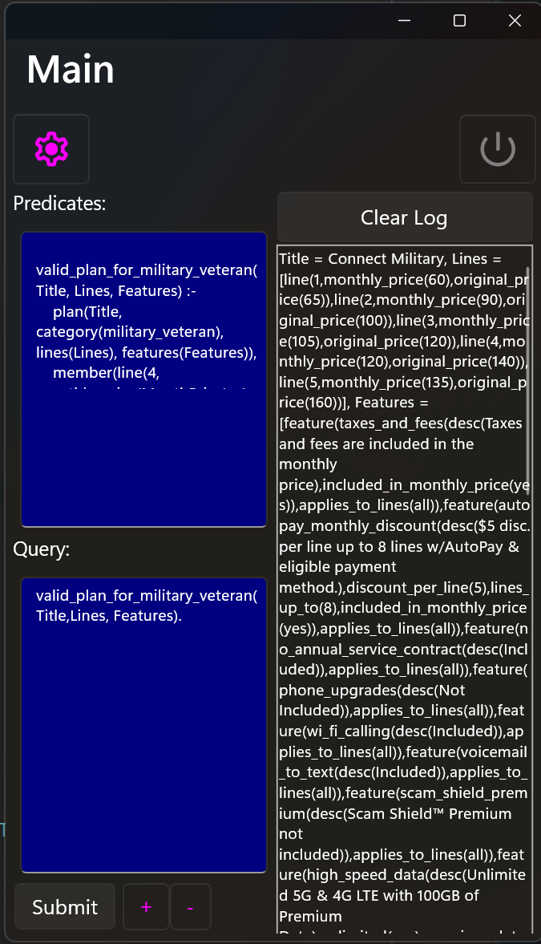
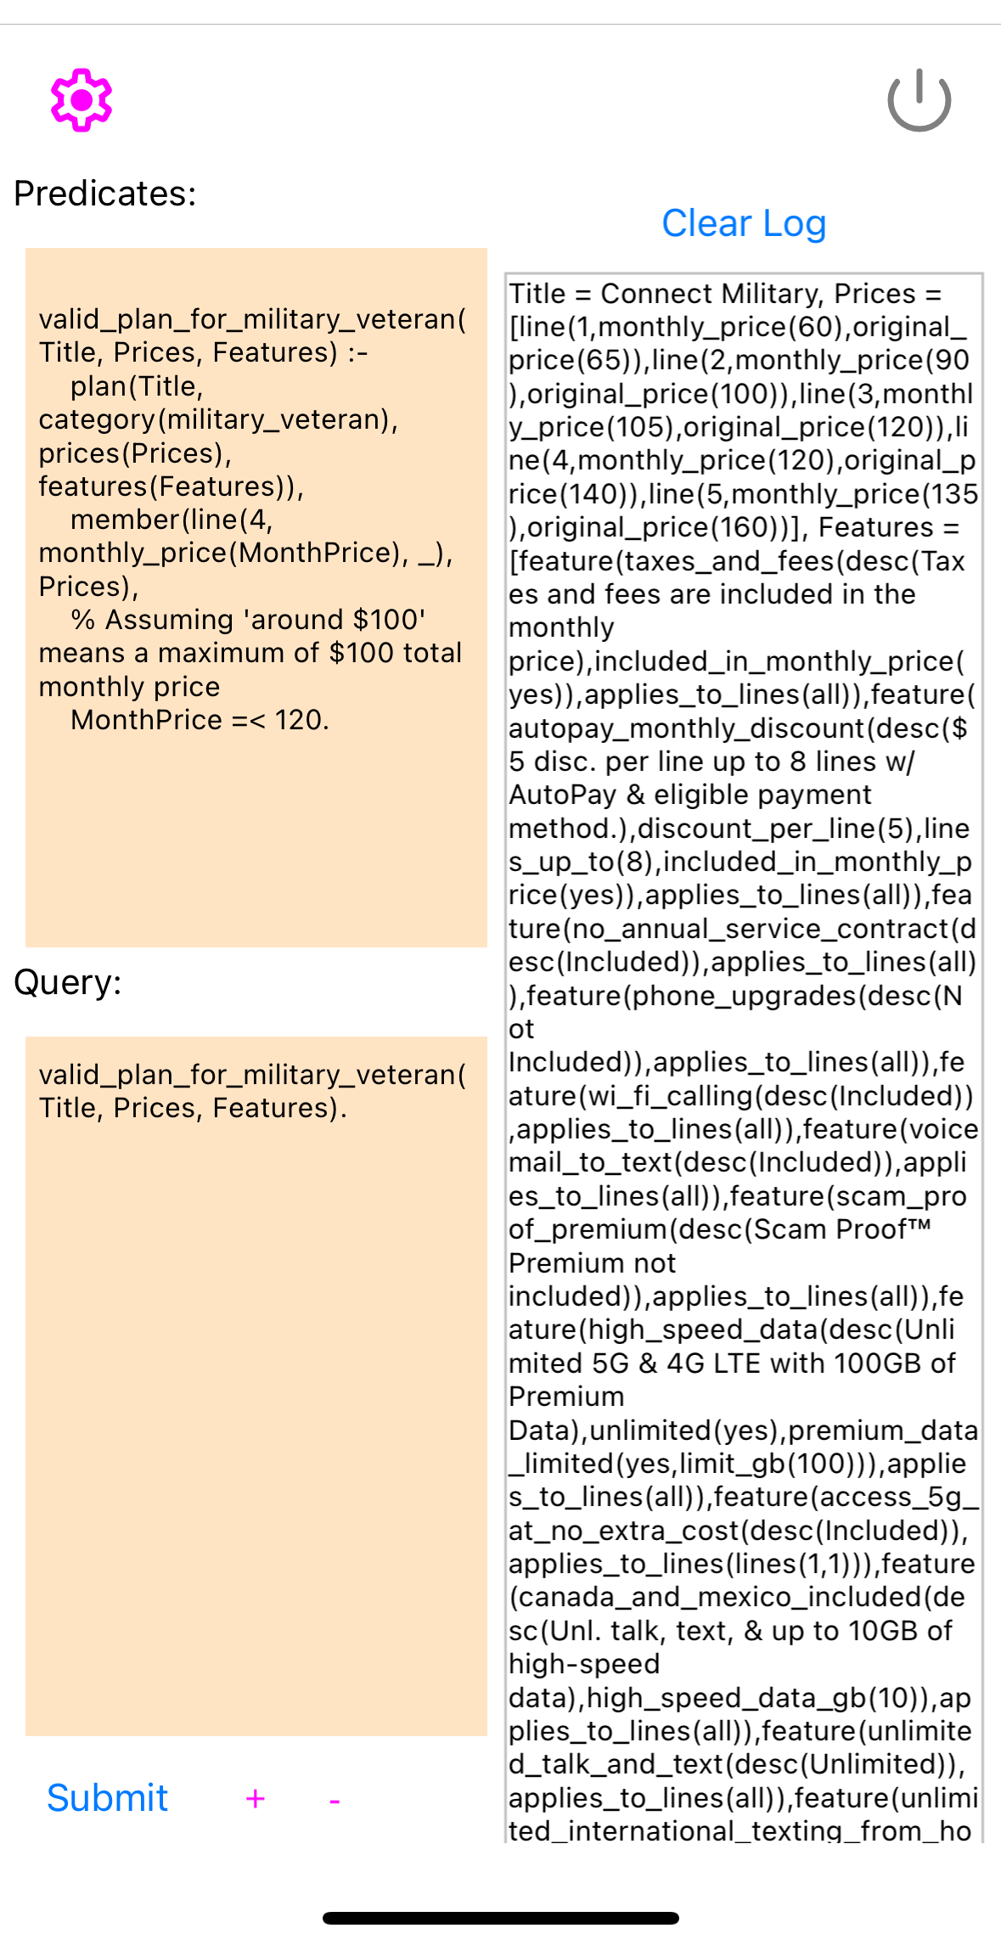
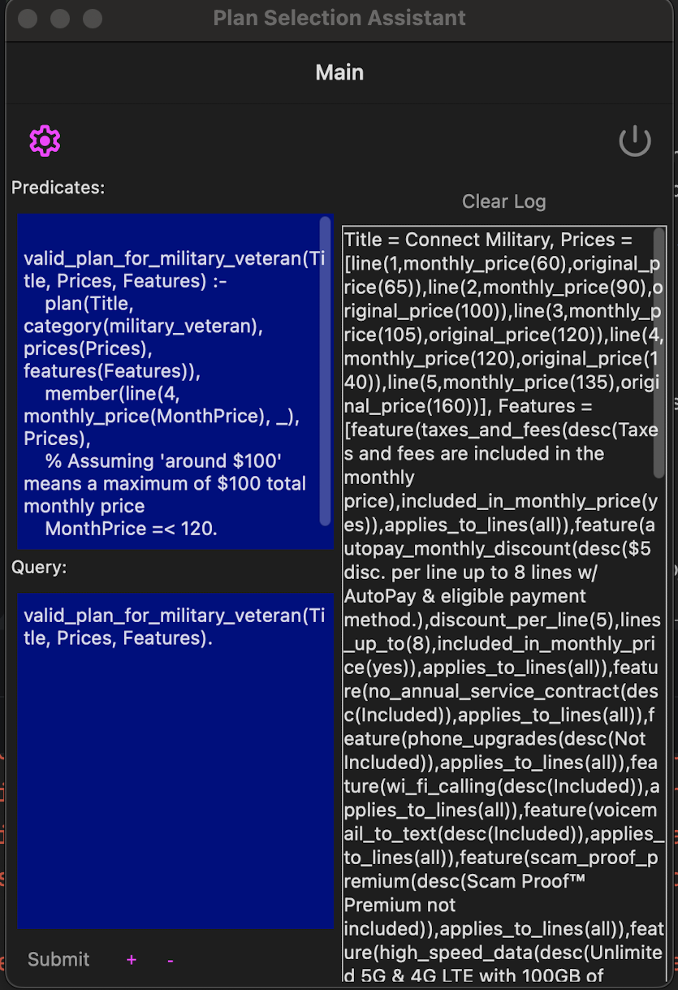
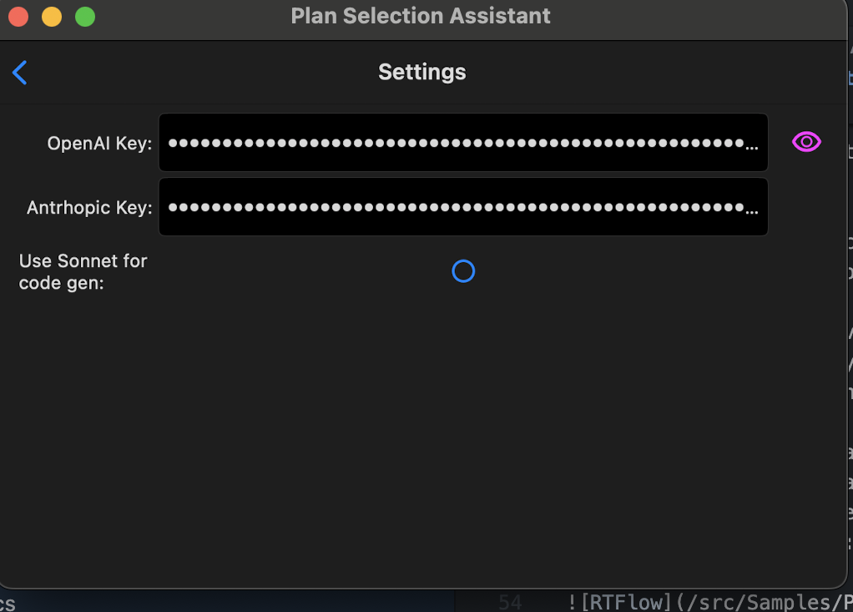
Connect to OpenAI
MacOS
Android
Windows
IOS
Settings

