Slide 1
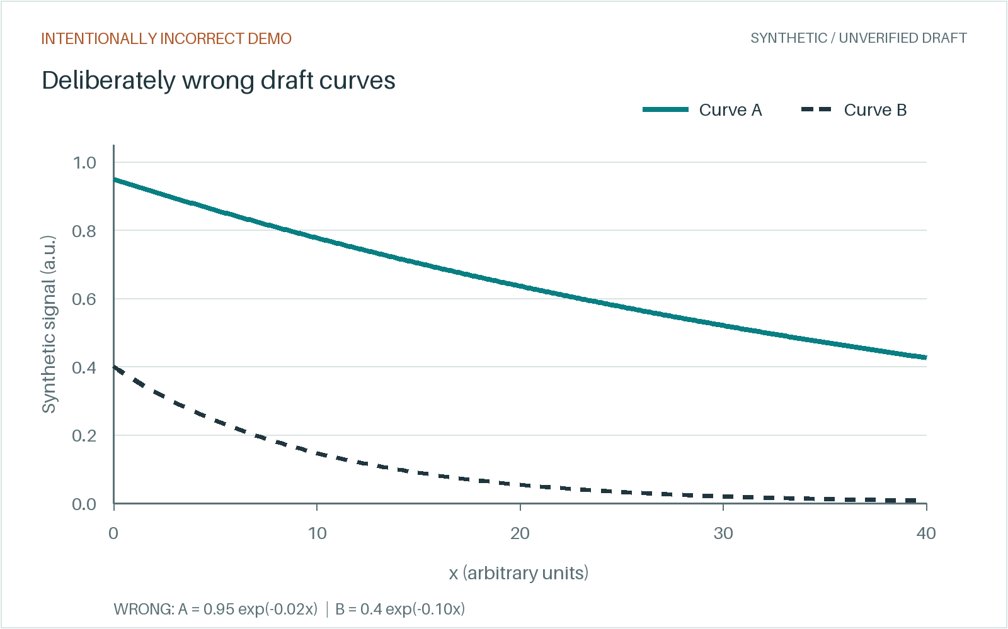
UNVERIFIED DRAFT / SYNTHETIC DEMO
INTENTIONALLY INCORRECT / 01
Two curves. Editable structure.
Controlled illustration: wrong draft figure and unsupported formulas.
01 / FORMULAS
y_{A}(x) = 0.95 exp(-0.02x)
y_{B}(x) = 0.4 exp(-0.10x)
Draft values disagree with the source.
Verify against synthetic-paper.pdf.
02 / EDITABLE FLOW
Define
Sample
Plot
UNVERIFIED FIGURE / DO NOT USE
Replace from source paper Figure 1.
Draft panel. Intentionally incorrect synthetic curves.
SYNTHETIC DEMO / Deliberate errors; not actual GPT output.
01
Notes:
SYNTHETIC DEMO / UNVERIFIED DRAFT. The wrong curves and native formulas are deliberate: y_A(x) = 0.95 exp(-0.02x); y_B(x) = 0.4 exp(-0.10x). This is a controlled illustration, not actual GPT output; no model call occurred. Reference synthetic-paper.pdf, page 1, Figure 1 and Section 1 for the correct source. Replace this panel with source-figure.png and correct the editable formula text. No measured data, real authors, institutions, publication, or DOI are involved.

