Slide 1
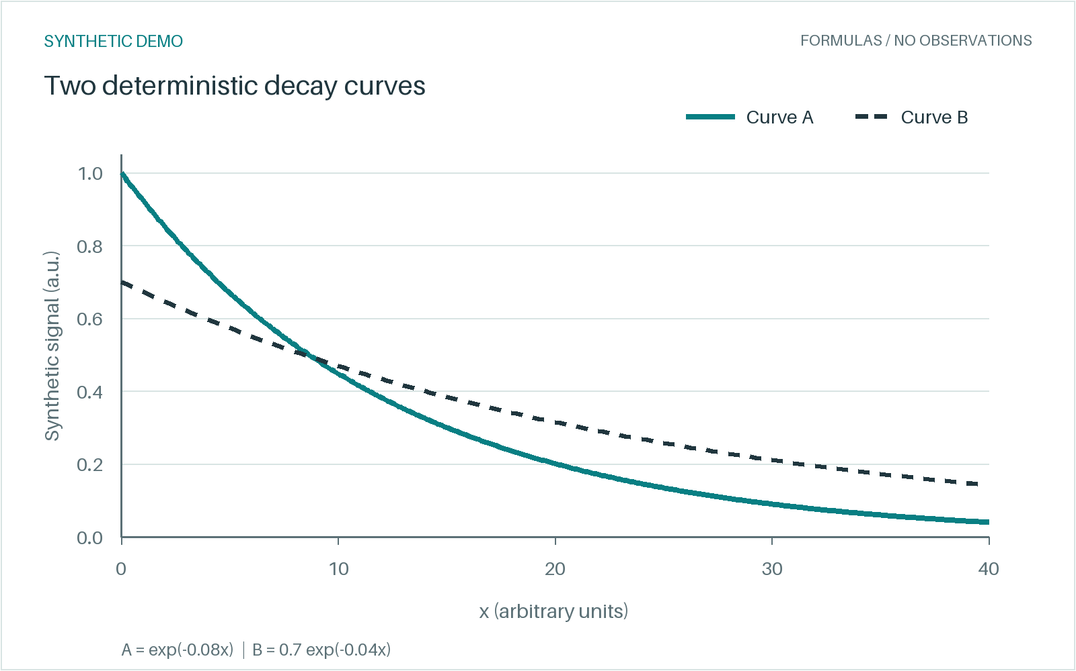
SYNTHETIC DEMO
CONTROLLED FIXTURE / 01
Two curves. Editable structure.
Deterministic mathematics for testing slide reconstruction.
01 / FORMULAS
y_{A}(x) = exp(-0.08x)
y_{B}(x) = 0.7 exp(-0.04x)
CSV: x = 0 to 40, at unit steps.
Values are generated, never observed.
02 / EDITABLE FLOW
Define
Sample
Plot
SOURCE FIGURE PRESERVED
One independent, movable PNG.
Figure 1. Formula-generated curves; arbitrary units.
SYNTHETIC DEMO / Formula-generated values; no measured study.
01
Notes:
SYNTHETIC DEMO. y_A(x) = exp(-0.08x); y_B(x) = 0.7 exp(-0.04x). No measured data, authors, institutions, publication, or DOI. Known object positions define this controlled fixture. This is not a blind OCR reconstruction or an automatic-reconstruction benchmark. Formulas are native editable text runs, not Office Math objects. The source PNG is embedded unchanged.

