Slide 1
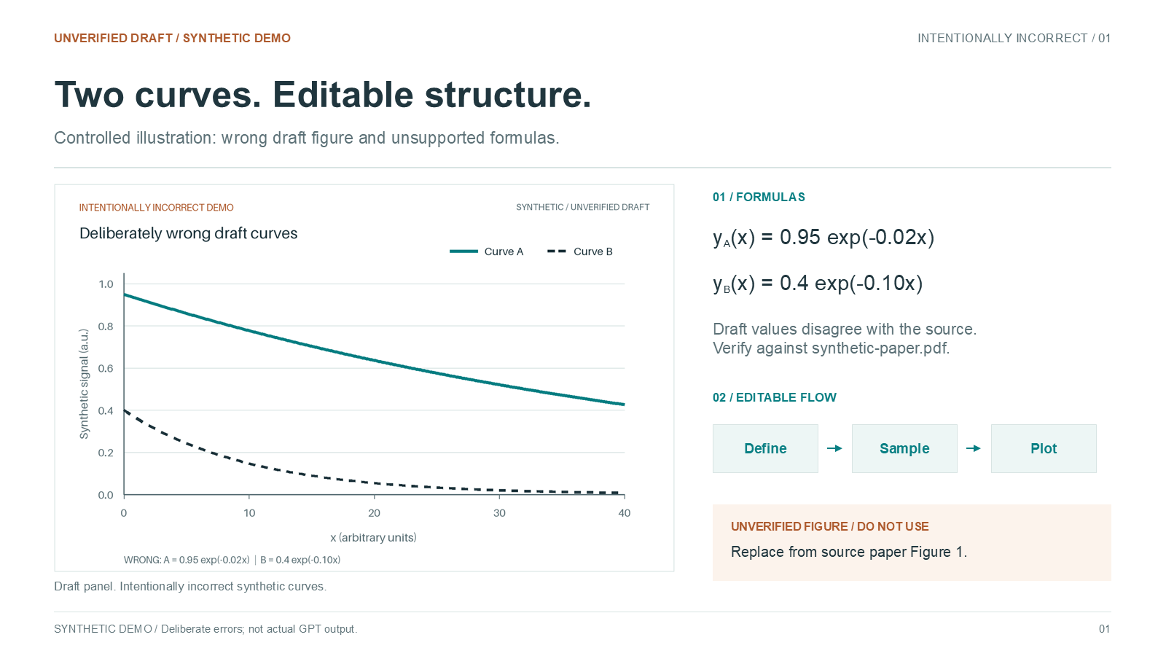
Notes:
SYNTHETIC DEMO. Flattened from an intentionally incorrect controlled draft. Not actual GPT output. Check the supplied synthetic paper Figure 1.

