Slide 1
You Only Look Once path to design a detector
Feng Wang
AIRD, Coretronic Co.
Apr 17, 2019
The slides and a list of references can be found from
https://github.com/fwcore/object-detection

Slide 2
Outlines
Concepts in object detection
A brief history of object detection
YOLO
design
loss function
training
weaknesses

Slide 3
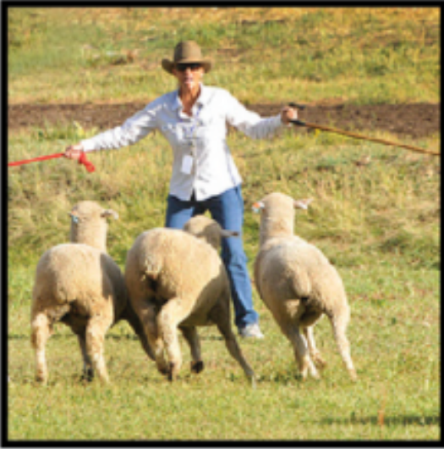
Classification vs detection/recognition

Slide 4
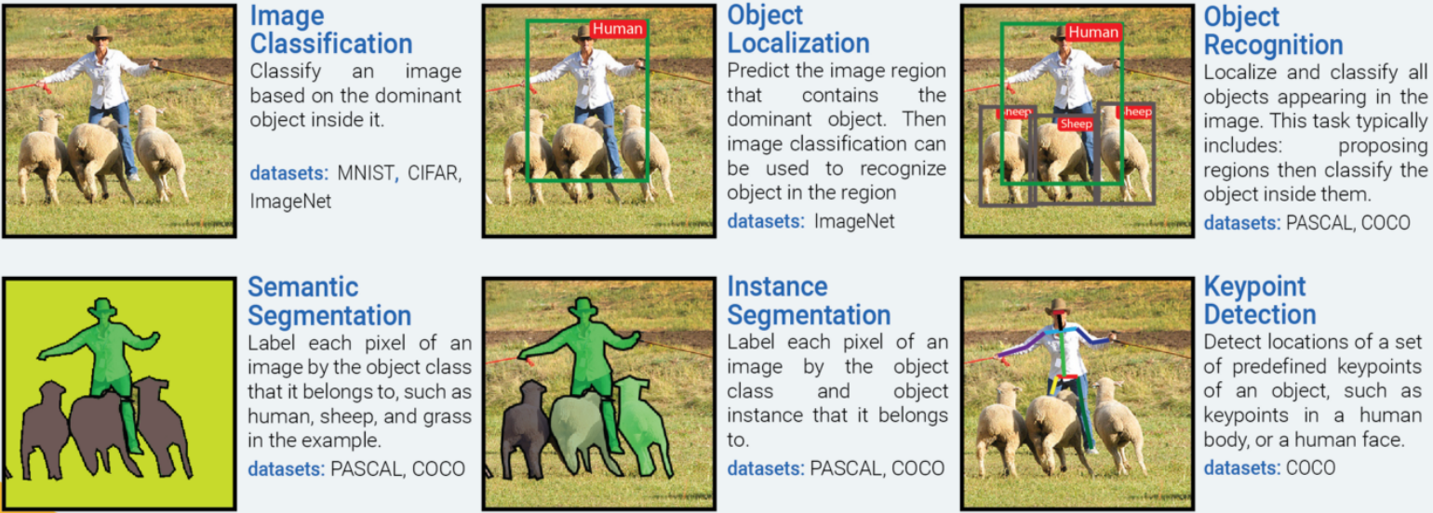
Common tasks on images
https://medium.com/@nikasa1889/the-modern-history-of-object-recognition-infographic-aea18517c318

Slide 5
Bounding box proposal
Region of interest, region proposal, box proposal
Ground truth
Proposed bounding box
5 parameters
w, h
x, y
confidence score: how likely it contains an object & accuracy of the box

Slide 6
How good: Intersection over Union (IOU)
Overlap Area
Examples
IOU =
Union Area
0:
1:

Slide 7
Outlines
Concepts in object detection
A brief history of object detection
YOLO
design
loss function
training
weaknesses

Slide 8
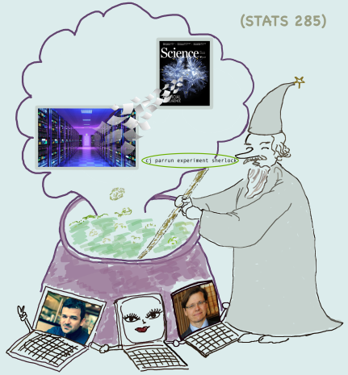
A brief history of object detection
https://stats385.github.io

Slide 9
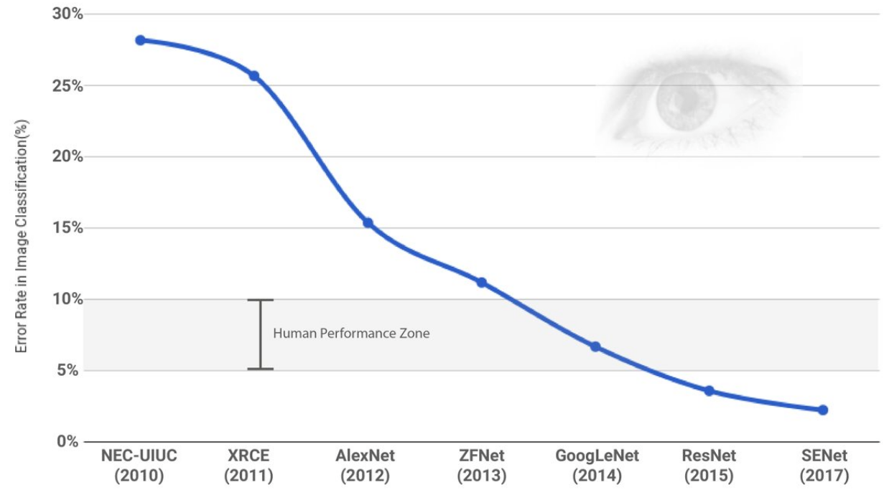
A brief history of object detection
Before CNN, people use handcrafted features to locate and classify objects. (not too bad)
CNN boosts the accuracy of classification
ImageNet

Slide 10
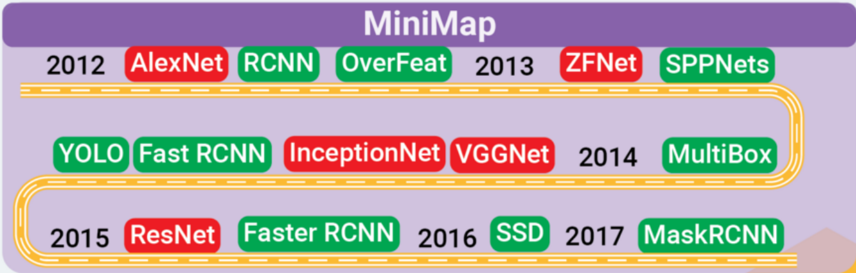
A brief history of object detection
Region proposal -> classification
e.g. RCNN
accurate
slow
Single shot:
Region proposal + classification
e.g. YOLO, SSD
fast
less accurate

Slide 11
Outlines
Concepts in object detection
A brief history of object detection
YOLO
design
loss function
training
weaknesses

Slide 12
YOLO: you look only once
Results
x, y, w, h
confidence score: contain an object & box accuracy
class score: belong to a class
Look once
Let's use CNN, since it's good.
Why not regress?
They are just numbers.

Slide 13
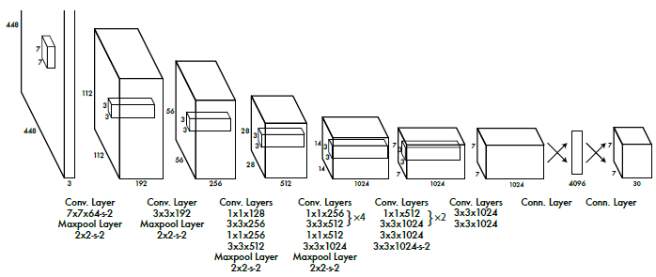
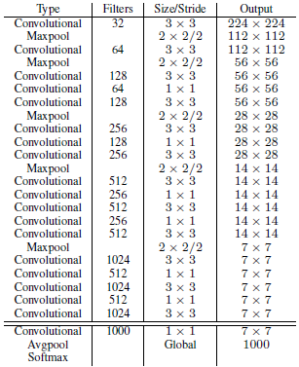
Let's go to CNN
YOLO v1's CNN: GoogLeNet variant, 24 layers
YOLO v3's CNN: darknet-53
YOLO v2's CNN: darknet-19, 19 layers

Slide 14
Let's do regression
-- wait, wait, how many bounding boxes? Where are they initially?
Better solution: using grids
Results for one box
x, y, w, h
confidence score: contain an object & box accuracy
class score: belong to a class
Maybe set N as a large number?
Maybe initially put them randomly?
Note: N is large, but much smaller than R-CNN's region proposal.

Slide 15
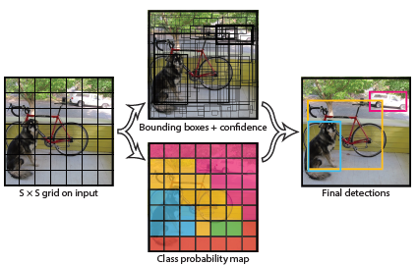
Let's do regression with non-maximal suppression
Grid 1 | Proposed box 1 x, y, w, h confidence score | Proposed box 2 x, y, w, h confidence score | Class scores class 1 class 2, ... class 20
... | ... | ... | ...
Grid SxS | Proposed box 1 x, y, w, h confidence score | Proposed box 2 x, y, w, h confidence score | Class scores class 1 class 2, ... class 20
We can use CNN to extract features, and finally perform a regression to detect objects.
YOLO v1: fully connected layers
v2 & v3: convolutional layers
arXiv: 1506.02640, 1612.08242, 1804.02767
vector size: SxSx(5x2+20)

Slide 16
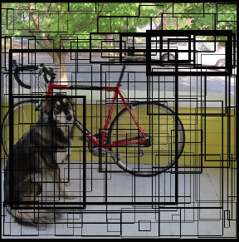
Loss function
Problems
One object is partially/fully covered by several boxes.
Most boxes has no objects.
Multi-task training problem: location & class
Small objects need more accurate location & box size.
Solution

Slide 17
Oh, no math please. Let's speak human language
Problem 1:
One object is partially/fully covered by several boxes.
Each true object has one proposed box “responsible” to it.
Rule: the one with highest overlap with the ground truth boxes.
When inference, we use non-maximal suppression to select the best among the proposals.

Slide 18
Human language
5
Problem 2:
Most boxes has no objects.
0.5

Slide 19
Human language
Problem 3:
Multi-task training problem: location & class.
Weighted sum: here the problem is left untouched.

Slide 20
Human language
sqrt
Problem 4:
Small objects need more accurate location & box size.

Slide 21
Other problems
x, y can be out of the grid cell
smaller objects can locate worse than the largers
probability can be out of [0, 1]

Slide 22

Fix them in YOLO v2
Pre-defined box size

Slide 23
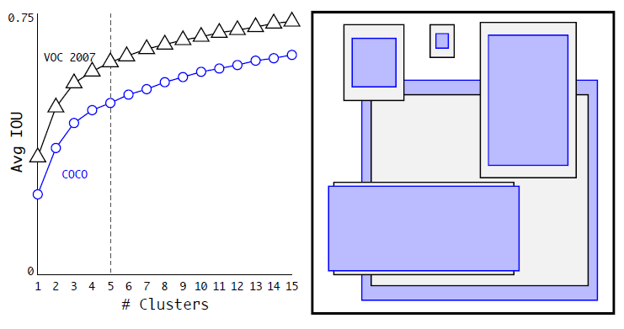
Pre-defined box: anchor
Naturally, objects have special aspect ratios and sizes.
This can be a good starting point.
We don't need randomly initialized boxes' shapes.
Handcrafted box size vs clustering algorithms
Box can reshape during training.
The number of pre-defined boxes is a hyperparameter
v2 uses 5
v3 uses 9
Anchor-free detection is a research topic, see https://arxiv.org/abs/1904.01355 for an instance.
anchors used in YOLO v2

Slide 24
Improvements (in v2)
Resizing image sizes randomly during training: {320, 352, ..., 608}
CNN only reduce an image by a constant factor (here 32), hence is robust to input image size
resize every 10 epochs.
multi-scale training
Passthrough layer
No loss to perform reshaping
Odd number of grid cells
vs
Feature map

Slide 25
Training
ImageNet:
classification dataset
COCO/PASCAL VOC:
detection dataset
YOLO
Step 1:
train classification backbone
Step 2 (transfer learning):
remove head layers
add regression as new head
fine-tune backbone & train head
Training tricks
decaying learning rate
batch normalization
data augmentation

Slide 26
Performance

Slide 27
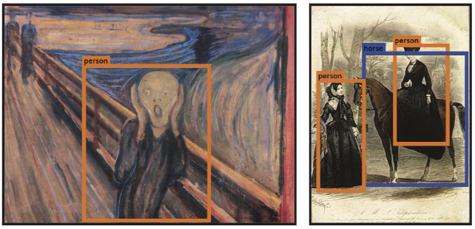
Generalizability
Picasso & People-Art dataset

Slide 28
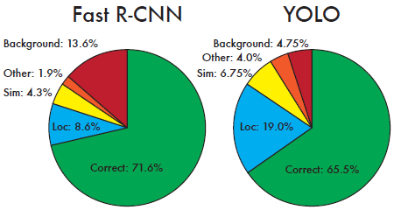
But ... no free lunch
YOLO is not as accurate as RCNN-series models
multi-task problem: YOLO wins in less background error, however, loses in localization error.
YOLO is poor for detecting small objects
CNN: training on ImageNet may not generalize well for small objects (classification)
loss function equalizes location weights for small & large objects (localization)
YOLO is not good at crowd objects
non-maximal suppression. See an improvement: Adaptive NMS (arXiv:1904.03629)
YOLO is bad when encountering strange aspect ratio
pre-defined anchors, or anchors learned from data. Go anchor-free (arXiv:1904.01355).
50+ years

Slide 29
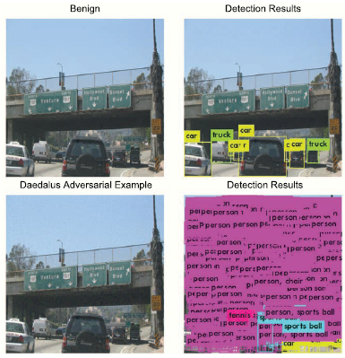
Security
CNN (classification) can be fooled, as well as YOLO, and the issues can be even worse.
Non-maximal suppression is fooled.
Daedalus: Breaking Non-Maximum Suppression in Object Detection via Adversarial Examples. arXiv:1902.02067

Slide 30
Is there anything helpful to improve?

Slide 31
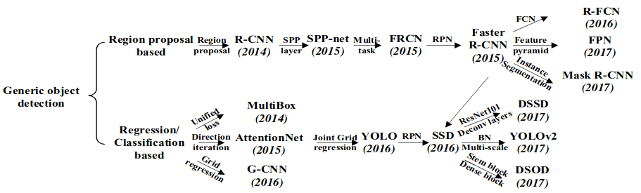
Darwin's evolution
arXiv: 1807.05511

