Slide 1
SSD: single shot detector
Feng Wang
AIRD, Coretronic Co.
May 03, 2019
The slides and a list of references can be found from
https://github.com/fwcore/object-detection

Slide 2
Outlines
Review a few key concepts in object detection
SSD (arXiv: 1512.02325)
design
loss function
training

Slide 3
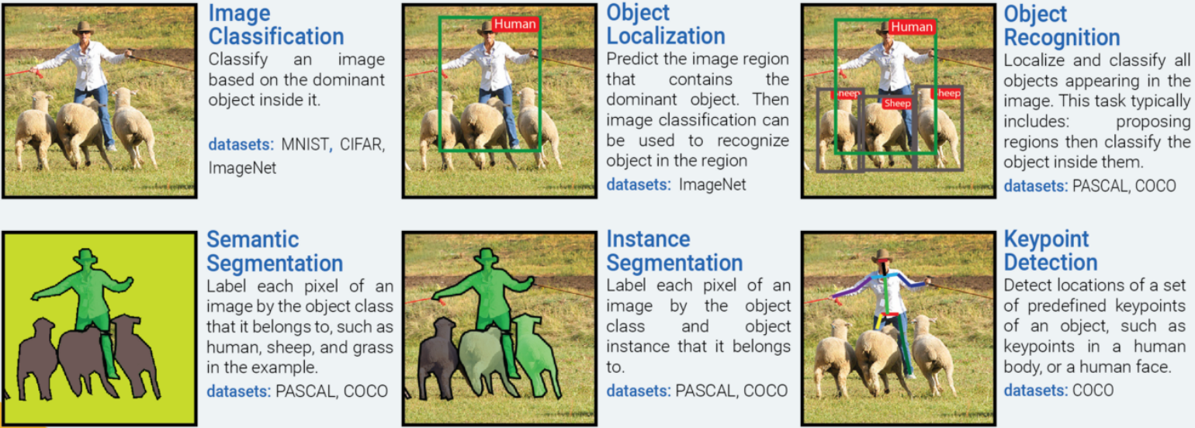
Common tasks on images
https://medium.com/@nikasa1889/the-modern-history-of-object-recognition-infographic-aea18517c318

Slide 4
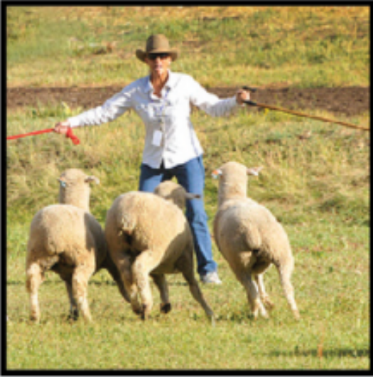
Bounding box proposal
Region of interest, region proposal, box proposal
Ground truth
Proposed bounding box
5 parameters
w, h
x, y
confidence score: how likely it contains an object & accuracy of the box
SSD predicts 4 parameters + class score for each box

Slide 5
How good: Intersection over Union (IOU)
Overlap Area
Examples
IOU =
Union Area
0:
1:
Jaccard overlap

Slide 6
Outlines
Review a few key concepts in object detection
SSD (arXiv: 1512.02325)
design
loss function
training
focusing on the difference with YOLO

Slide 7
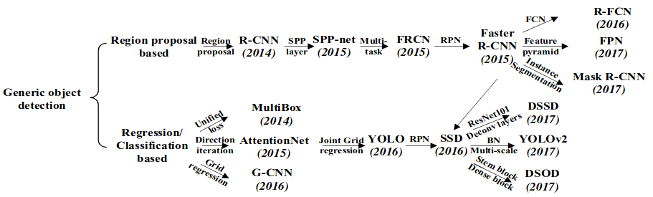
SSD's relation with other detectors

Slide 8
SSD: single shot detector
Results
x, y, w, h
confidence score: contain an object & box accuracy
class score: belong to a class
Single shot
(Look once)
use CNN
use regression with convolution

Slide 9
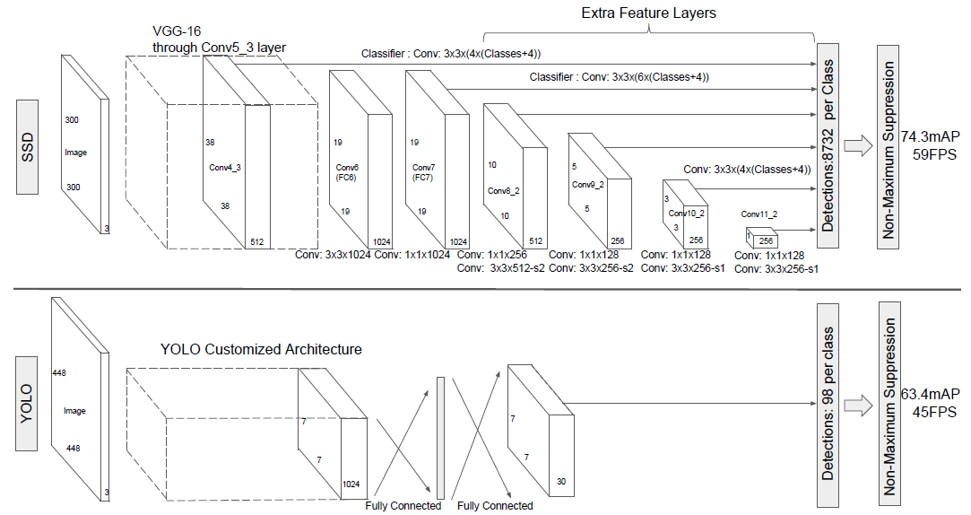
CNN backbone (base network)

Slide 10
Bounding box
YOLO uses grid on raw images.
SSD takes advantage of the feature map, which is a “grid” coarse-grained from the raw images.
Parameters for one box
x, y, w, h
class score: belong to a class
Number of boxes in feature map (FM)
(4+class)*(FM size)

Slide 11


Multiscale bounding box
Each layer is targeted to the given scale
a_{r}: aspect ratio of default box
default box center = grid center
box is learnable

Slide 12
Rules for multiscale bounding box
training
inference
IoU > 0.5 with ground truth
many boxes -> one ground truth
filter out confidence < 0.01
non-maximum suppression

Slide 13
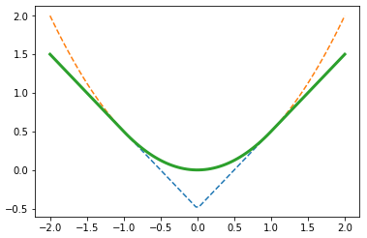
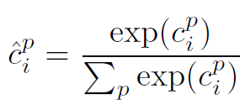
Loss function (before rescaled by the number of matched boxes)
smooth_{L1}
L2
L1
hard negative mining
1. sort by c⁰
2. add top ones to loss function
3. neg : pos <= 3:1
α x
=1

Slide 14
Training
Mutli-resolution input is not necessary.
Low-res (300x300, 512x512) is enough. Faster R-CNN: 1000x600
Data augmentation is very useful.
zoom in: image patches with size [0.1, 1] and aspect ratio [0.5, 2]
zoom out: randomly place the image on a canvas of 16x of the original image size filled with mean values before random crop. (It increases small object accuracy. Maybe we can replace it by randomly cropping a high-res image.)
horizontal flip
photo-metric distortion

Slide 15
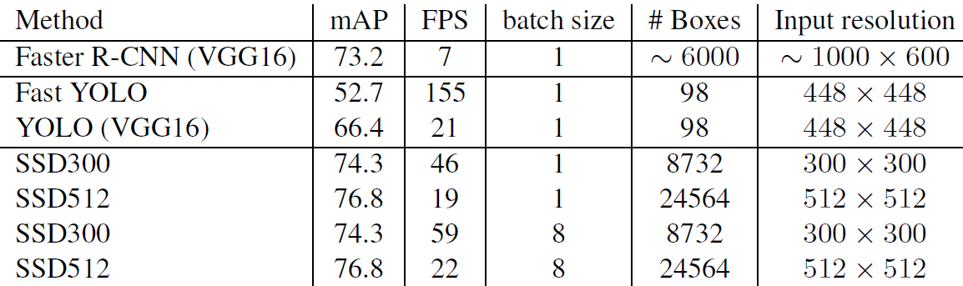
Performance
From SSD paper
arXiv: 1512.02325
From YOLOv2 paper
arXiv: 1612.08242

