Slide 1
Replicability and data/algorithm storage and availability
3rd Workshop on Replication in Extended Reality (WoRXR)
Florian Weidner

Slide 2
Outline for the next 15 minutes
Why publish data and algorithms?
What could (should) we store?
Where to store?
How do we document it?
What’s to consider?
Final thoughts + Miro board

Slide 3

Comments and stuff I forgot?
https://miro.com/app/board/uXjVNbzLiFY=/?share_link_id=572243707148

Slide 4
Why publish data?
Reproducibility: reanalysing existing data in the same manner.
Replicability: reconducting the analysis, including data collection.
Obviously: reproducibility and replicability. For example:
Prototype shared: test exactly the same.
Data shared: calculate exactly the same
Everything: do exactly the same.
But also:
Comparison with new findings easier (e.g., UI)
Making improvements is easier (iterations)

Slide 5
What could (should?) we store?
Measurement data (raw + processed)
Simulation data
Observations
Data from surveys, questionnaires and interviews
Software, code, scripts
Audio-visual data
...etc.

Slide 6



Where to store?
„Popular“: osf.io, zenodo.ort, IEEEDataPort
Some institutions have platforms
Criteria:
Offers DOI
promises long-term storage
Stable funding
(Free)
Notes:
https://evodify.com/free-research-repository/
re3data.org

Slide 7
Two min video osf

Slide 8
Two min video zenodo

Slide 9
Compare osf zenodo ieeedataport

Slide 10
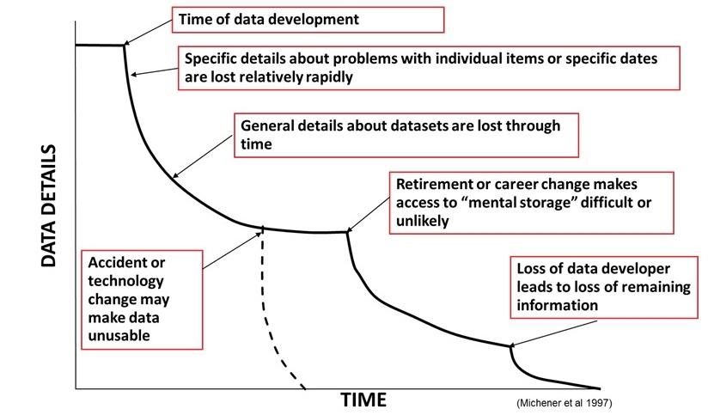
How do we document it?
Data documentation is the precise recording of the development of research data in the research process with the aim of making data comprehensible and reusable.
It should contain information on workflows, technical environments and processing steps.

Slide 11
How do we document it?
README files
Version control
Codebook
Documented code
Jupyter Notebooks
Workflow screenshots
…

Slide 12
What could be a (soft) requirement?
Executable + setup instructions
Study protocol and self-defined questions
Raw data + scripts to calculate results in paper
Video
Preprint

Slide 13
What’s to consider?
Privacy?
Licenses?
Time pressure before deadline
…

Slide 15
https://www.acm.org/publications/policies/digital-artifacts
https://journals.ieeeauthorcenter.ieee.org/create-your-ieee-journal-article/prepare-supplementary-materials/
https://journals.ieeeauthorcenter.ieee.org/create-your-ieee-journal-article/research-reproducibility/

Slide 16
How to store?
https://en.wikipedia.org/wiki/FAIR_data
https://www.go-fair.org/fair-principles/
Fair != open

