Slide 1
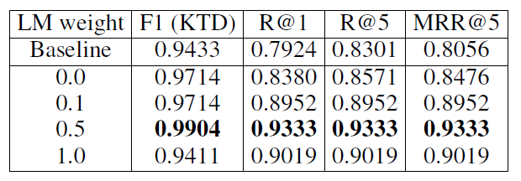
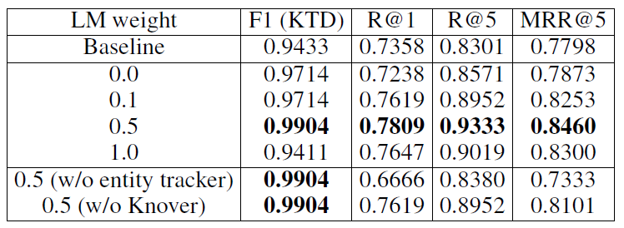
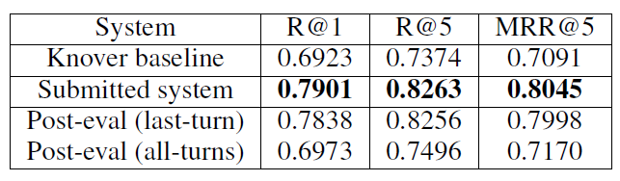
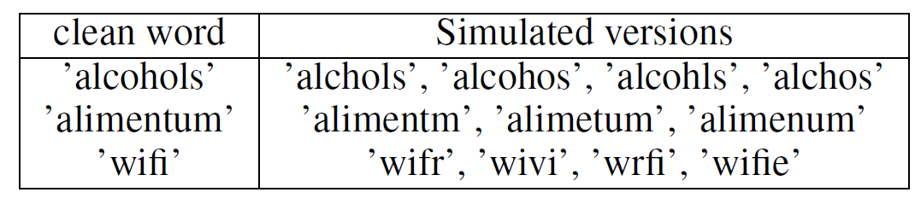
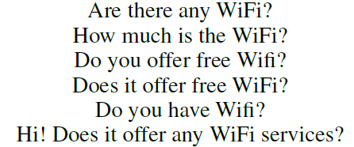
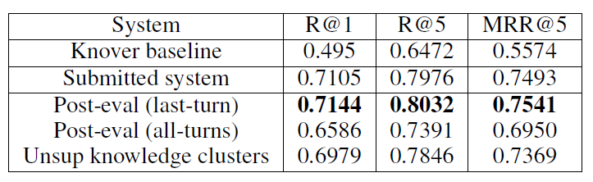
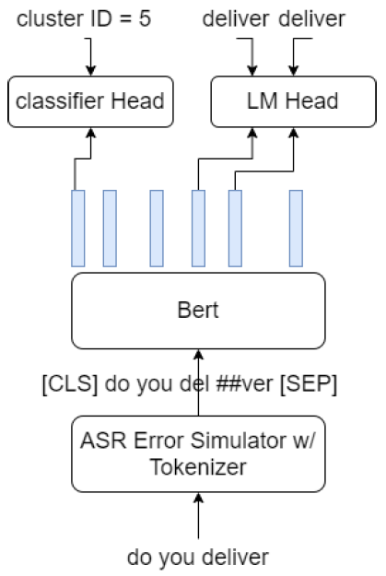
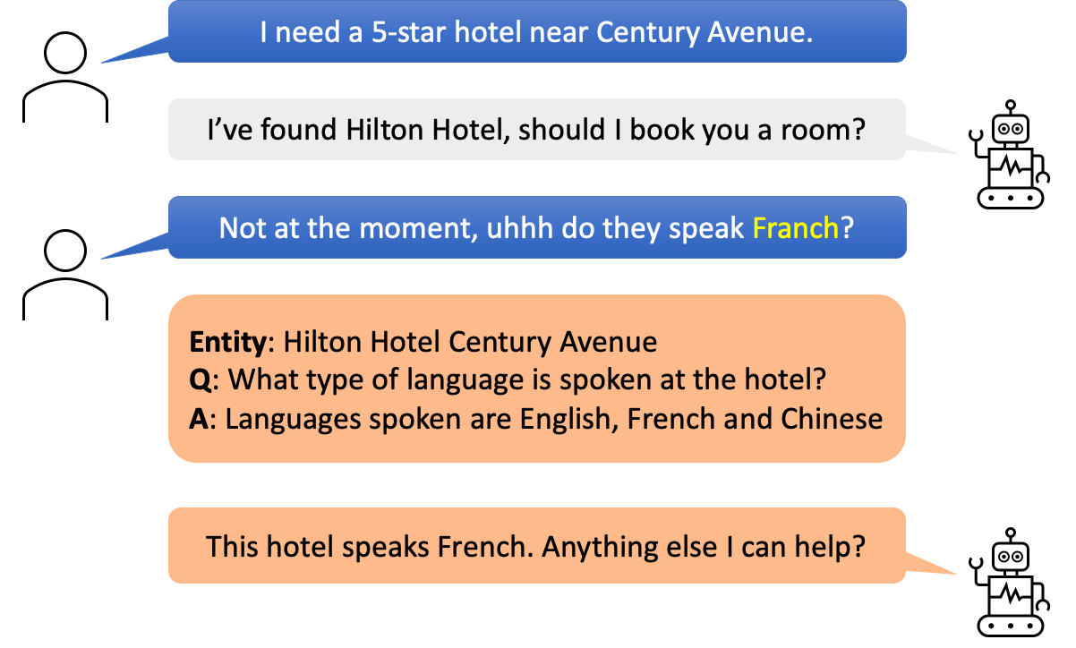
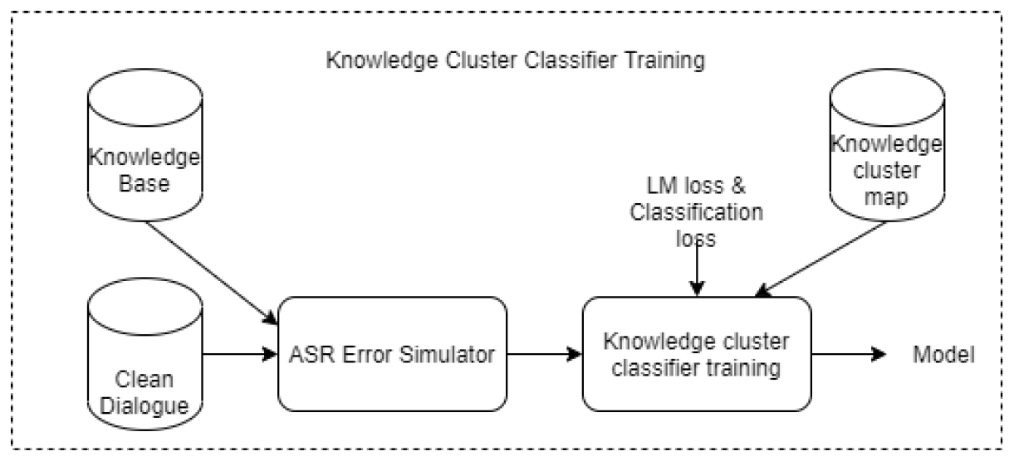

Robust Unstructured Knowledge Access In Conversational Dialogue With ASR Errors
Yik-Cheung Tam, Jiacheng Xu, Seeger Zou, Zecheng Wang, Tinglong Liao, Shuhan Yuan
{yt2267, jx1038, jz3714, zw2374, tl2564, sy2448}@nyu.edu
1 Background
3 ASR error simulator
4 Results
Performance of spoken language understanding (SLU) can be degraded with automatic speech recognition (ASR) errors.
Proposal:
1. Use ASR error simulator
Corrupt clean data randomly
Correct errors & classify jointly
2. Unsupervised knowledge clustering + knowledge reranking
12k knowledge titles => matching dialogue with all titles is costly
Entities share similar titles => group titles to form knowledge cluster (KC) => Fast recall of titles
Highlight:
Ranked 3 out of 16 teams’ best submissions in knowledge selection (KS)
No human transcriptions required
Leverage confusion networks from ASR output to generate all possible confusion word pairs:
Ok do they (delver | deliver | delo | over | lover | del | dolo) => delver-deliver, delver-delo, … del-dolo
Perform letter-to-letter alignment between each word pair:
d e l * v e r
d e l i v e r
Estimate letter-rewriting probs: P(t | s, i) at position i
Given a clean word, an erroneous word is generated by replacing/inserting letters randomly (see paper for detail)
DSTC10 dev set split into 2 parts: 132/131 dialogues for train/test
KC test
KS test
DSTC10-eval KTD
“kommen toor” from “coit tower”.
4 Unsupervised knowledge clustering
DSTC10-eval KS
Use 12k title-body pairs as +ve
Randomly generate unmatched title-body pairs as –ve
Train binary Bert classifier: [CLS] title [SEP] body [SEP]
Iteratively merge C_{i} and C_{j} if majority of cross title-body pairs are classified as +ve according to a threshold
5 Discussion & Future work
GPT2 / pointer-gen for generating ASR errors did not work
Error simulation based on word-confusion matrix did not work
Approach cannot deal with phonetic errors: “kommen toor” vs “coit tower”
Extend to other SLU tasks
Compare with other simulators
5 KC classification with self-correction
2 Task overview
Bert with KC classification and language model heads
Knowledge access under ASR errors
[1] Wang et al. 2020. ASR Error Correction with Augmented Transformer for Entity Retrieval. In Proceedings of Interspeech.
[2] Weng et al. 2020. Joint contextual modeling for ASR correction and language understanding. In Proceedings of ICASSP), 6349–6353.
[3] Kim et. al. 2022. DSTC10 Track Proposal: Knowledge-grounded Task-oriented Dialogue Modeling on Spoken Conversations. In DSTC10
Workshop @ AAAI
KB

