Slide 1
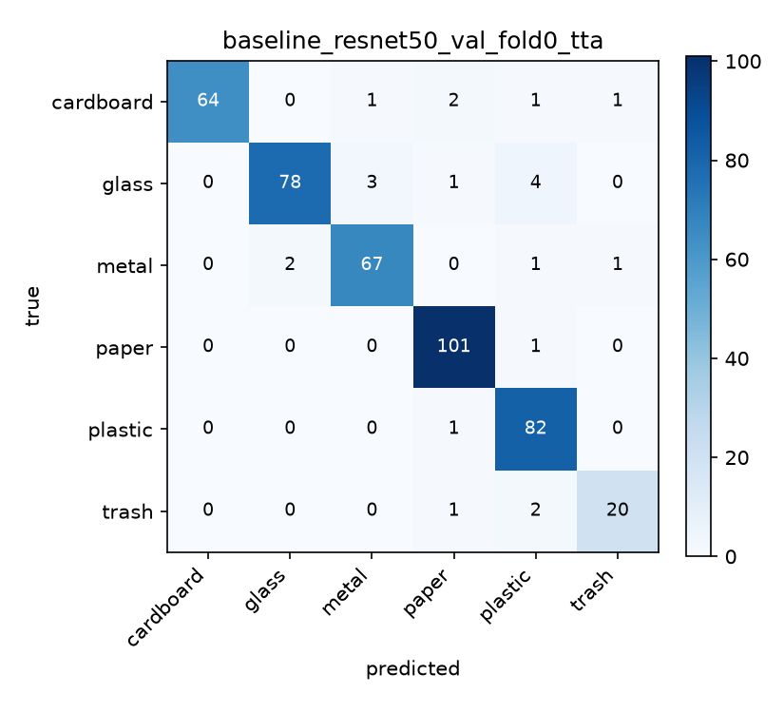
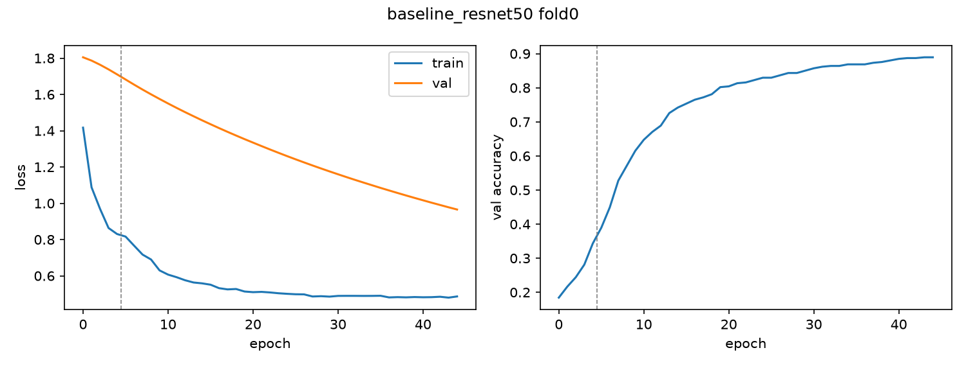
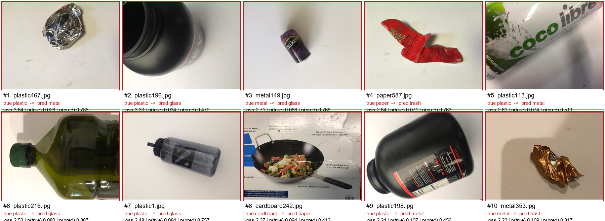
SECOND LIFE AI
GROUP [##] · [NAME] · [NAME] · [NAME] · [NAME]
Leakage-Aware Trash Classification
A reproducible six-class pipeline, an honest held-out test, and a live sorting experience
NYU SHANGHAI · AI SUMMER PROGRAM 2026
01
Problem & Data
03
Leakage-Free Method
04
Results
Can a model sort a waste photo reliably—without seeing the same physical object in both training and evaluation?
A simple model with a strict evaluation pipeline
89.20%
94.93%
1
Deduplicate
→
2
Split
→
3
Augment
→
4
Fine-tune
→
5
Infer
HELD-OUT TEST · 322/361
VALIDATION + 4-VIEW TTA
TrashNet · 2,527 images · 6 classes
Perceptual groups keep near-identical views together.
Train / validation / test are group-disjoint.
Basic transforms apply to training images only.
ImageNet ResNet-50, 224px, two-phase training.
Average four deterministic views with TTA.
94.14%
+8
Paper
594
VALIDATION MACRO-F1
VAL IMAGES FIXED BY TTA
Glass
501
MODEL
Plastic
482
ResNet-50 · 224 px
Metal
410
weighted sampler · label smoothing 0.1 · weight decay 0.05 · seed 42
Cardboard
403
The model is intentionally conventional; the contribution is trustworthy measurement.
Trash
137
THE DATASET TRAP
What changed the result?
TrashNet contains many photographs of the same object from different angles. Random image-level splits can leak object identity across sets.
Configuration
Val. accuracy
Net images
Decision
Raw baseline
93.09%
—
Reference
02
Evaluation Contract
+ four-view TTA
94.93%
+8
Adopted
Split by near-duplicate group, augment only after splitting, and touch the quarantined test set once.
384px progressive
94.93%
0
Rejected
Modern augmentation
95.62%
+3 vs TTA
Rejected
Weight decay 0.10
94.70%
−1
Rejected
1,732
434
361
Pre-registered acceptance gate: at least +7 validation images, no macro-F1 drop, and no major class-recall loss.
Validation confusion matrix · same locked checkpoint + TTA
TRAIN
VALIDATION
HELD-OUT TEST
Training behavior & error evidence
KEY RESULT
Test measured once before intervention; never used to select experiments.
TTA improved accuracy without retraining. All three training interventions failed the pre-registered adoption gate.
WHY THIS IS CREATIVE
•
Accuracy that survives scrutiny
•
Fixed seeds and committed split identities
•
Every run logged with a configuration hash
05
Takeaways
•
Test-spent guard blocks accidental re-evaluation
1
Split by object, not just image.
2
Report test and validation separately.
OFFICIAL METRIC
3
Better evaluation can matter more than a newer backbone.
89.20%
Learning curves
Highest-loss audit examples
322 / 361 held-out test images
ERROR AUDIT
4
Remaining errors include ambiguity and label noise.
This is the test result. The higher 94.93% figure is validation + TTA.
29 of the 30 highest-loss test examples were errors. Manual review judged 14 clearly ambiguous or mislabeled, plus one borderline case.
Interpretation: some remaining error is a data-quality ceiling—not automatically a modelling failure.
Source: TrashNet (Thung & Yang, 2016). Test result was measured once and not reused for model selection. All values trace to experiments.csv and FINAL_SUMMARY.md.

