Slide 1
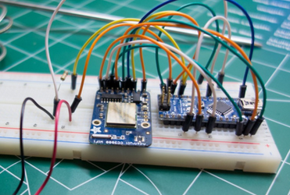
ardiuno meetup
8 Nov 2014

Slide 2
Example Code
https://github.com/fwin-dev/arduino_sonar_web_api/tree/master/arduino

Slide 3
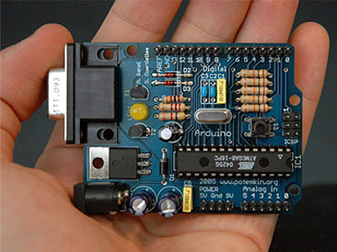

Arduino 101
Started 2005
Open-source electronics
prototyping platform
  Open-source hardware
  Open-source software
Hardware based on 8-bit Atmel AVR microcontroller or 32-bit Atmel ARM
Very popular in the maker community
http://arduino.cc/

Slide 4
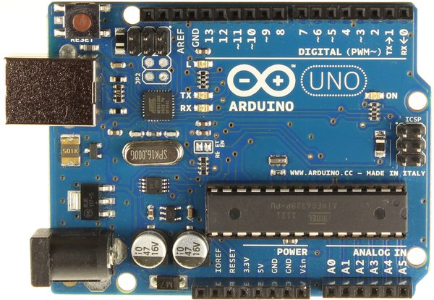
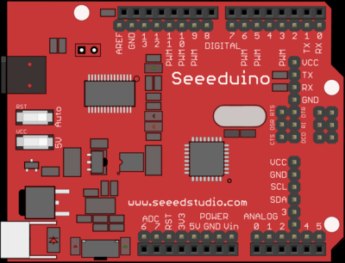
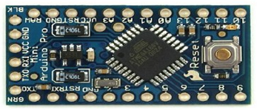
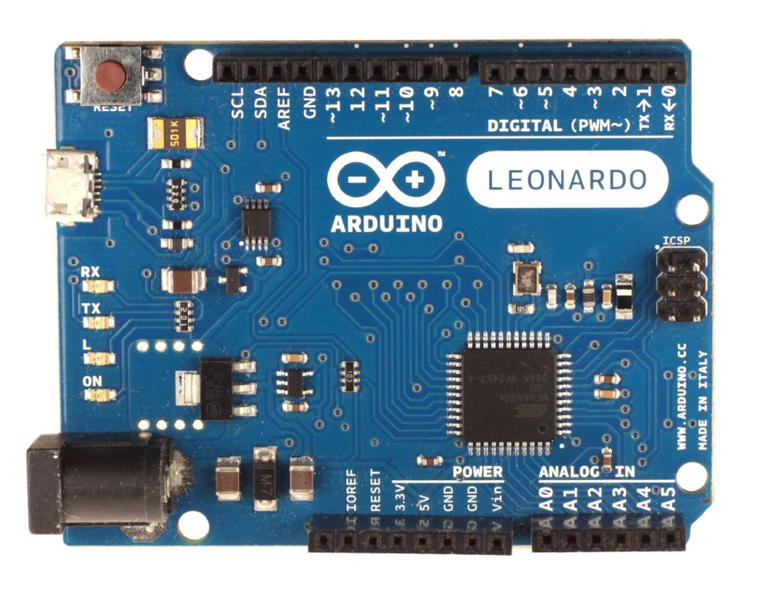
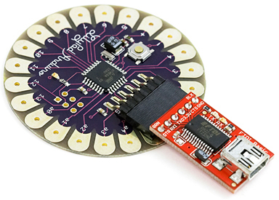
51 Flavours and counting
Uno is current “standard”, uses ATMega328 < $20
Leonardo uses ATMega32u4 < $18
Mini/Nano uses Atmega328P < $5

Slide 5
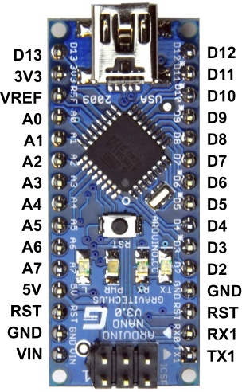
Arduino Nano
Microcontroller Atmel ATmega328
Operating Voltage (logic level) 5 V
Input Voltage 7-12 V
Input Voltage (limits) 6-20 V
Digital I/O Pins 14 (of which 6 provide PWM output)
Analog Input Pins 8
DC Current per I/O Pin 40 mA
Flash Memory 32 KB of which 2 KB used by bootloader
SRAM 2 KB
EEPROM 1 KB
Clock Speed 16 MHz
Dimensions 0.73" x 1.70"
http://arduino.cc/en/Main/ArduinoBoardNano

Slide 6
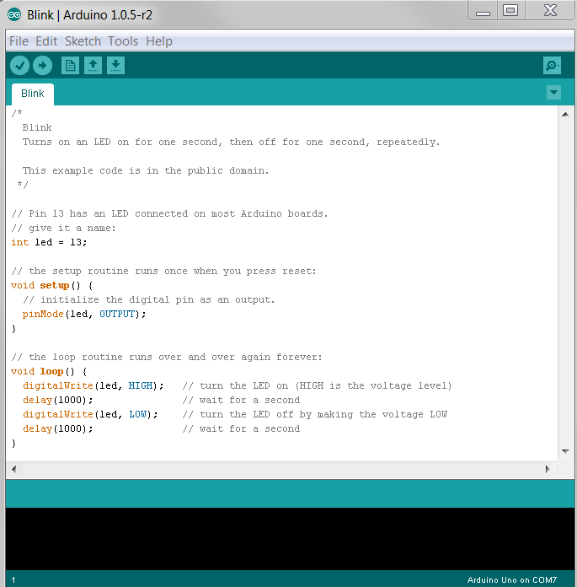
Arduino IDE
Upload
to Board
Serial
Monitor
Save
Compile
Integrated Development Environment (IDE)
All-in-one programming tool with built in compiler
Arduino language is C-like
Messages
http://arduino.cc/en/Main/Software

Slide 7
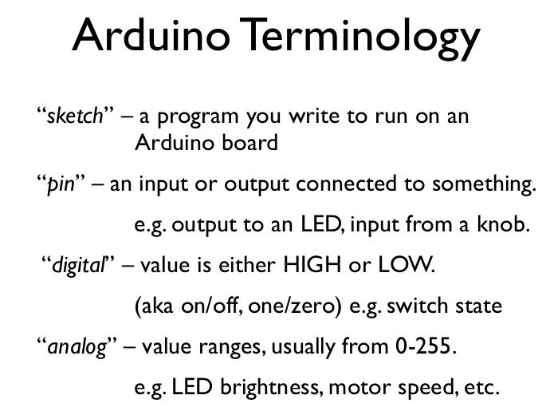

Slide 8
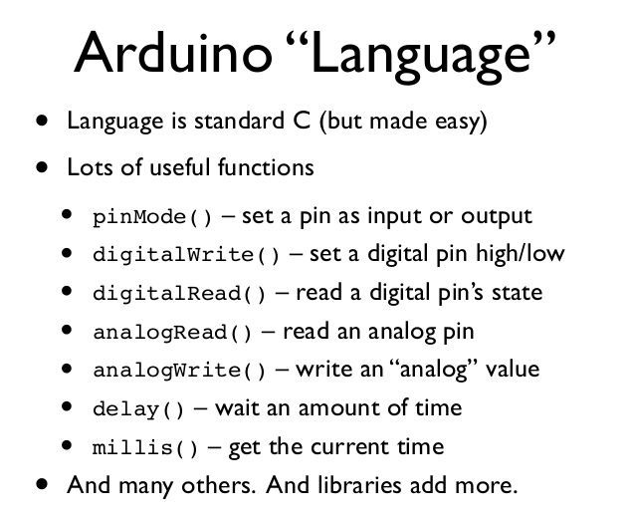

Slide 9
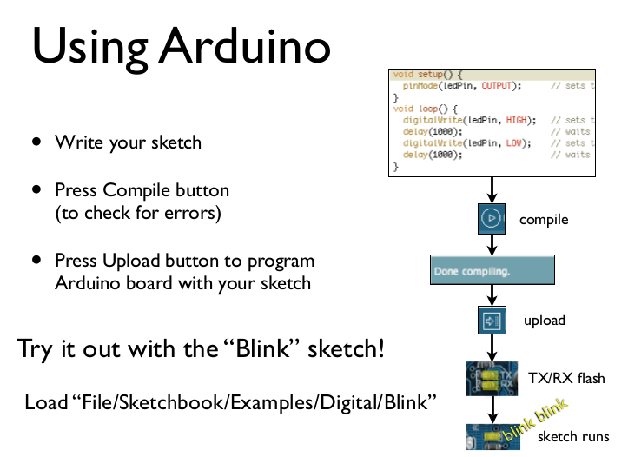

Slide 10
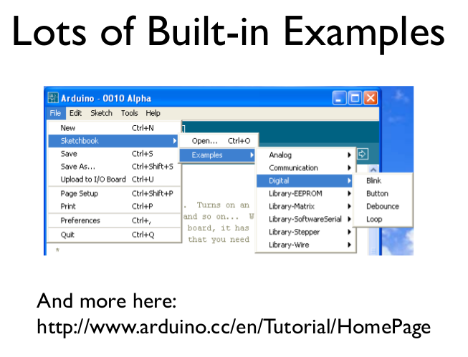

Slide 11
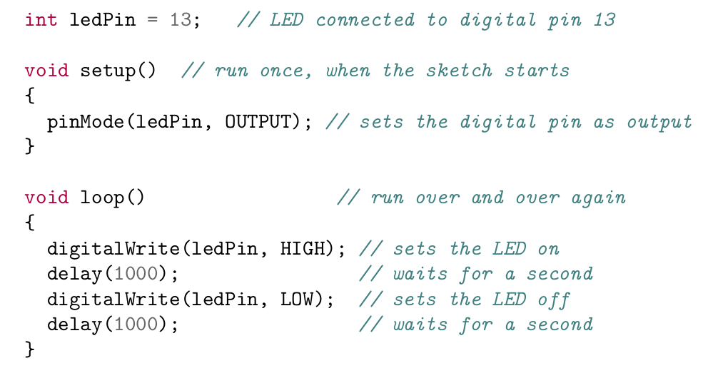
Hello Blinky World

Slide 12
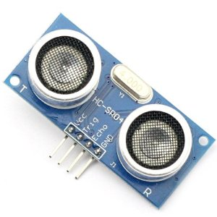
HC-SR04 Ultrasonic Sensor
2cm~500 cm resolution : 0.3 cm
Trig pin to any digital output
Echo pin to any digital input
Pulse Trig, read echo, calculate distance
Pace of Sound = 1 / Speed of Sound = 1 / 0.03435 = 29.1 ųs/cm

Slide 13
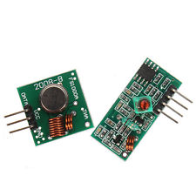
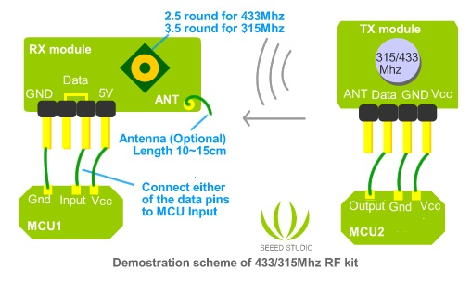
433Mhz RF Transmitter + Receiver Module
Other cheap modules are:
315/330MHz,
2.4GHz
FCC regulates 433MHz:
~no more than 10 minutes
on every hour
~20-200m LOS; 4Kbps
Noisy, interference from door bell, garage openers, cordless phone
Easy to use with VirtualWire Library

Slide 14



Slide 15
Today's Task List
Install Arduino IDE
Install CH340G Driver
Modify Blink example to print to Serial console
Breadboard HC-SR04 Ultrasonic Sensor and read distance
Breadboard 433Mhz RF Transmitter and send distance
Breadboard RF Receiver and then transmit received messages

Slide 16
Stretch Goals
Add checksum to transmission
Use additional Components and Sensors
  LEDs
  Light Sensors
  Pushbuttons
  ?

Slide 17
Install Arduino IDE
http://arduino.cc/en/Main/Software
Arduino 1.0.6

Slide 18
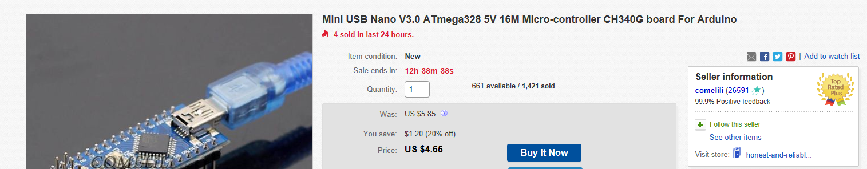
Install CH340G Driver
Some Arduino clones use a CH340G USB chip and you'll need to install a driver.
https://github.com/fwin-dev/arduino_sonar_web_api/tree/master/CH340_drivers

Slide 19
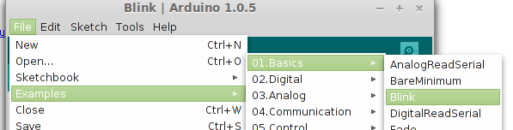
Modify Blink example
Print “on” and “off” as the LED blinks.
In setup add: Serial.begin(9600);
In loop add: Serial.println(“on”);
Serial.println(“off”);

Slide 20
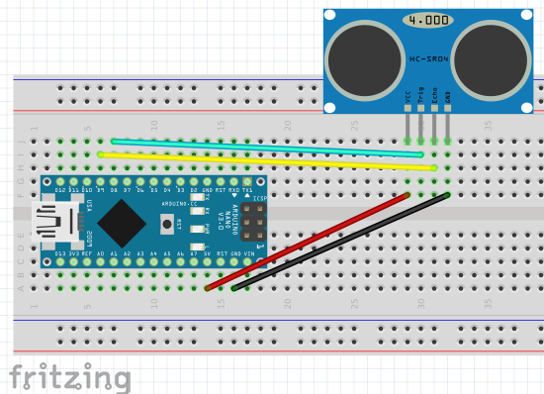
Breadboard HC-SR04
Arduino D8 => sonar trigger pin
Arduino D9 => sonar echo pin

Slide 21
Read HC-SR04 Distance -
Setup
#define trigPin 8 // sonar trigger
#define echoPin 9 // sonar echo
void setup() {
Serial.begin(9600);
pinMode(trigPin, OUTPUT);
pinMode(echoPin, INPUT);
}

Slide 22
Read HC-SR04 Distance -
loop
void loop() {
int duration, distance;
digitalWrite(trigPin, HIGH);
delayMicroseconds(1000);
digitalWrite(trigPin, LOW);
duration = pulseIn(echoPin, HIGH);
distance = (duration/2) / 29.1;
if (distance >= 200 || distance <= 0) {
Serial.println("out of range");
}
else {
Serial.print(distance);
Serial.println(" cm");
}
delay(500);
}

Slide 23
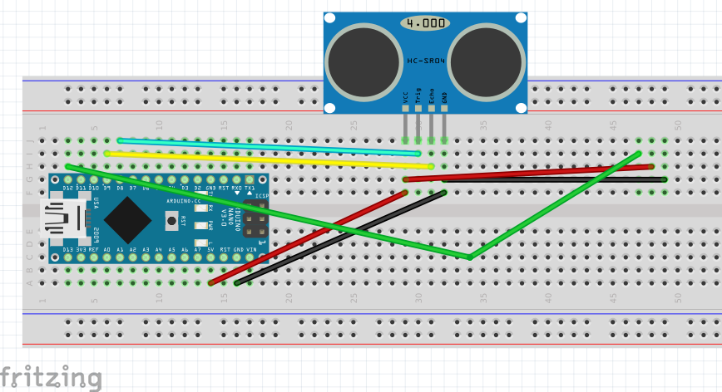
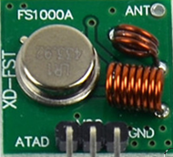
Breadboard RF Transmitter
Arduino D12 => Xmit data pin

Slide 24
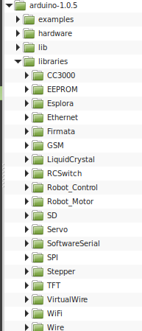
RF Transmitter
Install Virtual Wire
Github URL
Unzip into Arduino libraries folder

Slide 25
RF Transmitter - setup
#define LEDPin 13 // used to flash LED during transmit
#define xmitPin 12 // Transmitter connected to Arduino Pin
#define NAME "herman789" // name of ardiuno
#include <VirtualWire.h>
int randomDelay = 0; // random used for avoid transmit collision
void setup() {
...
// Initialise the IO and ISR
vw_set_ptt_inverted(true);
vw_setup(2000);
randomDelay = random(450, 650); // randomly pick a delay between transmits
Serial.print("randomDelay=");
Serial.println(randomDelay);
}

Slide 26
RF Transmitter - loop
void loop() {
...
} else {
// build JSON string. A good string will look like: {"i":"joe4", "d":97}
char msg[50];
msg[0]='\0';
sprintf(msg, "{\"i\":\"%s\", \"d\":%d}", NAME, distance);
Serial.println(msg);
digitalWrite(LEDPin, true); // Flash LED to show transmitting
const char* temp = msg;
vw_send((uint8_t *)temp, strlen(temp)); // send json string with virtual wire
vw_wait_tx(); // Wait until the whole message is gone
digitalWrite(LEDPin, false);
delay(200);
}
delay(randomDelay);
}

Slide 27
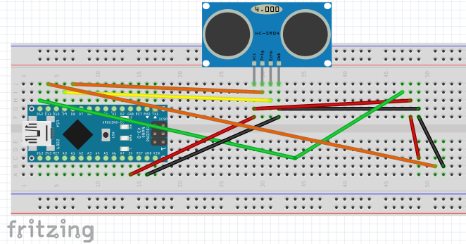
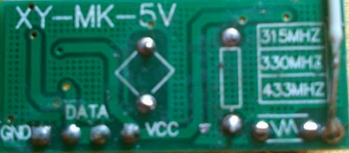
Breadboard RF Receiver
Arduino D11 => either data pin

Slide 28
RF Receiver - setup
#define recvPin 11 // Receiver connected to Arduino Pin
// buffer for receiving data
uint8_t recvbuf[VW_MAX_MESSAGE_LEN];
uint8_t recvbuflen = VW_MAX_MESSAGE_LEN;
void setup() {
...
// Start the receiver PLL running
vw_rx_start();
…
}

Slide 29
RF Receiver – loop
void loop() {
// reset recv buffer length and recv flag
recvbuflen = VW_MAX_MESSAGE_LEN;
boolean msgrecvd = false;
char recvmsg[20];
recvmsg[0]='\0';
// Non-blocking check if any data available
if (vw_get_message(recvbuf, &recvbuflen)) {
msgrecvd = true;
// null terminate our message
recvbuf[recvbuflen] = 0;

Slide 30
RF Receiver – loop cont
// debug print to serial monitor
Serial.print("Got: ");
Serial.println((char *)recvbuf);
String s = String((char *)recvbuf);
int idEnd = s.indexOf('"', 6);
s.toCharArray((char *)recvbuf, recvbuflen);
// build a partial JSON string
sprintf(recvmsg, "\"h\":\"%s\"", recvbuf);
// debug print to serial monitor
Serial.println((char *)recvmsg);
}

Slide 31
Example Code
https://github.com/fwin-dev/arduino_sonar_web_api/tree/master/arduino

