Slide 1
CE889 – Multilayer Perceptron – Lander game project
-Faizan Athar Waheed Khan

Slide 2
Data Partition and impact of Data Partition on Predictions
The most optimum fit for the data I collected was to divide it in an 80% to 20% ratio
30% data partition
Training 70%
Validation 15%
Test 15%
20% data partition
Training 80%
Validation 10%
Test 10%
95% data partition
Training 95%
Validation 2.5%
Test 2.5%
Predictions were correct 50% of the time
Lander crashed near the landing pad if the distance between the lander and landing pad was high
Predictions were correct 70% of the time.
Only ones with large distance and spikes around the landing pad failed.
Network was over trained.
Lander showed random behavior and started going up instead of trying to land.

Slide 3
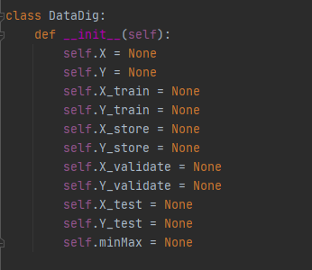
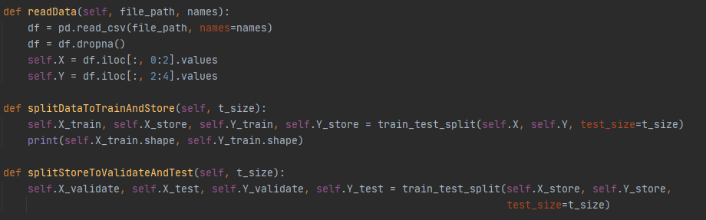
DataDig class for Data partitioning
Reading Data from disk
Splitting it in Train and Store – 80:20
Splitting Store in to Test and Validate - 50:50

Slide 4
Data Processing
Entire data set was checked for na values and drop if there was any. - No inconsistent data
Each feature from the data was treated separately – Features: X-distance, Y-distance, Y-Velocity, X-Velocity
Data was divided into input columns and output columns
Both the features in input and output columns were normalized separately
Mathematical MinMax equation used to normalized the data
MinMax Values obtained per column basis are stored, Same values are used later with the game for data pre-processing
Data also had a check for outliers but the performance of the game dropped with that – around 5000 samples got dropped. Used IsolationForest for checking. But it was removed to get a better performance

Slide 5
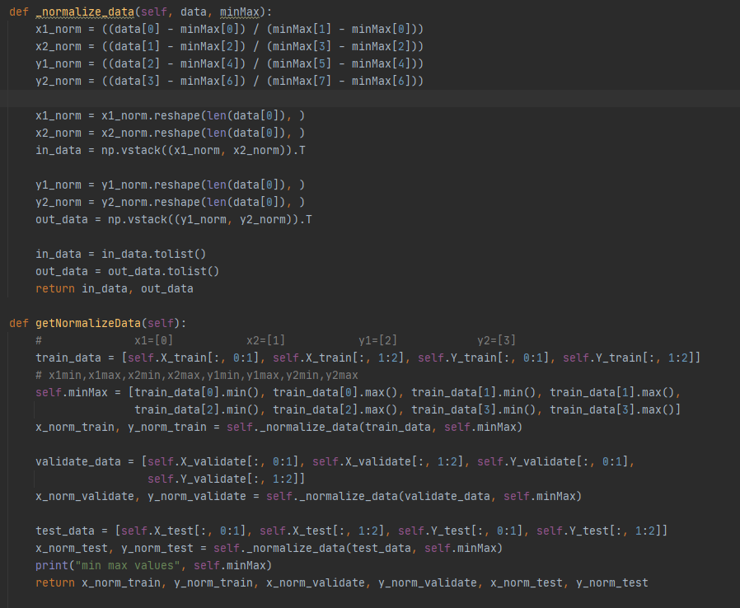

DataDig Class Member functions for Data Processing
Equation for Normalization

Slide 6

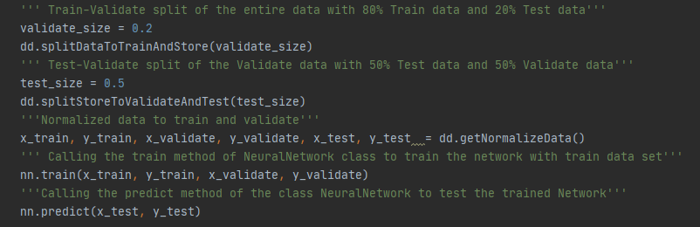
Architecture
Architecture consists of two Classes and Mathematical utility functions
Main -
Configures Network Parameters, creates Neurons and DataDig objects, initiates preprocessing.
Splits the data, starts the training and test respectively.

Slide 7
Design Architecture
DataDig Class – Used for Preprocessing of the data
Data Splitting
Data Storing
Data Normalization
Neurons Class – Implementation of Neural Network
Training -Feedforward and Back propagation
Validation
Test
Cost function
MatUtility – Matrix related mathematical operations
Sigmoid
Sigmoid Derivative
Transpose of Matrix
Dot Product of Matrix
Add Addition of Matrix

Slide 8
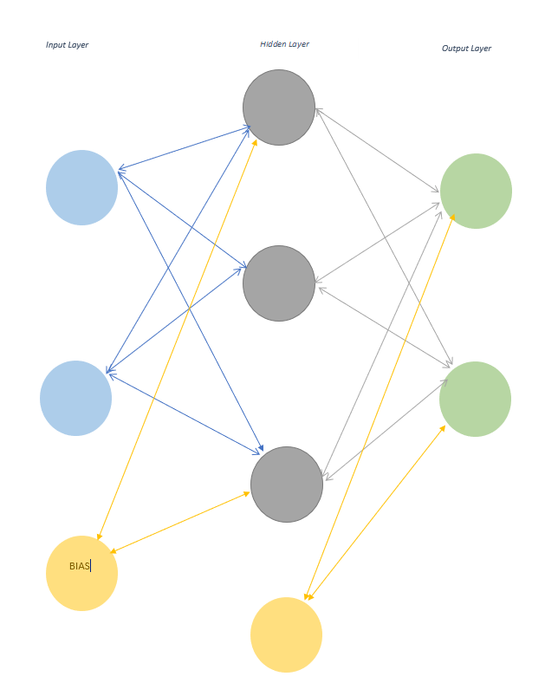



Network Architecture
Neural network architecture for optimal Performance
Input layer 2 Neuron nodes
Hidden layer 3 Neurons
Output layer 2 Neurons
Bias added at both Hidden layer and output layer.
Used Batches for BackPropogation
Back propagation is only done after every 256 rows of input data. This makes the processing fast.
Updating weights only after every 512 inputs rows in every epoch.
Sigmoid is used at activation function at both Hidden and output Layer.

Slide 9
Size Comparison of Hidden layer
Neurons Nodes in Hidden Layer
Impact
2 Neurons
4 Neurons
Between 5 – 8 Neurons
3 Neurons
Moret than 10 Neuron
Processing of the data was fast for each epoch but Network number of epochs to get a decent performance increased. RMSE – 0.145
Got a decent RMSE of 0.141 but it became constant after around 100 epochs, Network seemed to overtrain and game predictions were random
Got the lowest RMSE of around 0.137. Lander had a fixed pattern, after reaching the top of Landing pad, it started moving up instead of coming down.
RMSE fo around 0.131. Lander started crashing quite close to the landing surface, needed hyper parameters tuning now
RMSE started increasing and went up to around 0.4.
Network performance decreased

Slide 10
Hyper Parameters
Learning Rate – Momentum – Lambda - Epochs
lambda > 0.1,resulted in buffer overflow after a few epochs – Fixed to 0.1
Low Learning Rate and High Momentum -
This combination improved the performance of the network
High Learning Rate and Low Momentum -
With this combination train RMSE started high and the difference between train and validate loss was high.
Epochs
Needed at least 350 Epochs for game to perform decently, game performed at random for less than 350 epochs
More than 500 Epochs, game again starts random behavior.

Slide 11
Hyper Parameter Tuning
Tuned Values
Impact
Learning Rate - 0.1 Momentum – 0.9
Learning Rate - 0.1 Momentum – 0.8
Learning Rate - 0.2 Momentum – 0.9
Learning Rate - 0.2 Momentum – 0.7
Learning Rate – 0.3 Momentum 0.7
Showed random game performance, though RMSE Was similar to the last one.
Learning Rate > 0.3
RMSE starts increasing to around 0.4, Network stucks at a local minima.
To tune learning rate between 0.3 and 0.9, Hidden layer Neurons should be increased at least to 8.
Required more than 650 epochs for the network to converge. RMSE of curve of Train and validate were almost identical. Game performance – Random
Required more than 650 epochs for the network to converge. RMSE of curve of Train and validate were showed a little gap. Game performance – Random
Required around 400 epochs for the network to converge. RMSE of curve of Train and validate were showed a little gap. Game performance – Random
Required around between 350 - 500 epochs for the network to converge. RMSE of curve of Train and validate were nearly identical.
350 Epochs – Lander falls down
400 Epochs – Lander starts moving toward the landing surface but crashes
500 Epochs – Network overtrains, and lander start going up instead of coming down.
450 Epochs – Lander starts landing sometimes and crashes in specific scenarios, if distance is large and spikes around surface

Slide 12
RMSE and Early Stopping
Calculating RMSE on training data after every epoch and storing it in a list.
Calculating RMSE on Validation data set after every epoch and storing it in a list.
Plotting them after all the epochs.
Early stopping: check after 350 Epochs
Implemented early stopping criteria if the validation RMSE starts to rise after certain number of epochs. To test this average rmse of last 10 epochs is compared with the current epoch.

Slide 13
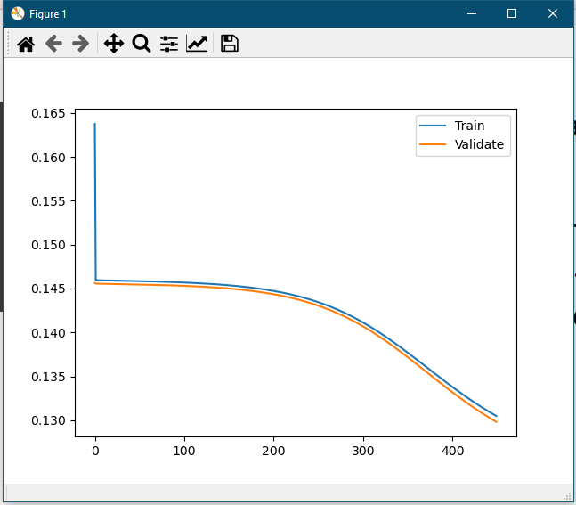
Plot of Train and Validate RMSE

Slide 14
Extra
4 architectures done
2 with numpy
2 without numpy
With Numpy
Training all the samples together, processing extremely fast and lands Lands 99% of the time
Training one row at a time: Very slow and bad performance
Without Numpy
Training all the sample together- extremely slow, didn't even wait to test
Training one row at a time, decent processing speed, game performance average to good.

