Slide 1

CE801 –Intelligent Systems and Robotics
-Faizan Athar Waheed Khan
#2004470

Slide 2
PID Controller
Sensors used Front Right sensor only
Sensor range ranges[539:639]
Ranges were obtained by keeping a box on the right front of the robot and reading echo scan messages: Implemented python code to get the minimum values from 0 – 719 ranges of list.
rostopic echo /scan
Minimum value from the ranges used for calculation
Minimum value refers to a point of the car nearest to the wall.

Slide 3
PID Tuning
Initially only proportional gain was tuned, Derivative gain and Integral gain were set to 0.
Next derivative gain was set to non zero and derivative error was calculated. Derivative gain was tuned continuously until the oscillations were damped
Integral gain was added to make sure the robot follows the wall at a desired distance. This was done by maintaining a list of historic proportional errors. Last 10 errors were added for this and multiplied with the Integral gain
PID = proportionalError * kP + totalIe * kI + derivativeError * kD
Right amount of proportional gain times proportional error (Required distance – current distance) resulted in an oscillating output, with robot trying to minimize the error and overshooting towards the wall and then to negate that going away from the wall towards 0 error. Resulting in continuous oscillations. Movement got a little stable by increasing the proportional gain .
proportionalError * kP
PID = proportionalError * kP
derivativeError = proportionalError – previousError
PID = proportionalError * kP + derivativeError * kD
integralError.append(proportionalError)
if len(integralError) > 9:
integralError.pop(0)

Slide 4
Right Edge Following
Sensors Used: Front Right Sensor and Back Right Sensor. Minimum value of these two sensore were selected at every callback from the LaserScan subscriber.
frontRightSensor = min(msg.ranges[540:629])
backRightSensor = min(msg.ranges[449:539])
These two sensor were used to control the trajectory of the car, to keep it moving in a straight line.
Example: if front right is close the wall and back right is far, the car is moving towards the wall. In this case fuzzy logic would turn the car towards left to keep it straight and vice-versa.
Sensor Ranges were obtained by keeping a block on the right front and right back.
Reading were obtained using rostopic echo messages:
Rostopic echo /scan messages.
Implemented basic python code to get the sensor ranges

Slide 5
Input Membership functions
Front Right Sensor and Back Right Sensor have similar membership functions:
3 membership functions Each, all the functions are Trapezoid functions
Near [0.1, 0.1, 0.2, 0.5] - Started with 0.1 because at the start of the program, sensor returns 0 value and gets the membership value of 1 of 'Near' membership function, which is not true if the car is not close to the wall.
These values were selected after several trial and errors, making sure that the car gets enough room to make turns and perform right edge following at optimal distance from the wall.
Sensor readings greater than 2, including 'inf' values were hardcoded 1.99, so that they fall under Far Membership function
NEAR | 0.1 | 0.1 | 0.2 | 0.5
MEDIUM | 0.2 | 0.5 | 0.5 | 0.7
FAR | 0.5 | 0.7 | 0.9 | 2.0

Slide 6
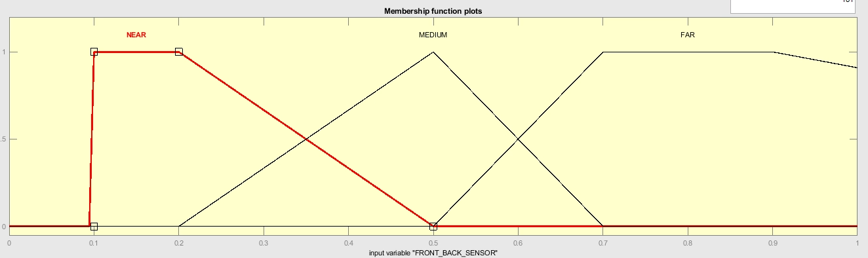
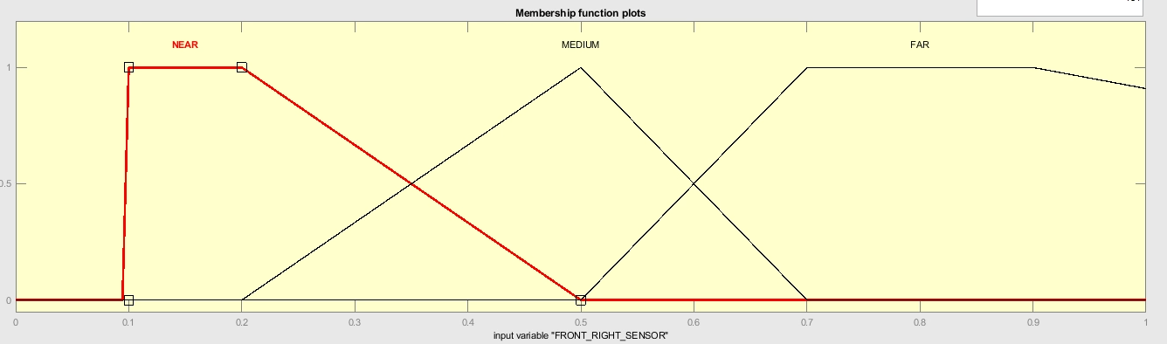
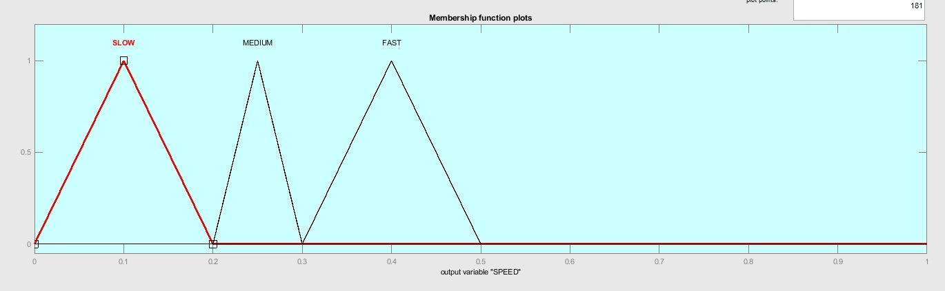

Membership functions Visualisation
Input Membership Functions
Output Membership Functions

Slide 7
Rule Base
RIGHT FRONT SENSOR | RIGHT BACK SENSOR | SPEED | STEER
NEAR | NEAR | SLOW | LEFT
NEAR | MEDIUM | SLOW | LEFT
NEAR | FAR | SLOW | LEFT
MEDIUM | NEAR | SLOW | RIGHT
MEDIUM | MEDIUM | MEDIUM | FORWARD
MEDIUM | FAR | MEDIUM | LEFT
FAR | NEAR | SLOW | RIGHT
FAR | MEDIUM | MEDIUM | RIGHT
FAR | FAR | FAST | RIGHT

Slide 8
Output Membership functions
Two output - Speed and Steer
SPEED: 3 membership functions, all the functions are Triangle functions
STEER: 3 membership functions, all the functions are Triangle functions
Slow | 0.0 | 0.1 | 0.2
Medium | 0.2 | 0.25 | 0.3
Fast | 0.3 | 0.4 | 0.5
Right | -0.7 | -0.5 | -0.3
Forward | -0.3 | 0.0 | 0.3
Left | 0.3 | 0.8 | 1.3

Slide 9
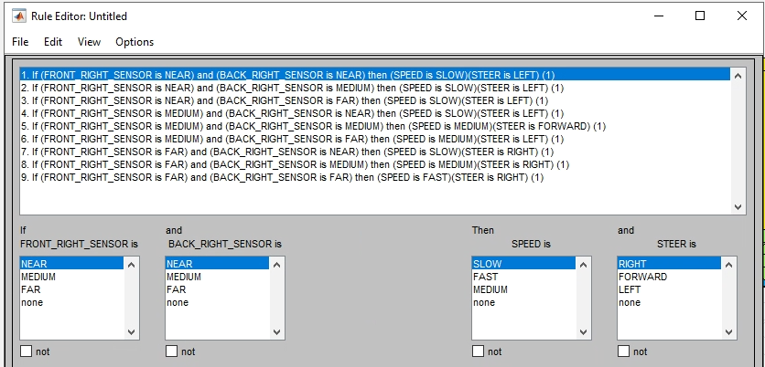
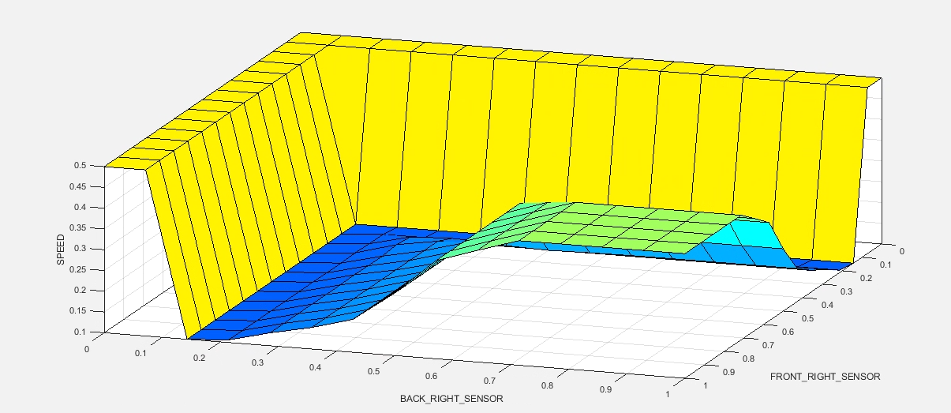
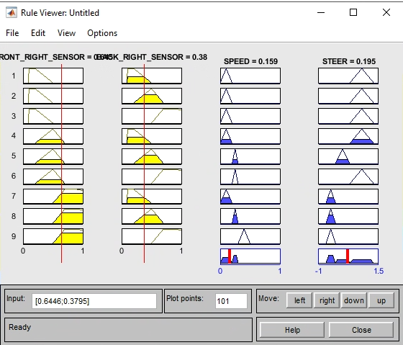
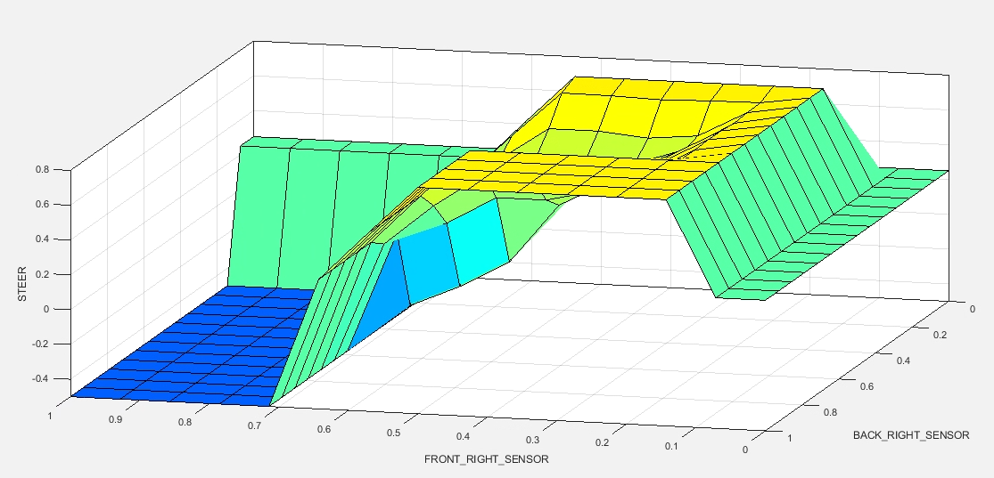
Control Surface and Rules

Slide 10
Obstacle Avoidance
Sensors Used: Front Left Sensor and Front Right Sensor. Minimum value of these two sensore were selected at every callback from the LaserScan subscriber.
topLeftSensor = min(msg.ranges[0:10])
topRightSensor = min(msg.ranges[625:635])
These two sensor were chosen to avoid obstacle present in the front, either on the left or the right side front, take care of the centre front of the car as well. At any state if the sensor detects an obstacle with in 0.1 to 3 mts, Fuzzy logic activates obstacle avoidance behavior
Sensor Ranges were obtained by keeping a block on the front left and front right edge of the car
Reading were obtained using rostopic echo messages:
Rostopic echo /scan messages.
Implemented basic python code to get the sensor ranges

Slide 11
Input Membership functions
Front Left Sensor and Front Right Sensor have similar membership functions:
3 membership functions Each, all the functions are Trapezoid functions
Near [0.1, 0.1, 1.0, 1.5] - Started with 0.1 because at the start of the program, sensor returns 0 value and gets the membership value of 1 of 'Near' membership function, which is not true if the car is not close to an obstacle.
These values were selected after several trial and errors, making sure that the car gets enough room to make a turn to the left and perform obstacle avoidance at a sufficient distance from the obstacle.
Sensor readings greater than 3, including 'inf' values were hardcoded 2.99, so that they fall under Far Membership function
NEAR | 0.1 | 0.1 | 1.0 | 1.5
MEDIUM | 1.0 | 1.5 | 1.5 | 2.0
FAR | 1.5 | 2.0 | 2.5 | 3.0

Slide 12
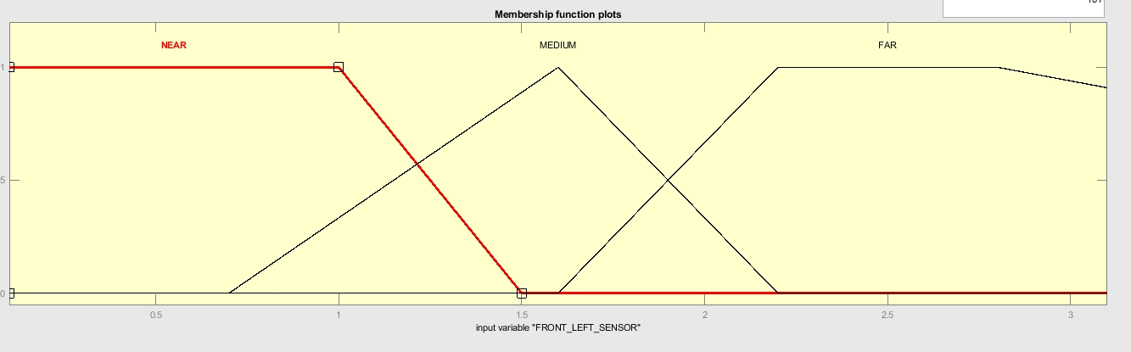
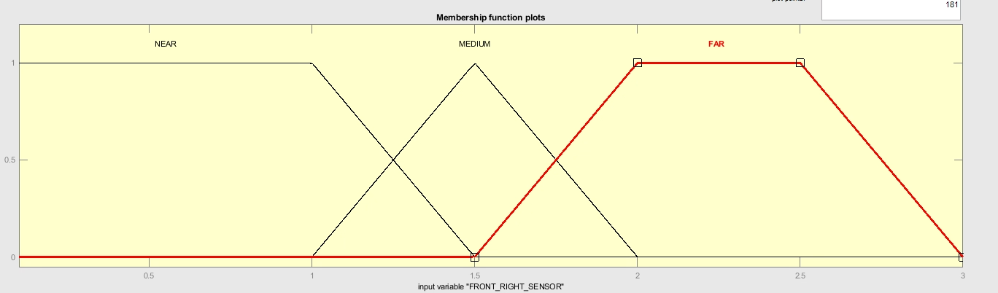
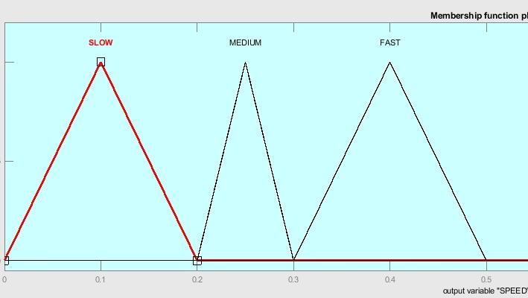
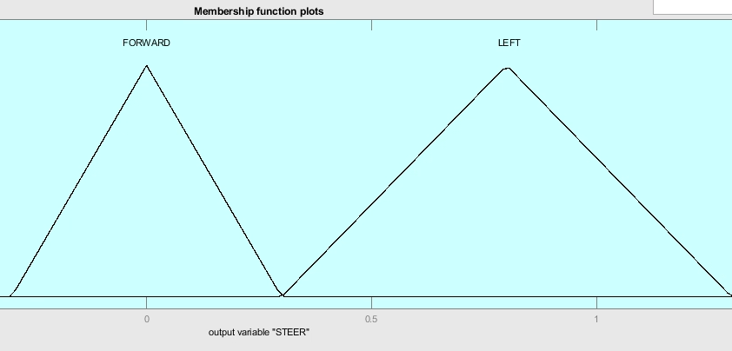
Input Membership Functions
Output Membership Functions

Slide 13
Rule Base
FRONT LEFT SENSOR | FRONT RIGHT SENSOR | SPEED | STEER
NEAR | NEAR | SLOW | LEFT
NEAR | MEDIUM | SLOW | LEFT
NEAR | FAR | SLOW | LEFT
MEDIUM | NEAR | SLOW | LEFT
MEDIUM | MEDIUM | SLOW | FORWARD
MEDIUM | FAR | MEDIUM | FORWARD
FAR | NEAR | SLOW | LEFT
FAR | MEDIUM | MEDIUM | FORWARD
FAR | FAR | FAST | FORWARD

Slide 14
Output Membership functions
Two output - Speed and Steer
SPEED: 3 membership functions, all the functions are Triangle functions
STEER: 2 membership functions, all the functions are Triangle functions
Slow | 0.0 | 0.1 | 0.2
Medium | 0.2 | 0.25 | 0.3
Fast | 0.3 | 0.4 | 0.5
Forward | -0.3 | 0.0 | 0.3
Left | 0.3 | 0.8 | 1.3

Slide 15
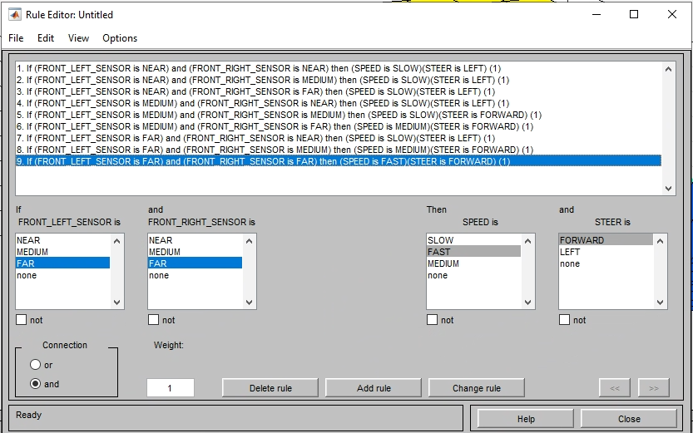
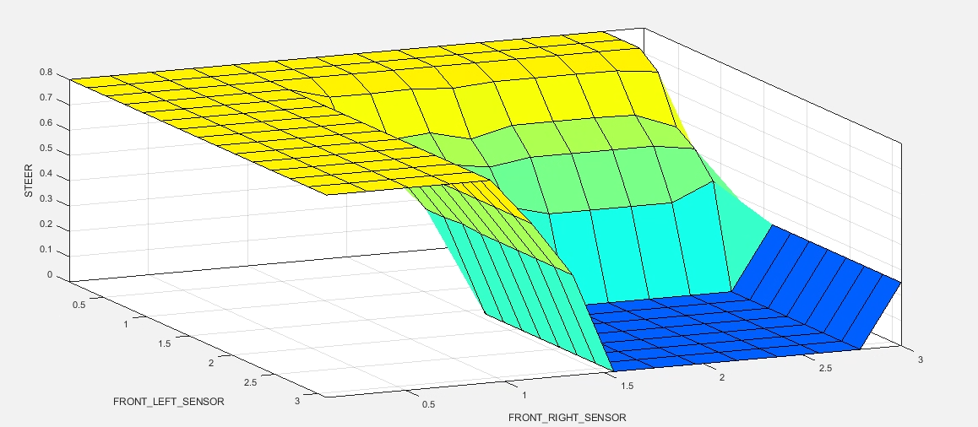
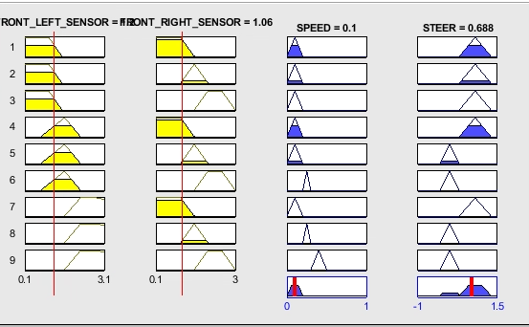
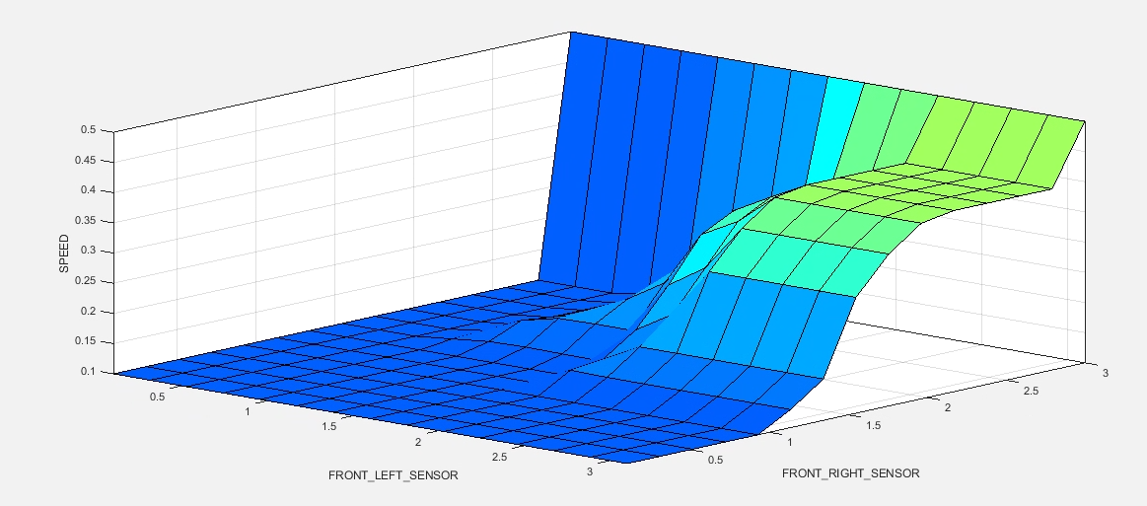
Control Surface and Rules

Slide 16
Control Architecture
Fuzzy logic is used to prioritize obstacle avoidance over right edge following.
Only Front sensor values are considered.
Minimum of the Front Left Sensor and Front Right Sensor value is considered.
min_top_dist = min(topLeftSensor, topRightSensor)

Slide 17
Control Architecture – Membership Functions
Only two Membership functions were needed: Both are Trapezoid functions.
'OA' - Obstacle Avoidance
'REF' - Right Edge Following
Near [0.1, 0.1, 1.0, 1.5] - Started with 0.1 because at the start of the program, sensor returns 0 value and gets the membership value of 1 of 'Near' membership function, which is not true if the car is not close to an obstacle.
OA | 0.1 | 0.1 | 1.0 | 1.5
REF​ | 1.0 | 1.5 | 2.0 | 3.0​

Slide 18
Rule Base
BEHAVIOR | SPEED | STEER
OA | Speed_OA | Steer_OA
REF | Speed_REF | Steer_REF
OUTPUT MEMBERSHIP FUNCTION
Values of Output Memebership function is dynamic in Control Architecture. SPEED & STEER is calculated independently from both REF and OA behavior They are then used to construct speed centre set and steer centre set. Speed and Steer centre set are 2 dictionaries constructed at runtime.
SPEED
STEER
SPEED_OA | Speed calculated from AO
SPEED_REF | Speed calculated from REF
STEER_OA | Steer calculated from AO
STEER_REF | Steer calculated from REF

Slide 19
Extra
In both PID controller and Fuzzy Logic with Control Architecture default behavior of the robot is to go around the wall and do the Right Edge following in a loop.

Slide 20
Commands to Execute fuzzy logic-based script
Right Edge Following:
rosrun <project-name> fuzzy_OA_REF.py REF
Obstacle Avoidance:
rosrun <project-name> fuzzy_OA_REF.py OA
Control Architecture:
rosrun <project-name> fuzzy_OA_REF.py Both

