Slide 1

Development of a risk score to analyze SARS-CoV-2 genomes
Presentation of group project from the practical course: SARS-2 Bioinformatics & Data Science
Friederike Wohlfarth

Slide 2
Outline
Overview of project
Results of data analysis
Results of Clustering
Results of ML
Risk Asessment
Conlusion
Notes:
Overview of project
Results of data analysis
Results of Clustering
Results of ML
Risk Asessment
Conlustion

Slide 3
Overview of the project
46 genomes -> alignments and statistics
perform clustering
develop advanced escape scores based on bloom score
develop a cummulative risk score for each sequence and find the most dangerous sequence
Notes:
46 genomes we had to first align to the Wuhan seuqence and then perform statistics (mutations, Indels, Spike protein)
Perform clustering (to find similarities)
develop advanced escape scores based on bloom score that signify the effect of one mutation on the binding of antibodies and so the immune escape
develop a cummulative risk score for each sequence and find the most dangerous sequence

Slide 4
Software and tools
conda environment: minimap2, SAMtools, BCFtools, etc.
Pangolin for lineage annotation
Covsonar for mutation profiling
SSH client for communication with server
Bash script, awk, grep
R for visualization and machine learning
Notes:
Software used: conda environment we installed during the seminar (minimap2, SAMtools, BCFtools, Pangolin for lineage annotation, Covsonar for mutation profiling); SSH client, Bash script, R visualization and machine learning

Slide 5
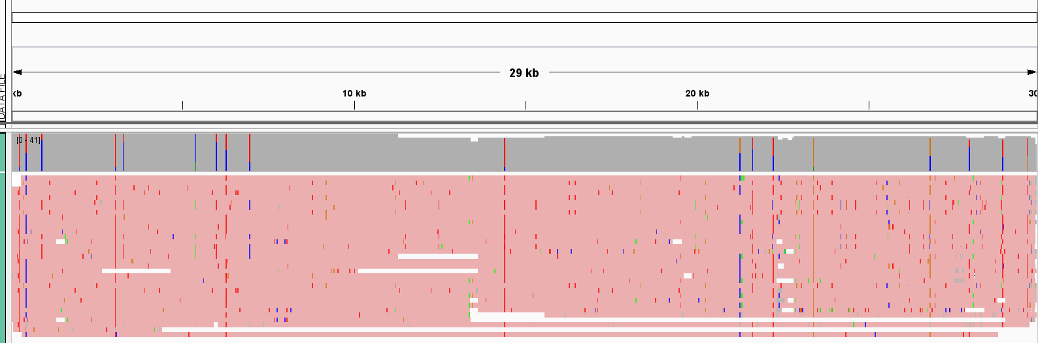
Alignment
N=46 sequences
12 proteins
Notes:
N=46 sequences
12 proteins
visualized in IGV
From these 12 proteins only spike protein was interesting
We intersected our files with a bed files for the positions

Slide 6
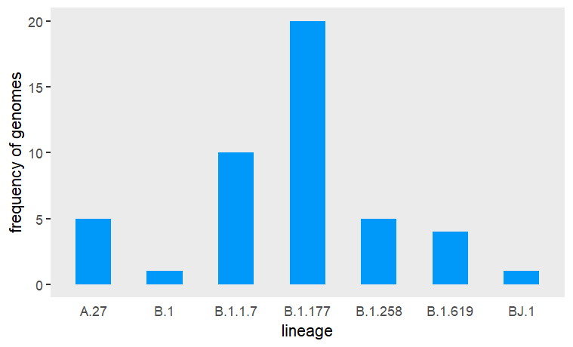
Lineages
genomes from 7 different lineages:
A.27
B.1
B.1.1.7
B.1.177
B.1.258
B.1.619
BJ.1
Notes:
7 different lineages assigned with pangolin
B.1.177 most often
For this we used a singularity container

Slide 7
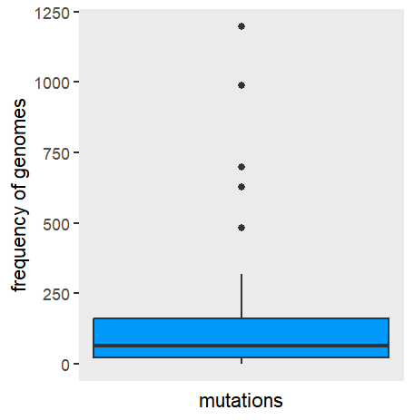
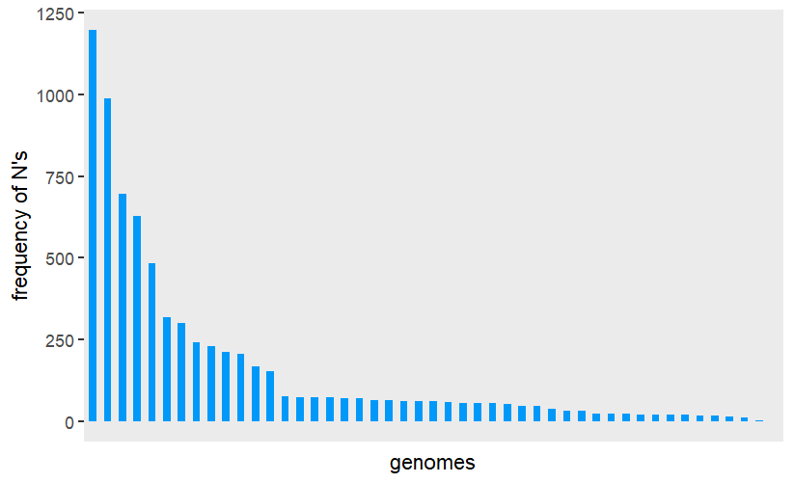
Ambiguous Nucleotides
in average 155 ambiguous nucleotides per genome (0.5 %)
good quality, over 99 % base calling accuracy)
high deviation
Notes:
Mean 155 ambiguous nucleotides
mean percentage of 0.5 % (good quality between Q20 and Q30, over 99 % base calling acc)
High deviation
Seq22 has 2. highest number of ns and highest proportion (almost 1/10)

Slide 8
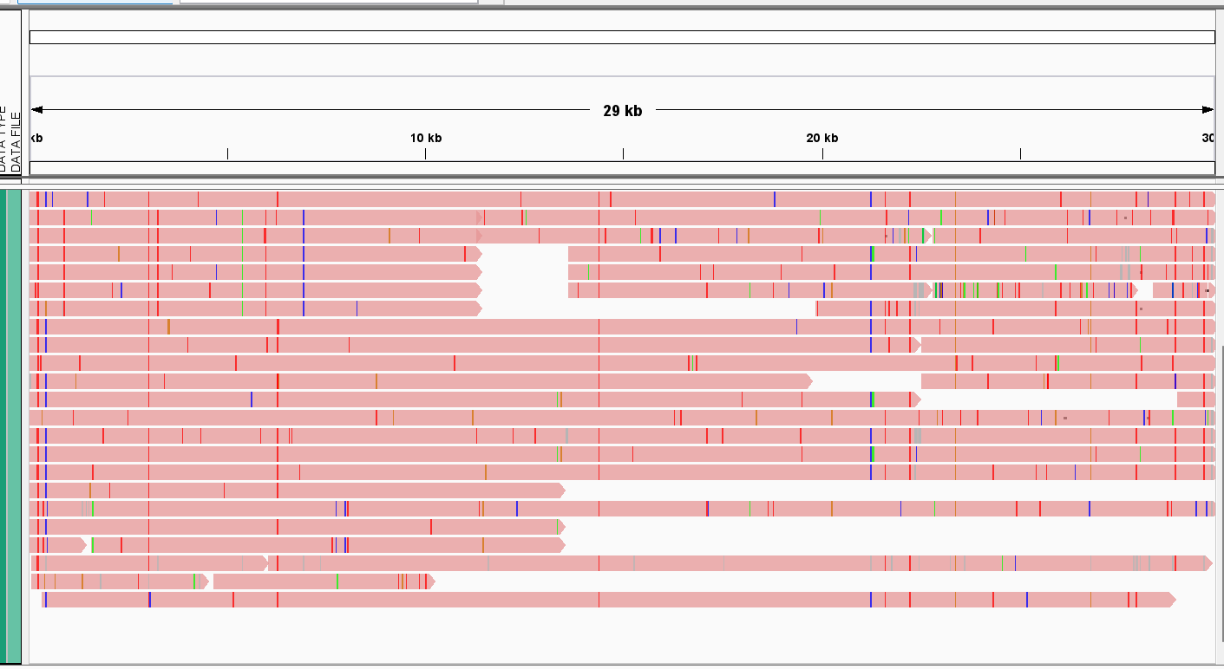
SNPs
443 unique mutations including deletions (no duplicates in the positions)
73 unique mutations in spike protein including deletions
equally distributed over the genomes
in average 30 SNPs per sample (every 10^-3)
Notes:
443 unique mutations including deletions (no duplicates in the positions)
73 unique mutations in spike protein including deletions
Equally distributed over genome
mean 30 SNPs per sample (every 10^-3)
seq 22 has most mutations (84) & shortest read (only ~10 0000 bp) and the second highest amount of ambious nucleotides although it is the smallest (1/10 error) ->sequencing error? Outlier!

Slide 9
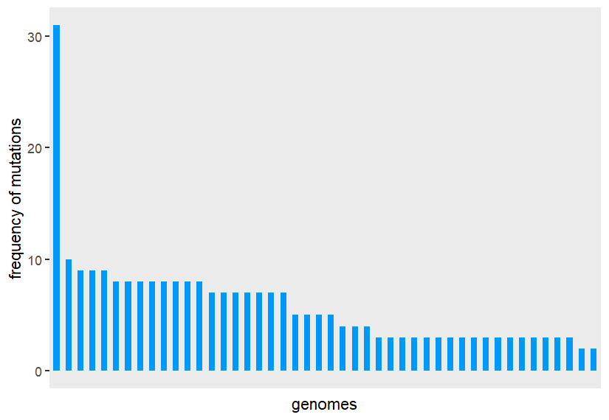
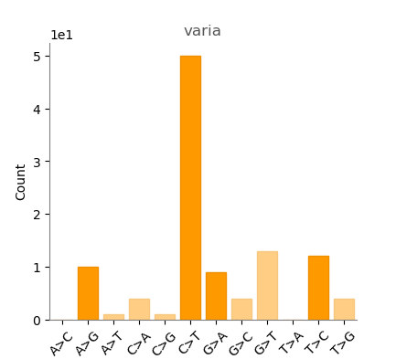
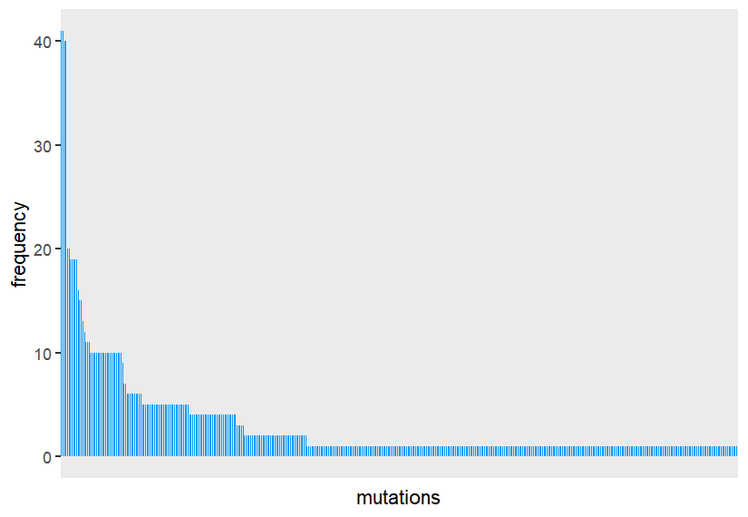
SNPs
every mutation occured ~ 3 times
mutation C3037T occurred 40 times
mostly C>T
Notes:
every mutation occured ~ 3 times
mutation C3037T occurred 40 times
mostly c>T

Slide 10
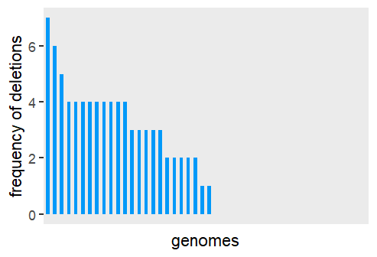
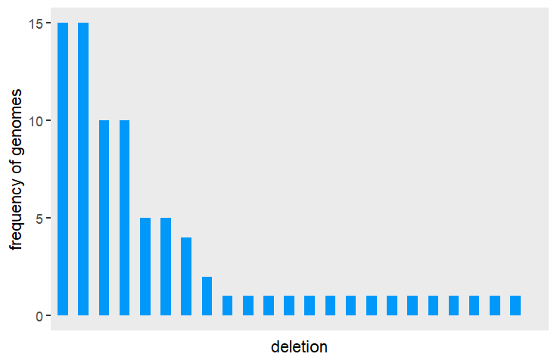
Deletions
23 unique deletions
1 unique deletion in spike (only once)
~ one deletion per sample
~ two genomes per deletion
many of them at the end of the genome
length mostly between one and ten, only 3 length greater 50
Notes:
23 unique deletions
1 unique deletion in spike (occured onl once)
Mean one deletion per sample
Each deletion approx. 2 times
Many of them at the end of the genome
Length mostly between one and ten, only 3 lenth greater 50

Slide 11
Amino Acid Mutations
345 unique amino acid mutations
65 amino acid mutations in spike protein
Notes:
345 unique amino acid mutations
65 aa mutations in spike, among them 4 deletions

Slide 12
Clustering
binary 46 x 443 matrix (0 if no mutation, 1 if mutation)
every position occured only once
performed PCA, kmeans clustering, UMAP visualization and machine learning
repeated for masked matrix (spike positions)
Notes:
Once we were done with aligning, we performed clustering
We Build a binary matrix with 46 rows and 443 columns similar to a allele frequency matrix (0 if no mutation, 1 if mutation)
Coincidentallly, very position occured only once
Performed PCA, kmeans clustering, UMAP visualization and machine learning on this matrix
Repeated for masked matrix only for spike positions

Slide 13
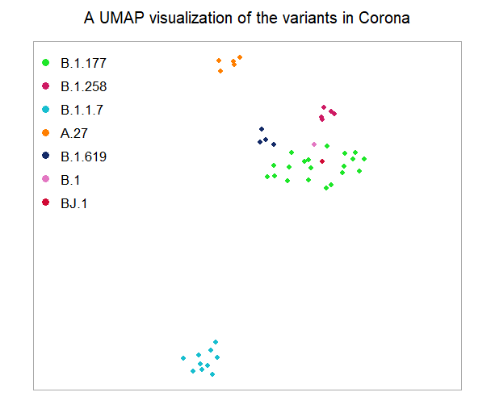
Results..Raw data
Lineages clearly visible
Notes:
Lineages clearly visible in the umap plot on the binary data matrix

Slide 14
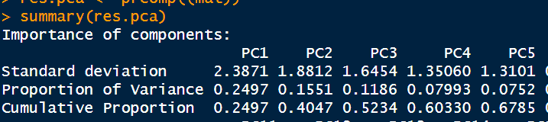
Results..PCA
First component explains 25 %, first five 68 %
Already good result
Notes:
First component explains 25 %, first 5 68 %
Already good result

Slide 15
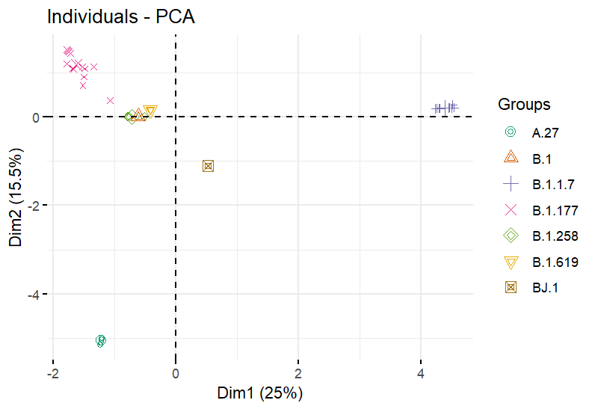
Results..PCA
Notes:
Most prevalent lineages, B.1.17 and B.1.177 already clearly separates from the rest

Slide 16
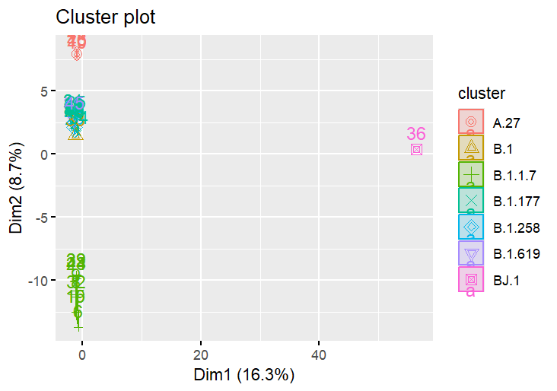
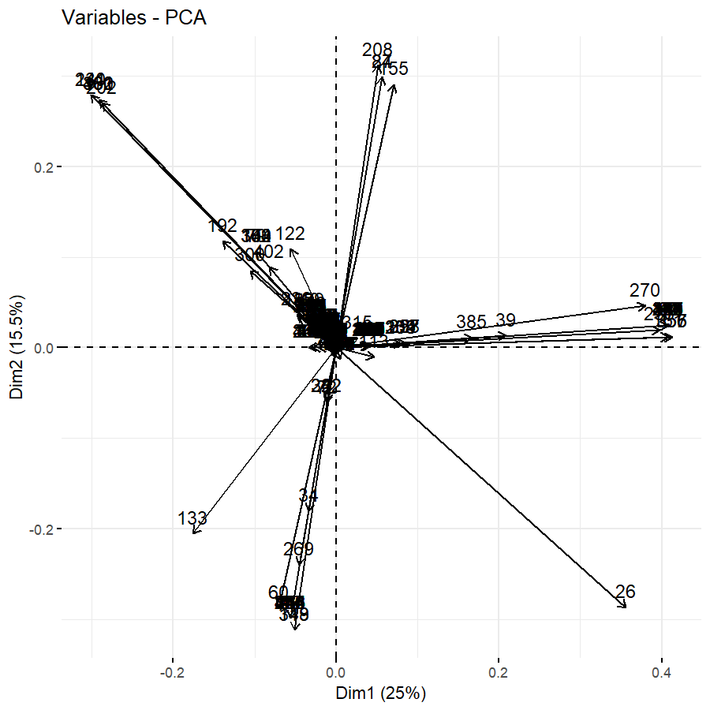
Results..kmeans
4 optimal clusters that overlap with lineages
B.1.17 and A.27 clearly separated
rest summarized in one group
se
Sequence 22
Notes:
4 optimal clusters that overlap with lineages
B.1.1.7 clearly is again separated (different)
Also is A.27 separated
Rest is summarized in one group

Slide 17
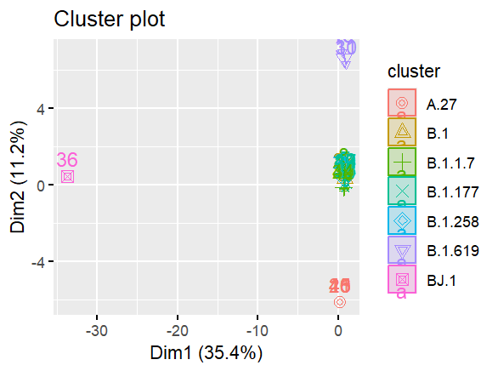
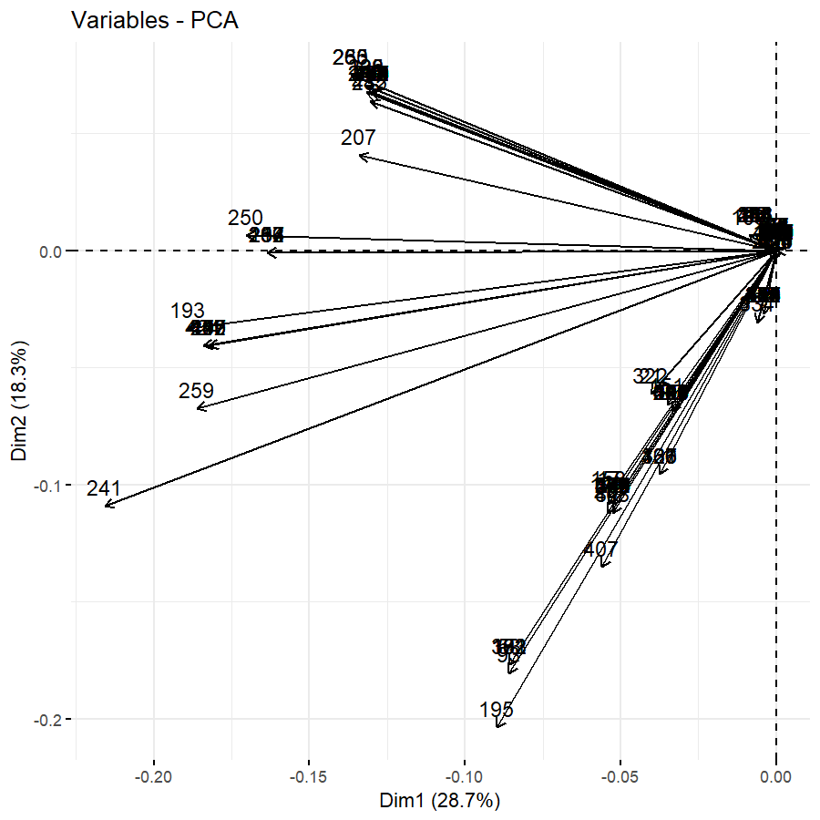
Results..Masking
PCA bit better: already 28 % for first component
kmeans finds again 4 clusters, had to remove 0 cols
greater proportion of important variables
Notes:
After masking the result of the
PCA a bit better: 6 % and 28 %
kmeans now 3 clusters, had to remove 0 cols
A27, BJ.1 and B.1.619 are now distinct clusters
greater proportion of important variables compared to rest

Slide 18
Risk scores
until now: we found clusters (that coincide with metadata), but we do not know if these variants all have the same impact on the immune escape
Some background info
now we add escape scores to evaluate the individual risk of a genome to escape the immune response/ potential therapeutics
Notes:
until now: we found clusters (that coincide with metadata), but we do not know if these variants all have the same impact on the immune escape
Some background info
now we add escape scores to evaluate the individual risk of a genome to escape the immune response/ potential therapeutics

Slide 19
Results..Escape Scores
started from escape score provided by Jesse Bloom et al.
escape scores for RBD in spike protein for 4,089 different antibodies and aa positions -> each antibody and each position has a score
new escape score: sum at each position -> range [2,500]
matched variant position (3 positions can be affected) -> for each putatively mutated position in the genome we have a score
perform steps like before only with scores in the matrix where provided
Notes:
Started from data from the escape calculator developed by Jesse Bloom / escape score / bloom score
Deep mutational scanning
Escape scores for RBD in spike protein for 4089 different antibodies and aa positions -> each antibody and each position has a score
new escape score: sum at each position -> range [2,500], 187 positions
Matched variant position (3 positions can be affected) -> for each putatively mutated position in the genome we have a score
perform steps like before only with scores in the matrix where provided

Slide 20
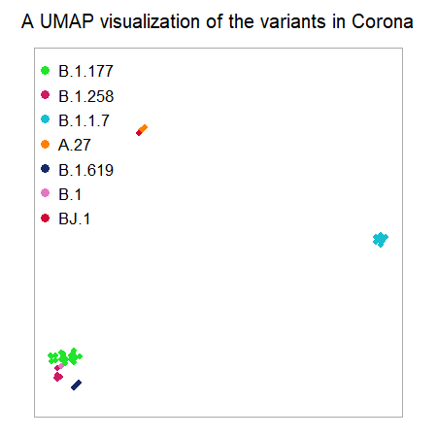
Results..Escape Scores
improvement of the PCA, first component already 42 %, first five 98%
with spike matrix even better (64 % for first, 99 % for first 5)
3 clusters in kmeans
In UMAP A.27,B.1.1.7 and rest separate
-> pattern of 3 clusters?
Notes:
improvement of the PCA, first component already 42 %, first five 98%
with spike matrix even better (64 % for first, 99 % for first 5)
3 clusters in kmeans
In umap A.27,B.1.1.7 and rest separate
-> pattern of 3 clusters?

Slide 21
Results..Escape Scores
Are A.27,B.1.1.7 distinct from the rest?
Both were reported as VOCs!

Slide 22
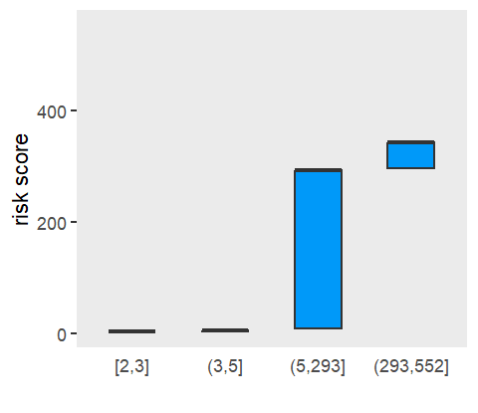
Finally: Risk Scores
assigned each sample a group based on quantiles
most dangerous variant is B.J.1 (sample 22), but maybe sequencing error
second highest A.27 followed by B.1.1.7
lowest B.1.177
within lineage variance is very low
highest risk group coincides with variants A.27 and BJ.1
Notes:
assigned each sample a group based on quantiles
most dangerous variant is B.J.1 (sample 22), but maybe sequencing error
second highest A.27 followed by B.1.1.7
lowest B.1.177
within lineage variance is very low
highest risk group coincides with variants A.27 and BJ.1

Slide 23
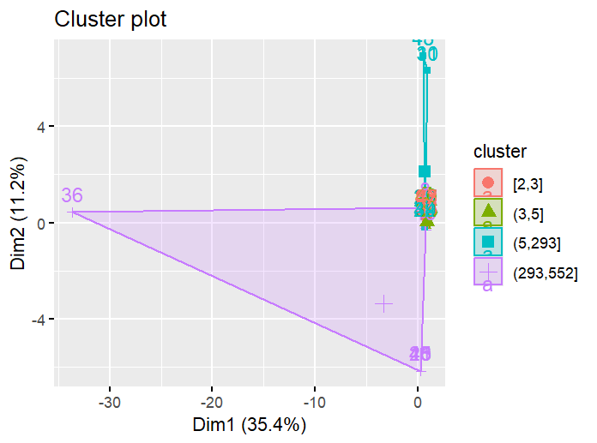
Results..Risk Scores
Notes:
highest risk group coincides with variants A.27 and BJ.1 also visible in PCA (highest risk group in purple on the right)

Slide 24
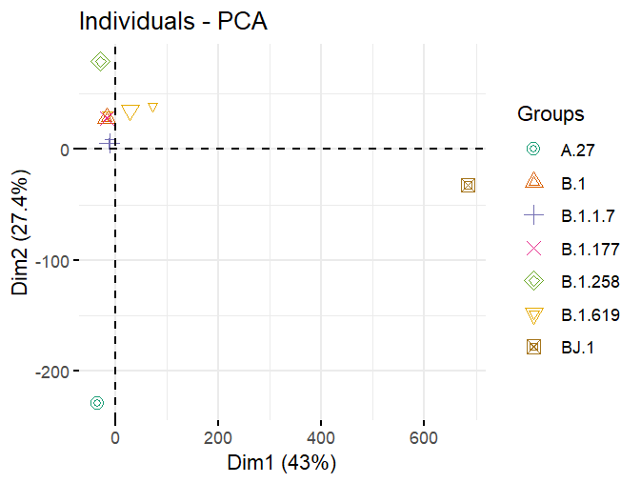
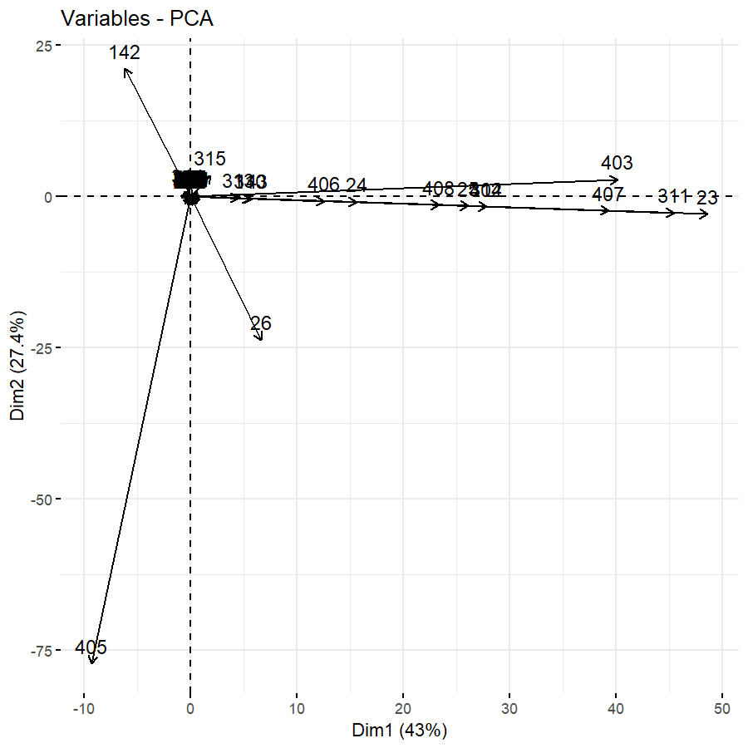
Results..Risk Scores
Notes:
In the PCA We can see that mainly variable 405 is responsible for separation of variant A.27
And indeed this is Mutation T22917G / L452 R and it is is exclusivly shared by the five samples of variant A.27
A.27: variant A.27 is characterized by a mutational pattern in the spike gene that includes the L18F, L452R and N501Y spike amino acid substitutions found in various variants of concern but lacks the globally dominant D614G (https://www.nature.com/articles/s41467-022-28766-y)

Slide 25
Results..Random Forest
trained a random forest classifier with the binned summed up escape scores as target variable (we call it a risk score)
accuracy 81%, sensitivity 100 %, specificity 67 %
Notes:
To apply our reults We finally trained a random forest classifier with the binned summed up escape scores as target variable (which call it a risk score)
Reason for the rf is that with the sum of the escape scores we learn nothing about the combination, maybe some mutations are enough to lead to a risky variant
Dataset was really small for that purpose only 14 test samples
Accuracy 81%, sensitivity 100 %, specificity 67 %
Most important variables? (5, 24, 29 )
Lowest error with mtry 84 ?? But 4 already works good enough

Slide 26
Discussion and Limitations
omit sequence 22 -> seuqencing error??
include weights for antibodies in escape score and inspect the antibodies more detailed / produce a population based escape score
current version of escape scores work best for mutations relative to early SARS-CoV-2 strains -> new study?

Slide 27
Summary
performed alignment and variant calling and provided statistical measures
performed clustering using kmeans and visualized the results using principal component analysis (which are the most important features??)
developed a risk score that summarizes the effect of mutations in the receptor binding domain (RBD) of the spike protein considering antibody escape (summary has not been done yet, does it make sense?)
categorized the sequences based on the distribution of the risk scores (quantiles) into 4 different categories / quantiles
trained a random forest classifier based on our data matrix to predict risk for immune escape
Notes:
Performed alignment and variant calling and provided statistical measures
Performed clustering using kmeans and visualized the results using principal component analysis (which are the most impotant features??)
Developed a risk score that summarizes the effect of mutations in the receptor binding domain (RBD) of the spike protein considering antibody escape (summary has not been done yet, does it make sense?)
Categorized the seuences based on the distribution of the risc scores (quantiles) into 4 different categories / quantiles
Trained a random forest classifier based on out datamatrix

Slide 28
References
Divya Sharma et al. “Predicting the immune escape of SARS-CoV-2 neutralizing antibodies upon mutation”. In: Biochimica et Biophysica Acta (BBA) - Molecular Basis of Disease 1870.2 (Feb. 1, 2024), p. 166959. issn: 0925-4439. doi: 10.1016/j.bbadis.2023.166959. url: https://www.sciencedirect.com/science/article/pii/S0925443923003253 (visited on 10/03/2024)
Allison J Greaney, Tyler N Starr, and Jesse D Bloom. “An antibody-escape estimator for mutations to the SARS-CoV-2 receptor-binding domain”. In: Virus Evolution 8.1 (Jan. 1, 2022), veac021.issn: 2057-1577. doi: 10.1093/ve/veac021. url: https://doi.org/10.1093/ve/veac021 (visited on 10/03/2024)
Interactive structural visualizations of escape mutation maps. Prospective mapping of viral mutations that escape antibodies used to treat COVID-19. url: https://jbloomlab.github.io/SARS-CoV-2-RBD_MAP_clinical_Abs/ (visited on 10/03/2024)
Prospective mapping of viral mutations that escape antibodies used to treat COVID-19 — Science. url: https://www.science.org/doi/full/10.1126/science.abf9302 (visited on 10/03/2024)

Slide 29
Then performed quantile filtering to perform risc assessment
Summed up the risc scores for every samples and assigned group based on quantiles of the overall summed up risc score
Highest risc group clearly separtes and coincides with a.27 and bj1.

Slide 30
Deep mutational scanning can systematically measure the antigenic impacts of all possible amino-acid mutations in the critical regions of the spike on monoclonal antibodies or sera
Antibodies against RBD domain
Most leading anti–SARS-CoV-2 antibodies target the viral receptor binding domain (RBD), which mediates binding to the angiotensin-converting enzyme 2 (ACE2) receptor
tly developed a deep mutational scanning method to map how all mutations to the RBD affect its function and recognition by antiviral antibodies (7, 8). This method involves creating libraries of RBD mutants, expressing them on the surface of yeast, and using fluorescence-activated cell sorting and deep sequencing to quantify how each mutation affects RBD folding, ACE2 affinity (measured across a titration series), and antibody binding

Slide 31
They showed that nonoverlapping sets of mutations escape distice antoibodies (bc they target different epitopes)
These escape fractions represent the estimated fraction of cells expressing that specific variant that fall in the antibody escape bin, so a value of 0 means the variant is always bound by antibody and a value of 1 means that it always escapes antibody binding. B

