Slide 1

Breaking ransomware
How you too can get insulted by cyber criminals
Fabian Wosar
CTO
fabian.wosar@emsisoft.com

Slide 2
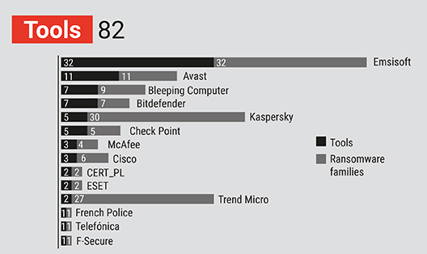
Who am I?
CTO at Emsisoft, which is a New Zealand anti-malware vendor
Got thrown out of Windsor Castle once for wearing a t-shirt that said “Why the fuck not” on it
Rescued two adorable little cats
The work of my team and I has cost ransomware groups over a billion US dollars
www.emsisoft.com

Slide 3
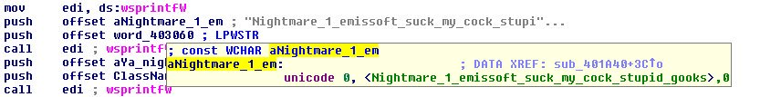
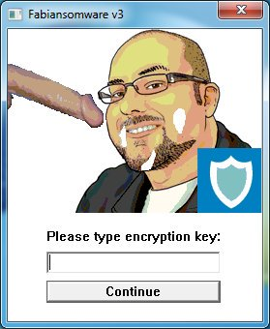

Who am I?
www.emsisoft.com

Slide 4
What we are going to touch on
Basics of cryptography
Simple cryptanalysis techniques
Ways to quickly assess the encryption scheme employed by ransomware
Common flaws you will find in ransomware
Some helpful tips to get you started and get you going along the way
www.emsisoft.com

Slide 5
What is ransomware?
Ransomware is a form of malicious software (malware)
Two major types
Screen lockers: Mostly dead now
Data encrypting ransomware: What we are talking about today
Ransomware is hugely profitable, because attackers don’t need to figure out how to monetise their victims
Gandcrab alone made over $2 billion in about 18 months before the operation was closed down by its operators in June 2019
Polls of enterprises world-wide suggest that 6 out of 10 companies had to deal with ransomware attacks in the past and more than two third of attacks caused more than half a million in damages
www.emsisoft.com

Slide 6
Commonly used terms and their meaning
Message: The data that you want to protect through encryption, like a text or a file
Plaintext: The unencrypted message
Ciphertext: The encrypted message
Cipher: Encryption algorithm
Key: The component that is used by an encryption algorithm to turn a plaintext into a ciphertext and vice versa
Symmetric or secret key encryption: The same key is being used for encryption and decryption of a message (for example AES, RC4, Blowfish)
Asymmetric or public key encryption: Different keys are being used for encryption and decryption of a message (for example RSA)
www.emsisoft.com

Slide 7
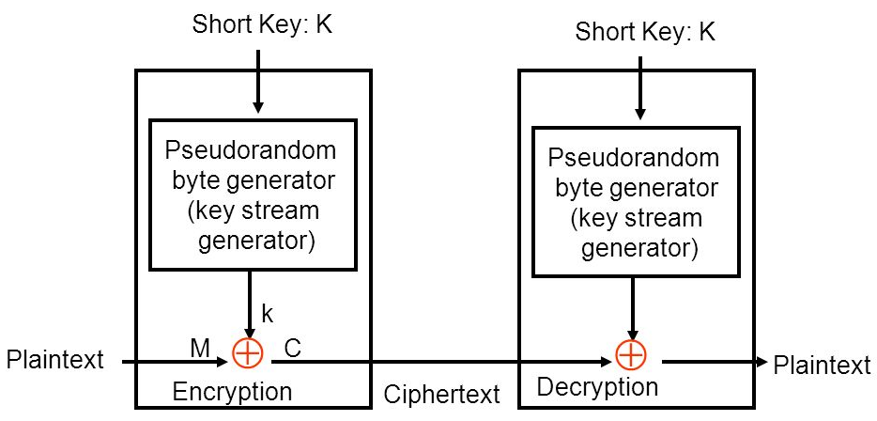
Stream ciphers
Type of symmetric key cipher
Basic idea is to create a stream of pseudorandom key values from a given key, usually referred to as the key stream
Each bit of the plaintext is then used to encrypt their corresponding bit in the key stream
Operation used for encryption is generally XOR
Most popular examples:
RC4
Salsa20
Rabbit
Golden rule: Never reuse a key!
www.emsisoft.com

Slide 8
Block ciphers
Type of symmetric key cipher
Operate on blocks of data
Blocks are transformed using the key, often by substitution and permutation
Most popular examples:
DES
AES
IDEA
Triple DES
Blowfish
Twofish
TEA
www.emsisoft.com

Slide 9
Random Number Generators
Two major types: Pseudo-Random Number Generators (PRNGs) and True Random Number Generators (TRNGs)
TRNGs rely on physical phenomena that are believed to be random
PRNGs use algorithms that produce a long sequences of apparently random results, but that are determined by a shorter initial value that is generally referred to as a seed value, meaning identical seeds will create identical sequences
The amount of entropy (randomness) that can be gathered and used by a TRNG is time limited
As a consequence TRNGs are often used to seed PRNGs to create large amounts of random data
PRNGs are divided into cryptographically secure and cryptographically insecure
Most default random() functions in programming languages belong to the latter category
Even cryptographically secure PRNGs may be insecure if improperly seeded
www.emsisoft.com

Slide 10
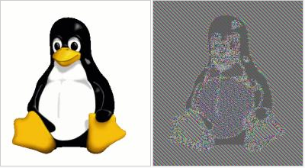
Block modes
Applying a block cipher to anything larger than one block, like a whole file, requires some extra work as identical blocks inside the plaintext will remain identical in the ciphertext
Solution are so called block modes that operate on the blocks in order to securely transform data larger than a block so it appears random
An Initialization Vector (IV) is used as the first block
Common modes:
ECB – Not using a block mode at all
CBC – Each block of plaintext is XORed with the previous ciphertext block
CFB, OFB, CTR – Turn block ciphers into stream ciphers
Various specialised block modes like XTS for disk encryption
www.emsisoft.com

Slide 11
Meet our target
Our target is GetCrypt, a ransomware that showed up May 2019
They updated their ransomware since then, so we can talk about flaws without giving them tips
Sample is quite easy to understand and simple, so if you want to do all of what I show here yourself, it’s a great first sample to look at
Hash is 4c0876373b6cf54b7ee328433c47a614644d75497bad44461dedf39f15f4693c
Download is available together with these slides at https://emsi.at/oxford
www.emsisoft.com

Slide 12
What are we after?
We aren’t interested in everything there is to know about the malware
We are looking for particular information that can help us decrypt it
Figure out what type of encryption is being used and the file format of encrypted files
Figure out how exactly files are encrypted and how the key material involved is being generated
Look for flaws that could allow us to break the encryption
Write a decrypter if possible
www.emsisoft.com

Slide 13
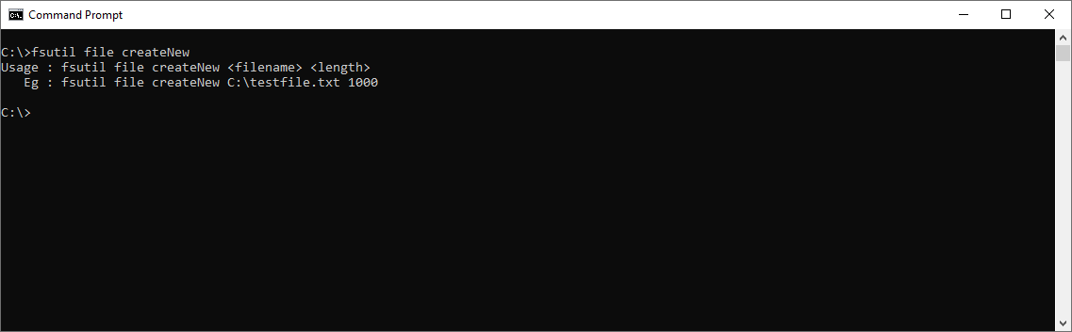
First recon
Sometimes it is incredibly helpful just to have the ransomware encrypt some files we know the content of
Files filled with zero bytes are perfect for this
Windows can generate zero-filled files for you with a simple command
www.emsisoft.com

Slide 14
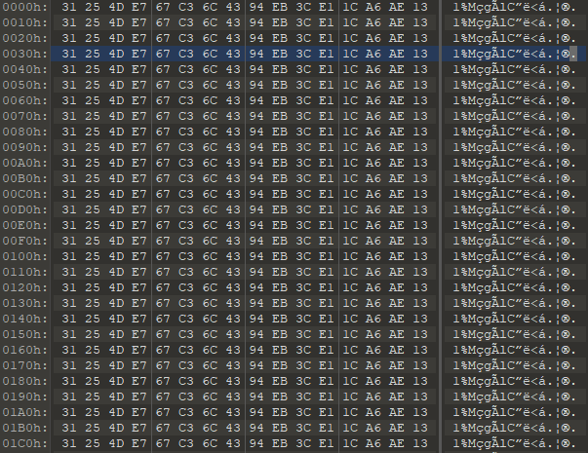
First recon
www.emsisoft.com

Slide 15
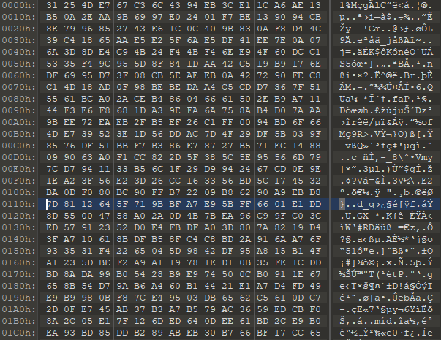
First recon
www.emsisoft.com

Slide 16
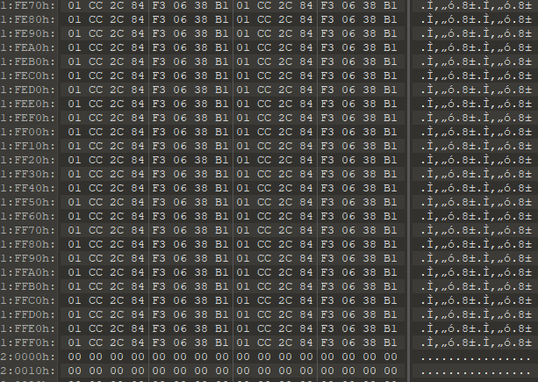
First recon
www.emsisoft.com

Slide 17
First recon
Baiting ransomware into encrypting files you know is hugely beneficial, as you can start comparing them to the originals
Can reveal block sizes, which can point towards certain algorithms
Can reveal partial encryption, which can reveal part of the file format
Comparing two files with similar content can reveal whether the same key is used for all files or not
Comparing the file sizes before and after can reveal whether the ransomware added any data like per-file keys to the file
Comparing the same file from two consecutive runs can reveal if the key is generated each run or is hardcoded or derived from the system somehow
Zero-filled files will also automatically reveal the keystream for stream ciphers, so just XOR it against a “normal” file and see if it opens
www.emsisoft.com

Slide 18
Let’s look at some strings
Strings will reveal a lot about an application
Even the absence of strings you would expect is a clue (usually that the file is obfuscated or packed)
Strings you would expect are:
References to system utilities to clear event logs or shadow copies
References to file extensions
Ransom notes and ransom note file names
Encryption constants
Interesting APIs that are imported
See a string you think looks odd or out of place? Google it.
www.emsisoft.com

Slide 19
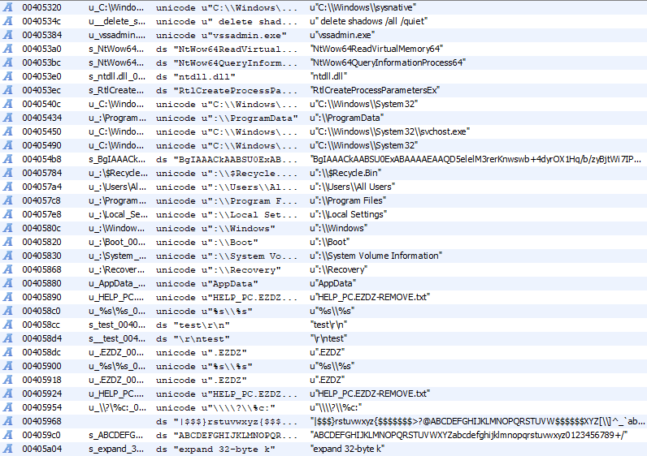
Let’s look at some strings
www.emsisoft.com

Slide 20
Let’s look at some strings
Looking at the Import Address Table in particular can give even more information about what a file may do
FindFirstFile/FindNextFile/FindClose is required to enumerate files and directories
Crypt* APIs imported from advapi32.dll may indicate usage of the Windows Crypto API
CreateFile/ReadFile/WriteFile/MapViewOfFile may indicate the reading and writing of files on the system
WNetOpenEnum/WNetEnumResource/WNetCloseEnum indicate network share enumeration
GetLogicalDrives indicate enumeration of all drive letters
These strings and APIs are often good points for cross referencing later during actual reverse engineering
www.emsisoft.com

Slide 21
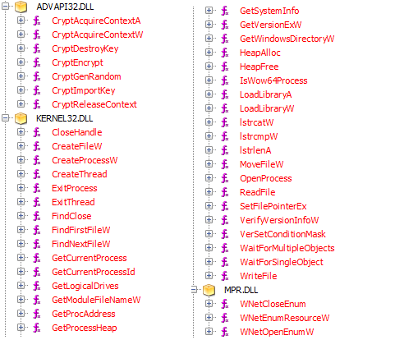
Let’s look at some strings
www.emsisoft.com

Slide 22
The actual reverse engineering
Reverse engineering is intimidating and time consuming
That’s why we did all that other stuff first, because we already have some idea about what we are getting into
There are no shortcuts to learning how to properly reverse engineer, but assembly is not as difficult as you may think and there are decent decompilers available for free like Ghidra that can help you
To become a good reverse engineer, you want to build heuristics in your mind to come up with rough ideas and assumptions what code does, then use the disassembly/decompiled code to prove or disprove those assumptions or ideas
Sometimes it’s unfortunately necessary to really go through the code instruction by instruction though, this is especially common at the beginning
www.emsisoft.com

Slide 23
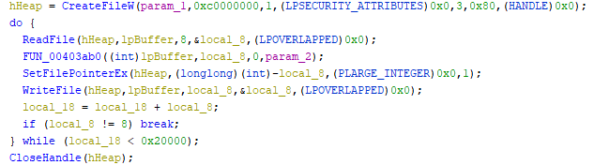
The actual reverse engineering
We know that the ransomware will read, encrypt, and write files, so checking out references to ReadFile and WriteFile is usually a good way to find the function that encrypts the file
www.emsisoft.com

Slide 24
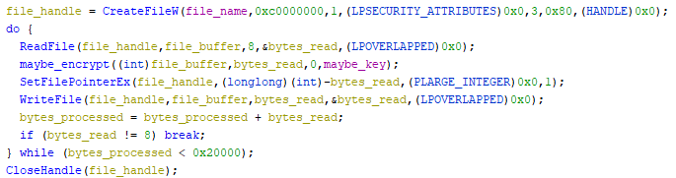
The actual reverse engineering
It’s always a good idea to give things names, makes it easier for you to track in your mind
Again, use your knowledge that you gathered previously to form an assumption, then check the code to prove or disprove it
www.emsisoft.com

Slide 25
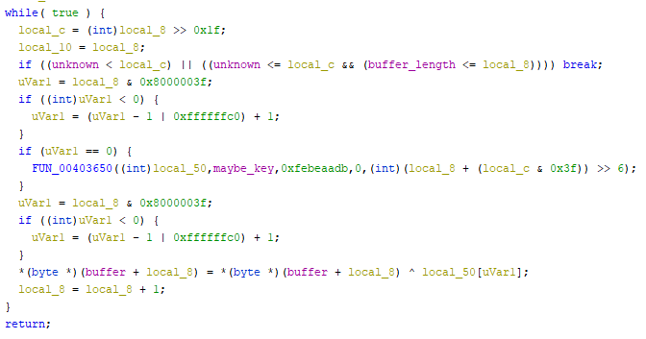
The actual reverse engineering
Let’s check maybe_encrypt out a bit closer …
Not a whole lot except another function call, so check that one …
www.emsisoft.com

Slide 26
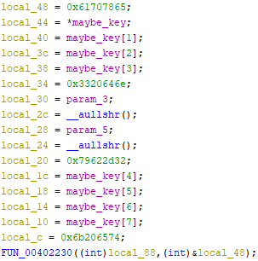
The actual reverse engineering
This looks more like it …
When you see magic constants like that, Google or Github are your friends!
www.emsisoft.com

Slide 27
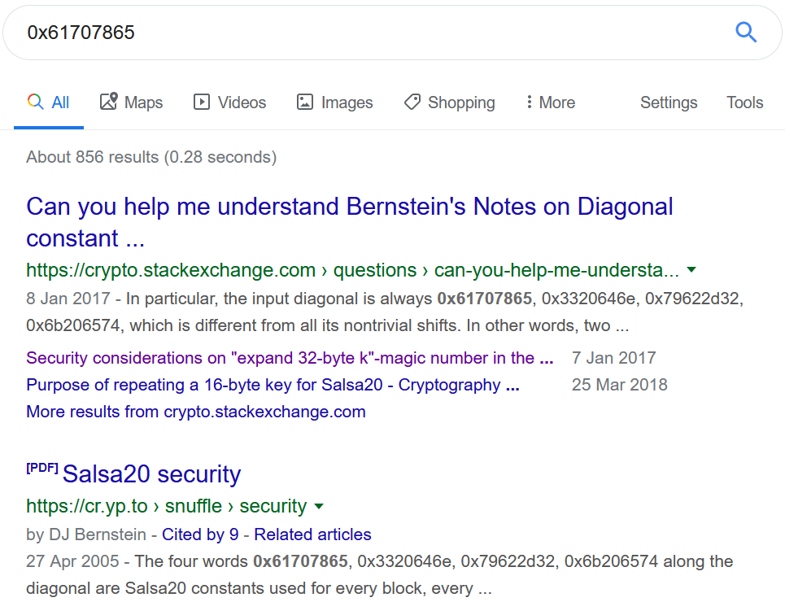
The actual reverse engineering
Look at that …
www.emsisoft.com

Slide 28
The actual reverse engineering
Salsa20 is a stream cipher
Usually it will receive a 128 bit or 256 bit key as well as a 64 bit nonce (number only used once)
Nonce is constant in our code, key doesn’t change
Key reuse in a stream cipher
Even worse: It resets the keystream every 8 bytes
But where does the key come from?
Let’s follow the references
www.emsisoft.com

Slide 29
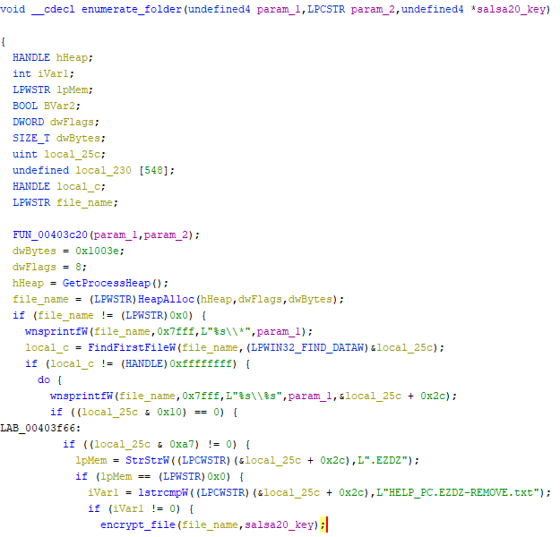
The actual reverse engineering
www.emsisoft.com

Slide 30
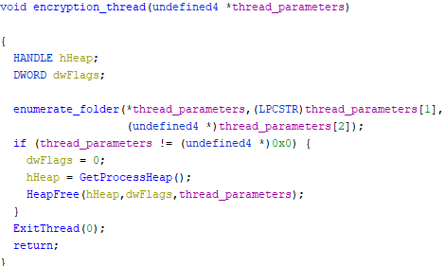
The actual reverse engineering
www.emsisoft.com

Slide 31
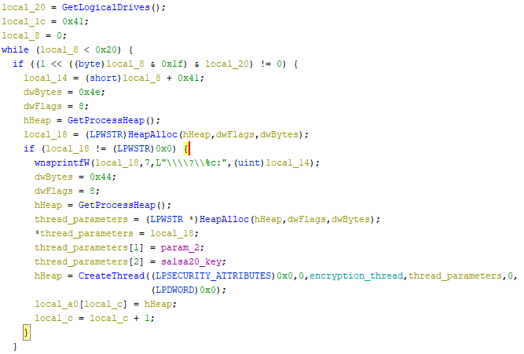
The actual reverse engineering
www.emsisoft.com

Slide 32
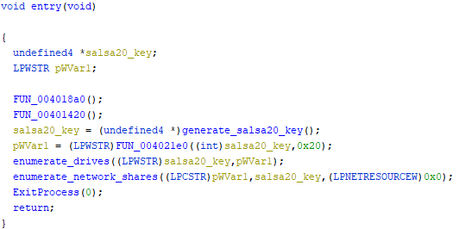
The actual reverse engineering
www.emsisoft.com

Slide 33
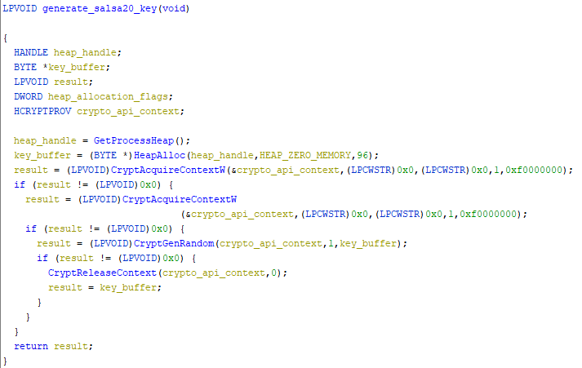
The actual reverse engineering
www.emsisoft.com

Slide 34
GetCrypt, more like GetOwned
GetCrypt authors made multiple mistakes that can be used to recover encrypted data
Their key is essentially 1 byte long so there are only 256 possible keys to begin with
They reuse the key and use a static nonce, so you can simply extract the keystream using a known plaintext and its ciphertext
They turned Salsa20 into a block cipher of sort, which means you essentially only need an 8 byte plaintext to begin with
www.emsisoft.com

Slide 35
Couple of closing words
Both ransomware authors as well as normal software developers get cryptography wrong all the time
Key generation is a very common issue (improperly seeded RNGs, insecure RNGs, truncated keys, too small keys)
Reused keys for stream ciphers as well as asymmetric cryptography
Custom implementations of algorithms that have issues
Custom algorithms that are rarely secure
Communicating the key back to the ransomware authors is often an issue
Command and control server security (lookout for potential legal trouble here)
www.emsisoft.com

Slide 36
Last but not least
There’s a ransomware sample available at https://emsi.at/oxford – try to break it!
You have until November 30th
Send your decrypter in any programming language you prefer as well as a writeup on what the flaw is and an outline of the process you used to figure it out to fabian.wosar@emsisoft.com using your Oxford email address
I heard books are expensive so I will give away two £150 Amazon gift cards, the first going to the first person who breaks it and the second to whoever provides the best and most detailed writeup
If you can’t figure it out, still send your progress in at the end of the month and if nobody solved it the gift cards go to the two people who got the furthest
www.emsisoft.com

Slide 37
www.emsisoft.com

Slide 38
Nemucod v1
www.emsisoft.com

Slide 39
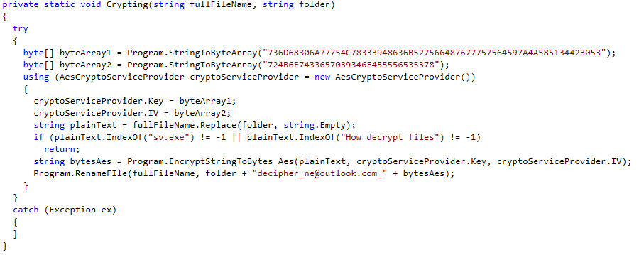
CryptConsole
www.emsisoft.com

Slide 40
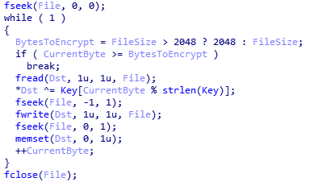
Nemucod v2
www.emsisoft.com

Slide 41
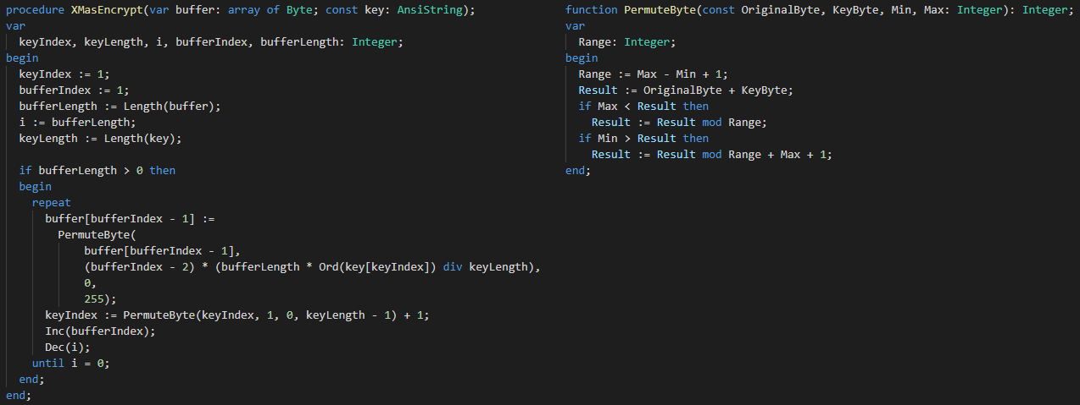
Merry X-Mas
www.emsisoft.com

Slide 42
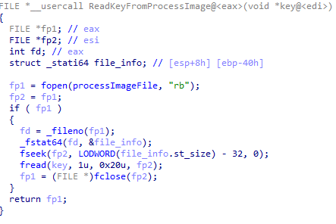

DMA Locker v1
www.emsisoft.com

Slide 43
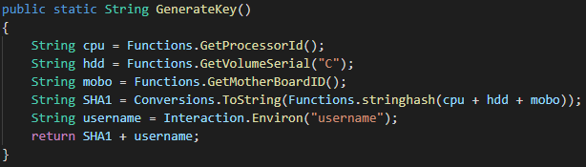
CryptoHost
www.emsisoft.com

Slide 44
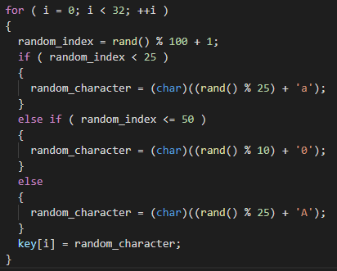
DMA Locker v2
www.emsisoft.com

Slide 45
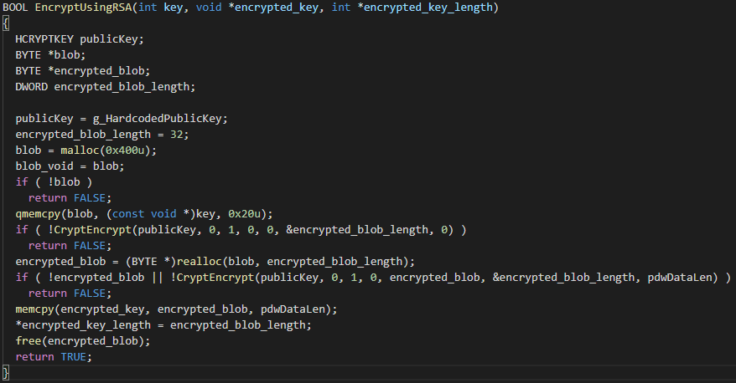
DMA Locker v3
www.emsisoft.com

Slide 46
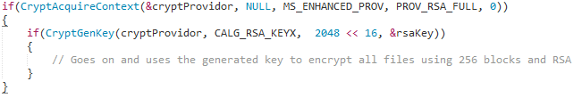
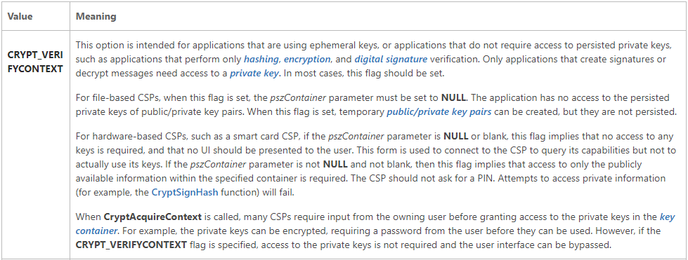
CryptoDefense
www.emsisoft.com

Slide 47
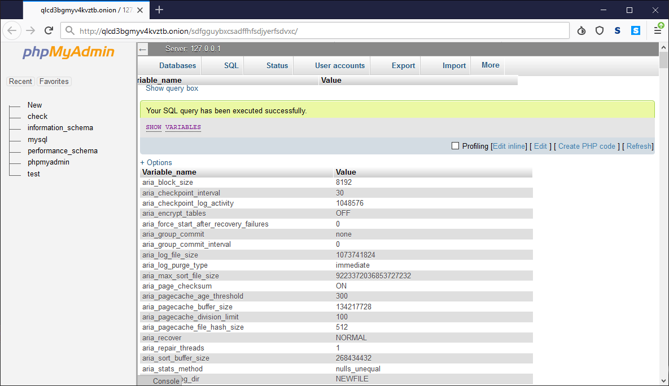
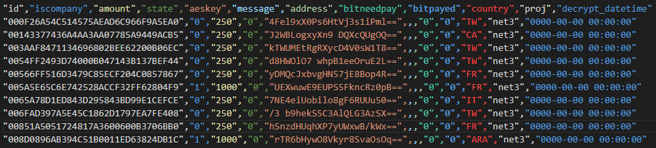
MegaLocker
www.emsisoft.com

Slide 48
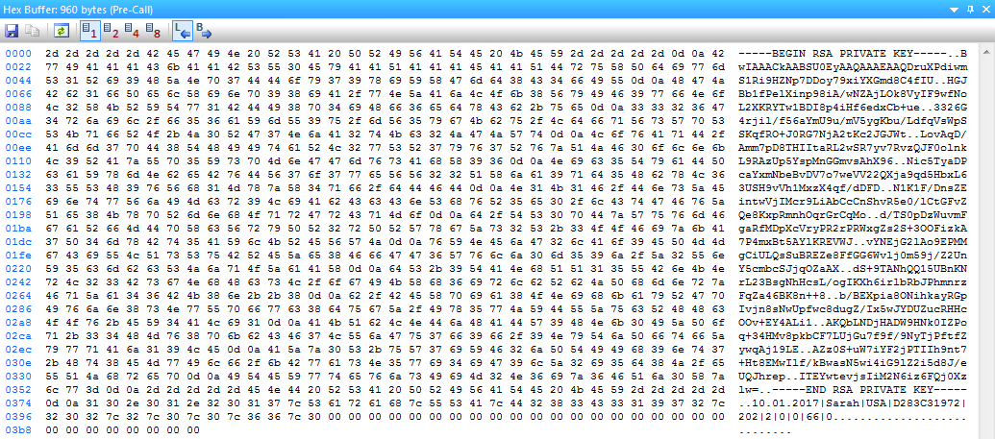
Spora
www.emsisoft.com

Slide 49
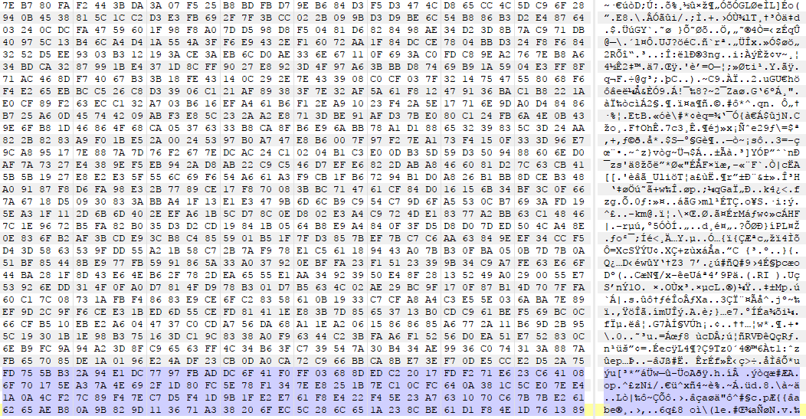
Spora
www.emsisoft.com

Slide 50
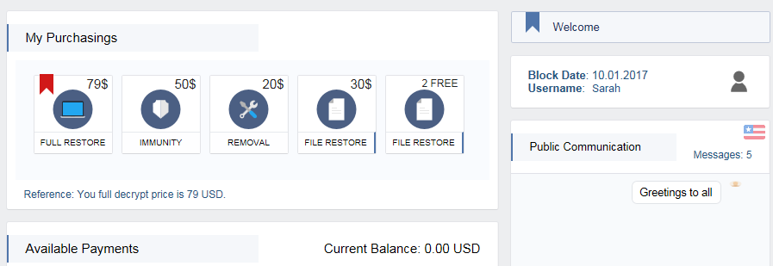
Spora
www.emsisoft.com

